Slide 1
Machine Learning Hotel Booking Cancellation Prediction SENG474
Junyi Wei V00979016
Siheng Chen V00935153
Yifan Zhu V00977863

Slide 2
Introduction
Data Preparation
Data Mining
Evaluation
Conclusion

Slide 3
Introduction
Hotel cancellations can significantly impact for hotel booking platforms
Provide a tool that optimizes both resource allocation and profit in the hospitality industry
We aim to contribute to the optimization of hotel operations and enhance the efficiency of hotel booking platforms

Slide 4
Data preparation
Drop unimportant feature
Fill missing categorical values with most frequent value
Visualization
Add feature
Categorical features encoding
Feature selection

Slide 5
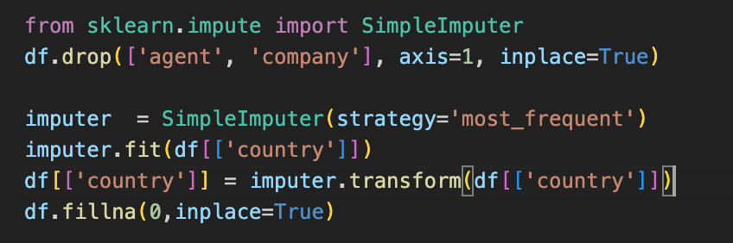
Drop unused feature & Fill the missing values
Drop “agent” and “”company” features and replace the missing values in “country” with most frequent value by SimpleImputer

Slide 6
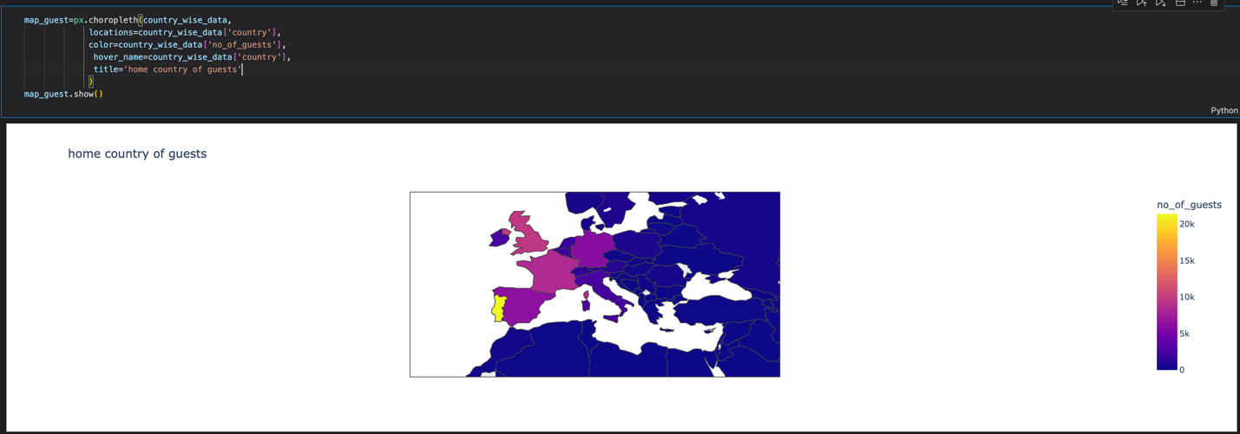
Visualization
Distribution of guests around the world

Slide 7
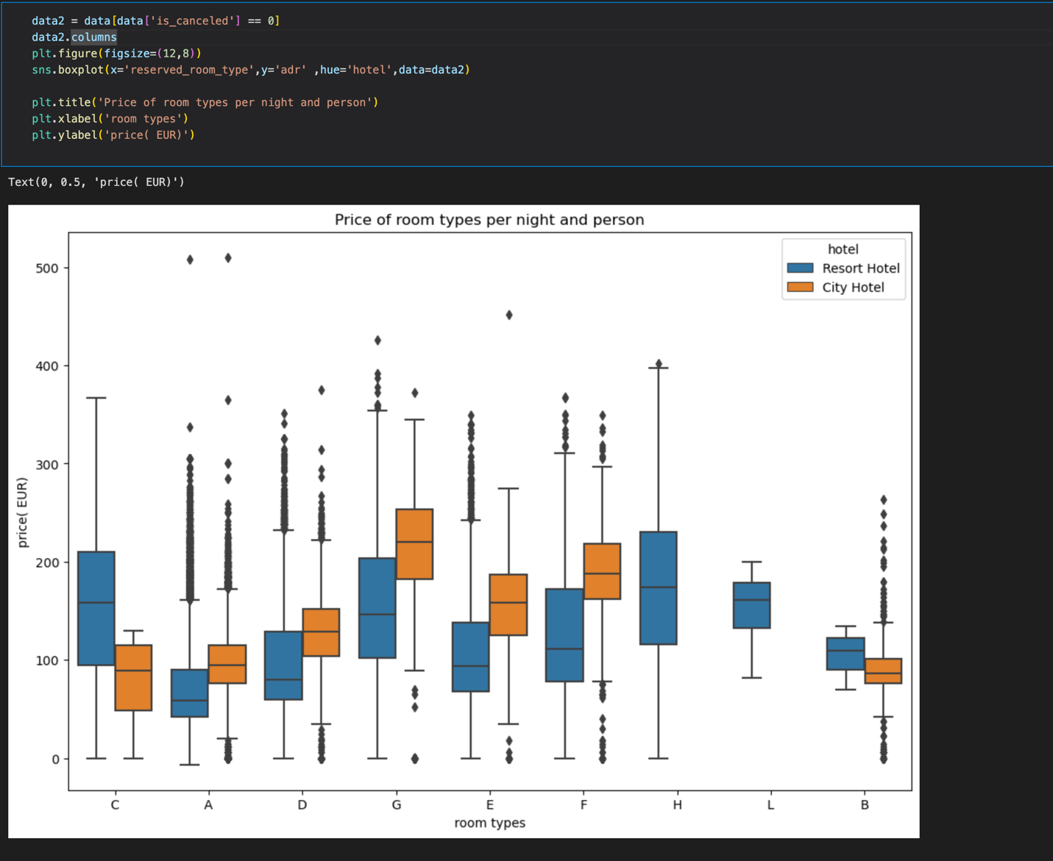
Visualization
Relationship between price distribution and room type

Slide 8
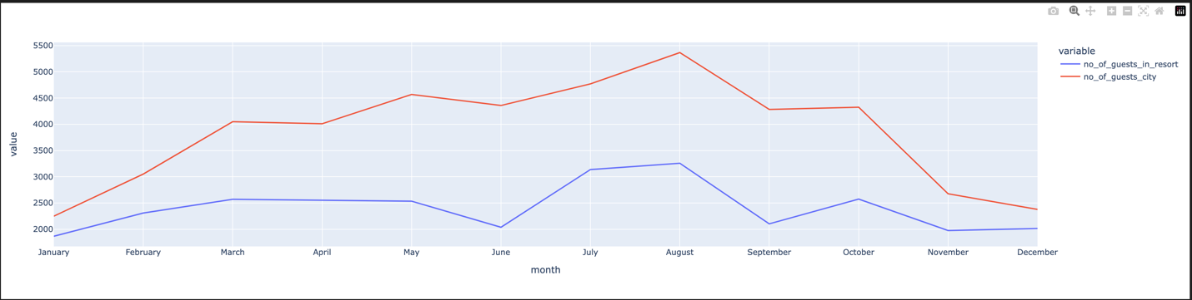
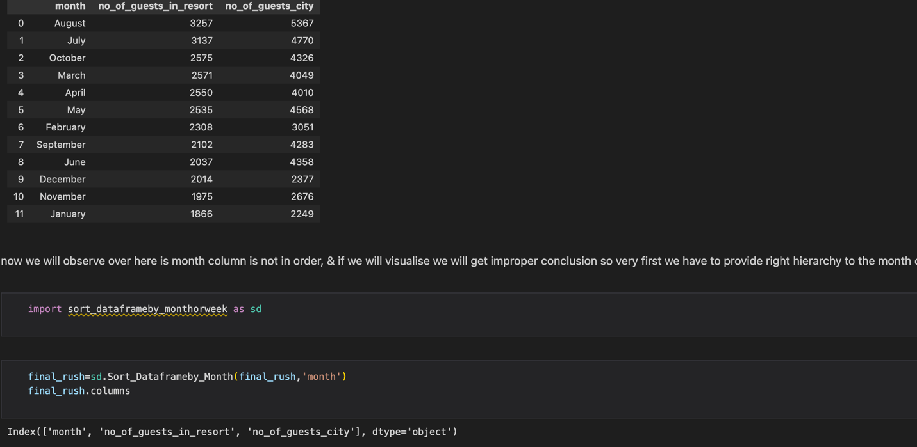
Visualization
Number of guests received by different types of hotels in different months.

Slide 9
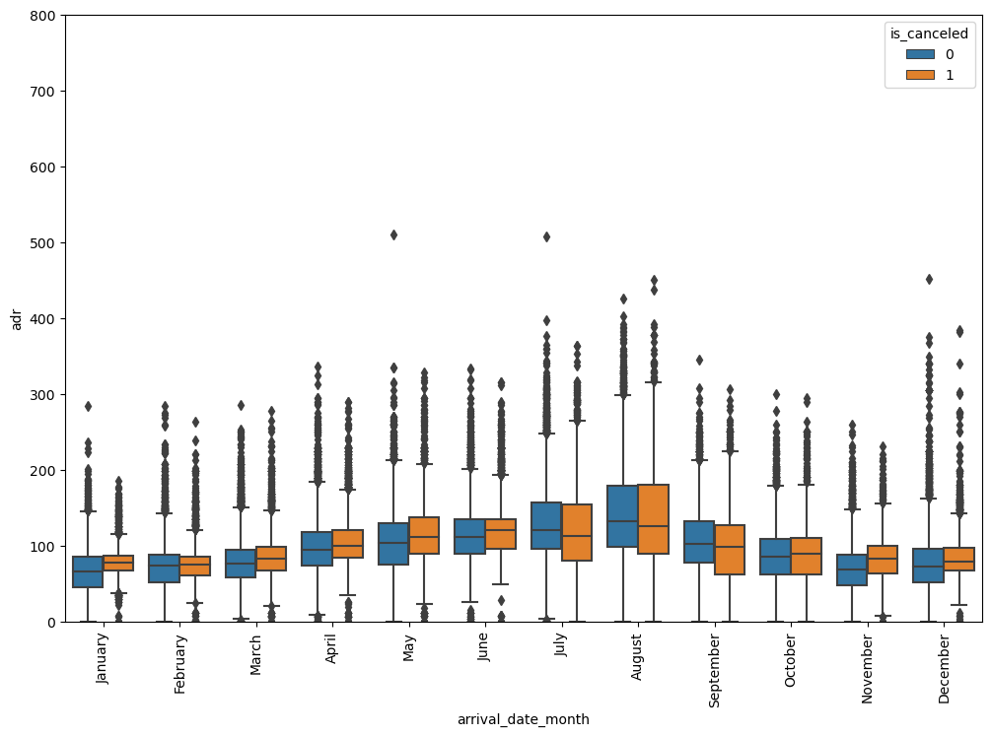
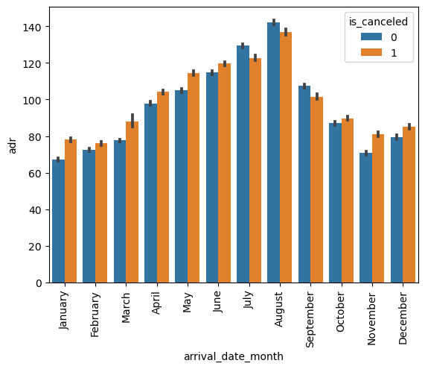
Visualization
Boxplot and bar chart of price in different months

Slide 10
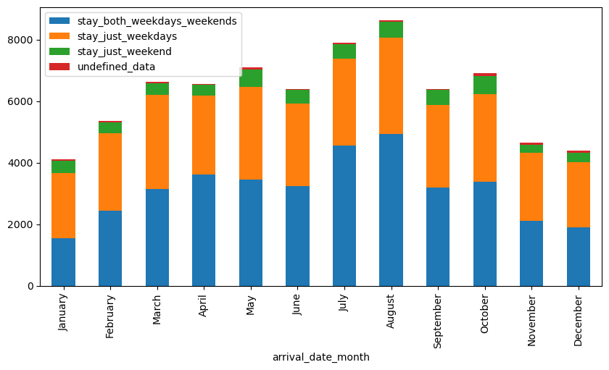
Visualization
stacked bar chart on days of booking

Slide 11
Add Features
Wrote a method family() to check if guests are family and add a column named “is_family” with values of the family()
added a feature named “total_customer” with the value of summation of the number of adults, children, and babies.
added a “total_nights” feature by summation of stays_in_week_nights and stays_in_weekend_nights

Slide 12
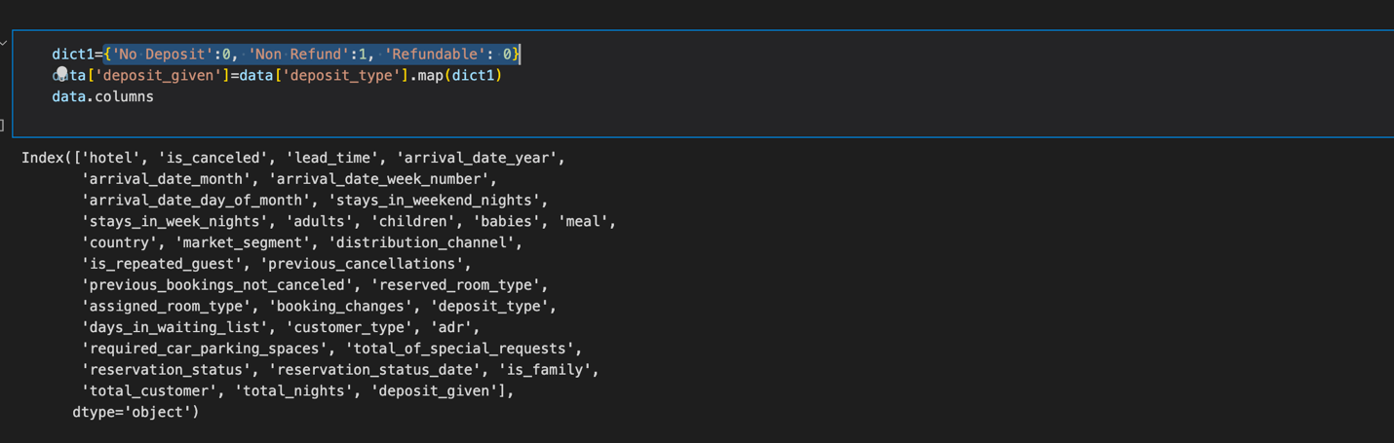
Feature encoding
Apply “deposit_type” to “deposit_given” by dictionary

Slide 13
Feature encoding
We encode each feature by taking the ratio of number of cancellations for each categorical value to the total number of reservations within that categorical value

Slide 14
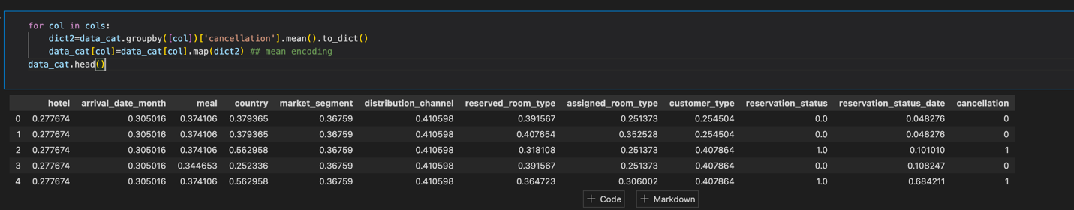
Feature encoding
For example, we encode the “hotel” value by taking the number of cancellations for each type of hotel(resort/city) to the total number of same type hotel reservations(with canceled or not canceled).

Slide 15
Feature selection
Co-relation
Feature selection

Slide 16
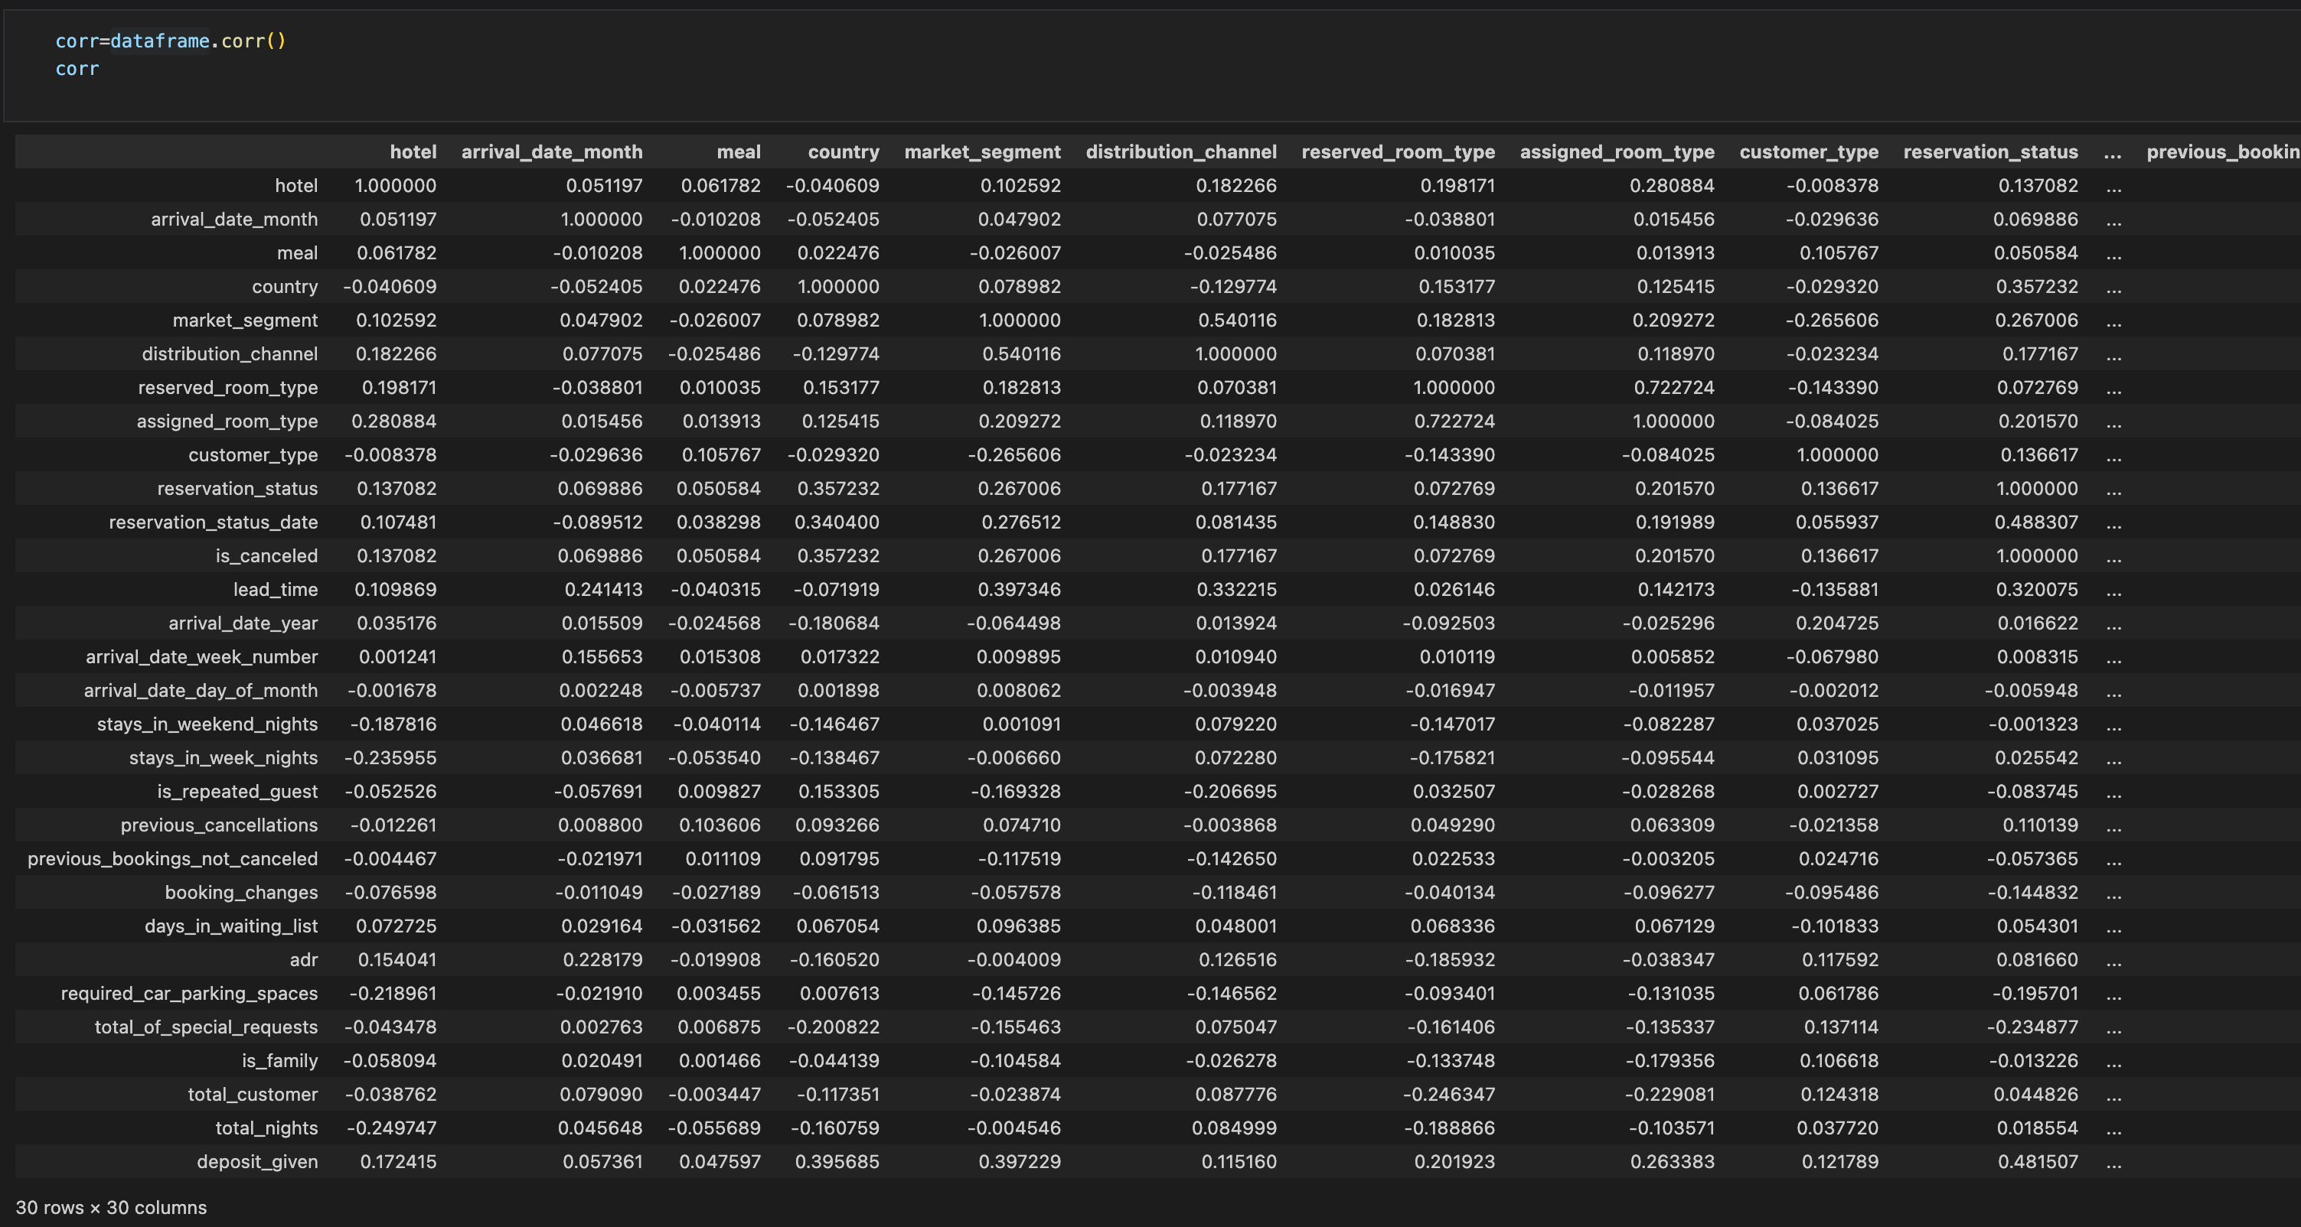
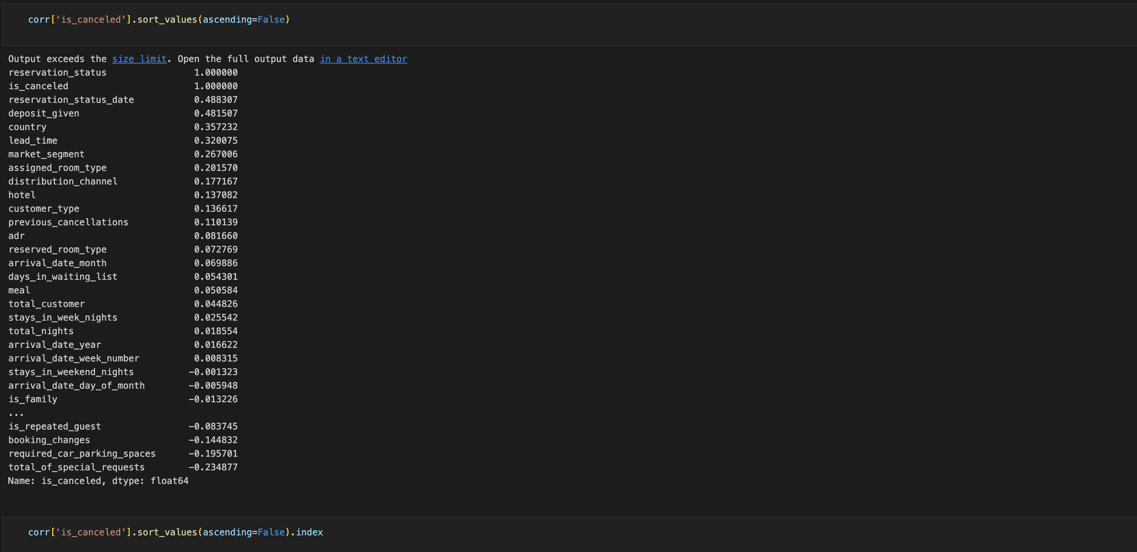
Feature selection/correlation
Used corr() method to see the correlation between each fields. If the correlation coefficient is near 1, there is a stronger correlation between 2 features. If the coefficient is near 0, then there is no correlation between features.

Slide 17
Feature selection/correlation
Remove the features have low correlation coefficient with “isCanceled” feature

Slide 18
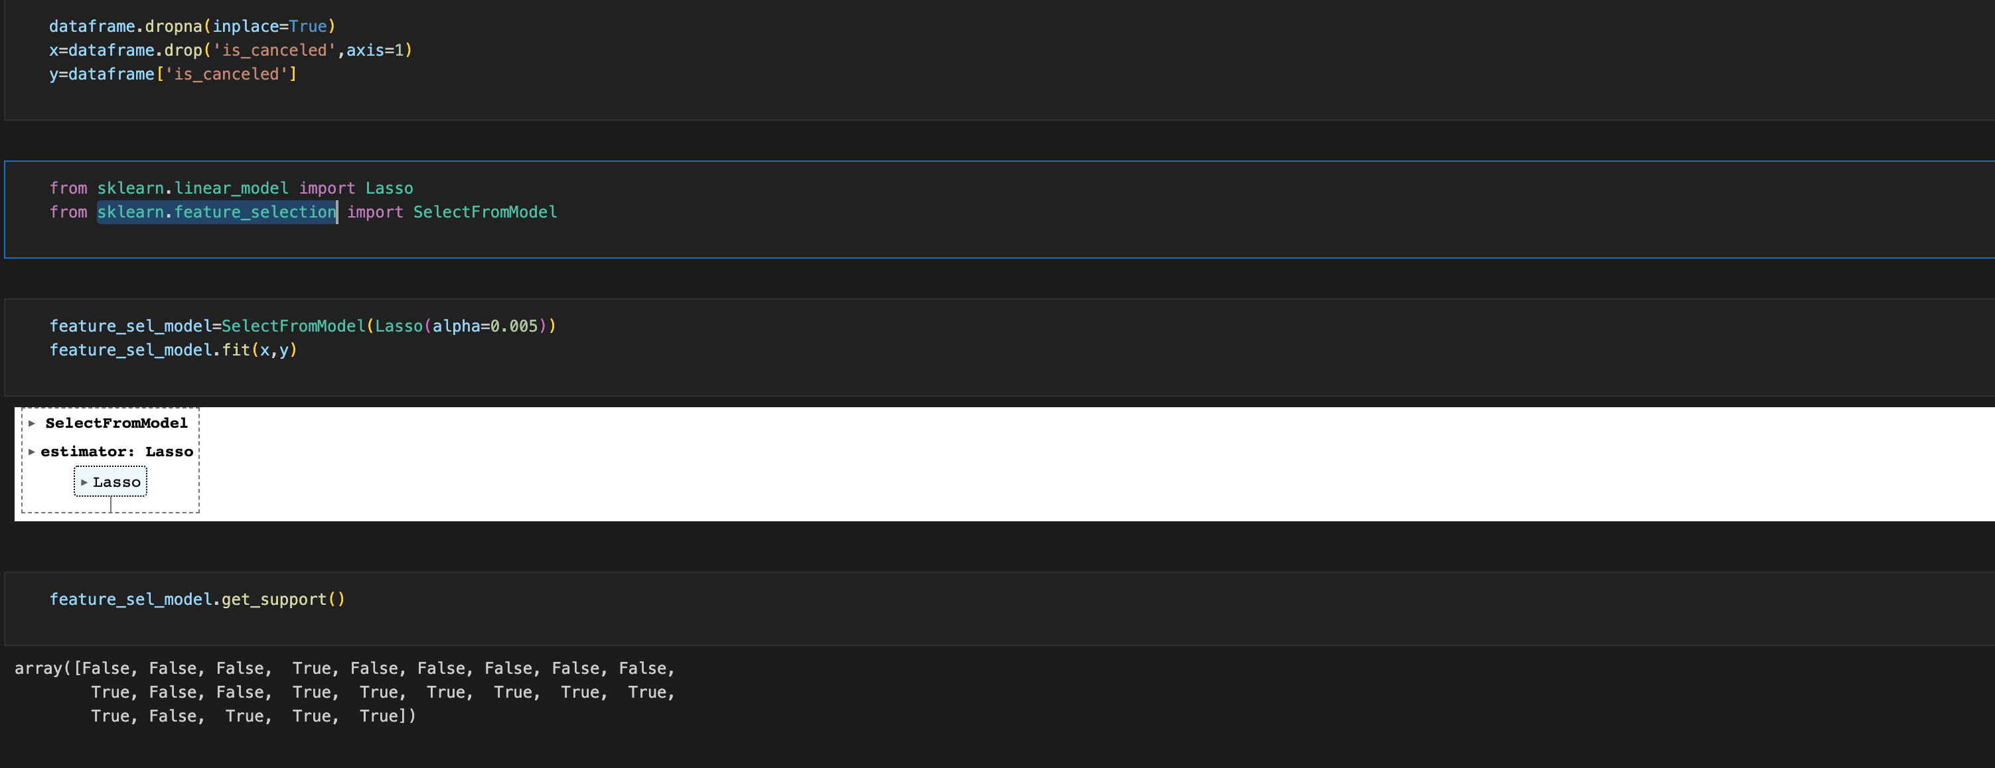
Feature selection
Split the data set into 2. The first set dropped “is_cancelled” feature, and the second set only has “is_canceled’ column(dependent set). We used SelectFromModel() from sklearn.feature_selection to further select important features.

Slide 19
Data mining
Split set
Logistic regression
Comparison between different models

Slide 20
Data mining/split set
We create the training data by importing train_test_split from sklearn.model_selection

Slide 21


Data mining/Logistic regression

Slide 22
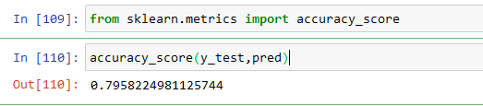
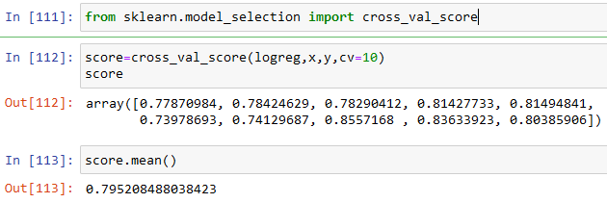
Data mining/Logistic regression

Slide 23
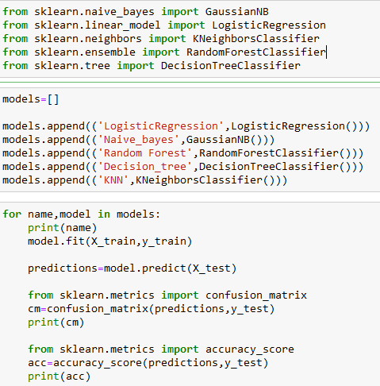
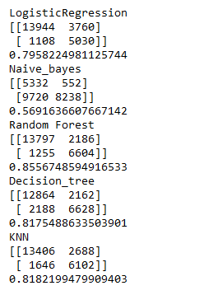
Data mining/Other models

Slide 24
conclusion
Focused on developing a model to predict hotel booking cancellations
Explored the distribution of guests from different countries, analyzed the relationship between price and room type using box plots, and examined the number of guests received by different types of hotels in different months using line charts
Added to enhance the model's predictive capabilities. Features such as "is_family”
Encoded by calculating the probability of cancellation for each categorical value, thereby enriching the dataset.
Used correlation analysis and SelectFromModel to select feature
Logistic regression and comparisons with other models

