Slide 1

Mushroom Classification
A Supervised Machine Learning Project

Slide 2
OBJECTIVE
In this project, we will examine the data and create a machine learning algorithm that will detect if the mushroom is edible or poisonous by its specifications using different classifiers.
SUMMARY:
A sample of 8124 mushrooms have been collected having different specifications for the study and was stored in (.csv file).

Slide 3
PROJECT WORKFLOW
Data Collection
Exploratory Data Analysis (EDA)
Data Pre-processing
Model Building, Training, Testing & Evaluating results
Feature Engineering
Model Validation
Finalising the model
Making Pipeline
Building & deploying UI app (using Streamlit & Streamlit cloud)

Slide 4
PACKAGES
Numpy
Pandas
Matplotlib
Seaborn
Sci-kit Learn
XGBoost
Pickle
Streamlit

Slide 5
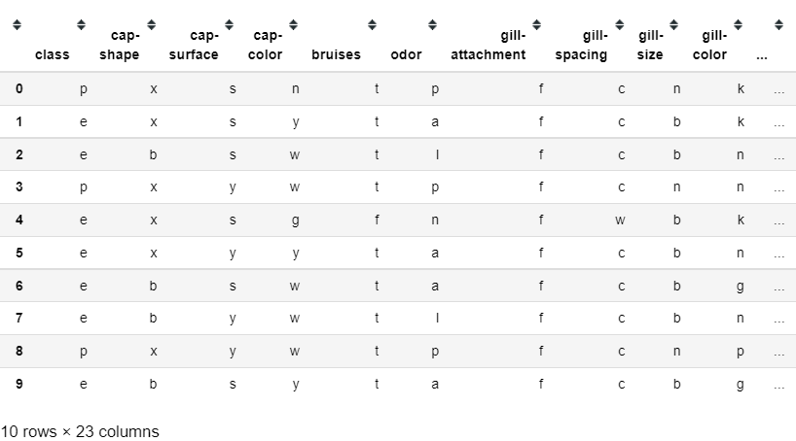
DATA AT GLANCE

Slide 6
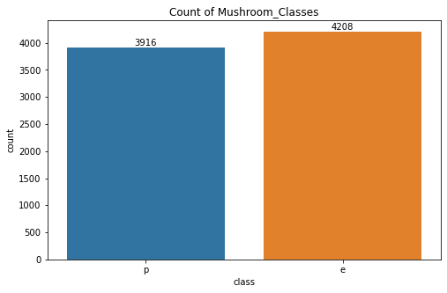
DATA ANALYSIS & VISUALIZATION
The Mushroom class is our target variable.
It has two classes edible (e) & poisonous (p).
The count of edible class mushroom (e) is slightly higher than poisonous class (p).
Hence, the dataset is a balanced dataset.

Slide 7
DATA PRE-PROCESSING
Since, the data is available only in categorical format we have to pre-process the data before model building.
We have used, Label Encoder library from scikit-learn package to encode our categorical features into numerical.
Now, our data is ready for model building process.

Slide 8
MODEL BUILDING & TRAINING
We have split the dataset in the ratio of 70:30 for training & testing purpose respectively.
We have used different classification models such as:
Logistic Regression.
Decision Tree
Random Forest
K-Nearest Neighbours
Support Vector Machines
XGBoost.

Slide 9
MODEL EVALUATION
We have used different metrics for evaluating the models.
Accuracy score.
Confusion Matrix
Classification Report

Slide 10
EVALUATION RESULTS
Models | Accuracy | Recall score | F1 score
Logistic Regression | 96% | 96% | 96%
Decision Tree | 100% | 100% | 100%
Random Forest | 100% | 100% | 100%
K-Nearest Neighbours | 100% | 100% | 100%
Support Vector Machine | 99% | 98% | 99%
XGBoost | 100% | 100% | 100%

Slide 11
FEATURE ENGINEERING
We have considered all the 22 features for predicting whether mushroom is edible or not. In reality, its not the case.
In feature engineering we consider only significant features which matters most for model prediction.
We have used following techniques:
Correlational Analysis
Chi-square method
Recursive Feature Elimination (RFE)
Decision Tree feature importance

Slide 12
FEATURE ENGINEERING RESULT
After analysis of feature engineering, we found there are 10 significant features for predicting whether mushroom is edible or not.
We have build the model as per 10 significant features and got the same results as using all features.
Below 3 models produced same result.
Decision Tree
Random Forest
XGBoost

Slide 13
MODEL VALIDATION
We have K-Fold Validation test for evaluating the models overall performance and stability.
Below 3 models were able to produce the best results.
Decision Tree
Random Forest
XGBoost

Slide 14
MODEL FINALISATION
After looking at the model’s overall stability and performance we decided to finalise the Random Forest model for our project.
Random Forest model was able to maximise the recall and f1 score.
Random forest model’s stability is 100%.

Slide 15
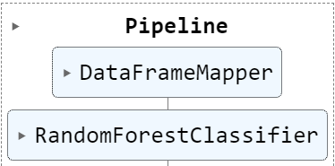
BUILDING PIPELINE
Pipeline is used for the making data flow with undergoing transformation and model training, testing & evaluation.
We have used Data-frame mapper and scikit-learn’s pipeline library for making pipeline.
Below is the diagram of the pipeline.

Slide 16
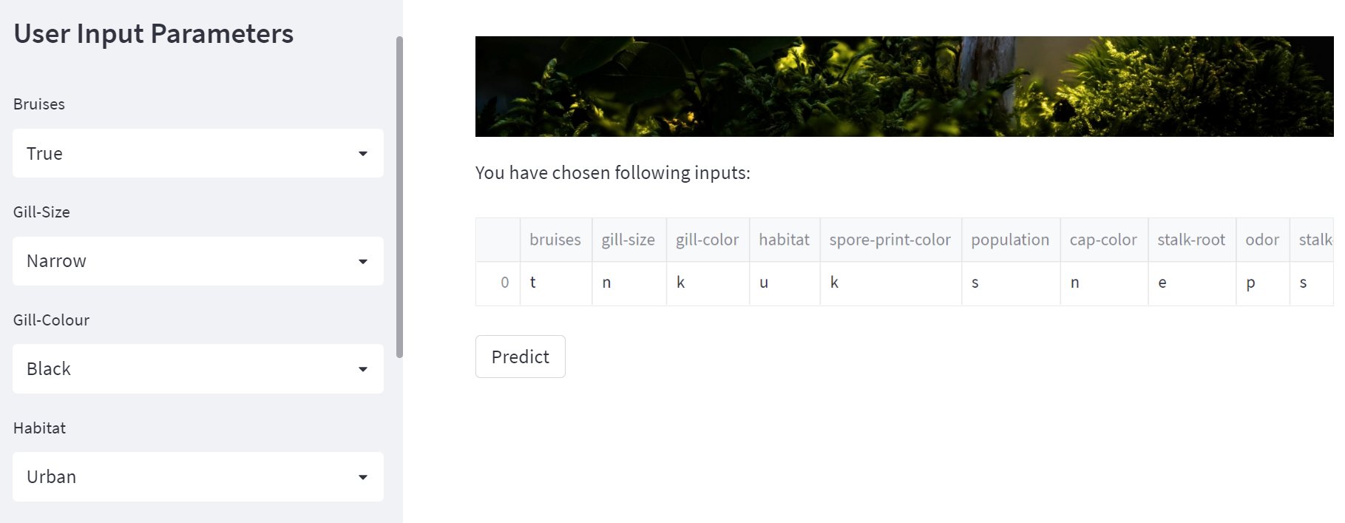
MODEL DEPLOYMENT – STREAMLIT CLOUD
Once the user selects the different parameters and click on predict, the model will run seamlessly and provide the result with either ‘edible’ or ‘poisonous’.

Slide 17
THANK YOU!

