Slide 1

SENTIMENT ANALYSIS – HOTEL REVIEWS

Slide 2

Objective
Our goal is to examine how travellers are communicating their positive and negative experiences in online platforms for staying in a specific hotel.
Our major objective is what are the attributes that travellers are considering while selecting a hotel. With this manager can understand which elements of their hotel influence more in forming a positive review or improves hotel brand image.
Summary
A sample dataset which consists of 20,000 reviews & ratings have been collected for the project. The dataset contains 2 features
Reviews - The reviews feature contains the reviews given by the visitors.
Ratings – The rating features contains the ratings given by the visitors respectively.

Slide 3
Project Workflow
Data Collection
Exploratory Data Analysis (EDA)
Text Data Pre-processing
Sentiment Analysis – Rule Based
Sentiment Analysis – Machine Learning Model
Resampling Techniques
Model Validation
Sentiment Analysis – Deep Learning Pre-trained model
Finalizing the model
Making Pipeline
Building & deploying UI app (using Streamlit & Streamlit cloud)

Slide 4
Packages
Pandas
Seaborn
Matplotlib
Sci-kit Learn
Imblearn
NLTk, Afinn, TextBlob
String
RE (Regular Expression)
Joblib, Cloudpickle

Slide 5
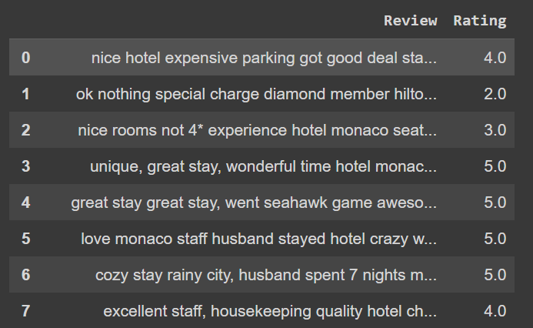
Data at Glance

Slide 6
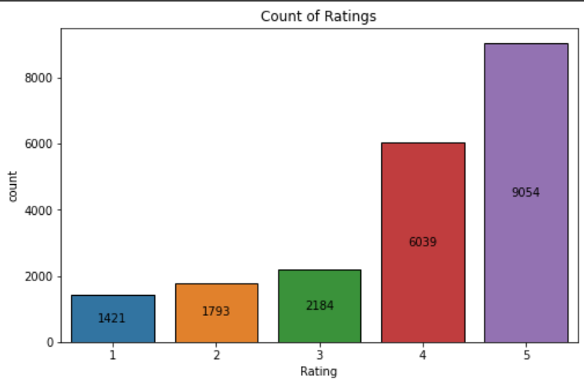
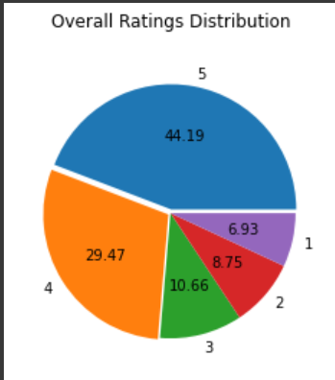
DATA ANALYSIS & VISUALIZATION

Slide 7
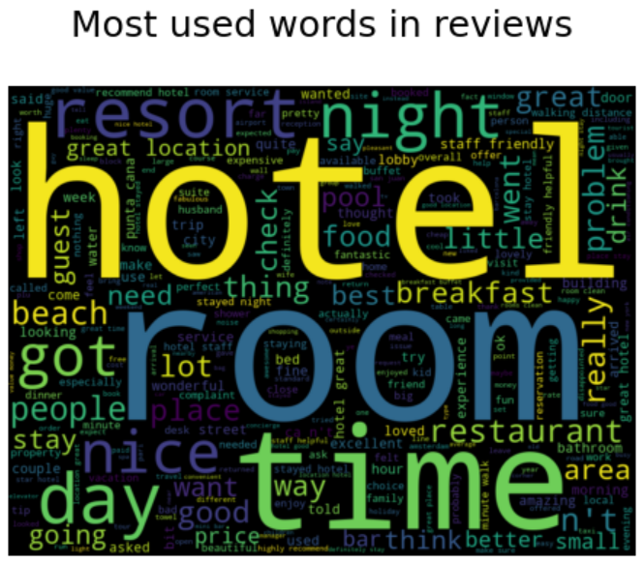
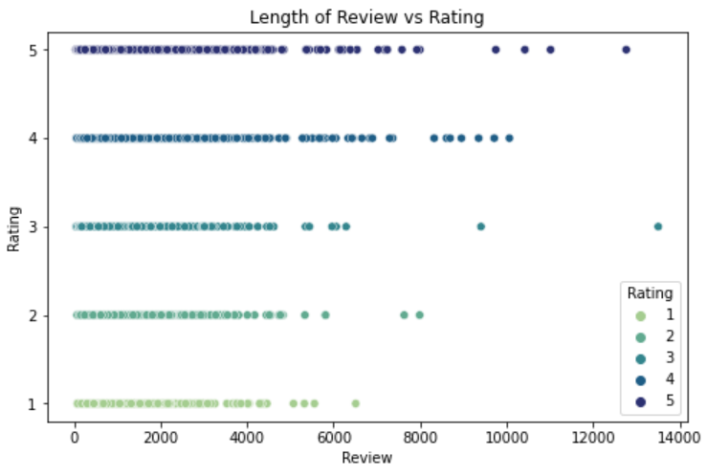
DATA ANALYSIS & VISUALIZATION

Slide 8
Text Data Pre-processing
Most of the text data are cleaned using below modules:
Since, the data is available only in text format we have to pre-process the data before model building.
We have used, String, Regular expression, NLTK modules to clean our text data.
And encode our target variable into binary format using Label encoding from sci-kit learn library.
Total length of review comparison –
Before text preprocessing : 14861007
After text preprocessing : 10397957
Now, our data is ready for further sentiment analysis & model building process.

Slide 9
Sentiment Analysis
Rule Based –
VADER (Valence Aware Dictionary For Sentiment Reasoning)
Text Blob
Lexicons with Polarity Scores – Afinn
Model Based –
Logistic Regression
Naive Bayes
Distilbert pretrained model

Slide 10
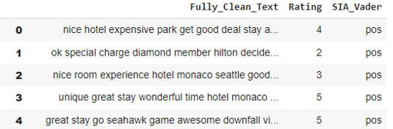
Rule Based Methods
Using NLTK’S VADER (Valence Aware Dictionary For Sentiment Reasoning)
VADER VADAR is a lexicon & rule based sentiment analysis tools specifically calibrated to sentiments most commonly expressed on social media platform. When calculating a polarity score Vader output four metrics : compound, negative, neutral & positive.
The compound score calculates the sum of all lexicon ratings which is normalized between -1 (most negative) to +1 (most positive)

Slide 11
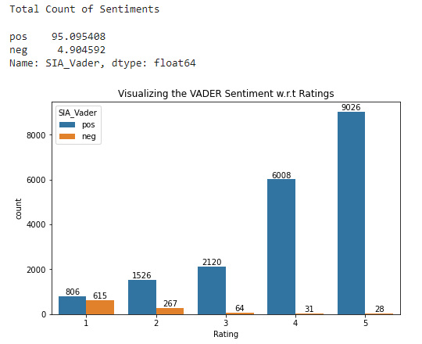
Rule Based Methods
NLTK’S VADER - – Sentiment Analysis
Note –
As we can see from above sentiment analysis, almost 95% reviews are tagged as ‘Positive’.
Even most of the lowest rated reviews are misclassified as positive.

Slide 12
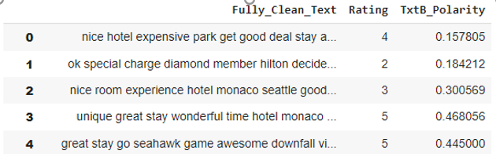
Rule Based Methods
TextBlob -
TextBlob is built on top of NLTK and also it is very easy to use and can process the text in a few lines of code. TextBlob can be used for complex analysis and working with textual data. When a sentence is passed into TextBlob it gives two outputs, which are polarity and subjectivity.
Polarity is the output that lies between [-1,1], where -1 refers to negative sentiment and +1 refers to positive sentiment.
Subjectivity is the output that lies within [0,1] and refers to personal opinions and judgments.

Slide 13
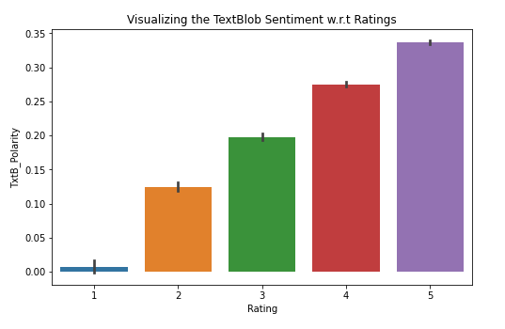
Rule Based Methods
TextBlob– Sentiment Analysis
Note –
As we can see from above analysis, the low score ratings are also having positive polarity scores.
Negative review polarity score is not negative but positively low scored. Hence it is difficult to interpret the positive & negative reviews using TextBlob.

Slide 14
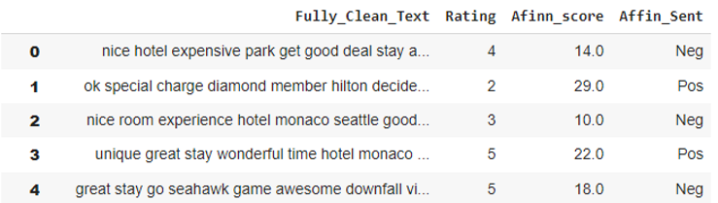
Rule Based Methods
Afinn Sentiment Analysis -
Afinn is the simplest yet popular lexicons used for sentiment analysis developed by Finn Årup Nielsen. It contains 3300+ words with a polarity score associated with each word.
Afinn is a list of words rated for valence with an integer between minus five (negative) and plus five (positive). The comparative score is simply: sum of each token / number of tokens

Slide 15
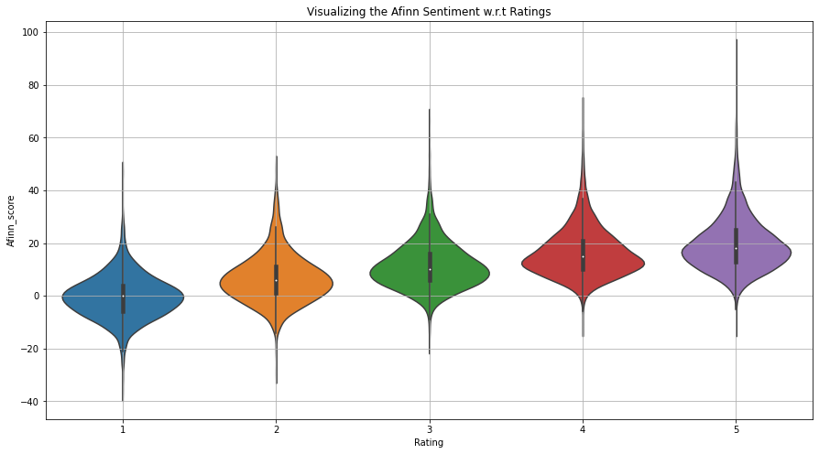
Rule Based Methods
Afinn– Sentiment Analysis
Note:
As we can see from above violin plot, top rated reviews, the minimum Afinn score is negative whereas bottom review highest afinn score is positive.
Hence, afinn is better than other rule based sentiment analysis, but unable to segregate between lowest and highest review

Slide 16
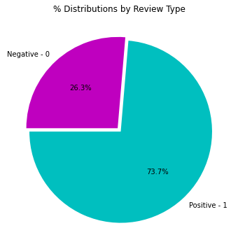
Sentiment Analysis
Model Based –
Steps :
Label encoding
TFIDF Vectorizer
Model building, training, testing – Imbalanced data
Sampling methods
Model building, training, testing – balanced data
Model validation

Slide 17
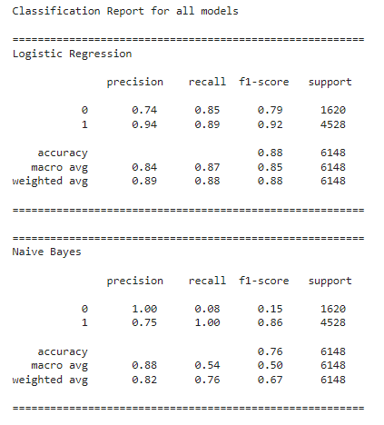
Model Evaluation – Imbalanced data
From above model evaluation,
As per confusion matrix, our goal is minimize the False Positives & Negatives. Hence, Logistic Regression model was able to minimize False Negatives & Positives but still we have to reduce it as much possible.
As per classification report, we would try to maximize recall class 0, 1. Naive Bayes model's recall value for class 0 is poor compared to Logistic Regression model.

Slide 18
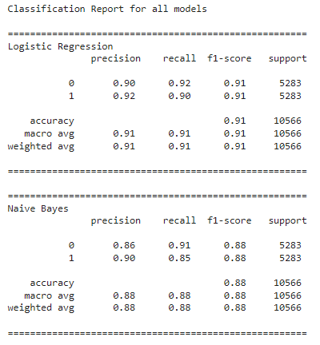
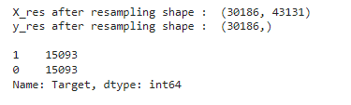

Sampling Techniques
SMOTE: Synthetic Minority Over sampling Technique-
SMOTE works by selecting pair of minority class observations and then creating a synthetic point that lies on the line connecting these two.
It is pretty liberal about selecting the minority points and may end up picking up minority points that are outliers.
From above analysis,
We can say that after applying the sampling method smote technique to our data, the accuracy has improved by more than 30% for Naive Bayes model.
Also, the recall class 0, 1 has been improved.

Slide 19
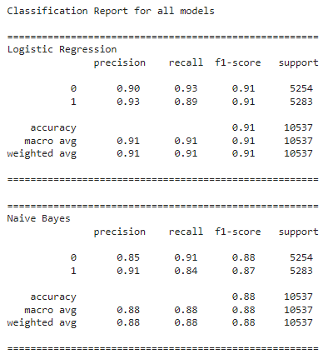
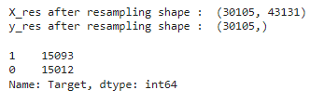

Sampling Techniques
Adaptive Synthetic Sampling (ADASYN)-
It involves generating synthetic samples inversely proportional to the density of the examples in the minority class. That is, generate more synthetic examples in regions of the feature space where the density of minority examples is low, and fewer or none where the density is high.
From above analysis,
There's a minimal improvement in minority class compared to smote technique, even though the accuracy remained the same more or less.

Slide 20
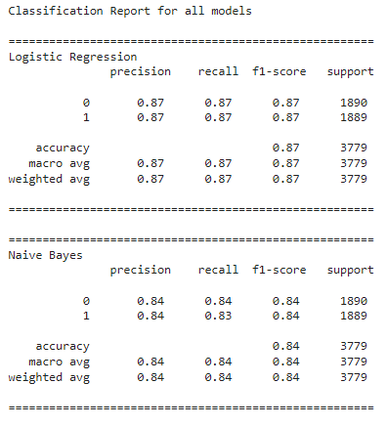
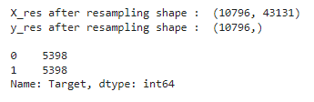

Sampling Techniques
Random Under Sampler -
A simple under-sampling technique is to under sample the majority class randomly and uniformly.
This can potentially lead to the loss of information. But if the examples of the majority class are near to others, this method might yield good results.
From above analysis,
The majority class data has been brought down close to minority class.
There's a decrement in the accuracy for Logistic Regression as well as the Naive Bayes accuracy scores compared to smote resampled data accuracy score

Slide 21
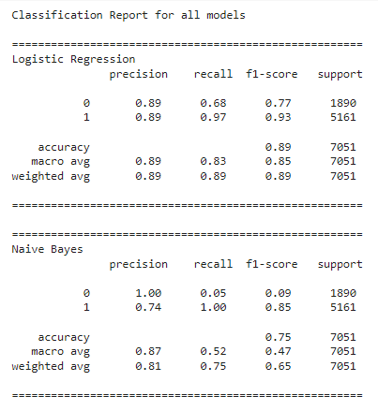
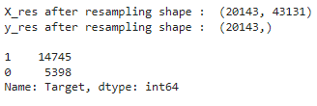

Sampling Techniques
Tomek Links -
Tomek Links ability to remove the data that are identified as Tomek links from the majority class (that is, samples of data from the majority class that is closest with the minority class data)
From above analysis,
We can see there's a decrement in minority recall class 0, for Logistic Regression & Naive Bayes model compared to other sampling techniques.
Both, these models have under performed with this technique

Slide 22
Model Validation
K-Fold –
Cross Validation on original data –
The cross validation score is around 89% for Logistic Regression with 1% deviation, 77% for Naive Bayes model with 1.2% deviation on original dataset respectively.
Cross Validation on SMOTE data –
The cross validation score is around 92% for Logistic Regression with 0.7% deviation, 88% for Naive Bayes model with 0.6% deviation on SMOTE dataset respectively.
Note:
After analysis of sampling techniques, we will choose smote resampled data for further analysis for machine learning based sentiment analysis.
Hence, as we observed the accuracy, precision and recall score have been improved using smote.

Slide 23
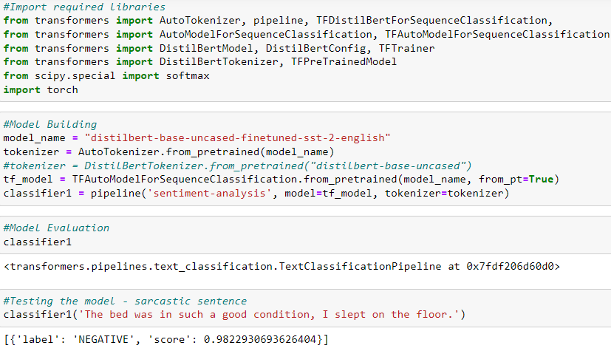
Model Based - Deep Learning Pretrained Models
Distilbert -
Model Description: This model is a fine-tune checkpoint of DistilBERT-base-uncased, fine-tuned on SST-2. This model reaches an accuracy of 91.3 on the dev set (for comparison, Bert bert-base-uncased version reaches an accuracy of 92.7)

Slide 24
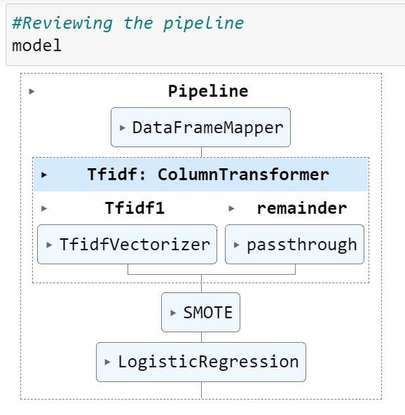
Building Pipeline
Pipeline —
It helps us to automate the process and maintain the order of execution for our machine learning models. This pipeline can be used to integrate multiple steps into one, so that the data will go through sequence of steps. Thus instead of calling the above steps separately the pipeline concatenates all of the steps into one specific system ,enhances the readability and reproducibility.

Slide 25
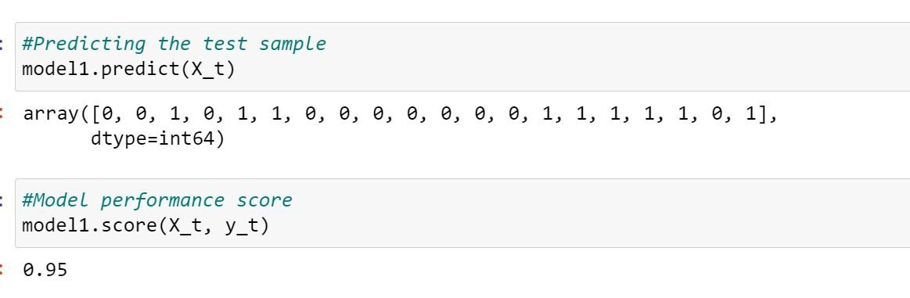
Model Based - Deep Learning Pretrained Models
Testing The Pipeline On Dataset – Drawn 10 random samples from our dataset for testing purpose and remaining samples were used for training the pipeline

Slide 26

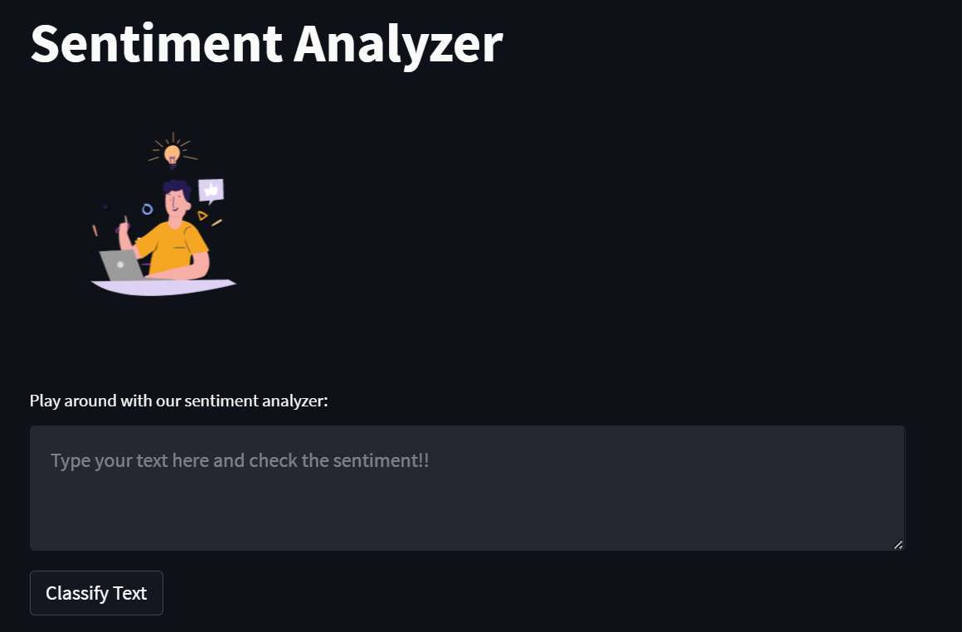

Streamlit Cloud – Machine Learning Model

Slide 27

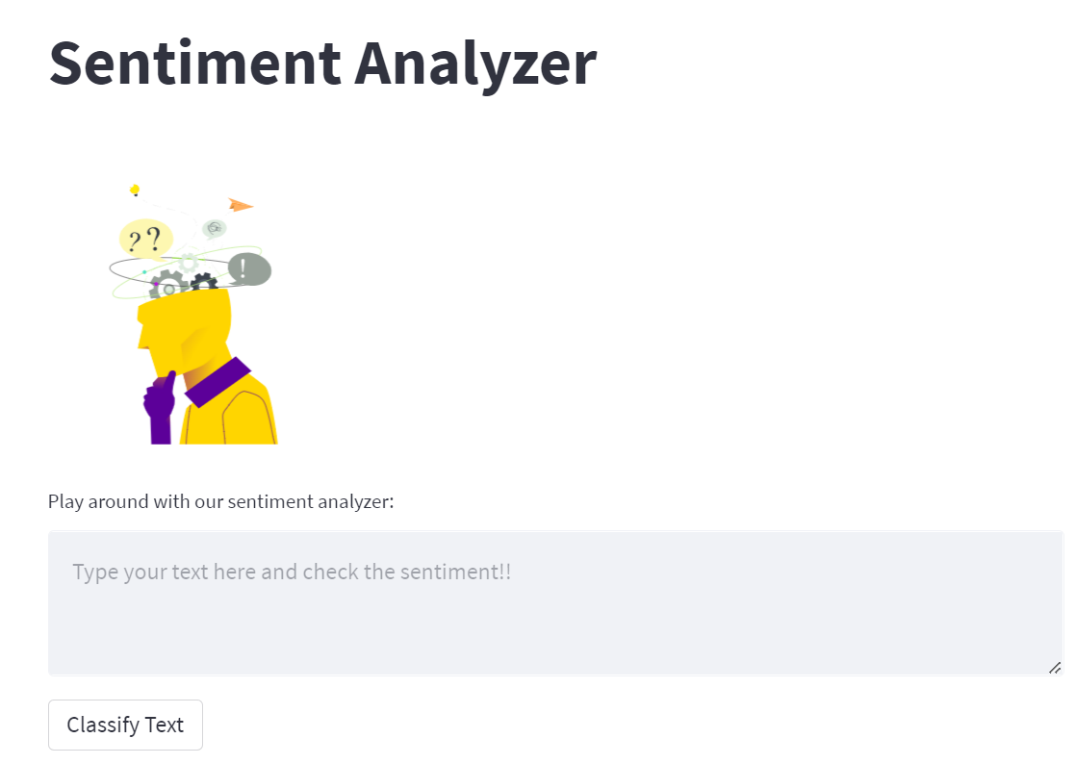

Streamlit Cloud – Deep Learning Model

Slide 28

Thank You

