Slide 1
A filtering procedure to process non-stationary signals
The Biomechanics Laboratory, Pennsylvania State University
Daniel J. Davis & John H. Challis

Slide 2
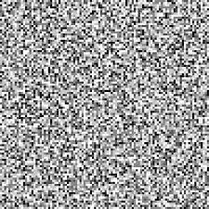

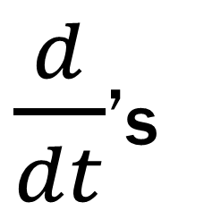
Importance of Filtering
$\frac{d}{dt}$’s
Low-pass
Butterworth
Notes:
- Derivatives are almost ubiquitous, but amplify high frequency noise
Apply filter to rid our signal of noise whilst retaining the signal of interest.
Commonly this is a “Butterworth” filter

Slide 3
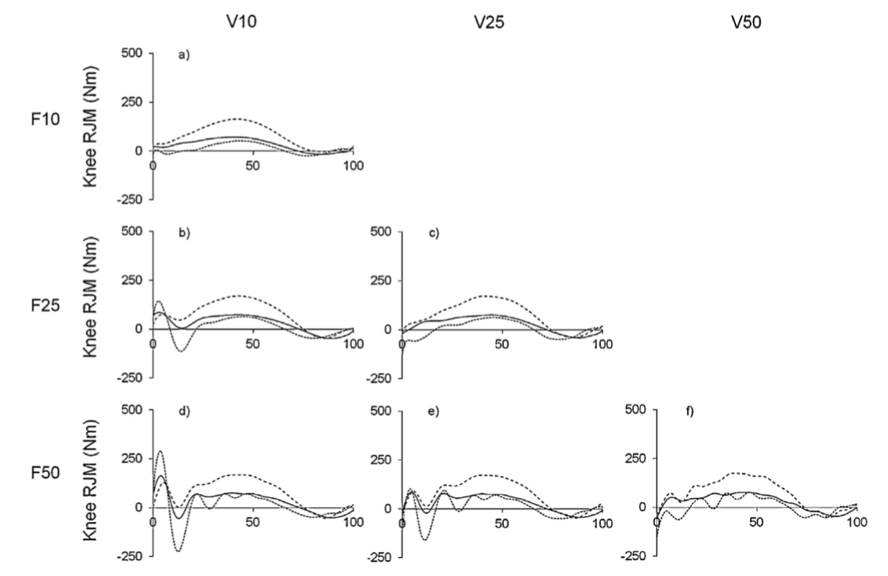
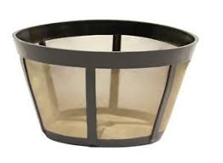
Filter Selection
Different filter → different results Bezodis et al (2013); Kristianslund et al (2012)
Vs.
10 Hz
15 Hz
Notes:
Knee joint moment during from 3 participants running filtered at varying frequencies. Just one example of varying results with different filtering techniques
V= video

Slide 4
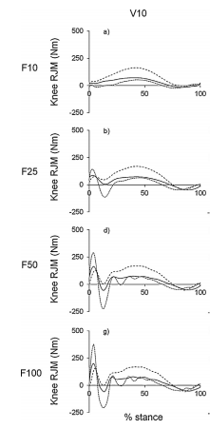
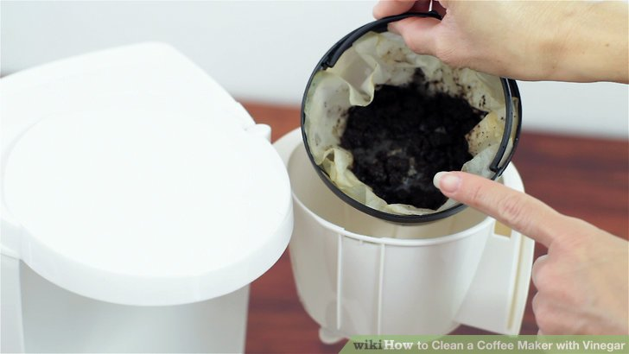
Filter Application
Inverse Dynamics-
Recommendation: filter position and force data at same frequency Van den Bogert & de Koning (1996); Bisseling and Hof (2006)
High frequency components are effectively “thrown away”
Force Signal
Notes:
An area where filtering is vastly important is inverse dynamics (method by which calculate moments, forces, work, and power at joints)
Current recommendation to filter position and force data with same fco
High frequency force & segment acceleration signals at impact → we filter position data a relatively low frequency and attenuate the segmental accelerations
Force data contains higher frequency components, might filter at 50-100 Hz. Better capture high frequencies, but introduces impact artifact to moment.
Apply this low frequency filter to forces attenuates some of that signal as well, so accelerations can “absorb” GRFs
“knee moment looks great! Why bother changing?”
What if peak/impact segmental accelerations are of interest? “Tibial acceleration” returns 27,000 results on google scholar
Calls for a different filtering method
What if those peak segmental acceleration are of interest? What if peak reaction forces are of interest?
Could filter forces … - Joint reaction forces require accurate segmental acceleration estimates, otherwise GRF dominates significantly more.
“Approach not ideal when reaction forces are of interest,” Edwards (2011)

Slide 5
Filter Selection – how do we decide?
Filter that “seems to” attenuate most of the noise?
5 Hz, 10 Hz, 15 Hz?
Auto determination methods
Residual Analysis Winter (2009)
Auto-correlation Based Procedure (ABP) Challis (1999)
Notes:
These round #’s are often used as they “seem to” filter most of the noise.
Might also use an automatic method to introduce some objectivity in filter selection.
Methods analyze the signal to determine which filter is “best”

Slide 6
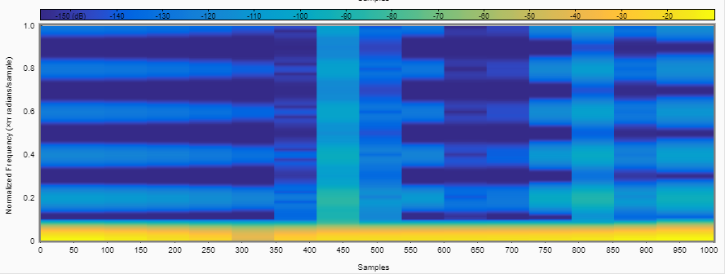
One Filter, One Frequency?
Most signal power in walking < 6 Hz, running < 15 Hz Antonsson & Mann (1985); Winter (2009)
Impact force content during walking and running ranged from ~7 to ~50 Hz Antonsson & Mann (1985); Boyer and Nigg (2004);
Van den Bogert & de Koning (1996)
Notes:
All methods up to this point use single frequency filter cut-off
1st Issue: only filter the data at a single frequency. If we know the entire signal isn’t at a signal frequency, this single filter is inherently a compromise between high and low “best matches”
EXPLAIN WTF THIS IS
So if we can see that the movement isn’t at one frequency, how do we go about applying “optimal” different filters to these different frequencies?
Could use spectrogram like above, but how do we quantify?

Slide 7

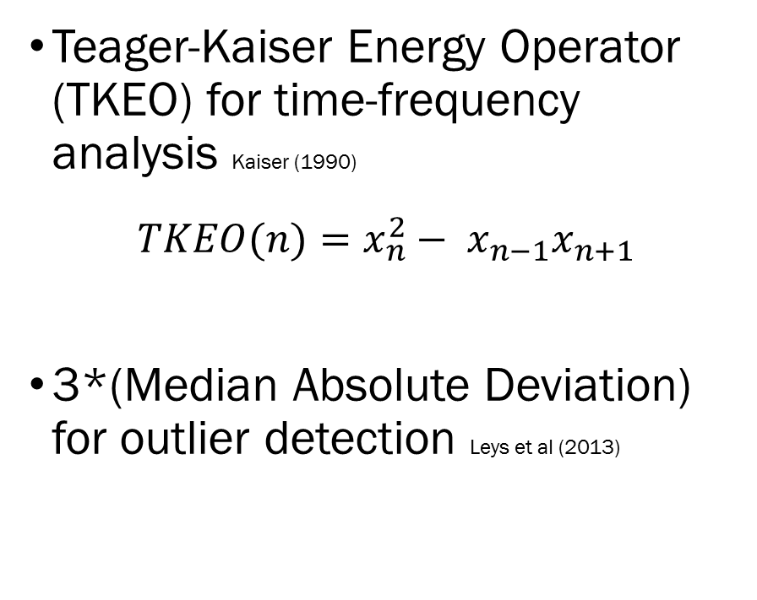
Detecting Signal Differences
Teager Kaiser Energy Operator
Teager-Kaiser Energy Operator (TKEO) for time-frequency analysis Kaiser (1990)
$$TKEO(n)=x_{n}^{2}− x_{n−1}x_{n+1}$$
3*(Median Absolute Deviation) for outlier detection Leys et al (2013)
Energy
New section
Samples
Dowling (1985)
Van den Bogert & de Koning (1996)
Notes:
One method is the Teager-Kaiser Energy, allowing for “on the fly” signal energy calculation.
First applied the Teager-Kaiser algorithm, which calculates the “energy” of oscillating signal.
Wanted to determine when this “energy” was different. Used 3*MAD.
Used points where the TKEO exceeded this value, and determined those to be “new sections.”
- First is for Dowling data, one “marker”
Van den Bogert ground reaction force data (COM acceleration = weighted-average of body segment accelerations).
Multiple markers, multiple methods.
Teager-Kaiser: xn^2 – (xn+1)(xn-1) = Energy
-“a simple algorithm is derived that enables on-the-fly calculation of the ‘energy’ required to generate, in a certain sense, a signal.”
- “above expression gives us a good measure of the energy of the oscillating signal when the sampling rate of the signal is greater than eight times the frequency of oscillation of the signal (at least two sample points in each quarter cycle of sinusoidal oscillation.”
-sensitive to noise. Appropriate to lowpass filter.

Slide 8
New Method for Signal Processing
Filter and double-differentiate position data with ABP determined cut-off
Calculate TKEO
Compute Median Absolute Deviation to define sections
Conduct ABP on each individual section, produces filter cut-off for each
Filter data-set at each of these frequencies
Join sections of data together
Notes:
Calculate TKEO of filtered acceleration data
Acceleration because high frequency components that we want to tease out
Can use mean of acceleration data or GRF data as is weighted average of segment accelerations
Cut-points are not that sensitive to different filter cut-offs pre double differentiation

Slide 9
Acceleration Comparisons
Section 1
Section 2
Section 3
RMSE | % Error for Max | % Error for Min
41.4% | 1.1% | 50.8%
RMSE | % Error for Max | % Error for Min
41.4% | 1.1% | 50.8%
26.7% | 0.7% | 13.7%
Dowling (1985)
Notes:
ABP compares well to RA that I mentioned earlier, and generalized cross-validated quintic spline from Woltring

Slide 10
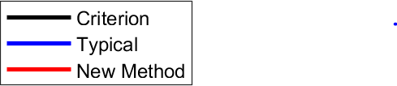
Angular Accelerations
RMSE: ~60% vs. 89%
~42% vs. 55%
~25% vs. 40%
New Procedure vs. Typical Filtering (15Hz)
Van den Bogert & de Koning (1996)

Slide 11
Linear Accelerations
~59% vs. 73%
~31% vs. 42%
~15% vs. 31%
~16% vs. 33%
~16% vs. 31%
~20% vs. 30%
New Procedure vs. Typical Filtering (15Hz)
Van den Bogert & de Koning (1996)

Slide 12
Joint Forces
RMSE: ~12% vs. 25%
~10% vs. 23%
~9 % vs. 20%
New Procedure vs. Typical Filtering (15Hz)
Van den Bogert & de Koning (1996)

Slide 13
Ground Forces
RMSE: ~7% vs. 14%
New Procedure vs. Typical Filtering (15Hz)
Van den Bogert & de Koning (1996)

Slide 14
Summary
Teager Kaiser Energy Operator
Better classification of non-stationary movements
Retaining higher frequency impact signals
Better estimate accelerations
Better joint and ground reaction force estimates
Energy
Samples
Notes:
By reducing need for compromise between high and low frequency portions of signal . . . Which allows us to…
Filtering impact signals at higher frequency, attenuating less force signal.
Important for loading rates, for joint loading

Slide 15
Questions?
Thank you!
Notes:
Application?
- Better classification of impacts and their relation to rest of movement. Has implications for loading rate of tissues.
Sure, could filter all data at 45-50 Hz, but for inverse dynamics wouldn’t be able to use anything beside impact phase of movement as incorporating noise in kinematic data.

Slide 16
A filtering procedure to process non-stationary signals
The Biomechanics Laboratory, Pennsylvania State University
Daniel J. Davis & John H. Challis

Slide 17
Signal Processing
Auto-correlation Based Procedure (ABP) on each section
Minimizes auto-correlation of residual resulting from given filter Challis (1999)
Filter entire data set at each recommended filter cut-off
Join section estimates together with weighted difference

Slide 18
Segment Linear Accelerations
~59% vs. 73%
~31% vs. 42%
~15% vs. 31%
~16% vs. 33%
~16% vs. 31%
~20% vs. 30%
New Procedure vs. Typical Filtering (15Hz)
Van den Bogert & Koning (1996)

Slide 19

Accelerations
Segment Angular Acceleration
RMSE = ~60% vs. 89%
~42% vs. 55%
~25% vs. 40%
New Procedure vs. Typical Filtering (15Hz)
Van den Bogert & Koning (1996)
Notes:
Van den Bogert published 2D position data for an individual’s stride as well as joint moments and ground reaction forces. Superimposed noise. Applied 15 Hz filter.

Slide 20
Angular Accelerations
RMSE: ~60% vs. 89%
~42% vs. 55%
~25% vs. 40%
Acceleration [rad/s²]
New Procedure vs. Typical Filtering (15Hz)
Van den Bogert & de Koning (1996)

Slide 21
Linear Accelerations
~59% vs. 73%
~31% vs. 42%
~15% vs. 31%
~16% vs. 33%
~16% vs. 31%
~20% vs. 30%
New Procedure vs. Typical Filtering (15Hz)
Van den Bogert & de Koning (1996)

Slide 22
Ground Forces
RMSE: ~7% vs. 14%
New Procedure vs. Typical Filtering (15Hz)
Van den Bogert & de Koning (1996)

Slide 23
Summary
Teager Kaiser Energy Operator
Better classification of non-stationary movements
Retaining higher frequency impact signals
Better estimate accelerations
Better joint and ground reaction force estimates
Energy
Samples
Notes:
By reducing need for compromise between high and low frequency portions of signal . . . Which allows us to…
Filtering impact signals at higher frequency, attenuating less force signal.
Important for loading rates, for joint loading

