Slide 1
Altered joint biomechanics elucidated by single-leg landings
Daniel Davis
Faculty Mentor: Dr. Boyi Dai
Department of Kinesiology and Health Promotion

Slide 2
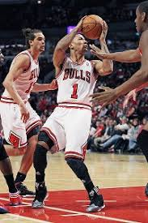
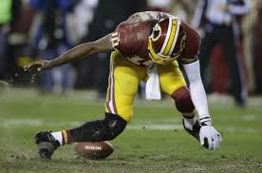
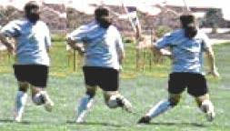
Introduction
Anterior Cruciate Ligament (ACL)
Prevents anterior translation and internal rotation of tibia (Ganapathy et al., 2018)
Injured often in sport (Kay et al., 2017; Hootman, Dick, & Agel, 2007)
Images from google

Slide 3
Introduction
Knee Valgus (Hewett et al., 2010; Boden et al., 2010; Ganapathy et al, 2018)
Knee flexion angle (Yu & Garrett, 2007; Devita & Skelly; 1992; Podraza & White, 2010; Ganapathy et al, 2018)
Hip flexion angle (Ganapathy et al., 2018)
Asymmetrical loading (Hewett et al., 2010)

Slide 4
Introduction
Single-leg landings at various angles (Sinsurin et al., 2017)
Directional effects on:
Hip flexion
Knee flexion
Hip abduction/adduction
Only tested lateral direction
Participants “stuck” their landing
(DiCesare et al., 2015)

Slide 5
Introduction
Purpose
To understand how the lower extremity deals with single-leg landings from various medial and lateral angles

Slide 6
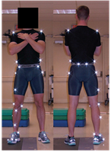
Methodology
24 Recreational Athletes
10 Males, 14 Females
Age: 21.27 ± 1.11 years
Height: 1.75 ± 0.09 meters
Mass: 72.89 ± 10.44 kilograms
23 Retro-Reflective Markers
Bertec Force Place (1600 Hz)
8 Vicon 3D Cameras (1000 Hz)
30 cm box

Slide 7
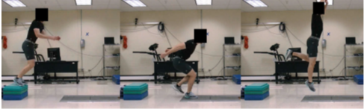
Methodology
Force Plate
Box
½ height
½ height
Box placed ½ participant’s height from force plate
Hopped off box with both feet, landed with dominant leg on force plate, jumped vertically for highest distance, landed again on single leg
5 conditions, 3 trials per condition, order randomized
Lateral, lateral 45, forward, medial 45, medial
½ height
½ height
½ height

Slide 8

Notes:
Forward

Slide 11
Results
Jump Height: lateral condition displayed lowest
Stance Time: greater in medial and lateral conditions

Slide 12
Results
Hip
Flexion: forward greatest, medial and lateral displayed lowest
Abduction: lateral > lateral 45 > forward > medial 45 > medial

Slide 13
Results
Hip
Flexion: forward greatest, medial > lateral
Abduction: lateral > lateral 45 > forward > medial 45 > medial

Slide 14
Results
e
c
d
b
a
Notes:
Abduction = negative, logical trend

Slide 15
Results
Knee
Initial Valgus angle : lateral conditions > forward > medial conditions
100 ms Valgus angle: lateral condition displayed the greatest
Initial Flexion angle: lateral condition displayed the greatest
100 ms Flexion angle: No differences

Slide 16
Results
c
a
Notes:
Trend from lateral to medial (lateral = most dangerous)

Slide 17
Results
Knee
Initial Valgus angle: lateral conditions > forward > medial conditions
100 ms Valgus angle: lateral condition displayed the greatest
Initial Flexion angle: lateral condition displayed the greatest
100 ms Flexion angle: No differences

Slide 18
Results
Knee
Initial Valgus angle: lateral conditions > forward > medial conditions
100 ms Valgus angle: lateral condition displayed the greatest
Initial Flexion angle: lateral condition displayed the greatest
100 ms Flexion angle: No differences

Slide 19
Results
Knee
Initial Valgus angle: lateral conditions > forward > medial conditions
100 ms Valgus angle: lateral condition displayed the greatest
Initial Flexion angle: lateral condition displayed the greatest
100 ms Flexion angle: No differences

Slide 20
Discussion
Lateral condition is “riskiest”
More hip abduction ➔ greater knee valgus
Center of Mass placement

Slide 21
Discussion
Differences in performance variables along with kinematics at the hip and knee joints due to different landing directions.
Recommendations:
Understanding of different landing conditions effects
Landing training
Increased knee, hip, and trunk flexion angles
Increased hamstring activation/strength (Griffin et al., 2006; Hewett et al., 2010; Ganapathy et al, 2018)
Fall

Slide 22
Acknowledgments
Wyoming INBRE
Dr. Boyi Dai
Meghan Critchley
Cormick Eaton & Cameron Olson

Slide 23
References
Boden, B. P., Sheehan, F. T., Torg, J. S., & Hewett, T. E. (2010). Non-contact ACL injuries: mechanisms and risk factors. The Journal of the American Academy of Orthopaedic Surgeons, 18(9), 520.
Devita, P., & Skelly, W. A. (1992). Effect of landing stiffness on joint kinetics and energetics in the lower extremity. Med Sci Sports Exerc, 24(1), 108-115.
DiCesare, C. A., Bates, N. A., Barber Foss, K. D., Thomas, S. M., Wordeman, S. C., Sugimoto, D., ... & Ford, K. R. (2015). Reliability of 3-Dimensional Measures of Single-Leg Cross Drop Landing Across 3 Different Institutions: Implications for Multicenter Biomechanical and Epidemiological Research on ACL Injury Prevention. Orthopaedic journal of sports medicine, 3(12), 2325967115617905.
Ganapathy, P.K., Collins, A.T., Garrett, W.E.,(2017). Mechanisms of Noncontact Anterior Cruciate Ligament Injuries. In The Anterior Cruciate Ligament: Reconstruction and Basic Science (pp. 16-18). Elsevier Science Health Science
Griffin LY, Albohm MJ, Arendt EA, et al. Update on ACL Prevention: Theoretical and Practical Guidelines. Am J Sports Med. 2006;34(9):1512–1532.
Hewett, T. E., Ford, K. R., Hoogenboom, B. J., & Myer, G. D. (2010). Understanding and preventing acl injuries: current biomechanical and epidemiologic considerations-update 2010. North American journal of sports physical therapy: NAJSPT, 5(4), 234.
Images from Google.com
Sinsurin, K., Srisangboriboon, S., & Vachalathiti, R. (2017). Side-to-side differences in lower extremity biomechanics during multi-directional jump landing in volleyball athletes. European journal of sport science, 17(6), 699-709.
Taylor, K. A., Terry, M. E., Utturkar, G. M., Spritzer, C. E., Queen, R. M., Irribarra, L. A., ... & DeFrate, L. E. (2011). Measurement of in vivo anterior cruciate ligament strain during dynamic jump landing. Journal of biomechanics, 44(3), 365-371.
Yu, B., & Garrett, W. E. (2007). Mechanisms of non-contact ACL injuries. British journal of sports medicine, 41(suppl 1), i47-i51.

Slide 24
Altered joint biomechanics elucidated by single-leg landings
Daniel Davis
Faculty Mentor: Dr. Boyi Dai
Department of Kinesiology and Health Promotion

Slide 25
Results
Forward
Medial 45
Medial
Lateral 45
Lateral
A>b>c>d>e at a significance level of p < 0.05

Slide 26
Results

Slide 27
Results

Slide 28
Results
a
a
a
a
b

Slide 29
Results
c
c
b
a
ab
Notes:
Moving leg laterally/medially, not as much hip flexion needed

Slide 30
Results
b
b
b
a
a
Notes:
Trend from lateral to medial (lateral = most dangerous)

Slide 31
Results
a
a
a
a
a

Slide 32
Results
a
b
b
b
b

Slide 33
Discussion
Considerations
Controlled laboratory task
Didn’t control center of mass location
Didn’t control jump height
Future Work
Introduce reactive component
Covariant analysis

