Slide 1


Campus Infrastructure in the AI Era
Campus Open Platform Architecture and MCP Ecosystem Design
Notes:
各位领导、老师和技术同仁们，大家好。欢迎来到今天的分享会。今天我要和大家探讨的主题是“AI时代校园基建”。在大模型技术席卷全球的背景下，高校的信息化基础设施正面临着一次彻底的重构。我们将重点剖析如何构建一个校园开放平台，特别是如何通过MCP协议让AI真正接入校园网、图书馆等底层系统，并保障其安全可控。

Slide 2
01
Background and Challenges of Campus Infrastructure in the AI Era
Contents
02
Core Architecture Design of the Campus Open Platform
Contents
Overall Architecture Design and Evolution Path of Campus Infrastructure in the AI Era
03
Security Control and Key Management Mechanism
04
Agent Ecosystem and Future Evolution
Notes:
今天的报告将分为四个核心部分展开。首先，我们会审视传统校园系统面临的痛点以及AI时代带来的新诉求；其次，深入拆解校园开放平台的核心架构，特别是MCP协议的应用；第三部分，我们将聚焦大家最关心的安全问题，探讨密钥管理与零信任鉴权；最后，展望校级智能体生态的未来演进路径。

Slide 3

CHAPTER 01
Background and Challenges of Campus Infrastructure in the AI Era
Paradigm Shift from Information Silos to Intelligent Collaboration
Notes:
让我们先进入第一部分，聊聊AI时代校园基建的背景与挑战。在过去十几年里，高校信息化建设取得了很大成就，但面对今天大模型带来的范式革命，我们原有的系统架构是否还能支撑未来的智慧校园？这是我们需要首先回答的问题。

Slide 4

Background
Pain Points of Traditional Campus Systems and Demands of the AI Era
Traditional campus systems have long suffered from data silos and fragmented interactions, forcing students and faculty to navigate cumbersome cross-system operations. The advent of the AI era demands that campus infrastructure shift from "passive response" to "proactive intelligence," urgently requiring a unified open platform to support seamless integration between large models and underlying business systems.
Traditional Infrastructure Pain Points
01
Systems for academic affairs, student affairs, and finance operate independently with inconsistent data interface standards, causing severe information barriers and delays in cross-departmental business workflows.
02
Students and faculty must frequently switch between multiple graphical interfaces to complete tasks, lacking a unified natural language interaction entry, resulting in extremely high service access costs.
AI Era Demands
03
Large models require standardized tool invocation protocols to understand and execute campus business rules, demanding that underlying systems expose machine-readable API capabilities.
04
Students and faculty expect to accomplish tasks on demand through "single-sentence instructions," requiring the platform to possess intelligent intent recognition and cross-system service orchestration capabilities.
Digital Campus Life Scenarios · Mobile Campus Service Interaction
Notes:
大家看这页的对比。左边是我们熟悉的现状：教务、学工、财务系统各自为政，师生办个事要在五六个系统里来回切换，数据接口标准不一，形成了严重的信息壁垒。而右边是AI时代的新诉求：大模型不是用来看的，是用来干活的。它需要底层系统暴露出机器可读的API，需要标准化的工具调用协议。师生也期望以后办事就像聊天一样，一句话就能搞定，这就要求我们的平台必须具备跨系统的服务编排能力。

Slide 5
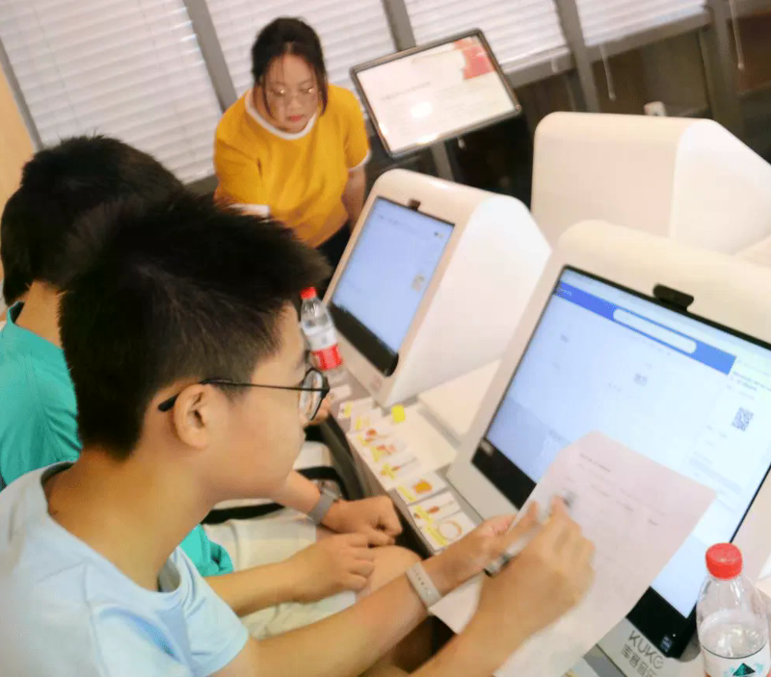
SMART CAMPUS · TREND
The Inevitable Trend of Leaping from "Digitalization" to "Intelligence"
Smart campuses are undergoing a profound leap from process digitalization to service intelligence. By introducing large models and knowledge graphs, campus infrastructure is no longer merely about data storage and display, but has evolved into an intelligent hub with understanding, reasoning, and execution capabilities, comprehensively reshaping digital education governance models.
01
The maturity of NLP and knowledge graph technologies enables systems to accurately understand complex campus business rules, achieving a shift from "people seeking services" to "services seeking people."
NLP + Knowledge Graph
02
The deployment of specialized large models in campus vertical scenarios has significantly improved the efficiency and accuracy of high-frequency scenarios such as official document generation, intelligent form filling, and workload statistics.
Domain LLM
03
The Ministry of Education's "AI + Education" action plan explicitly proposes building an educational intelligent computing service platform, providing policy guidance for the intelligent upgrading of university infrastructure.
AI + Education
University Library Digital Learning Scenario
Notes:
这种转变不是我们凭空想象的，而是技术发展和政策导向的必然结果。首先，NLP和知识图谱技术已经足够成熟，系统终于能听懂复杂的校务规则了，实现了“服务找人”。其次，像华中师范大学等标杆高校已经证明，专用大模型在公文生成、智能填表等场景能大幅提升效率。更重要的是，教育部“人工智能+教育”行动计划已经明确提出了建设教育智能算力服务平台的要求，这为我们高校基础设施的升级提供了最坚实的顶层设计支撑。

Slide 6

Chapter 02
Core Architecture Design of the Campus Open Platform
Building an Integrated, Layered Intelligent Hub Foundation
Notes:
明确了背景和挑战，接下来我们进入第二部分，也是最核心的部分：校园开放平台的架构设计。我们将为大家拆解这个平台是如何通过分层设计，将AI能力与校园底层系统完美融合在一起的。

Slide 7
Architecture Blueprint
Overall Architecture Blueprint of the Campus Open Platform
The platform adopts a four-layer architecture of "entry - front-end - middle platform - foundation," forming a tightly coupled intelligent system. The middle platform serves as the intelligent hub integrating AI capabilities and MCP toolkits, the foundation provides computing and data support, and the front-end achieves precise service delivery and on-demand scheduling through personalized workbenches.
Intelligent Entry and Front-end
AI Middle Platform and MCP Gateway
Computing Foundation and Data Lake
The unified entry supports PC and mobile terminals, providing policy-based personalized application consoles for precise service delivery.
The middle platform deploys a large model application gateway, enabling collaboration and on-demand invocation of various AI tools, encapsulating complex business logic.
The foundation provides intelligent computing capabilities, high-speed networks, and distributed storage, supporting localized inference and fine-tuning of large models for one-stop services.
The front-end flexibly accesses various campus business systems through intelligent interfaces, with intelligent detection and service aggregation mechanisms to effectively bypass faulty nodes.
The introduction of the MCP standard protocol transforms campus system capabilities into toolkits understandable by large models, bridging the interaction link between agents and underlying systems.
Integrating all campus business data to build high-quality corpora and business knowledge graphs, providing continuously evolving knowledge nourishment for agents.
Unified Entry · Personalized Console
Large Model Gateway · MCP Protocol
Intelligent Computing · Knowledge Graph
Notes:
大家看这张架构蓝图。我们采用了经典的四层架构。最上面是智能入口和前台，师生通过手机或电脑接入，前台的智能接口能自动避开故障节点，聚合各类服务。中间是AI中台，这是整个系统的大脑，它部署了大模型网关，并把校园系统的能力封装成了MCP工具集。最下面是算力底座和数据湖，提供智算能力和高质量的业务语料库。这四层紧密耦合，让AI不仅能“想”，还能安全地“做”。

Slide 8

Protocol Architecture
MCP Protocol Empowerment: Key Technology to Break System Silos
MCP (Model Context Protocol), as a standard bridge connecting large models and campus underlying systems, has fundamentally changed the fragmented dilemma of traditional API integration. It encapsulates the capabilities of basic systems such as campus networks and libraries into standardized context tools, enabling agents to read data and execute operations safely and efficiently.
Standardized Interface Specification: The MCP protocol defines unified tool description and invocation specifications, enabling large models to understand and invoke system capabilities through standard interfaces without writing custom code for each campus system.
Dynamic Interactive Operations: Through the MCP toolkit, agents can not only obtain static data but also execute dynamic interactive operations such as "querying campus card balance" and "reserving library seats," achieving true on-demand service.
Command-line Direct Connection Mode: The combination of command-line tools and the MCP protocol provides large models with the most direct and secure system interaction method, effectively avoiding the high latency and error rates associated with traditional graphical interface automation.
University Data Center · Campus IT Infrastructure Foundation
Notes:
这里我要重点讲一下MCP协议，也就是模型上下文协议。它是连接大模型和校园底层系统的标准桥梁。以前我们对接系统，每个系统都要写一套定制代码，碎片化严重。现在有了MCP，大模型只需通过标准接口就能理解并调用系统能力。更关键的是，它不仅能查数据，还能执行“预约座位”、“充值校园卡”这样的动态操作。结合命令行工具，我们彻底抛弃了脆弱的图形界面自动化，让AI与系统的交互变得极其直接且安全。

Slide 9
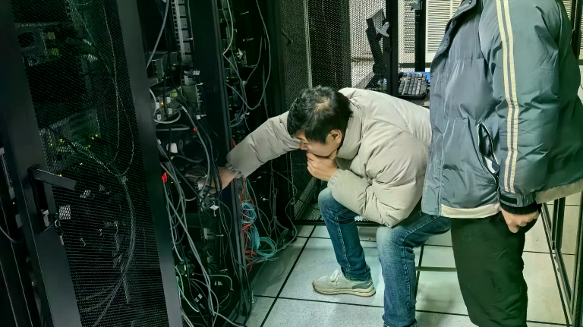
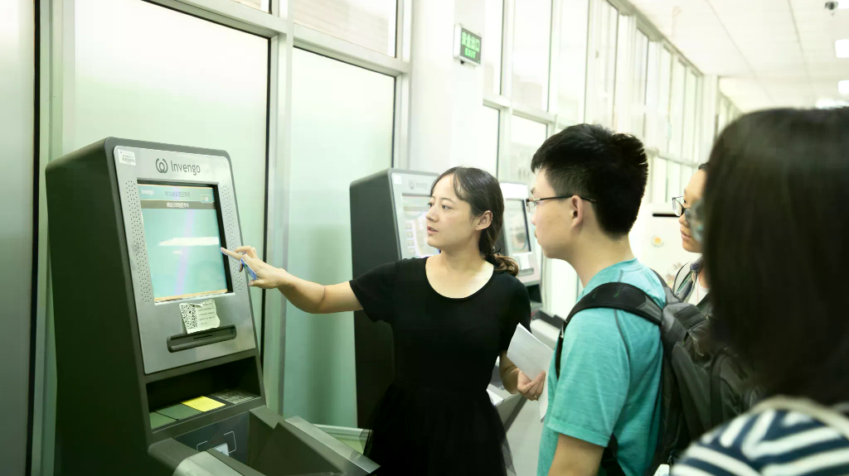
Infrastructure Integration
Basic System Integration: MCP Toolkits for Campus Network and Library
For high-frequency basic services such as campus networks and libraries, the platform has built fine-grained toolkits through the MCP protocol. This not only enables agents to accurately respond to network troubleshooting and literature retrieval needs, but also transforms originally isolated backend management systems into intelligent service nodes that can be invoked by AI at any time.
Campus Network Operations Site
Smart Library Services
Campus Network Operations MCP Tools
Library Service MCP Tools
Provides tools for network status diagnosis, IP address query, and bandwidth limit removal, supporting agents in automatically troubleshooting network issues for students and faculty.
Encapsulates capabilities such as collection search, e-book download, and loan period query, supporting agents in making personalized literature recommendations based on students' academic backgrounds.
Integrates with billing and authentication systems to achieve "one-sentence recharge" and "frictionless authentication," significantly reducing ticket pressure on IT service desks.
Integrates space reservation and seat management systems, enabling intelligent allocation and conflict coordination of study room resources through natural language instructions.
Notes:
我们来看看MCP具体是怎么用在校园网和图书馆这两个最基础的系统的。对于校园网，我们封装了网络诊断、IP查询、限速解除等工具，AI助手可以直接帮学生排查故障，甚至一句话完成充值，大大减轻了IT服务台的压力。对于图书馆，除了常规的馆藏检索，我们还打通了空间预约系统，学生说“帮我找个明天下午有插座的自习位”，智能体就能自动完成资源分配和冲突协调。这就是把孤立的后台系统变成了AI随时可调度的服务节点。

Slide 10

CHAPTER 03
Security Control and Key Management Mechanism
Building Campus Data Defense in a Zero-Trust Environment
Notes:
能力越大，责任越大。AI能直接操作校园底层系统，安全问题就成了悬在头顶的达摩克利斯之剑。第三部分，我们将详细汇报平台是如何通过零信任架构和严密的密钥管理，来构筑校园数据防线的。

Slide 11
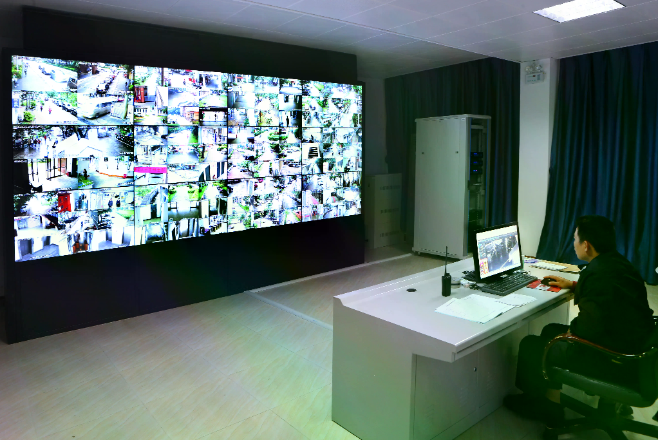
SECURITY ARCHITECTURE
Access Control and Authentication System under Zero-Trust Architecture
While empowering AI with powerful execution capabilities, the campus open platform must establish strict zero-trust security boundaries. Through multi-dimensional identity authentication and fine-grained permission control, agents always follow the "principle of least privilege" when invoking core campus systems, preventing data leakage and unauthorized operation risks.
Dual Access Control Mechanism
RBAC + ABAC
Introduces dual access control based on roles and attributes, dynamically calculating agent operation permissions based on identity, department, and scenario. The system evaluates user identity attributes and resource sensitivity in real time, achieving fine-grained dynamic permission allocation.
Human-AI Collaborative Review Mechanism
High Risk
High-risk operations such as financial reimbursement and grade modification forcibly trigger secondary manual authorization, ensuring absolute security at key business nodes. The review process is embedded in the agent execution chain, forming dual guarantees of automation and manual supervision.
Unified Gateway Authentication
MCP Gateway
All MCP tool invocations are authenticated through a unified gateway, comparing context and security policies in real time, automatically intercepting abnormal frequency and unauthorized access. The gateway layer integrates audit logs, completely recording agent operation trajectories to support post-incident traceability analysis.
University Cybersecurity Monitoring Center · Real-time Data Dashboard
Notes:
我们平台的安全基石是“零信任”架构。AI在调用核心系统时，绝不是拿到一个超级管理员账号就畅通无阻了。我们采用了RBAC和ABAC双重机制，系统会根据学生的身份、所在院系甚至当前所处的网络环境，动态计算智能体的权限。对于像财务审批、成绩修改这种高风险操作，系统会强制触发人工二次授权。所有的调用请求都必须经过统一网关的实时校验，一旦发现异常频次或越权企图，系统会自动拦截，确保数据万无一失。

Slide 12
Security Architecture
API Key Full Lifecycle Management and Audit Tracking
Access keys are the "digital passes" for agents to connect to campus systems. The platform has built a full lifecycle management closed loop covering key generation, distribution, rotation, revocation, and auditing, ensuring every system interaction is traceable and verifiable, providing financial-grade security for campus data assets.
Key Generation
Auto Rotation
RSA
Auto
Uses asymmetric encryption algorithms to generate unique key pairs for each agent instance, supporting setting key validity periods and invocation quotas by business scenario.
Establishes an automated key rotation mechanism that seamlessly triggers key updates without service interruption when potential leakage risks are detected or lifecycle thresholds are reached.
Blockchain Audit
Security Dashboard
Log
Live
Detailed records of each API invocation's timestamp, caller identity, request parameters, and response status, forming tamper-proof blockchain audit logs.
Provides a visual security dashboard for real-time monitoring of key usage anomalies and traffic spikes, supporting one-click circuit breaking of high-risk agent system access permissions.
Notes:
访问密钥就是智能体连接校园系统的“数字通行证”。我们建立了一套全生命周期的管理闭环。在动态管理方面，我们为每个智能体实例生成唯一的非对称加密密钥对，并且支持自动化轮换，一旦发现潜在风险，系统会在不中断服务的情况下无缝更新密钥。在审计追踪方面，每一次API调用的时间、身份、参数都会被记录在不可篡改的区块链日志中。我们的安全看板能实时监测流量异常，必要时可以一键熔断高危智能体的权限，做到有迹可循、有据可查。

Slide 13

Chapter 04
Agent Ecosystem and Future Evolution
Toward an Open, Collaborative, and Continuously Growing Digital Workforce Network
Notes:
有了坚实的架构和安全的底座，我们的最终目标是什么？是构建一个繁荣的智能体生态。最后一部分，我们将探讨如何通过校级AI中心和“驯养”机制，让校园里的数字劳动力持续成长。

Slide 14
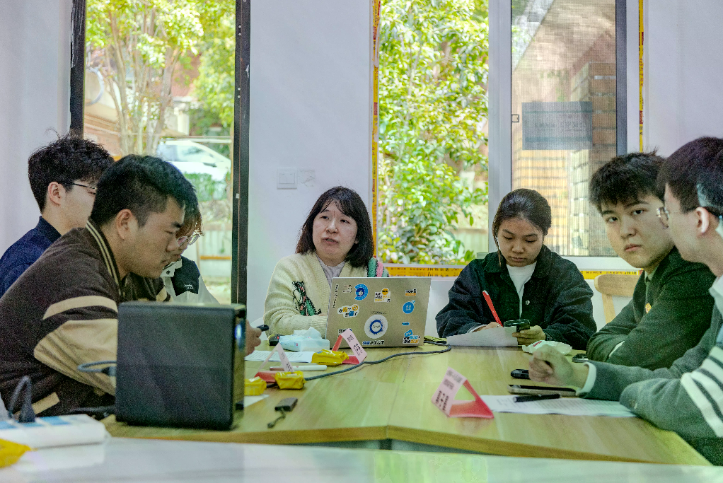
ECOSYSTEM
Building a University-level AI Center and SKILLS Plaza
The ultimate form of the campus open platform is a thriving agent ecosystem. By building a university-level AI center and SKILLS Plaza, the platform centrally opens up dispersed computing, model, and tool capabilities, encouraging students and faculty to independently create personalized agents based on the MCP protocol, achieving an ecological leap from "unilateral school provision" to "co-construction and sharing."
01
University AI Center Unified Management
Unified management of intelligent computing resources and base large models, providing low-threshold agent development environments and API invocation quotas for all students and faculty, avoiding duplicate "silo-style" AI application construction across departments.
02
SKILLS Plaza Open Aggregation
As the "app store" for campus agents, it aggregates various MCP tools and Agent templates submitted by official and student/faculty developers, supporting one-click subscription and flexible combination.
03
Capability Assessment and Review Assurance
Establishes agent capability assessment and listing review mechanisms to ensure each toolkit complies with campus data security regulations and business logic standards, guaranteeing healthy and orderly ecosystem development.
University Makerspace · Student-Faculty Teams Co-building Agent Ecosystem
Notes:
校园开放平台的终极形态，不应该只是几个官方开发的工具，而应该是一个生态。我们规划了校级AI中心，统筹全校的算力和基础大模型，给师生提供低门槛的开发环境，避免各个院系重复造轮子。同时，我们推出了SKILLS广场，这就好比校园里的“App Store”，老师和学生开发者可以把基于MCP协议做好的工具传上去，供大家一键订阅。当然，自由不等于放任，平台会建立严格的上架审核机制，确保每一个工具都符合数据安全规范。

Slide 15
GOVERNANCE FRAMEWORK
Agent "Taming" Mechanism and Human-AI Collaborative Responsibility Chain
Agents are not one-and-done standard software, but digital workforce requiring continuous "taming." Universities must establish optimization mechanisms based on real business feedback and clear responsibility boundaries, allowing agents to continuously evolve within a safe and controllable framework, ultimately achieving a new paradigm of human-AI collaborative campus governance.
"Taming" and Evolution Mechanism
Responsibility Chain and Compliance Governance
01
Establishes a task negative list, clearly defining that in high-risk scenarios (such as academic evaluation and disciplinary action), agents can only provide auxiliary suggestions, and automatic decision-making is strictly prohibited.
01
Builds a human-AI collaborative responsibility chain, ensuring manual review nodes always exist in key business workflows, with important results traceable to specific responsible persons and agent versions.
02
Introduces Reinforcement Learning from Human Feedback (RLHF), using likes or correction data on agent responses to continuously fine-tune localized business large models.
02
Coordinates development and security, establishes special prevention mechanisms for algorithmic discrimination, privacy leakage, and academic fraud, and regularly conducts agent ethics and security audits.
RLHF · NEGATIVE LIST
HUMAN-IN-THE-LOOP · AUDIT
Notes:
最后，我想强调一个理念：智能体不是买来就能用的标准软件，它是需要持续“驯养”的数字劳动力。所谓“驯”，就是建立边界。我们制定了任务负面清单，像学术评价、纪律处分这种高风险场景，AI只能做辅助，绝不能自动决策。同时，我们引入人类反馈强化学习，利用师生的纠错数据让模型越来越聪明。在责任链方面，我们确保关键业务始终有人工复核，并且建立了防范算法歧视和隐私泄露的专项审计机制。只有统筹好发展与安全，AI才能真正成为校园治理的好帮手。

Slide 16

Embrace the AI Era, Reshape Campus Infrastructure
Thank You for Listening and Discussion
Notes:
AI时代的校园基建，不仅是技术的升级，更是教育治理理念的重塑。通过MCP协议、零信任安全与开放的智能体生态，我们有信心为全校师生打造一个真正懂他们、帮他们、且安全可靠的智慧校园底座。感谢大家的聆听，接下来欢迎大家提问和交流。

