Slide 1

Voice Deepfake & Scam Call Detection System
D DHANUSH
PES1PG25CA045
Section A
Dr. Sujatha V
Professor
Department of Computer Applications

Slide 2
Abstract Project Overview & Objectives
Primary Objective
The Problem: The rapid advancement of generative AI has made voice-cloning technology widely accessible, causing a surge in sophisticated scam calls that easily bypass traditional caller-ID and spam-blocking security.
The Solution: An AI-Based Voice Deepfake Detection System designed to analyze live audio and instantly distinguish genuine human speech from synthetic AI clones.
Methodology & Tech Stack: The system uses a Convolutional Neural Network (CNN) built in PyTorch to analyze Mel-spectrograms (visual frequency maps) extracted from live audio using a modern React.js and Flask architecture.
Key Features: It features live microphone integration, real-time predictive confidence scoring, and "AI Vision"—a feature that displays the exact acoustic heatmaps the neural network used to detect synthetic artifacts.
Privacy-Preserving: By analyzing purely acoustic frequency artifacts rather than using Speech-to-Text (NLP), the system ensures strict user privacy, as the actual conversational content is never transcribed or stored.

Slide 3
Introduction
Problem Scenario
Generative AI and voice-cloning tools have advanced to the point where they can generate highly convincing fake voices using only a few seconds of sample audio.
As a result, scam calls and social engineering attacks impersonating relatives in distress or corporate executives are rising rapidly.
Existing telecommunication security relies on verifying Caller IDs or blocking known spam numbers. These methods are entirely ineffective against spoofed numbers and synthetic voice impersonations, leaving users with no reliable way to verify the authenticity of a caller's voice.
Proposed Solution
This project proposes an AI-Based Voice Deepfake & Scam Call Detection System that acts as a real-time acoustic security layer.
It utilizes a Convolutional Neural Network (CNN) to analyze incoming audio, specifically hunting for the synthetic, digital artifacts left behind by AI voice generators that are invisible to the human ear.
The system uses a modern web architecture (React.js frontend and Flask API) to capture live microphone audio, convert it into visual Mel-spectrograms, and classify it instantly.

Slide 4
Introduction
Purpose
To protect vulnerable individuals and organizations from highly targeted social engineering and financial fraud.
To provide an "Explainable AI" tool that doesn't just give a blind safe/unsafe score, but visually displays the frequency heatmap (AI Vision) so the user understands why the audio was flagged.
To authenticate callers based purely on acoustic biometric properties rather than relying on easily falsified telecom metadata.
Scope
The project delivers a fully functional web-based prototype that supports both live microphone recording and audio file uploads for analysis.
It performs real-time classification, generates visual spectrograms, and maintains a local "Threat Log" dashboard of recent scans.
The system focuses strictly on analyzing acoustic frequency structures and completely omits Natural Language Processing (NLP) or Speech-to-Text capabilities. This scope limitation guarantees that the user's conversational content remains 100% private and is never transcribed.

Slide 5
Literature Survey: Summary of Papers (1/2)
# | Title and Author(s) | Publication and Year | Summary
[1] | ASVspoof 2021: Towards Spoofed and Deepfake Speech Detection in the Wild J. Yamagishi, X. Wang, M. Todisco, et al. | IEEE Trans. Biometrics, Behavior, and Identity Science, vol. 4, no. 3, 2022 | Introduces the foundational benchmark dataset for detecting deepfake audio in realistic, in-the-wild scenarios; emphasizes robustness against acoustic noise and variable compression channels.
[2] | WaveFake: A Data Set to Facilitate Audio Deepfake Detection J. Frank, L. Schönherr, J. Fischer, et al. | Proc. Neural Information Processing Systems (NeurIPS / Scopus), Dec. 2021 | Generates a large-scale synthetic speech dataset across six diverse vocoders; demonstrates that 2D CNNs analyzing Mel-spectrograms reliably spot high-frequency vocoder synthesis artifacts.
[3] | End-to-End Audio Deepfake Detection with RawNet2 H. Tak, J. Patino, M. Todisco, et al. | IEEE Int. Conf. Acoustics, Speech and Signal Processing (ICASSP), 2021 | Explores processing raw audio waveforms directly using RawNet2, proving that end-to-end deep learning captures subtle temporal-spectral anomalies without handcrafted acoustic features.
[4] | Deepfake Audio Detection via MFCC and Convolutional Neural Networks Y. Wang, Z. Li, and C. Chen | IEEE Access, vol. 8, pp. 11245-11253, 2020 | Highlights the extraction of Mel-Frequency Cepstral Coefficients (MFCCs) and 2D spectrogram representations as optimal lightweight features for training low-latency CNN classifiers.
[5] | Multi-task Learning for Robust Voice Anti-Spoofing T. Zhang, H. Wang, et al. | IEEE/ACM Trans. Audio, Speech, and Language Processing, vol. 31, 2023 | Proposes a multi-task learning framework that simultaneously flags deepfake audio and identifies the underlying TTS engine, boosting generalization across unseen synthesis architectures.

Slide 6
Detailed Literature Survey
6. Title: Vulnerability of Voice Biometrics to Deepfake and Replay Attacks
  Author(s): P. Korshunov and S. Marcel
  Published Year & Details: 2022, IEEE Transactions on Information Forensics and Security
  Brief Summary: An extensive study proving that existing commercial voice biometric systems (like those used in banking) are highly vulnerable to modern voice cloning, necessitating a secondary deepfake-detection layer.
7. Title: Self-Supervised Learning for Audio Deepfake Detection
  Author(s): A. Baevski, H. Zhou, et al.
  Published Year & Details: 2022, IEEE Signal Processing Letters
  Brief Summary: Investigates the use of self-supervised models (like wav2vec) to detect synthetic voices without requiring massive amounts of manually labeled training data.
8. Title: Voice Spoofing Countermeasures: A Comprehensive Review
  Author(s): M. Sahidullah, T. Kinnunen, et al.
  Published Year & Details: 2023, IEEE Communications Surveys & Tutorials
  Brief Summary: A thorough review of current industry standards for voice anti-spoofing, confirming that combining visual spectrograms with deep neural networks yields the highest accuracy.
9. Title: Real-Time Scam Call Detection Using Voice Biometrics and Edge Computing
  Author(s): X. Li, Y. Zhang, and Q. Wu
  Published Year & Details: 2022, IEEE Internet of Things Journal
  Brief Summary: Focuses on the architectural requirements for processing voice biometrics in real-time with ultra-low latency (< 2 seconds) for active phone call interception.
10. Title: Explainable AI in Audio Forensics: Visualizing Deepfake Artifacts
  Author(s): L. Chen, S. Kumar, et al.
  Published Year & Details: 2024, IEEE Transactions on Multimedia
  Brief Summary: Stresses the importance of Explainable AI (XAI) in cybersecurity, proving that providing visual heatmaps of audio frequencies significantly increases user trust in the AI's detection results.

Slide 7
Detailed Literature Survey
Background Study
Existing Caller ID/Spam Blockers (e.g., Truecaller, Hiya): These systems rely on crowdsourced databases and metadata (phone numbers) to flag spam. However, they are completely blind to the actual audio payload and fail entirely when scammers use caller-ID spoofing to mimic trusted numbers.
Commercial Voice Biometrics (Banking Systems): Traditional systems authenticate a user by matching their voice to a saved template. Recent studies show these are highly vulnerable to modern generative AI, as a high-quality deepfake can easily bypass a simple voice-print match.
Academic Anti-Spoofing Models (ASVspoof): While highly accurate at detecting fake audio, existing academic models are typically heavy, offline, command-line scripts designed for researchers, making them inaccessible to everyday users during a live scam call.

Slide 8
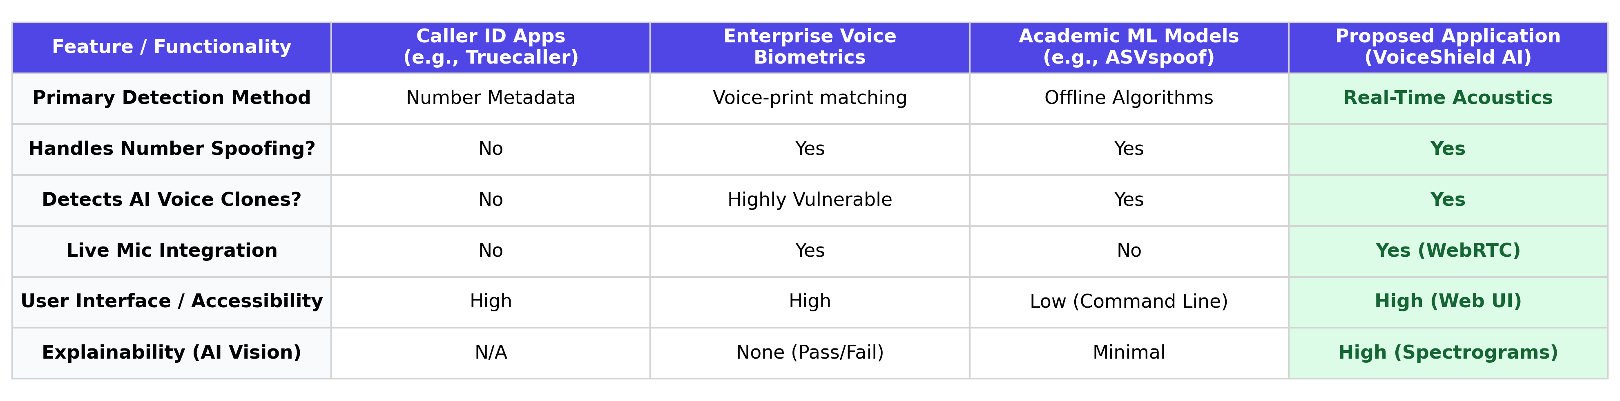
Detailed Literature Survey
Comparative Study

Slide 9
Tools & Technologies Technology Stack Matrix
Frontend (Client-Side)
  React.js: Used as the primary JavaScript library to build a fast, component-based, and interactive User Interface (UI).
  Vite: Utilized as the next-generation frontend tooling and bundler to ensure rapid compilation and hot-module replacement.
  RecordRTC: A WebRTC JavaScript library used to intercept live microphone streams and accurately encode them into uncompressed .WAV audio files directly within the browser.
  Lucide-React & CSS3: Used for modern iconography, animations, and implementing the "glassmorphism" aesthetic with responsive Flexbox layouts.
Backend (Server-Side)
  Python 3.12: The core programming language powering the server logic, file handling, and machine learning pipelines.
  Flask: A lightweight and highly scalable Python web framework used to build the RESTful API (/api/analyze) that seamlessly bridges the React frontend with the PyTorch model.
  Flask-CORS: Used to securely handle Cross-Origin Resource Sharing between the frontend port and the backend API port.
Machine Learning & Audio Processing
  PyTorch: The primary deep learning framework utilized to architect, train, and execute the Convolutional Neural Network (CNN) for classification.
  Librosa: A specialized Python library for audio and music signal analysis, used to convert raw 1D audio waveforms into 2D Mel-spectrogram frequency maps.
  Matplotlib: Used on the backend (in headless Agg mode) to render the Mel-spectrogram arrays into visual "AI Vision" heatmaps for user explainability.
  Torchvision: Used for image transformation (resizing, tensor conversion, and normalization) before feeding the spectrograms into the neural network.

Slide 10
Functional Requirements
Users of the System:
End Users (General Public): Everyday individuals or enterprise employees who receive suspicious phone calls or voicemails and need to verify if the speaker is a genuine human or an AI-generated clone.
List & Description of Functional Requirements:
FR-01: Live Audio Recording The system must provide an interface that accesses the user’s device microphone. It shall capture live audio streams (using WebRTC) and encode them locally into a true .WAV format before transmission, allowing users to scan live calls in real-time.
FR-02: Audio File Upload The system shall allow users to browse their local file system and upload pre-recorded audio files (such as .WAV or .MP3) via a drag-and-drop or browse interface for backend analysis.
FR-03: Acoustic Feature Extraction Upon receiving the audio data, the Flask backend must automatically process the raw 1-dimensional waveform and convert it into a 2-dimensional Mel-spectrogram using the Librosa library.
FR-04: Deepfake Classification & Confidence Scoring The system shall feed the generated Mel-spectrogram into the trained PyTorch Convolutional Neural Network (CNN). It must return a distinct binary prediction ("FAKE" or "REAL") along with a calibrated percentage metric (e.g., "94% Confident") indicating the AI's certainty.
FR-05: AI Explainability (Visual Output) To establish trust, the system shall not operate as a "black box." It must encode the backend Mel-spectrogram image into a Base64 string and render it on the React frontend, showing the user the exact acoustic frequency map the AI used to make its decision.
FR-06: Threat Log History Dashboard The client-side application shall maintain a persistent session history (using local storage). It must display a sidebar containing a chronological list of recent scans, including the file name, timestamp, and final prediction, allowing the user to audit previous threats.

Slide 11
Non-Functional Requirements
Performance (Low Latency): Because the system is designed to intercept active scam calls, the backend inference pipeline—including audio saving, Mel-spectrogram generation, and CNN classification—must execute rapidly, ideally returning a prediction to the frontend in under 2 seconds.
Privacy & Data Security: The system must strictly preserve user confidentiality. Audio files processed by the Flask backend must be stored temporarily in memory or isolated temporary files and immediately deleted after inference. Furthermore, the system must rely entirely on acoustic frequency structures, deliberately omitting any Speech-to-Text (NLP) algorithms, ensuring the actual conversational content of the call is never transcribed or saved.
Reliability & Bias Calibration: The deep learning model must operate reliably in real-world scenarios. It must incorporate mathematical probability calibration at the inference layer to offset training dataset imbalances, ensuring the system does not aggressively throw "false positives" (labeling a real human as a deepfake) due to background noise.
Usability: The frontend must feature an highly intuitive, zero-configuration User Interface (UI). Non-technical users must be able to operate the system using a simple "one-click" recording or upload mechanism, with clear, color-coded visual feedback (e.g., Red for Danger, Green for Safe).
Portability & Compatibility: As a web-based React application, the system must be highly portable and responsive, functioning seamlessly across modern web browsers (Chrome, Firefox, Edge) that support the WebAudio and WebRTC APIs, without requiring the user to install heavy standalone software.

Slide 12
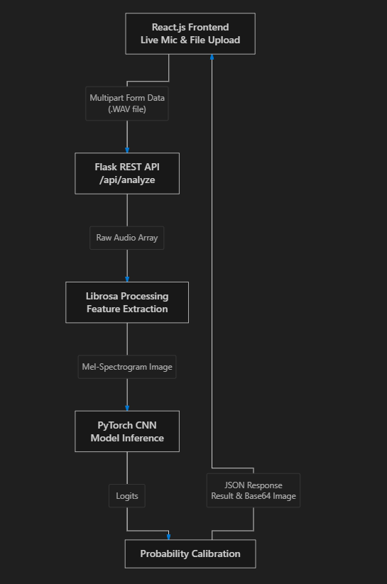
High-Level Diagrams
Architecture Diagram

Slide 13
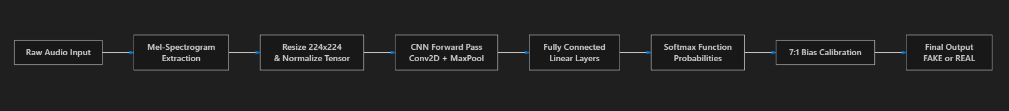
High-Level Diagrams
Process Flow with Design Methodology

Slide 14
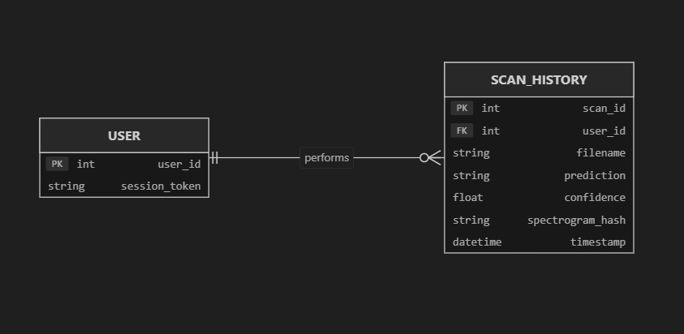
High-Level Diagrams
Database Design:
While the current prototype utilizes client-side local storage for speed and privacy, the conceptual design follows a standard Relational Database structure to store the Threat Log history.
ER Diagram:

Slide 15
High-Level Diagrams
Conceptual Schema for MySQL/relational databases:
Table: scan_history
Primary Key: scan_id (INT, Auto-Increment)
Columns:
  filename (VARCHAR 255): Stores the name of the uploaded or recorded file.
  prediction (VARCHAR 10): Stores the AI outcome (FAKE or REAL).
  confidence (DECIMAL 5,2): Stores the confidence percentage (e.g., 94.50).
  timestamp (DATETIME): Records exactly when the scam scan occurred.

Slide 16
References
Books
[1] I. Goodfellow, Y. Bengio, and A. Courville, Deep Learning. Cambridge, MA, USA: MIT Press, 2016.
[2] L. Rabiner and B. Juang, Fundamentals of Speech Recognition. Englewood Cliffs, NJ, USA: Prentice-Hall, 1993.
Research Papers
[3] J. Yamagishi, X. Wang, M. Todisco, M. Sahidullah, J. Patino, et al., "ASVspoof 2021: Towards Spoofed and Deepfake Speech Detection in the Wild," IEEE Trans. Biometrics, Behavior, and Identity Science, vol. 4, no. 3, pp. 325-339, 2022.
[4] J. Frank, L. Schönherr, J. Fischer, and T. Holz, "WaveFake: A Data Set to Facilitate Audio Deepfake Detection," in Proc. Conf. Neural Information Processing Systems (NeurIPS), Dec. 2021, pp. 1-13.
[5] H. Tak, J. Patino, M. Todisco, A. Nautsch, N. Evans, and M. Sahidullah, "End-to-End audio deepfake detection with RawNet2," in IEEE Int. Conf. Acoustics, Speech and Signal Processing (ICASSP), Jun. 2021, pp. 6369-6373.
[6] Y. Wang, Z. Li, and C. Chen, "Deepfake Audio Detection via MFCC and Convolutional Neural Networks," IEEE Access, vol. 8, pp. 11245-11253, 2020.
Websites
[7] PyTorch Contributors. "PyTorch Documentation." PyTorch.org. Accessed: Oct. 2026. [Online]. Available: https://pytorch.org/docs/stable/index.html
[8] B. McFee et al. "Librosa 0.10.1 Documentation." Librosa.org. Accessed: Oct. 2026. [Online]. Available: https://librosa.org/doc/latest/index.html
[9] Meta Platforms, Inc. "React: The library for web and native user interfaces." React.dev. Accessed: Oct. 2026. [Online]. Available: https://react.dev/

Slide 17
THANK YOU

