Slide 1

AUDIO-AUGMENTED PROMPTING FOR HUMOR EXPLANATION IN OPEN-SOURCE LANGUAGE MODELS
Dimitar Dimov
25/04/2026

Slide 2

INTRODUCTION
Large language models have shown strong performance on many natural language understanding tasks.
However, humor understanding remains challenging.
Humor often depends on ambiguity, context, wordplay, and pronunciation.
Text alone may not always provide enough information to explain the joke correctly

Slide 3
MOTIVATION
Many jokes, especially puns, rely on how words sound.
In such cases, written text may hide important pronunciation-based cues.
Audio can provide additional information about the spoken form of the joke.
This motivates the use of multimodal prompting for humor explanation.

Slide 4
RESEARCH QUESTION
Does adding audio improve the quality of humor explanations generated by open-source language models?
The paper compares explanations generated from:
Text-only input
Audio-only input
Text-plus-audio input

Slide 5
HUMOR TYPE: PUNS
Puns are a form of humor based on ambiguity.
They often involve two possible interpretations of the same or similar-sounding words.
Homographic puns use the same written form.
Heterographic puns use different written forms but similar pronunciation.
Audio is expected to be especially useful for heterographic puns.

Slide 6
PROPOSED APPROACH
The paper uses a controlled multimodal prompting setup.
The same joke is provided to the model under different input conditions.
The model generates an explanation of the humor mechanism.
The explanations are then normalized and evaluated using a separate judging model.

Slide 7

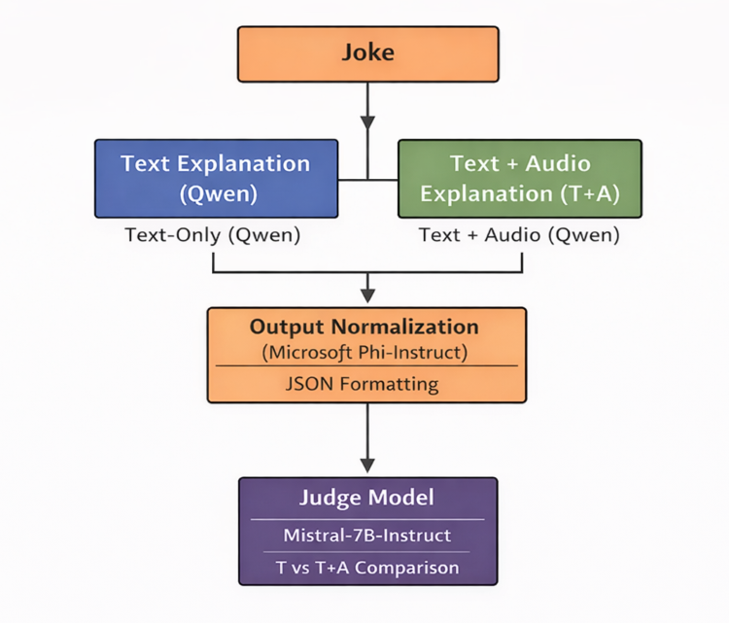
EXPERIMENTAL PIPELINE
The experimental pipeline consists of four steps:
Generate explanations from text-only input
Generate explanations from audio or text-plus-audio input
Normalize outputs into strict JSON format
Evaluate explanation quality using a separate judge model

Slide 8
AUDIO GENERATION
Audio versions of the jokes are generated using Piper TTS.
The audio is synthesized directly from the original joke text.
No manual emphasis, timing, or prosody annotations are added.
The audio is used only as an auxiliary signal for pronunciation-related ambiguity.

Slide 9
PROMPTING SETUP
All experiments are performed in a zero-shot setting.
The prompt explains the difference between puns and non-puns.
The model is asked to decide whether the input is a pun and explain the linguistic mechanism.
Few-shot examples and explicit chain-of-thought prompting are not used.

Slide 10
DATASETS
The evaluation uses three humor datasets:
SemEval 2017 Task 7 contains homographic puns, heterographic puns, and non-puns.
Context-Situated Puns contains sentence-level pun examples with annotations.
ExplainTheJoke contains broader humor examples beyond pun-based humor.

Slide 11
MODELS
Qwen2-Audio is used for explanation generation.
Qwen3-Omni is used for extended SemEval experiments.
Microsoft Phi is used for JSON normalization.
Mistral 7B Instruct is used as an independent judging model.
All models are locally deployable open-source models.

Slide 12
EVALUATION METHOD- SEMEVAL
The main evaluation is comparison-based.
For each joke, the judge model compares explanations from different input conditions.
The judge selects the explanation that is more correct, clear, and accurate.
A tie is allowed when both explanations are similar in quality.
No audio is provided to the judging model.

Slide 13
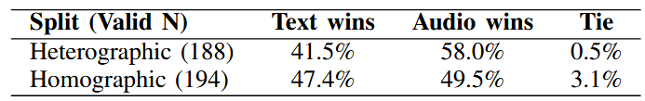
KEY RESULT: SEMEVAL
Audio helped most in pronunciation-based puns.
In SemEval, Text + Audio performed better especially for heterographic puns.
This suggests that audio is useful when the joke depends on sound similarity.
Audio helps most when the pun depends on sound similarity.

Slide 14
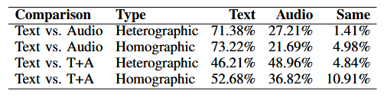
EXTENDED SEMEVAL RESULTS
Qwen3-Omni was evaluated with:
Text-only
Audio-only
Text + Audio
Key findings:
Audio-only was weaker than text-only.
Text + Audio was better than audio alone.

Slide 15
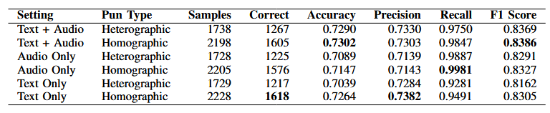
SEMEVAL CLASSIFICATION RESULTS
The generated outputs were also evaluated against the original SemEval gold labels.
Text + Audio achieved the best F1 scores.
Audio-only had high recall, but weaker overall balance.
Text-only remained competitive, especially for homographic puns.

Slide 16
EXAMPLE: AUDIO HELPS
Joke: “A chicken farmer’s favorite car is a coupe.”
Text-only explanation: Incorrectly interprets the wordplay as coupe → couple
Text + audio explanation: Correctly identifies the intended sound-based link: coupe → coop.
Takeaway: Audio helped the model detect the pronunciation-based pun.

Slide 17
EXAMPLE: AUDIO DOES NOT HELP
Joke: “I had some back trouble, but it’s all behind me now.”
Text-only: Correctly explains the double meaning of “behind me.”
Text + Audio: Adds less accurate reasoning about the word “back. “
Takeaway: Audio may not help when the humor depends more on meaning than pronunciation.

Slide 18
EVALUATION METHOD - CSP AND ETJ
Explanations were scored independently.
The judge gave each explanation a score from 1 to 5 based on:
correctness
clarity
humor mechanism
avoiding hallucinations
Then:
higher score = preferred explanation
equal score = tie

Slide 19
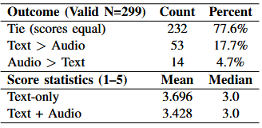
CONTEXT-SITUATED PUNS
Most examples resulted in equal scores.
Paired t-test
t(298) = 1.62, p = 0.106
The high tie rate and p = 0.106 show that audio did not significantly improve explanations.

Slide 20

EXPLAIN THE JOKE RESULTS
For broader humor, the difference was small.
Paired t-test
t(376) = 0.94, p = 0.348
For general humor, audio provides little benefit because many jokes depend on context, not pronunciation.

Slide 21
LIMITATIONS
TTS audio may not reflect natural human delivery
Prosody and emphasis were not manually controlled
Local open-source models may produce unstable outputs
Judge-model evaluation may not fully match human judgment
Audio is less useful for humor based on context or world knowledge

Slide 22
CONCLUSION
Audio is useful, but not universally.
Most useful for:
pronunciation-based puns
heterographic puns
sound-based ambiguity
Less useful for:
general humor
context-based jokes
semantic ambiguity
Audio works best as a complementary signal together with text.

Slide 23

QUESTIONS

