Slide 1
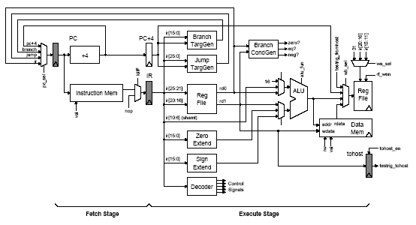
Verilog 2 - Design Examples
L03-<number>

Slide 2
Verilog can be used at several levels
High-Level Behavioral
A common approach is to use C/C++ for initial behavioral modeling, and for building test rigs
Register Transfer Level
automatic tools to synthesize a low-level gate-level model
Gate Level
L03-<number>

Slide 3
Writing synthesizable Verilog
Recap: Combinational logic
Use continuous assignments (assign)
  assign c_i = b_o + 1;
Use always_comb blocks with blocking assignments (=)
always_comb
begin
out = 2’d0;
if (in1 == 1)
out = 2’d1;
else if (in2 == 1)
out = 2’d2;
end
Every variable should have a default value to avoid inadvertent introduction of latches
Don’t assign to same variable from more than one always block. Race conditions in behavioral sim, synthesizes incorrectly.
always blocks allow more expressive control structures, though not all will synthesize
default value
L03-<number>

Slide 4
Writing synthesizable Verilog: Sequential logic
Use always_ff @(posedge clk) only with non-blocking assignment operator (<=)
always_ff @( posedge clk )
c_o <= c_i;
careful when mix pos-edge & neg-edge triggered flip-flops
Do not assign the same variable from more than one always block. Race condition in behavioral simulation; synthesizes incorrectly.
Do not mix blocking and non-blocking assignments
  only use non-blocking assignments (<=) for sequential logic.
  only use block assignments (=) for combinational logic.
Like in software engineering, express your design as a module hierarchy that corresponds to logical boundaries in the design. Also, separate datapath and control (more later).
L03-<number>

Slide 5
An Example: Good Style
logic a_n, b_n, c_n;
logic a_r, b_r, c_r;
always_ff @( posedge clk )
begin
a_r <= a_n;
b_r <= b_n;
c_r <= c_n;
end
assign b_n = a_r + 1;
assign c_n = b_r + 1;
a
b
c
+1
+1
Readable, combinational and sequential logic are separated.
Consistent naming: A_r is the output of the register and A_n (or A_n) is the input.
L03-<number>

Slide 6
An Example: Good Style
logic a_n;
logic b_n, c_n;
logic a_r, b_r, c_r;
always_ff @( posedge clk )
begin
a_r <= a_n; // list in any order
b_r <= b_n;
c_r <= c_n;
end
always_comb
begin
b_n = a_r + 1; // triggers when a_r or b_r changes
c_n = b_r + 1;
end
a
b
c
+1
+1
Readable, combinational and sequential logic are separated.
L03-<number>

Slide 7
Alternate implementation?
logic a_n, b_n, c_n;
logic a_r, b_r, c_r;
always_ff @( posedge clk )
begin
a_r <= a_n;
b_r <= b_n;
c_r <= c_n;
assign b_n = a_r + 1;
assign c_n = b_r + 1;
end
a
b
c
+1
+1
Syntactically Incorrect.
L03-<number>

Slide 8
An Example: Okay, but less readable?
logic a_n;
logic a_r, b_r, c_r;
always_ff @( posedge clk )
begin
a_r <= a_n;
b_r <= a_r + 1;
c_r <= b_r + 1;
end
a
b
c
+1
+1
Is (b_r == a_n+1) ?
Nope - Why?
a_r <= a_n creates
a register between
a_n and a_r, not a wire.
L03-<number>

Slide 9
Another style – multiple always blocks
logic a_n, b_n, c_n;
logic a_r, b_r, c_r;
always_ff @( posedge clk )
a_r <= a_n;
assign b_n = a_r + 1;
always_ff @( posedge clk )
b_r <= b_n;
assign c_n = b_r + 1;
always_ff @( posedge clk )
c_r <= c_n;
a
b
c
+1
+1
Does it have the same functionality?
Yes. But why?
It generates the same
underlying circuit.
L03-<number>

Slide 10
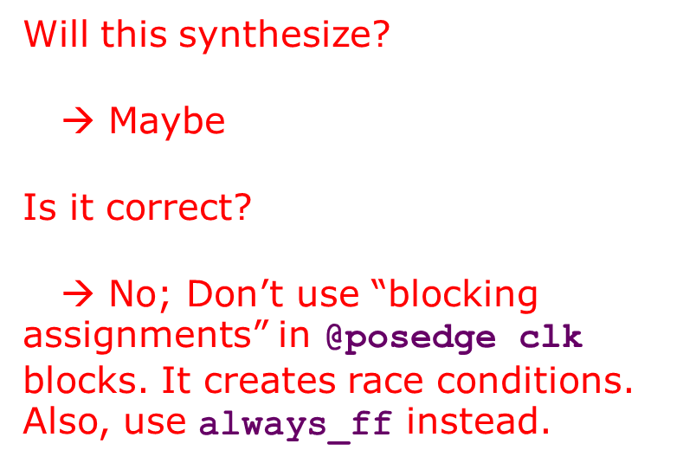
How about this one?
logic a_n, b_n, c_n;
logic a_r, b_r, c_r;
always @( posedge clk )
begin
a_r = a_n;
b_r = b_n;
c_r = c_n;
end
assign b_n = a_r + 1;
assign c_n = b_r + 1;
a
b
c
+1
+1

Slide 11
What does this do? (This is correct but bad code.)
logic b_i, c_i;
logic a_r;
logic sel;
always @( posedge clk )
begin
a_r <= 1’b0;
a_r <= b_i;
if (sel)
a_r <= c_i;
end
L03-<number>

Slide 12
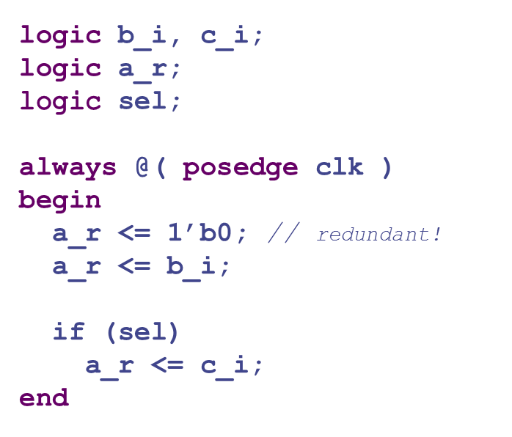
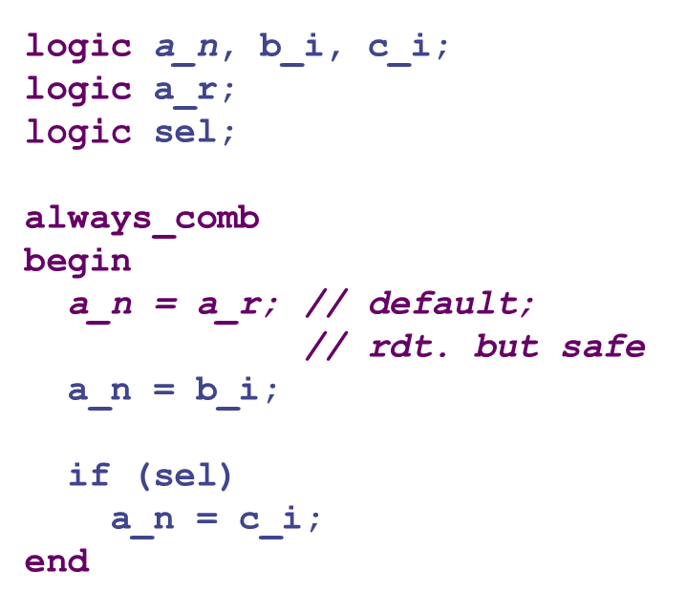
Desugar into separate comb. and seq. logic.
always_ff @( posedge clk )
a_r <= a_n;
L03-<number>

Slide 13
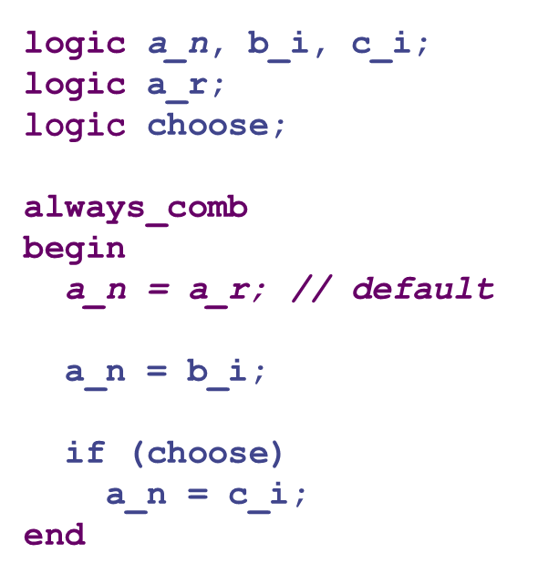
What does this do?
For each always_comb, assign, always_ff statement, draw the gates and wires.
b_i
0
a_n
c_i
1
choose
always_ff @( posedge clk )
a_r <= a_n;
a_n
a_r
L03-<number>

Slide 14
Verilog execution semantics
Confusing
Best solution is to write synthesizable verilog that corresponds exactly to logic you have already designed on paper. Separate combinational from sequential logic.
Debugging is difficult for Verilog. Don’t write code and “see if it works.” Test each “unknown” thing individually until you know what it does; then combine into larger entities.
Before you try to simulate, manually check every wire to make sure that it is correctly (1) defined, connected to (2) source and (3) destination, and that (4) the logic driving it appears to be correct.
  This is faster than finding the same bugs in the waveform viewer!
L03-<number>

Slide 15
SystemVerilog struct example
typedef struct packed {
logic [17-1:0] instr;
logic [10-1:0] addr;
} instr_packet_s;
instr_packet_s ip_n, ip_A_r, ip_B_r, ip_C_r;
assign ip_n = ‘{addr: addr_i
, instr: instr_i};
assign { addr_o, instr_o }
= { ip_C_r.addr, ip_C_r.instr };
always_ff @( posedge clk )
{ ip_A_r, ip_B_r, ip_C_r } <=
{ ip_n, ip_A_r, ip_B_r };
L03-<number>

Slide 16
Helpful SV Primitives
$bits( ) - number of bits required to hold value:
logic[31:0] foo; // $bits(foo) = 32
struct happy foo; // $bits(struct happy) =
$clog2( ) - number of address bits for a memory of size
- ceiling of log base 2 of X (eg for RF impl.)
// $clog2(2) = 1, $clog2(3,4) = 2,
// $clog2(5,6,7,8) = 3, …
’1,’0,’X,’Z – all 1’s, all 0’s, all X’s, etc.
logic [63:0] Word; logic [3:0] Byte; // byte = keyword
Word[Byte*8 +: 8] ; start at Byte*8; grab 8 bits upwards
Word[Byte*8 –: 8]; start at Byte*8; grab 8 bits downwards

Slide 17
Helpful SV Primitives, Cont.
typedef enum [2:0] { eFetch, eDecode, eExecute, eMemory, eWriteback } state_e;
state_e substate_r, substate_next;
always_ff @(posedge clk)
substate_r <= reset ? eFetch : substate_next;
always_comb
unique case (substate_r)
eFetch: substate_next = eDecode;
eDecode: substate_next = eExecute;
eExecute:
unique casez (instr_reg)
`SW: `LW: substate_next = eMemory;
default: substate_next = eWriteback;
endcase
eMemory:
unique casez(instruction)
`LW: substate_next = eWriteback;
default: substate_next = eFetch;
endcase
eWriteback: substate_next = eFetch;
default: substate_next = eFetch;
endcase

Slide 18
Useful functions
instr_packet_s storage [(2**LG_DEPTH)-1:0];
$clog2(LG_DEPTH) = ceiling log₂(LG_DEPTH)
2**LG_DEPTH == 2^{LG_DEPTH}
Useful for Parameters
when you need a width and also the number of bits to
address that width. Can also use clog2, but that does
not force the user to make things a power of 2.
(| c) // all of the bits of C or’d together (“or reduce”)
(& c) // all of the bits of C and’d together (“and reduce”)
(^ c) // all of the bits of C xor’d together (“xor reduce”)

