Slide 1


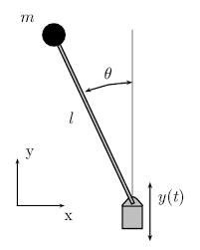
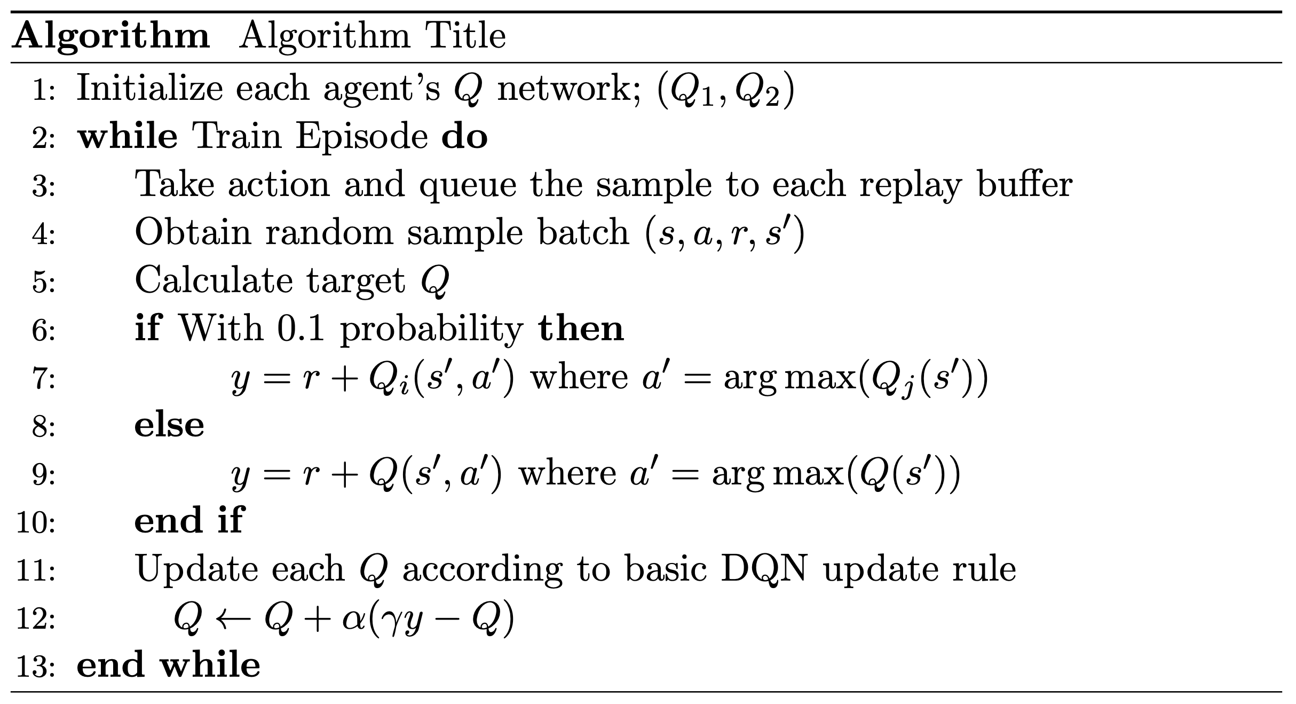
Bi-discounting Factor Q-Learning
Myeungseok Ryu, Minji Kim, Junseo Ha
School of Mechanical Engineering, Gwangju Institute of Science and Technology, 123 Cheomdan-gwagiro (Oryong-dong), Buk-gu, Gwangju, 61005, Republic of Korea
Introduction
Experiment
Most of RL algorithms need hyperparameter epsilon to ensure that the agent chooses action randomly to explore the environment. The factor epsilon can affect the performance and determine the range of the environment that agent explores. To omit the hyperparameter epsilon’s influence, we uses two agents that oversee long-term and short-term return respectively with their different discounting factors. Two agents advise each other by providing their experiences through the shared replay buffer and to take action that it never choose when update their Q-networks. Therefore, the agents can update their Q-networks including the actions they did not act indeed without the hyperparameter epsilon.
Pendulum Environment Hyperparameters
The objective of this environment is to swing the pendulum into an upright side.
State space is continuous and consists of cartesian coordinates and angular velocity.
Due to the characteristic of DQN, action space is discretized
Proposed Algorithm
Basic DQN Algorithm To make the agent acts randomly, hyperparameter epsilon is pre-defined. Basic DQN algorithm uses greedy action to update its Q-network. This update scheme removes dependencies between the agent policy and explored samples (Off-policy). Proposed algorithm Two agents whose discounting factors are small and large respectively are trained without the hyperparameter epsilon. Due to the feature of the off-policy, the replay buffer is available to both agents to save and access. Shared replay buffer can be filled sufficiently to train, so that the train starts earlier. Each agent utilizes another agent’s greedy action according to its Q-network with a 0.1 probability. Without random action, the agent is only able to reach the certain trajectory by the greedy action. By sharing the replay buffer, the agents are available to train with experiences that they never explore. Because the agent with small discounting factor is only attracted to the short-term reward, it cannot train overall environment, although another agent experiences are provided.
Agent | Epsilon | Discounting Factor (Gamma)
DQN | 0.9 (decaying to 0.5) | 0.99
Small Gamma | - | 0.1
Large Gamma | - | 0.9
Results & Discussion
Basic DQN Train Update Rule
Train Results
DQN
Small Gamma DQN
Large Gamma DQN
Proposed DQN Train Update Rule With Probability 0.1
Smoothen Train Result
Reward Table
Agent | Mean return (100 samples)
DQN | -207.835
Small Gamma | -1174.199
Large Gamma | -191.076
High and small gamma represents the size of each agent’s discounting factor.
Smoothen train result are smoothened with 30 episodes.
Reference
Conclusion
[1] Mnih, V., Kavukcuoglu, K., Silver, D. et al. Human-level control through deep reinforcement learning. Nature 518, 529–533 (2015) [2] gymnasium pendulum envirnoment. https://gymnasium.farama.org/environments/classic_control/pendulum/ [3] reinforcement learning DQN . https://pytorch.org/tutorials/intermediate/reinforcement_q_learning.html
The result of experiment shows that the proposed algorithm has similar performance measure. Without random action from epsilon, the proposed algorithm has converged stably. As expected, with high discounting factor the train result of agent can train without hyperparameter epsilon. On the other hand, the small discounting factor’s case has poor performance return.

