Slide 1
CREDIT CARD FRAUD DETECTION
Data Science Mini - Project

Slide 2
CONTENTS
Introduction
Literature Review
Problem definition
Requirement analysis
Proposed methodology
Implementation of the proposed methodology
Impact of the solution
Conclusion

Slide 3
Introduction
Credit cards are an important source of money transaction and are quite popular among its users. At the same time, they run risks of being compromised
Fraudulent cases in credit card transactions and uses have been witnessed numerous times
Modern computer algorithms are however made to prevent these things as much as possible
One of the most important methods is fraud detection and analysis

Slide 4
Literature Review
For this project we have been through multiple research papers to study in detail about the various aspects.
Some of the notable papers are:
Credit card fraud detection with a neural-network
- S Ghosh, DL Reilly.
Fraudulent credit card and its impacts on economy
- Dr. X Pyong, Dr. L Hamedani
Credit Card Fraud Detection and Analysis
Source - Kaggle

Slide 5
Problem Definition
Credit cards serve as an important mode of transaction and hence hold a significant value in terms of financial perspective
Detecting fraudulent transactions and phishing cases are very essential to maintain credit card integrity and transaction security
It is also a tedious method to manage the data and obtain valuable insights from it. Automation of detection and financial protection is the need of the hour
A proper algorithm is needed to ensure accurate prediction and repeatability.

Slide 6
Non-functional Requirements
Work must be self-explanatory.
UI/UX must be appealing and easy to comprehend.
Graphs and illustrations must be properly organized.
Latency of model working must be minimal.

Slide 7
Functional Requirements
The solution must be able to solve the problem with the highest possible accuracy
The data must be preprocessed before being used
Adequate amount of attention must be paid to bring out essential features by feature scaling
Working dataset must not contain any null or missing values
Predictions must provide realistic outcomes in tune with the fed data

Slide 8
System Requirements
R Studio.
CRAN version 4.0 or higher.
Windows 7 or higher, MAC OS X, Linux Distros (Ubuntu or CentOS)
A web browser (Google chrome(recommended), Safari, Mozilla Firefox, Brave browser or Internet Explorer).
A shinyapp.io account for public hosting.

Slide 9
Hardware requirements
Laptop
8GB RAM
i5 processor
4G Internet facility

Slide 10
Proposed Methodology
Load the dataset
Preprocess the data
Remove or manage missing values
Generate feature scaling results
Build the machine learning classifiers
Displaying the predicted results and graphs for the time frame
Conclude the observations

Slide 11
Implementation of the proposed methodology
Installing the required R libraries.
Fetching the data.
Displaying the data and preprocessing the data.
Setting prediction parameters.
Predictions on the data.
Visualization of the data.

Slide 12
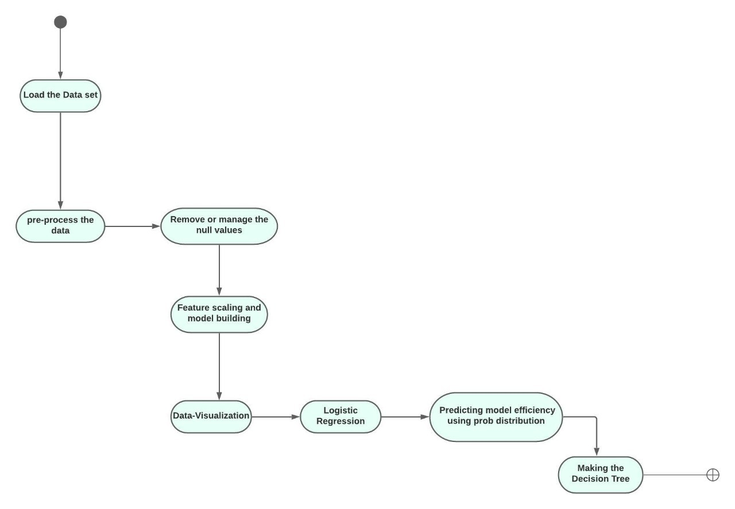
Flowchart

Slide 13
Implementation

Slide 14
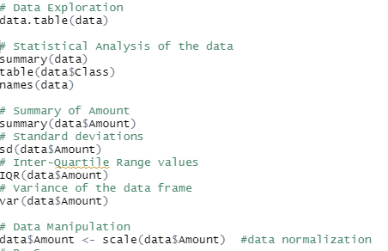
Data Exploration
Importing the data-set
Exploration of the data-set
Statistical Analysis of the data
Data manipulation
Data Normalization
Data exploration is the first step of data analysis used to explore and visualize data to uncover insights from the start or identify areas or patterns to dig into more

Slide 15
Data Cleaning
Remove duplicate or irrelevant observations
Filter unwanted outliers
Fix structural errors
Manipulation of Data
Searching for null values
Eliminating null values
Data cleaning is the process that removes data that does not belong in your dataset.
Techniques used for data cleaning may vary according to the types of data-set

Slide 16
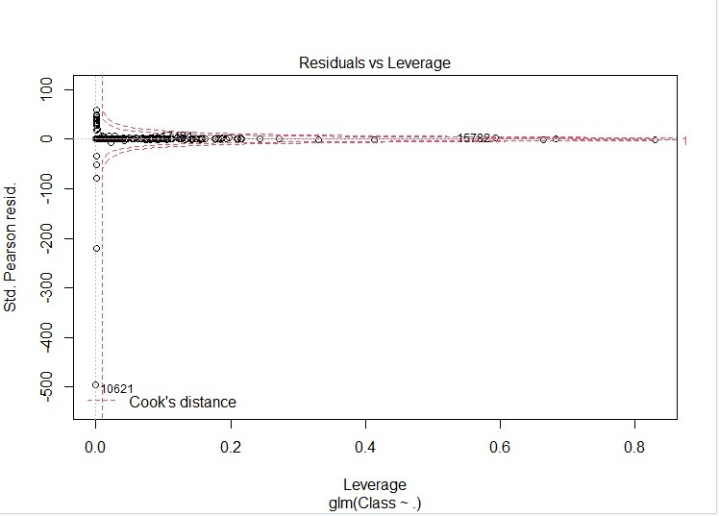
Data Visualization
Residuals vs Fitted:
Residuals here are the data which are not contributing to the cause
It is a scatter plot of residuals on the y axis and fitted values (estimated responses) on the x axis.
The plot is used to detect non-linearity, unequal error variances, and outliers
Black dots denotes residuals and red lines denotes fitted.

Slide 17
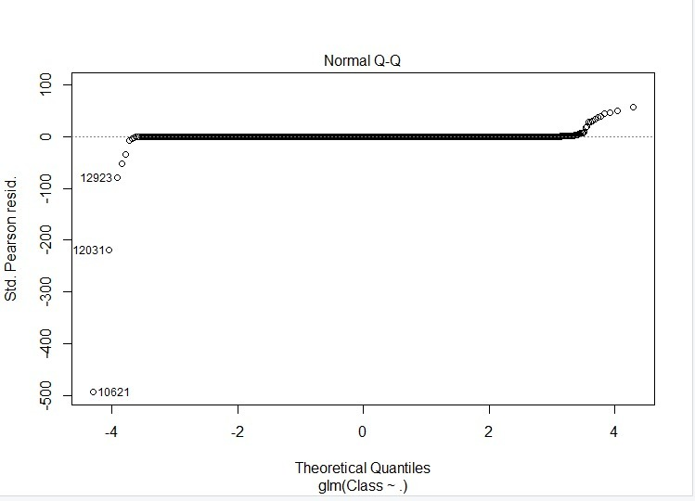
Data Visualization
Normal Q-Q:
A Q-Q plot is a scatterplot created by plotting two sets of quantiles against one another.
Used to find the type of distribution for a random variable whether it be a Gaussian Distribution, Uniform Distribution, Exponential Distribution or even Pareto Distribution, etc.
Type of distribution using the power of the Q-Q plot can be determined

Slide 18
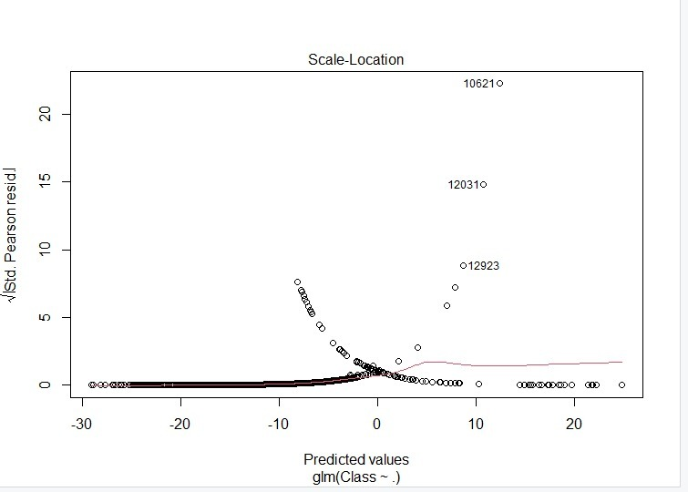
Data Visualization
Scale-Location plot:
Scale-Location plot shows whether residuals are spread equally along the ranges of input variables
The assumption of equal variance (homoscedasticity) could be checked with this plot
If we see a horizontal line with randomly spread points, it means that the model is good
Scale-location plot takes the square root of the absolute value of standardized residuals instead of plotting the residuals themselves

Slide 19
Data Visualization
Residuals vs Leverage:
A residuals vs. leverage plot is a type of diagnostic plot that allows us to identify influential observations in a regression model
Each observation from the dataset is shown as a single point within the plot
The x-axis shows the leverage of each point and the y-axis shows the standardized residual of each point
Observations with high leverage have a strong influence on the coefficients in the regression model. If we remove these observations, the coefficients of the model would change noticeably
In this Plot if the values are greater than 0.5 then that is fraud
also if the value exceeds the cooks distance in the y-axit it is called as a fraud value

Slide 20
Inputs of Team Members
Importing required Libraries and Data-set
Data Exploration and Cleaning
Analysis and Data Visualisation
Applying Algorithms
Decision Tree & Efficiency
Making the PPT
Working on the report
Shashwat
Ishan
Divyanshu
Akshat
Divyanshu
Shashwat and Divyanshu
Ishan and Akshat

Slide 21
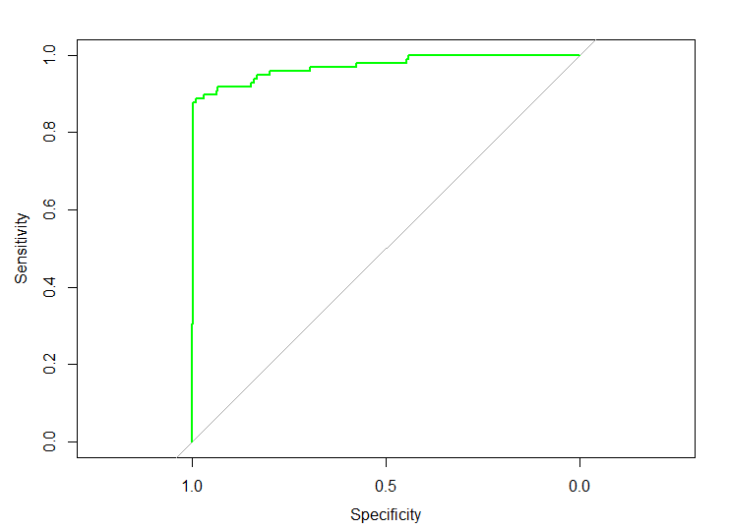
Conclusion
From the plot we can see that there is no disturbance till 0.9.
After that the graph starts showing deviation.
This concludes that the model is 90% efficient.

Slide 22
THANK YOU
DIVYANSHU BHASKAR

