Slide 1
Embedded System Design Raspberry Pi Mini-Project
Rock paper scissors game using GUI

Slide 2
Background
Rock paper scissors game is also known as stone paper scissors. It is a hand game that is usually played between 2 people, each player can randomly form any one of three from their hand.
A player who chooses rock will win by another player who chooses scissors but loose by the player who chooses paper; a player with paper will loose by the player with the scissors.
If both players choose the same then the game is tied. Rock paper scissors game is mainly played among kids.

Slide 3
KEY POINTS SOLVED
A quick stress reliever for anyone
A quick game interactive game for kids
One beautiful thing about the Rock Paper Scissors game is that you can improve your wellbeing and lifestyle by merely playing the game
The participants of the game can decide to use the game to fulfill a particular task. The following are a few examples of ways the game can be made fun and satisfy the original purpose of the game:
Used between siblings to decide who clears the table or trims the garden. Colleagues can also play the game to decide who pays the bill for lunch.
Addition and substitution of throws to extend the way the game is being played.

Slide 4
Objective
The objective is to make a rock-paper-scissor python project for single player that play against computer, in Python using GUI.
The game must have interactive buttons and a score counter.

Slide 5
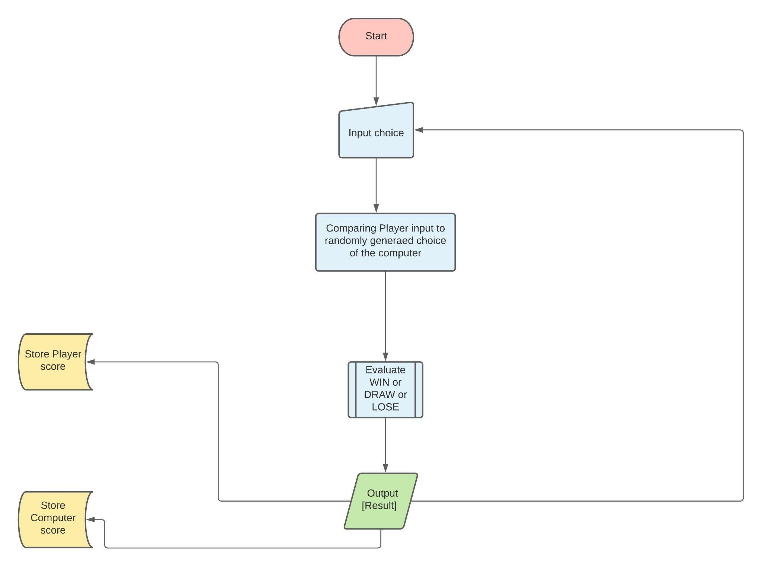
Block diagram
Block diagram

Slide 6
step to build a rock-paper-scissors game using python
Import required libraries
Initialize window
Code for user choice
Code for computer choice
Define functions
Define buttons

Slide 7
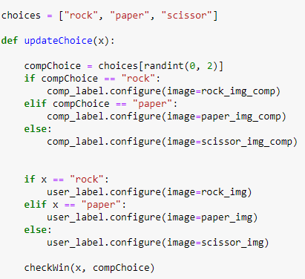
Methodology
Define the choices
Randomize the choice from computer.
We define a variable x for the input from the user.
We pass the user’s input and random choice from the computer to a defined function to compare win/loss.

Slide 8
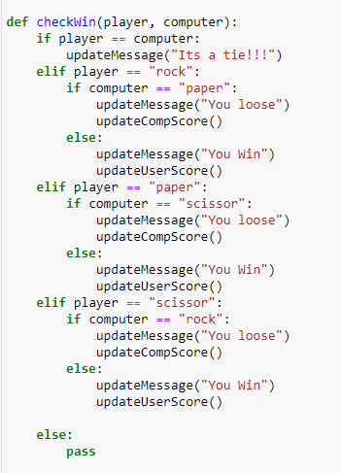
Methodology
The function compares various inputs and decides win loss accordingly.
If both inputs are same then, the program declares it a draw.
Win criteria is:
ROCK>>SCISSOR
SCISSOR>>PAPER
PAPER>>ROCK

Slide 9
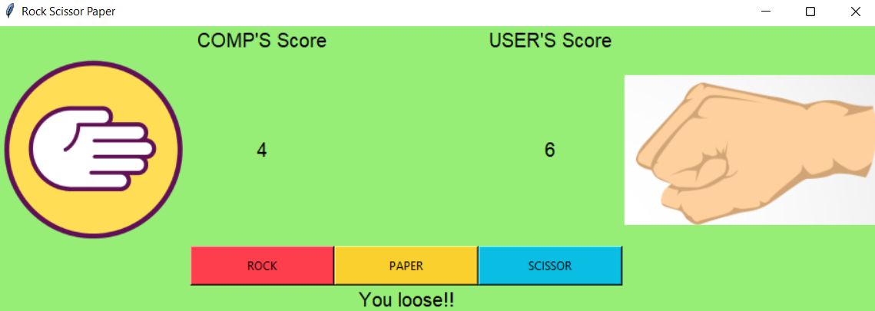
result

Slide 10
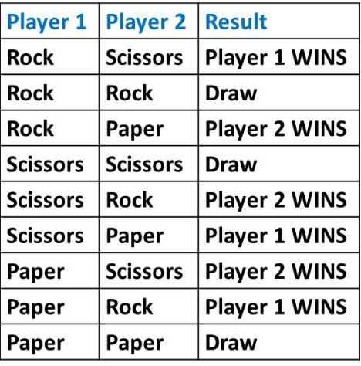
result
Rock paper scissor game in python using GUI was implemented.
Each win/loss situation is shown in the following table

Slide 11
Conclusion
In conclusion, the Rock Paper Scissors game does not follow difficult play patterns and does not conform to complex and unorthodox customs like that of the Olympics.
In other words, it offers simplicity in practice. You can play the Rock Paper Scissors game as an amateur to have fun and subscribe to the honor that it brings.
You can also pursue a career in it by becoming a professional RPS player like in every other professional sport globally.
In any way, the Rock Paper Scissors game is a game for everybody with unique physiognomies.

Slide 12
reference
https://www.geeksforgeeks.org/python-program-implement-rock-paper-scissor-game/
https://data-flair.training/blogs/python-rock-paper-scissors-game/

