Slide 1
Data Structure Design (2018-02)
Team Introduction

Slide 2
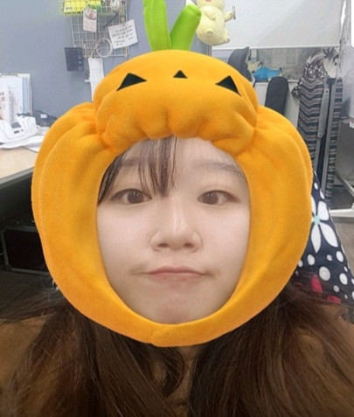
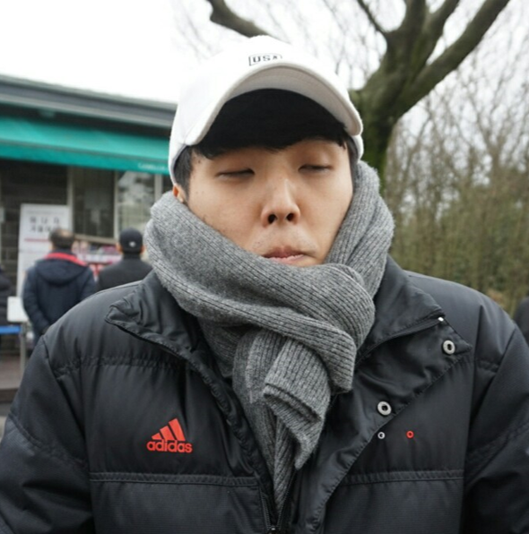
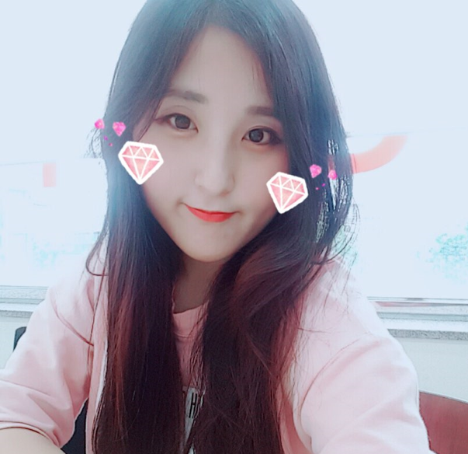

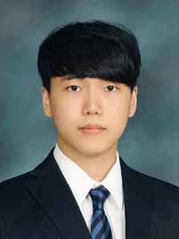
Team Introduction
About Member
또구설계
Team
Introduction
Member
Communication
권도경
김성재
박미지
이 용
조원희
20154077
20133659
20150207
20120596
20153129
Leader

Slide 3
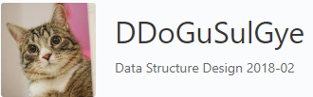

Team Introduction
About Communication
Team
Introduction
Member
Communication
https://github.com/orgs/DDoGuSulGye
깃 허브
카카오톡

