Slide 1
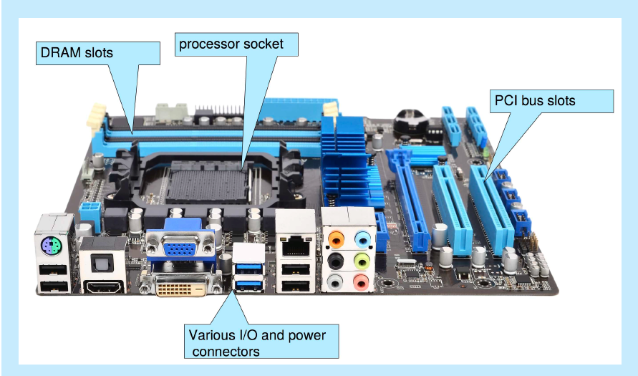
PC Motherboard

Slide 2
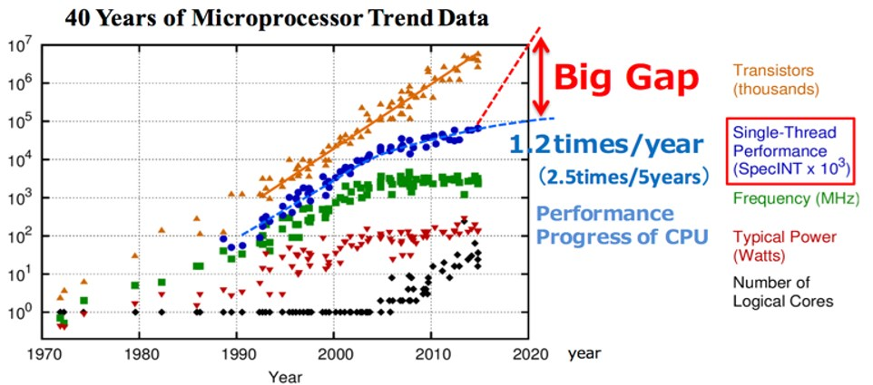
Moore’s Law
Reference: Ahmet Ceyhan, Interconnects for Future Technology Generations: CMOS with Copper/Low-κ and Beyond, PhD Thesis, 2018
Pre early 2000: frequency x 2 every 18 months
Post 2005: core count x 2 every 18 months

Slide 3
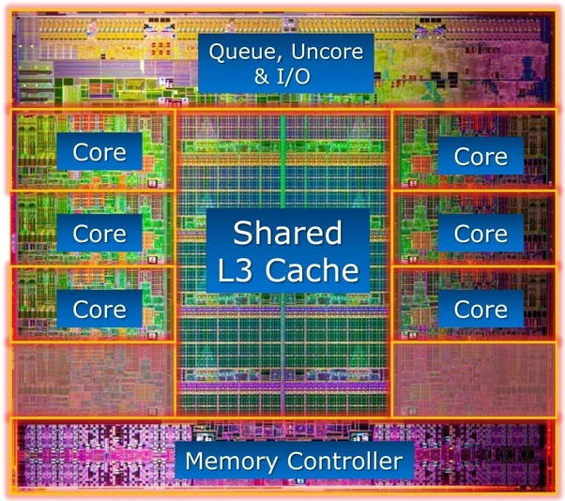
Modern Multi-core Processor
Your desktop computer today:
One processor chip with multiple cores
Shared & core- private caches

Slide 4
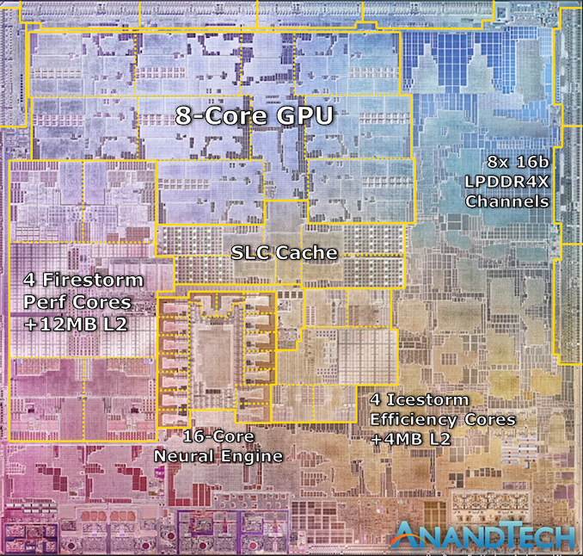

Slide 5
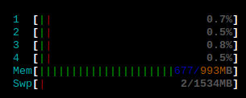
Hardware Threads
Hyper-threading (usually can be disabled)
Presented to the OS as additional “cores” or “CPUs”
Processor
OS view: 4 “CPUs” but 2 physical cores
Core
Core
Cache

Slide 6
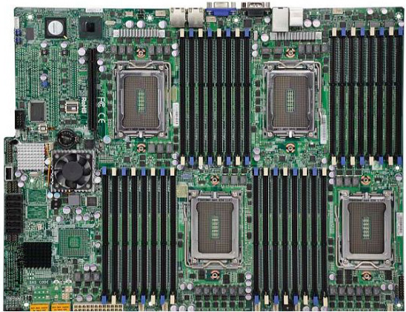
Multi-socket: even more parallelism
In the cloud and enterprises: multi-socket
Multiple processors in each server
Socket to place a multicore processor
Usually 4-32 cores per processor
Memory slots
Memory slots
Socket
Socket
Mainstream database servers: 2 – 4 sockets
Very high-end/mission critical: 8-32 sockets
Memory slots
Memory slots
Socket
Socket
https://www.servethehome.com/supermicro-h8qgif-review-quad-g34-motherboard/supermicro-h8qgi-f-overview/

Slide 7
Non-Uniform Memory Access (NUMA)
NUMA node:
A processor + local memory
Accessing local memory is faster than remote memory in other NUMA nodes, i.e., speed is not uniform
➔ “NUMA effect”
Processor
Processor
Core
Core
Core
Core
Core
Core
Core
Core
Memory
Cache
Cache
Memory
Interconnect: communication medium that links
Processors to processors
Processors to memory
E.g., Intel QPI/UPI, AMD HyperTransport
Processor
Processor
Core
Core
Core
Core
Core
Core
Core
Core
Memory
Cache
Cache
Memory

Slide 8
Memory/Storage Hierarchy
Cost per bit &
Performance
Capacity
CPU
Registers
1 cycle
higher
smaller
L1 Cache
~4 cycles
Volatile
L2 Cache
~10 cycles
L3 Cache
~60 cycles
Main memory
20-50ns
Volatile
Persistent memory
50-300ns
Flash/disk
Non-volatile
lower
larger
us, ms…
Tape
Must bring data from storage to memory for CPU to access

