Slide 1
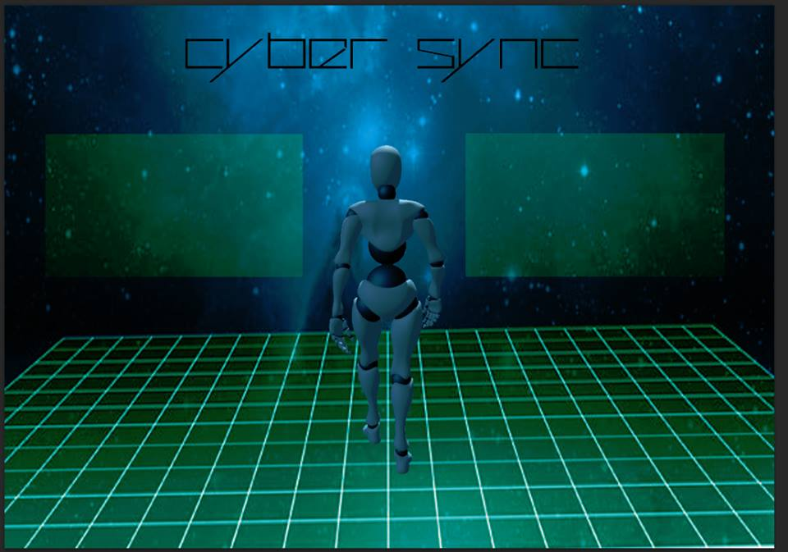
Aware
BRO13387450 Jack Browne CAT12375868 Lewis Catley
DRA12374169 Daniel Draper JAM13387239 Adam James
MAS11358736 Liam Mason HUN11216444 Emma J Huntley

Slide 2
Aware
Is grid based game, where the play must traverse the map to designated location while avoiding hazards.
The hazards represent problems and dangers that can be faced on the internet such as viruses and cyber bullying.
The designated locations are usual site you would access, e.g. bank, social media.

Slide 3
Roles
Adam - Implementor / Team worker
Daniel - Team worker / Co-ordinator
Lewis - Specialist / Monitor & evaluator
Liam - Plant / Complete finisher
Adam - Tools, Evaluation,Test, Presentation
Daniel - Game, Documentation, Presentation
Lewis - Game, Evaluation, Presentation
Liam - Game concept, Documentation,Test, Presentation
Notes:
Missing leader, so worked together without a soul decision maker.

Slide 4
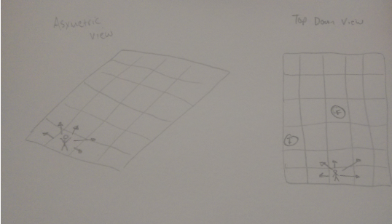
Processes
Discussed game ideas
Concept idea
Game
Documentation
Test
Present

Slide 5
Problems Faced
Members not turning up
Dan’s power cut
Adam’s blue screen
Liam’s illness
Concept delay
Loss of communication - loss of leader
Notes:
Risk matrix

Slide 6
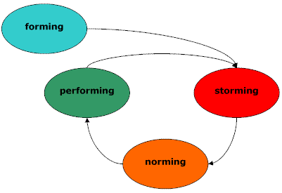
Tuckman
3. Small groups, so work easily discussed
4.No dissagrments, worked together.
Had a leader for start
No power struggle

Slide 7
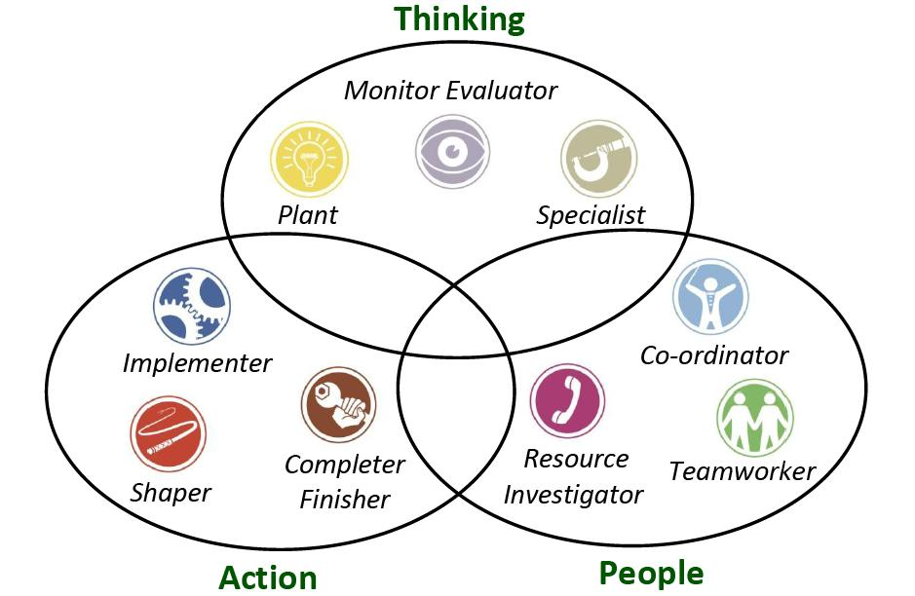
Belbin
Adam - Implementor / Team worker
Daniel - Team worker / Co-ordinator
Lewis - Specialist / Monitor & evaluator
Liam - Plant / Complete finisher

Slide 8
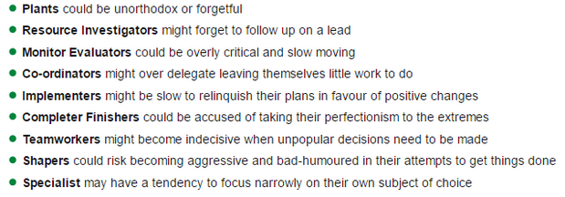
Disadvantages of Belbin

Slide 9
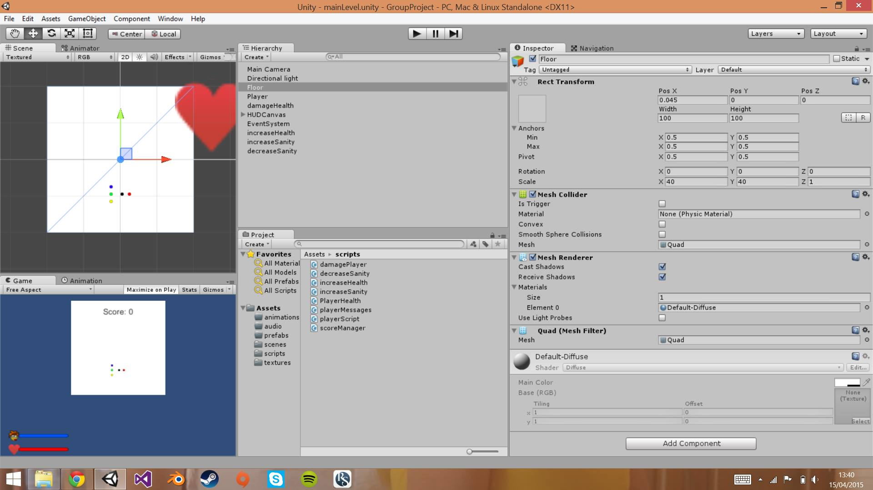
Tools

Slide 10
Reflection
Overall...
No arguments
Loss of leader
Two missing members
If we had more time…
Different game difficulties
Improve graphic fidelity
Better sounds
More features - threat encyclopedia

Slide 11
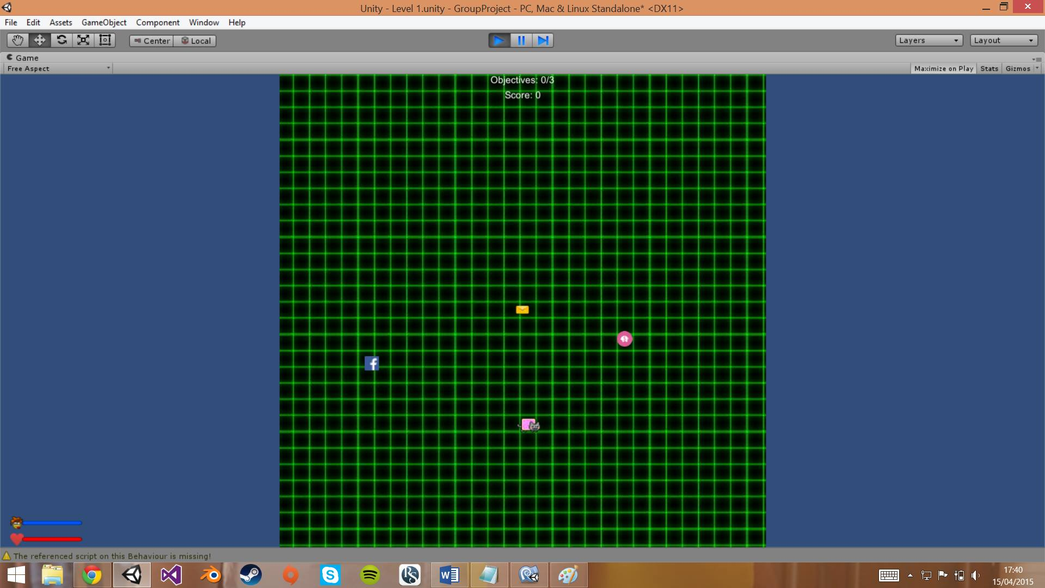
Game Achievements
Basic game that allow people from all backgrounds and skill levels to play.
Generates awareness of dangers while using the internet, and details on these.

