Slide 1
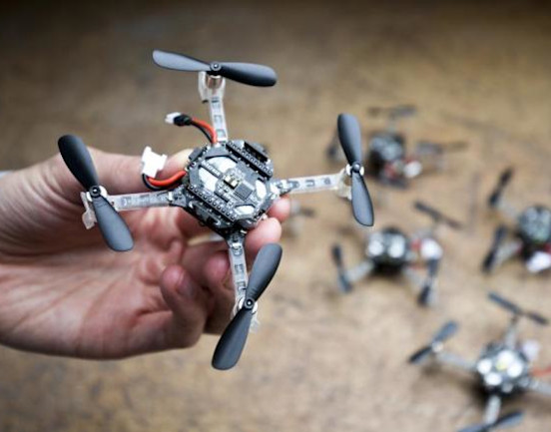
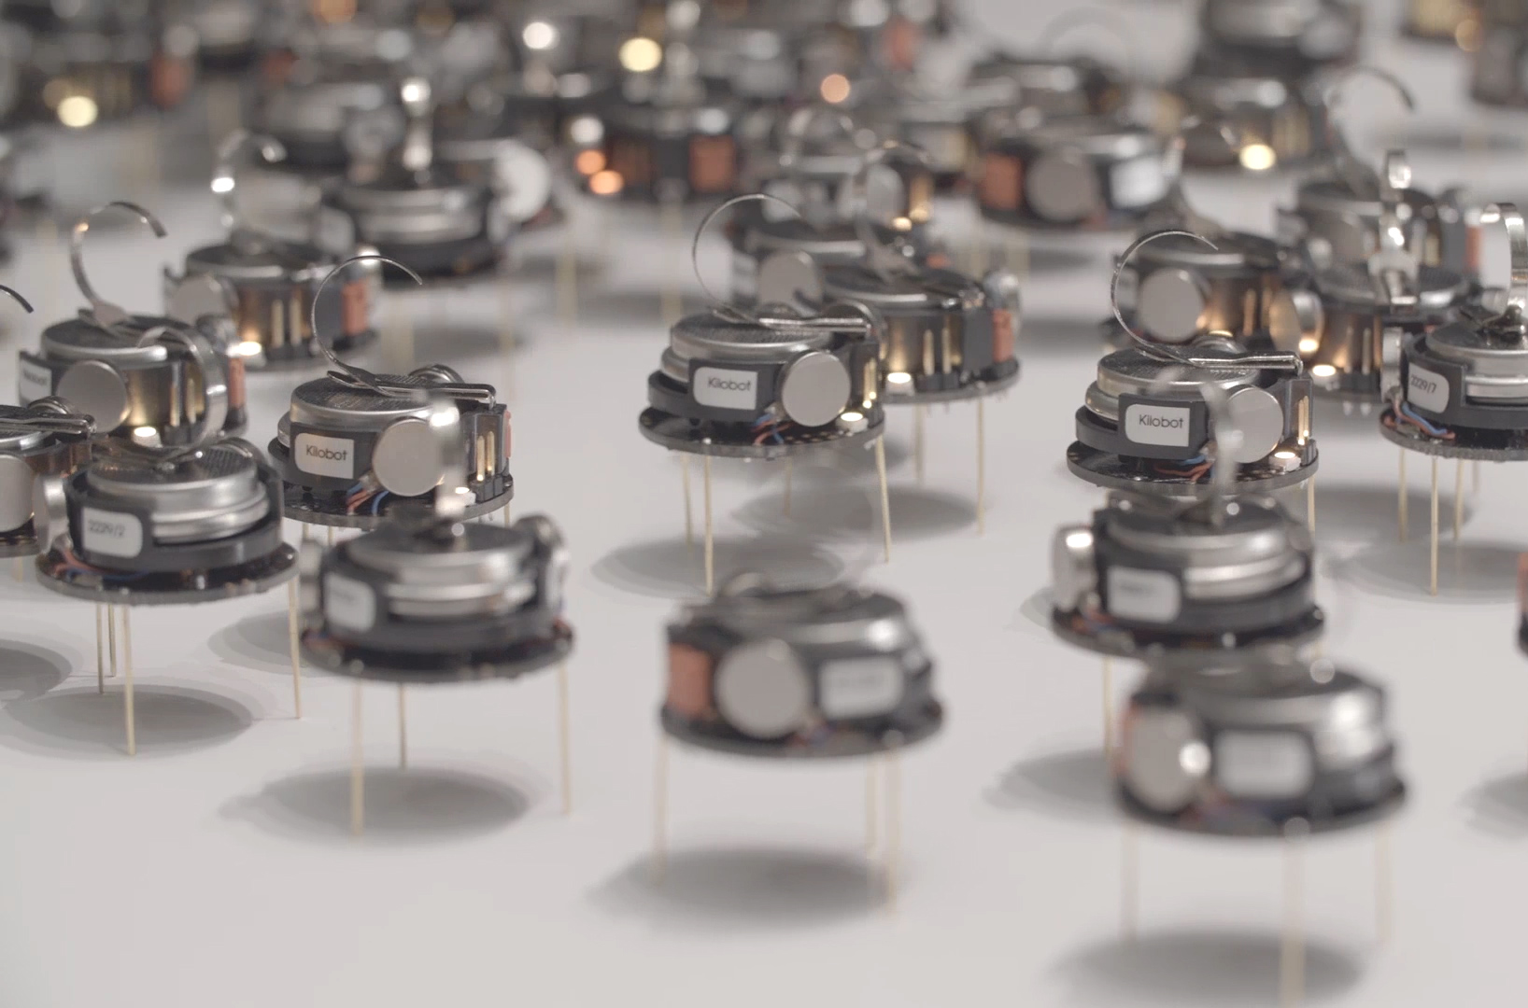
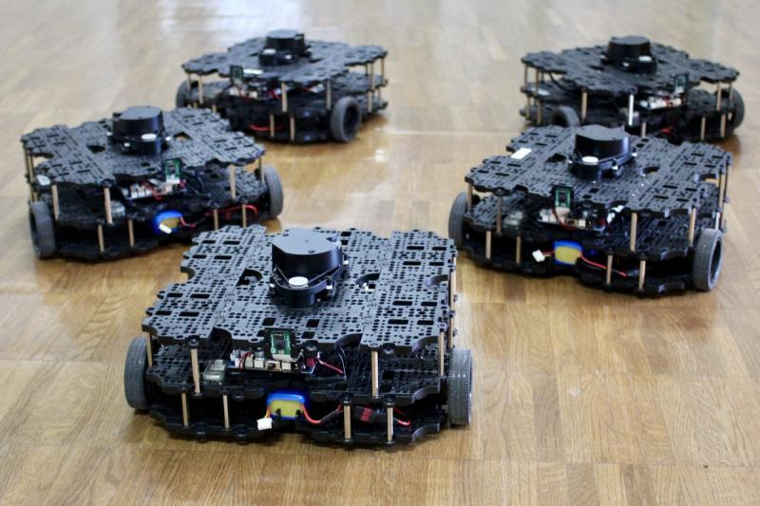

ECE693H, Spring 2025: Multi-robot System Design
“Multi-robot Systems 1”
Dr. Daniel Drew

Slide 2
Three Pillars Recap

Slide 3
Questions?

Slide 4
Class Overview
Lecture (~30 minutes)
Subsystem check-in (~30 minutes)

Slide 5
Multi-robot Systems: Lecture 1 of 4
Lecture 1: MRS Survey
Lecture 2: Motion Planning
Lecture 3: Task Assignment
Lecture 3: Communication and Control Paradigms

Slide 6
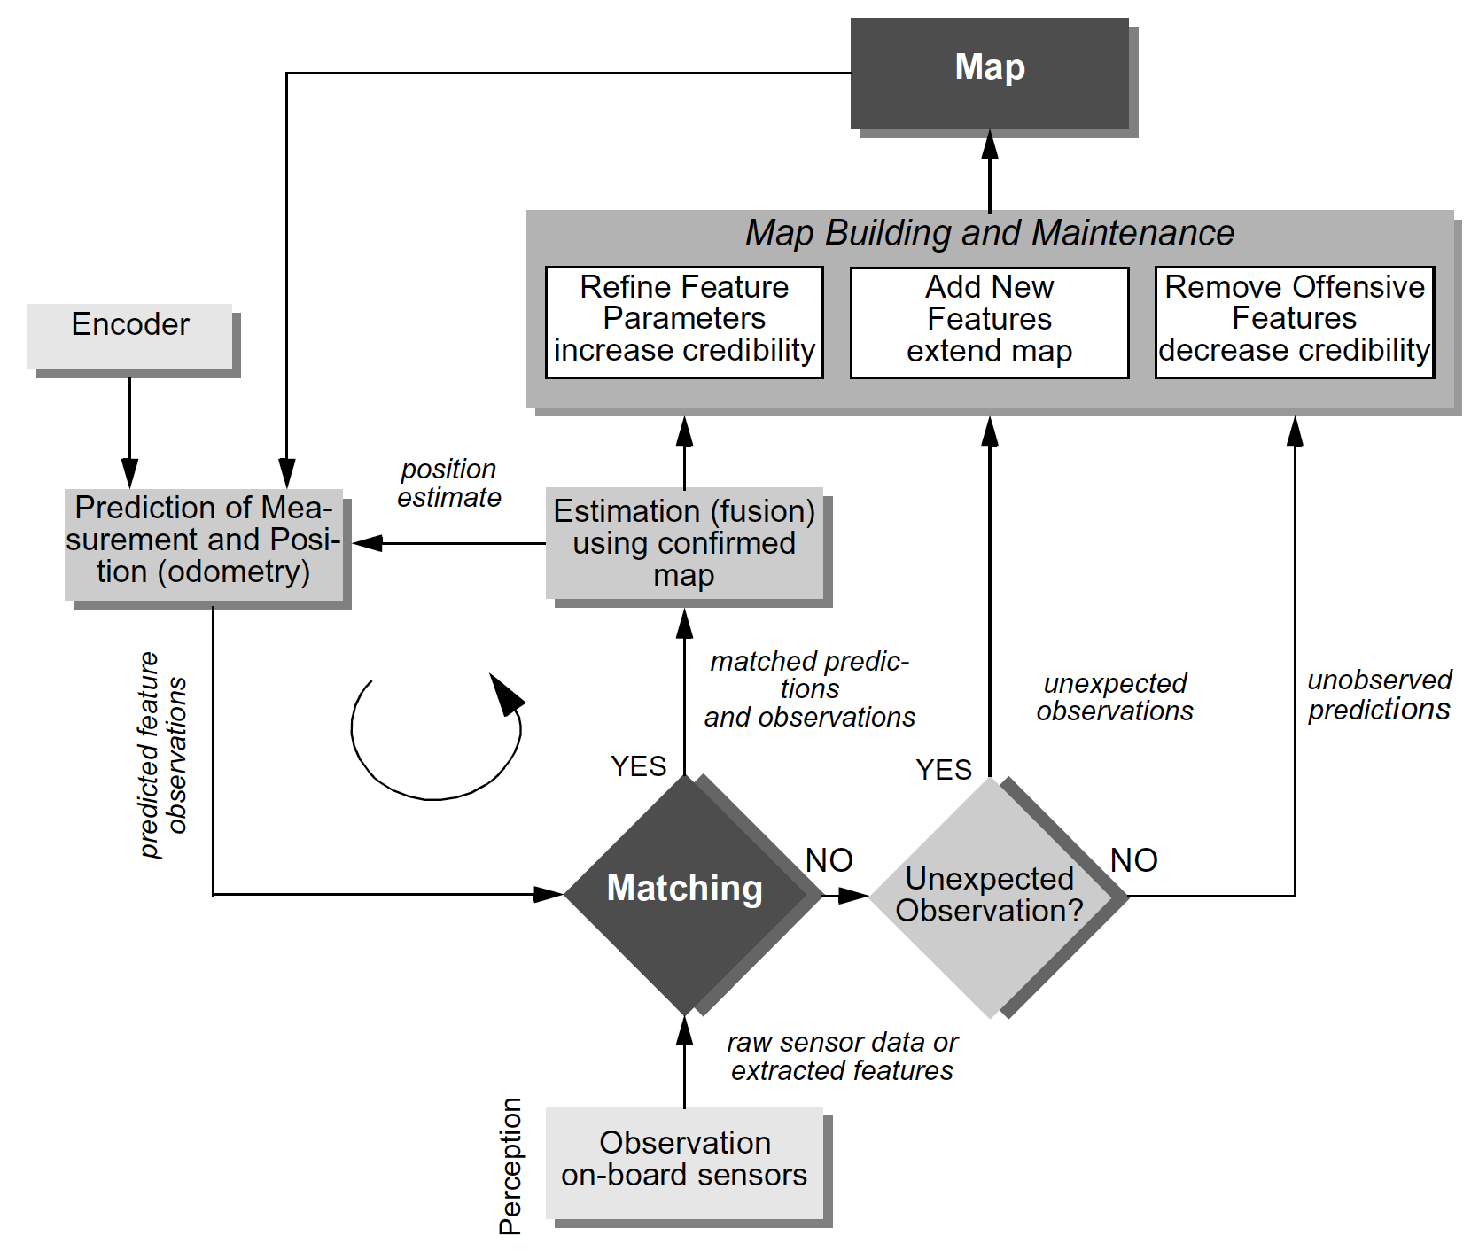
SLAM as an archetypical function
Mapping,
Feedback between Action and Perception
Localization
Perception

Slide 7
Lecture (~30 minutes)
Subsystem check-in (~30 minutes)
Questions?
Questions?
Lecture 1: MRS Survey
Lecture 2: Motion Planning
Lecture 3: Task Assignment
Lecture 3: Communication and Control Paradigms

Slide 8
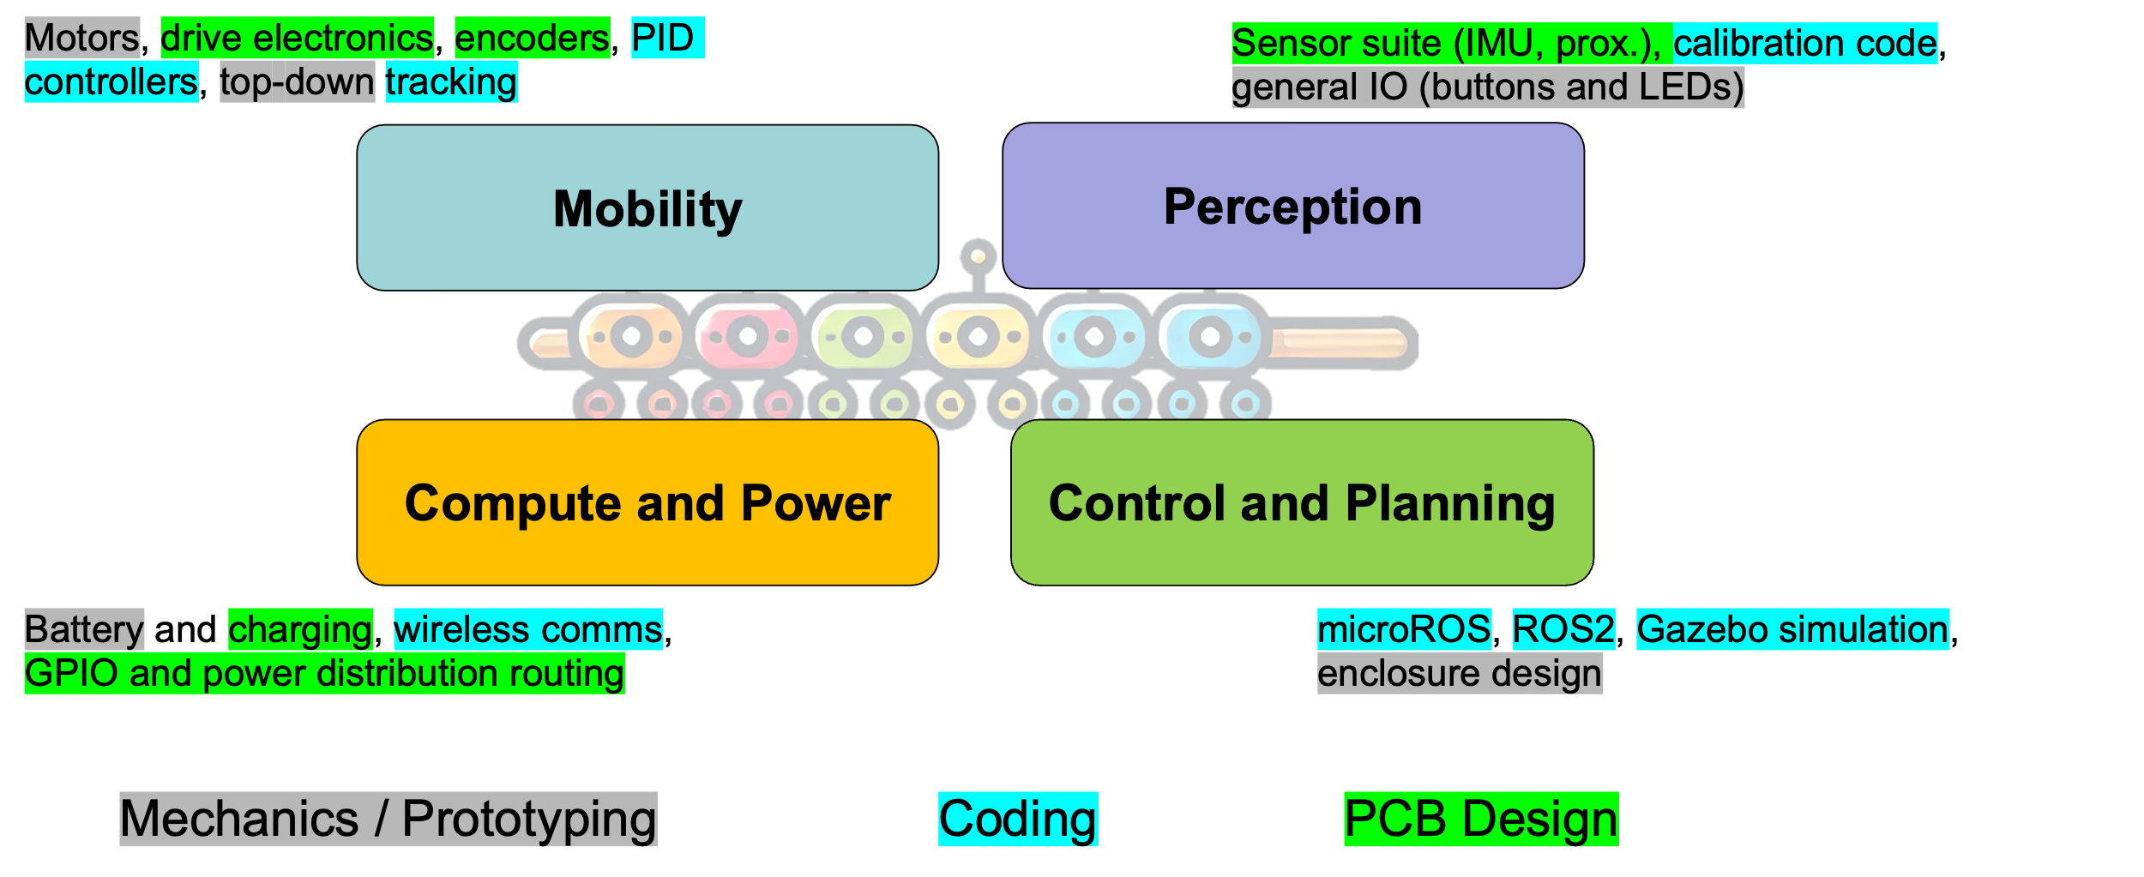
693H Robotic Subsystems
-Second Design Review Presentations are 3/10, 3/12
-You will be expected to have functional prototypes complete to show by then
-You will be expected to have PCB designs and final BoMs complete by then
Astound-the-Class 2 is scheduled for MONDAY, MARCH 3rd

