Slide 1
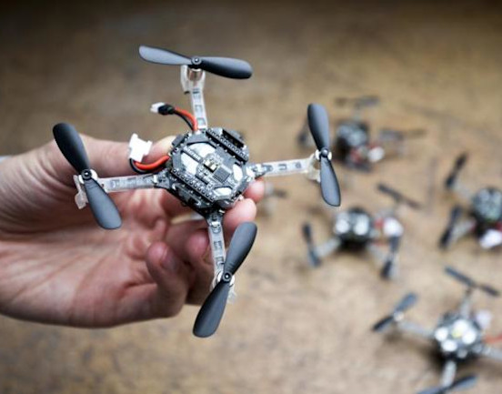
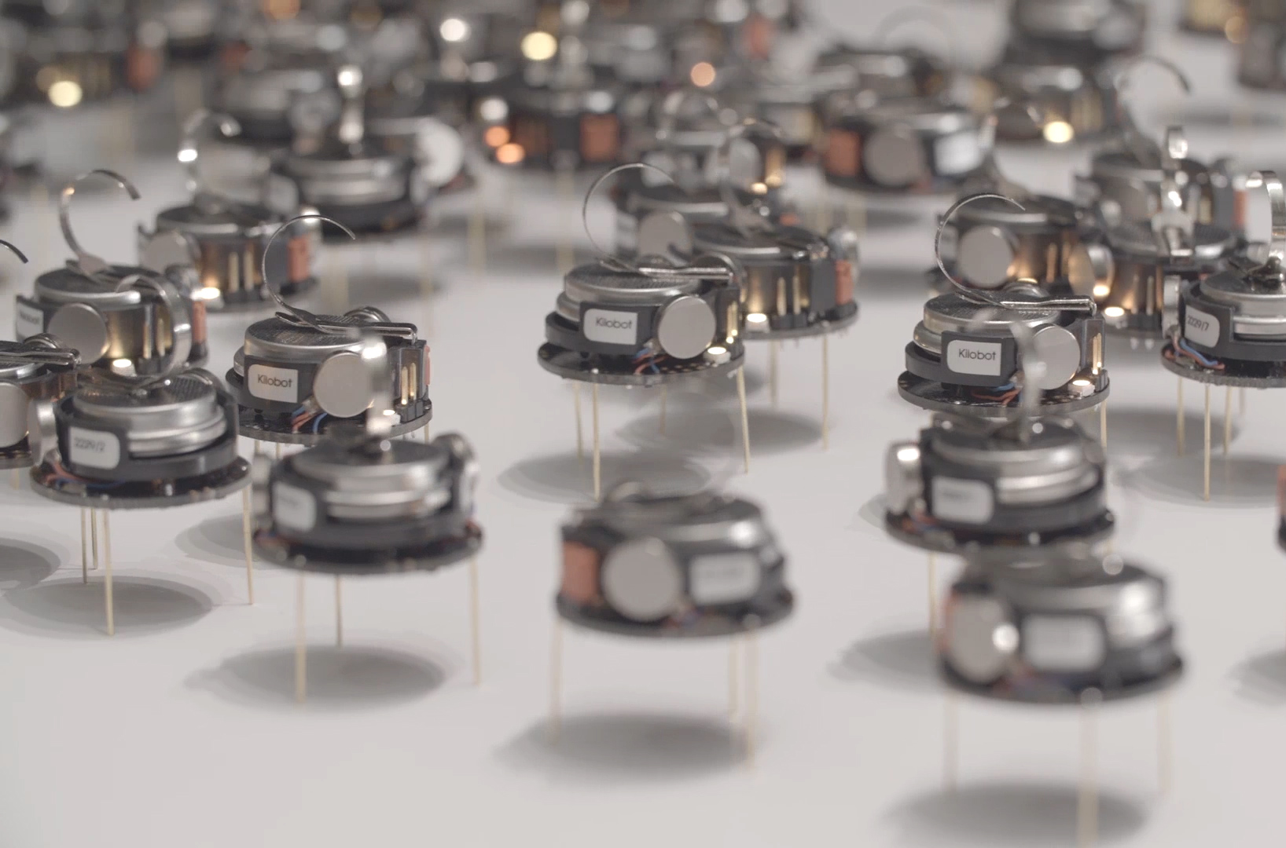
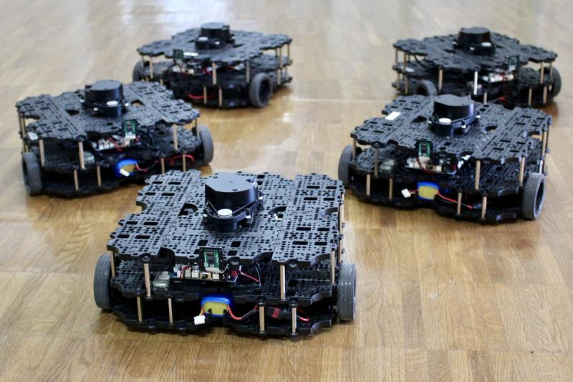

ECE693H, Spring 2025: Multi-robot System Design
“Action 1”
Dr. Daniel Drew

Slide 2
Action
Electromagnetic motors and motor drivers
Motor gearing
Encoders
Odometry
PID control
Nested PID structure

