Slide 1
Banking Data Mining Case Study
Knowledge Extraction and Machine Learning
2015/2016
Ruben Fernando Pinto Cordeiro ei11097@fe.up.pt
Duarte Nuno Pereira Duarte ei11101@fe.up.pt

Slide 2
Outline
Methodology
Understanding the business
Understanding the data
Descriptive data analysis
Predictive data analysis
Conclusions

Slide 3

Methodology

Slide 4
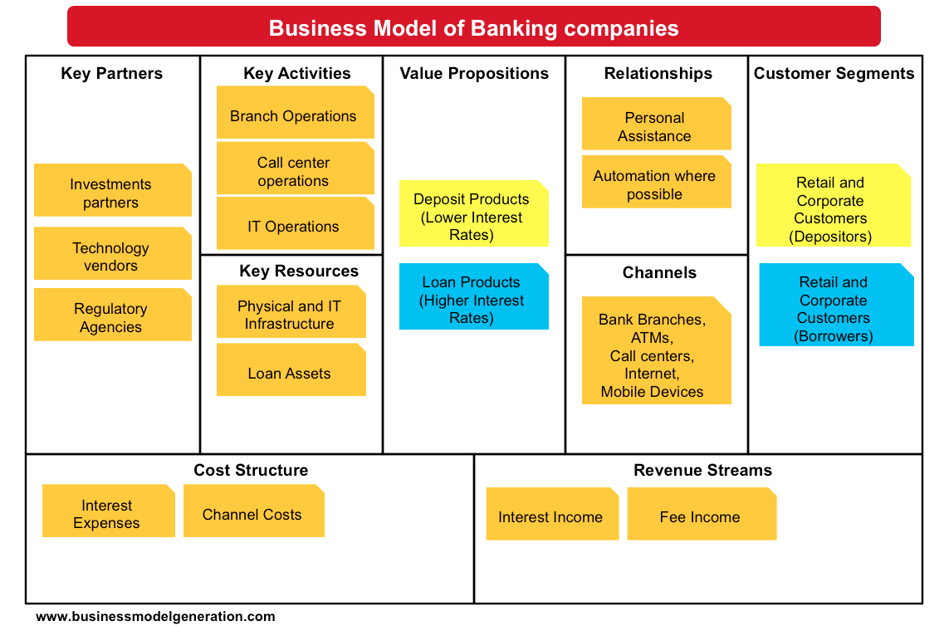
Understanding the business

Slide 5
Understanding the data

Slide 6
Data preparation
Data cleaning
Add labels where missing (district, …);
Extract gender from birth date in the Client relation;
Format dates and numbers;
Data transformation:
Calculate age in the Client relation;
Import raw data into RapidMiner;
Denormalize various relations for the descriptive and predictive analysis algorithms.

Slide 7
Descriptive data analysis

Slide 8
Descriptive data analysis
Segmentation
Primary parameters:
Assets & Liabilities
Geo-demographic data
Profitability
Secondary parameters:
Behavioristic segmentation
Life stage segmentation

Slide 9
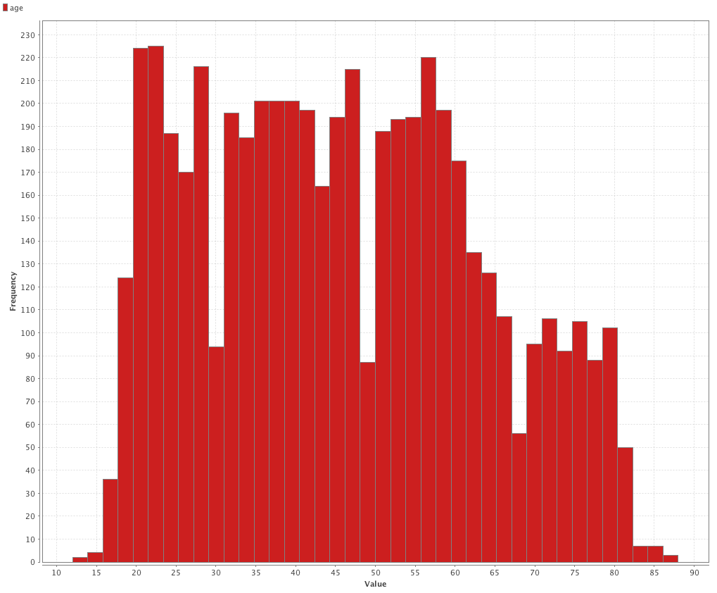
Age distribution

Slide 10
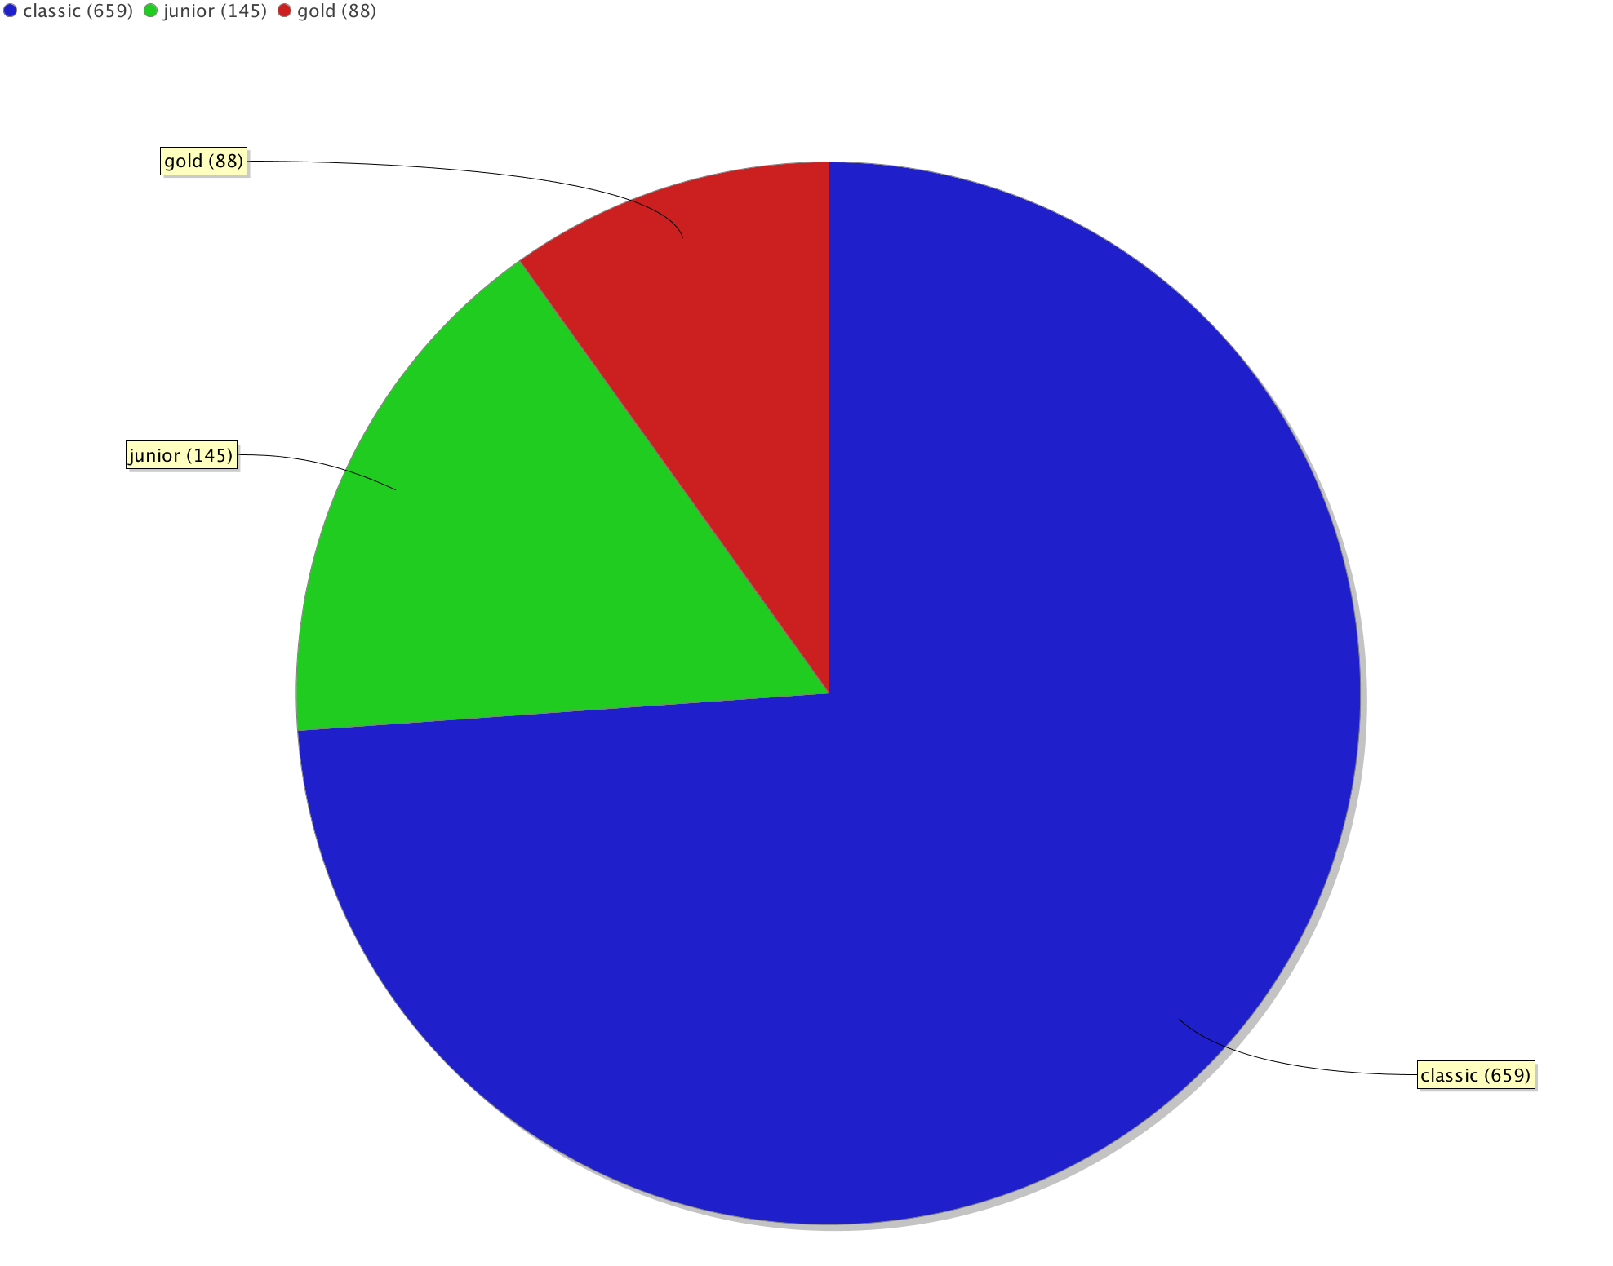
Credit card type distribution

Slide 11
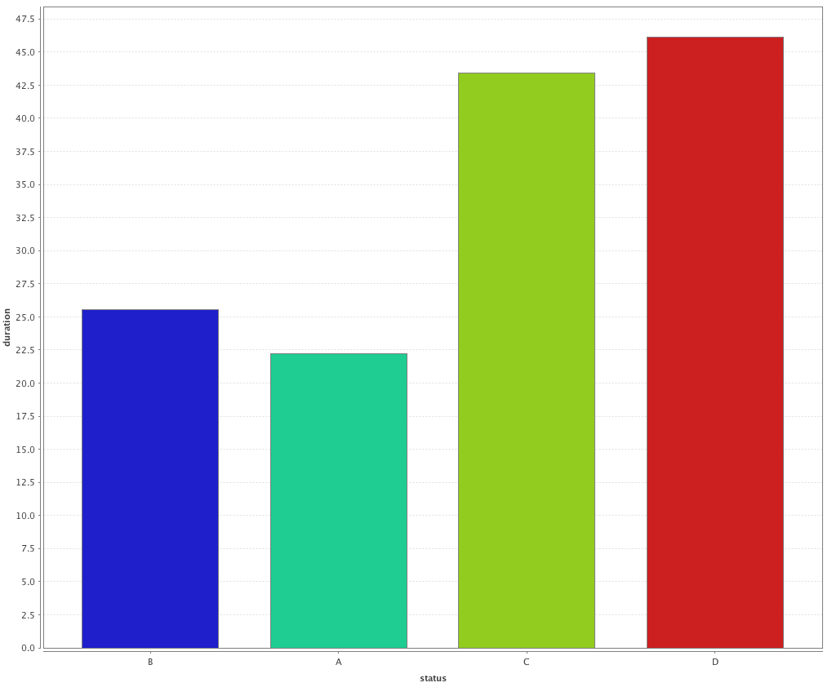
Average loan duration distribution by status

Slide 12
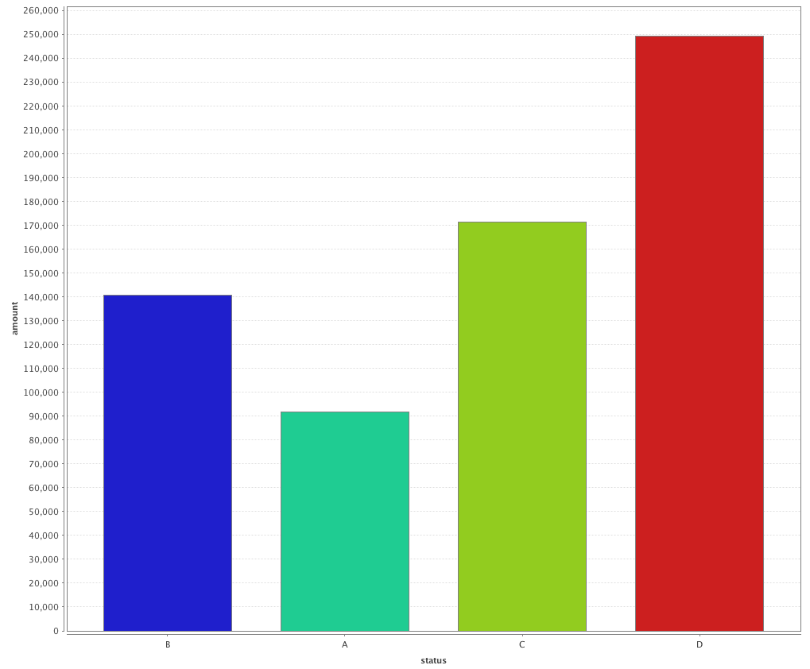
Average loan amount distribution by status

Slide 13
Exploratory data analysis: conclusions
Most of the issued credit cards are classic (649). There are more junior cards (145) than gold cards (88).
Good loans (A, B) tend to be of a lower amount and a shorter duration when compared to bad loans (C, D).

Slide 14
Clustering: Case 1
For the first clustering, the following attributes were pre-computed:
Amount: the total loan amount borrowed by each client;
Duration: the total loan duration by each client;
Payments: the monthly amount of loan payments made by each client;
Average Income: the monthly average income of each client;
Average Withdrawals: the monthly average withdrawals made by each client.

Slide 15
Clustering: Case 1

Slide 16
Clustering: Case 1
With this clustering process, the goal was to segment clients according to their assets and liabilities.
The clients in the Cluster 1 have less purchase power when compared to clients belonging to Cluster 2 and 3.

Slide 17
Clustering: Case 2
Attribute | Cluster 1 | Cluster 2 | Cluster 3
No. of entrepreneurs per 1000 inhabitants | 160,10 | 112,05 | 115,43
No. of municipalities with inhabitants 2000-9999 | 0,00 | 7,39 | 5,64
No. of municipalities with inhabitants 500-1999 | 0,00 | 23,17 | 26,41
No. of municipalities with inhabitants < 499 | 0,00 | 21,52 | 74,67
No. of municipalities with inhabitants >10000 | 1,00 | 2,24 | 1,42
Ratio of urban inhabitants | 100,00 | 70,42 | 55,75

Slide 18
Clustering: Case 2
With this clustering process, the goal was to segment clients according to geo-demographic data.
Clients in Cluster 1 belong to an urban environment with an higher ratio of entrepreneurs.
Clients in Cluster 3 live in a district with the smallest ratio of urban inhabitants.

Slide 19
Predictive Data Analysis

Slide 20
Predictive Data Analysis
The loans dataset is relatively small: 682 loans in total.
The status distribution of the loans is uneven: 606 loans are good, while only 76 loans are bad.
These factors make the prediction of bad loans more difficult, no matter what classification algorithm is used.

Slide 21
Decision Tree
Given the small dataset, there is a great danger of overfitting the data.
In order to mitigate the risk, the decision tree was pre-pruned, thus reducing the complexity of the final classifier.

Slide 22
Decision Tree
In RapidMiner:
The decision tree operator was used:
Criterion: information_gain;
Level of confidence set to 25%;
Applying pruning and pre-pruning;
Minimal gain set to 4%;
Maximal depth set to 6.

Slide 23
Decision Tree model
The following relations were joined: Client, Account, Loan, Disposition and Transactions.
For this classification, several attributes were pre-computed:
Average(ratio): Average debt-to-income ratio of the client.
Count(sanction_date): Number of sanctions that the client is responsible for. A sanction occurs when the client’s bank account balance reaches negative values.
Amount: the total loan amount borrowed by the client.
Payments: the monthly amount of loan payments made by the client.
Gender: the client’s gender.
VarWD: The monthly average variation of the withdrawals made by the client.

Slide 24
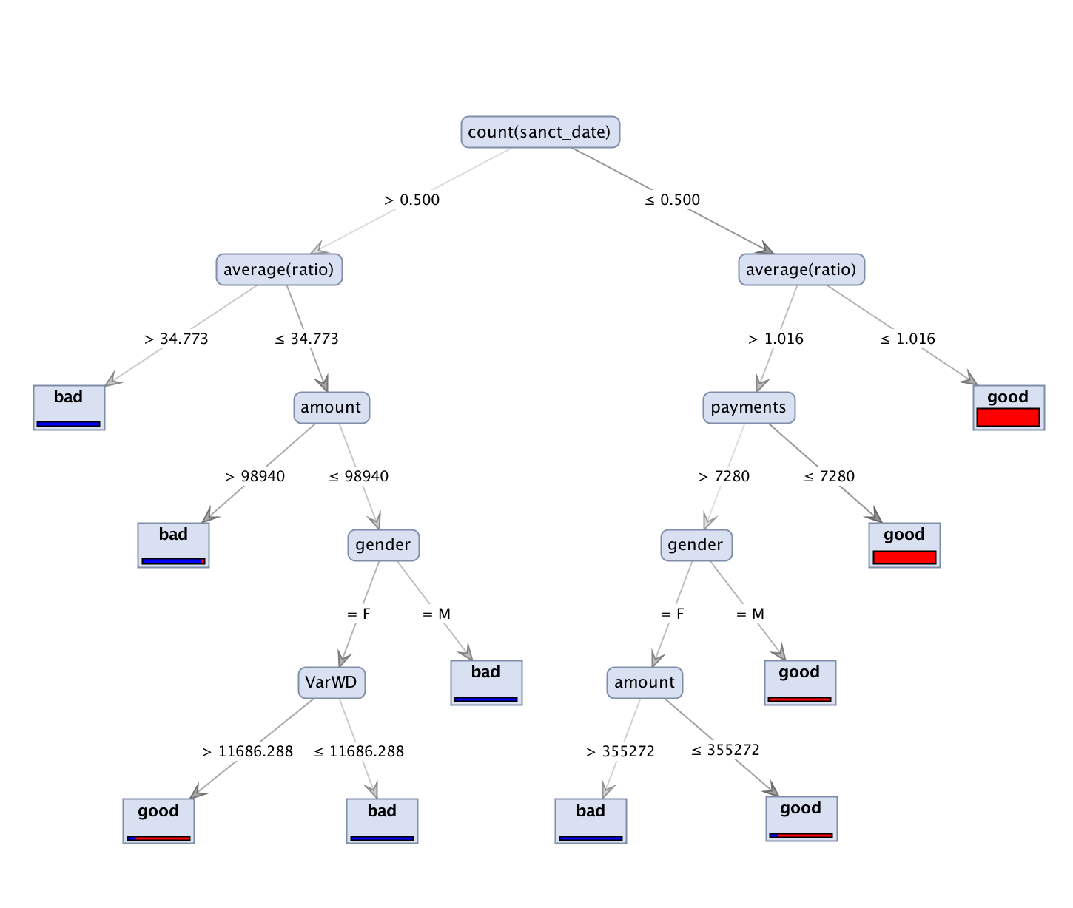
Decision Tree model

Slide 25
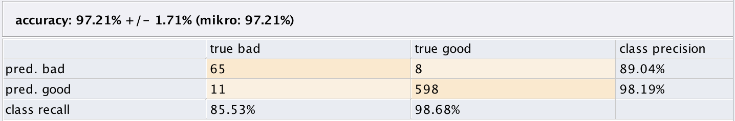
Decision Tree model: evaluation
Using the Rapidminer ‘x-validation’ operator (cross validation):
Number of validations: 15.

Slide 26
Naïve Bayes
The following relations were joined: Client, Account, Loan, Disposition and Transactions.
The same pre-computed attributes from the Decision Tree model were used.
In RapidMiner:
The Naïve Bayes operator was used:
The laplace correction option was set to true.

Slide 27
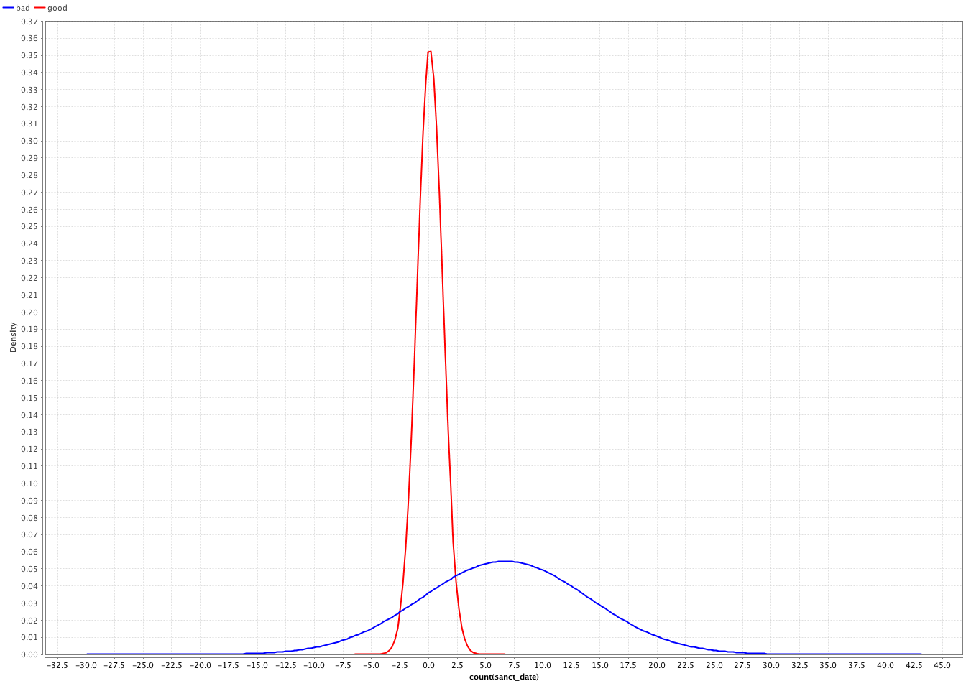
Naïve Bayes model

Slide 28
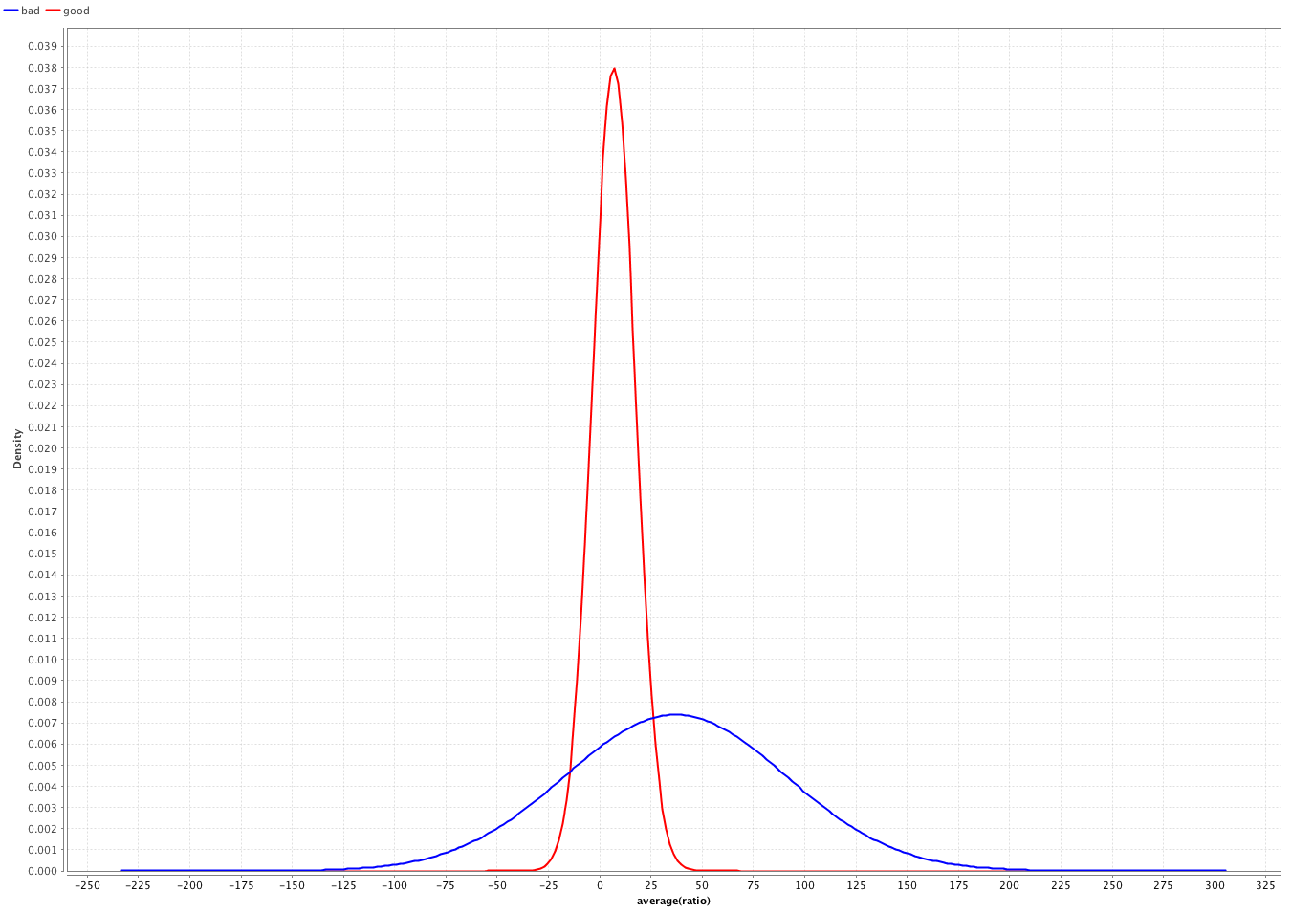
Naïve Bayes model

Slide 29
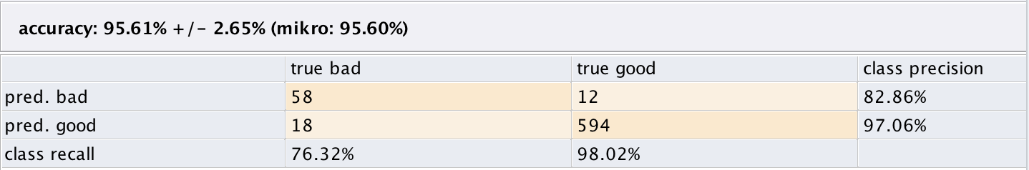
Naïve Bayes model: evaluation
Using the Rapidminer ‘x-validation’ operator (cross validation):
Number of validations: 15.

Slide 30
Neural Net model
Using the Rapidminer ‘Neural Net’ operator:
Training cycles: 500;
Learning rate: 0.3;
Momentum: 0.3;
Shuffle: true;
Normalize: true.
The following relations were joined: Client, Account, Loan, Disposition and Transactions.

Slide 31
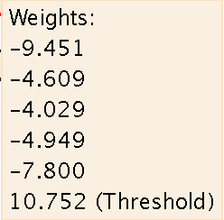
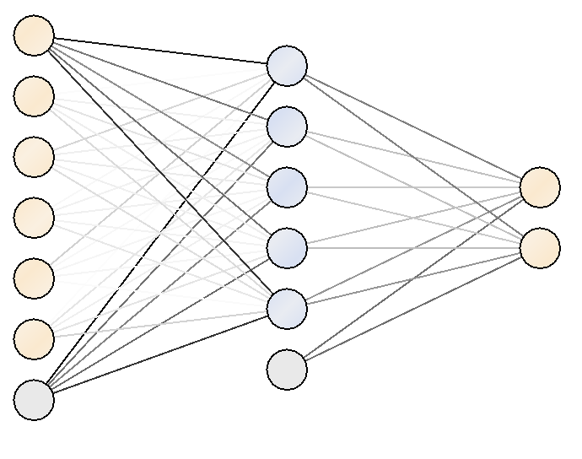
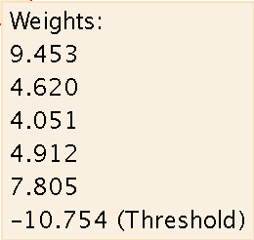
Neural Net model

Slide 32
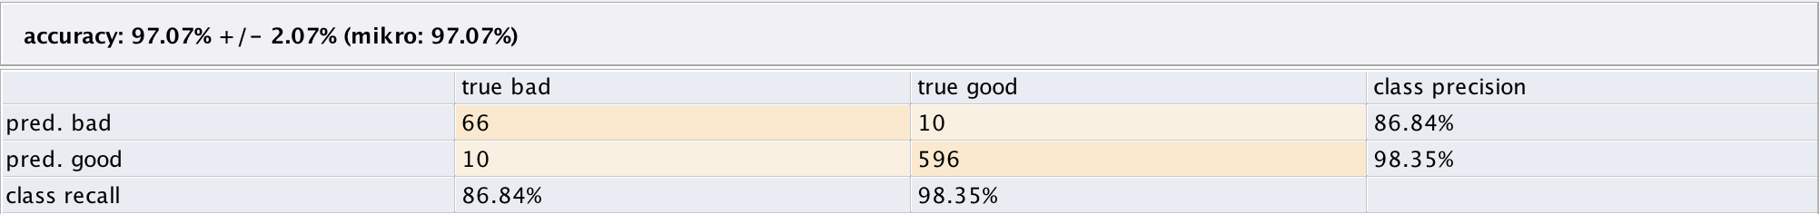
Neural Net Model: Evaluation
Using the Rapidminer ‘x-validation’ operator (cross validation):
Number of validations: 15.

Slide 33
Conclusions and future work
The data set example has a strong class imbalance, which can mislead some classification algorithms presented. There are two possible solutions:
Sampling of the input data;
Collection of new data.
Apply more predictive data mining algorithms for the creation of new models:
Nearest Neighbor;
Support Vector Machines;
Ensemble methods.

Slide 34
Conclusions and future work
Empirical validation of the predictive models in a real world scenario is essential.

