Slide 1
Banking Data Mining Case Study
Knowledge Extraction and Machine Learning
2015/2016
Ruben Fernando Pinto Cordeiro ei11097@fe.up.pt
Duarte Nuno Pereira Duarte ei11101@fe.up.pt

Slide 2
Outline
Methodology
Understanding the business
Understanding the data
Descriptive data analysis
Predictive data analysis
Conclusions

Slide 3

Methodology

Slide 4
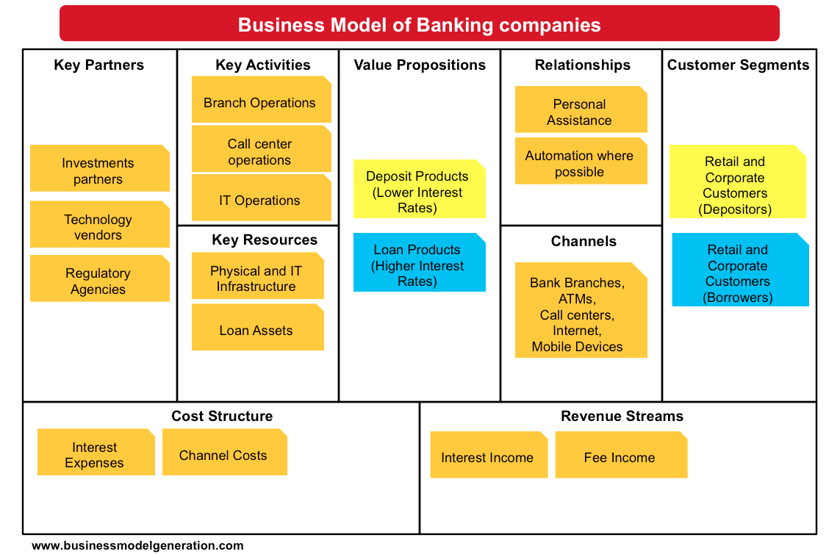
Understanding the business

Slide 5
Understanding the data

Slide 6
Data preparation

Slide 7
Descriptive data analysis

Slide 8
Descriptive data analysis
Segmentation
Primary parameters:
Assets & Liabilities
Geo-demographic data
Profitability
Secondary parameters:
Behavioristic segmentation
Life stage segmentation

Slide 9
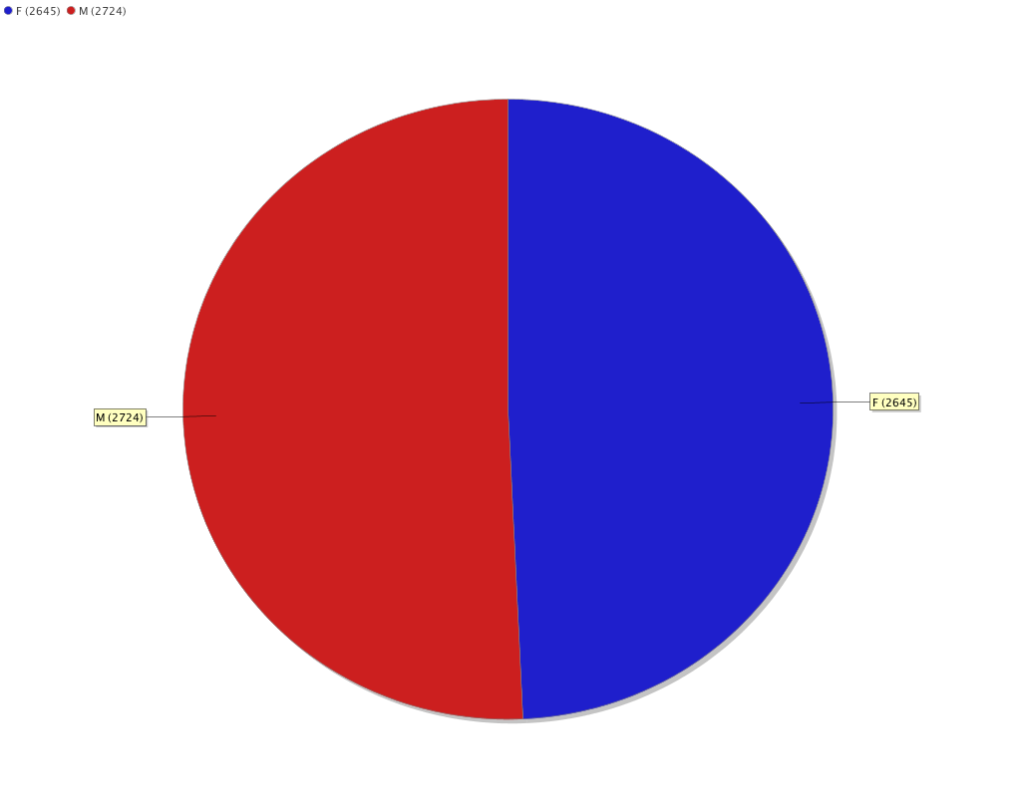
Gender distribution

Slide 10
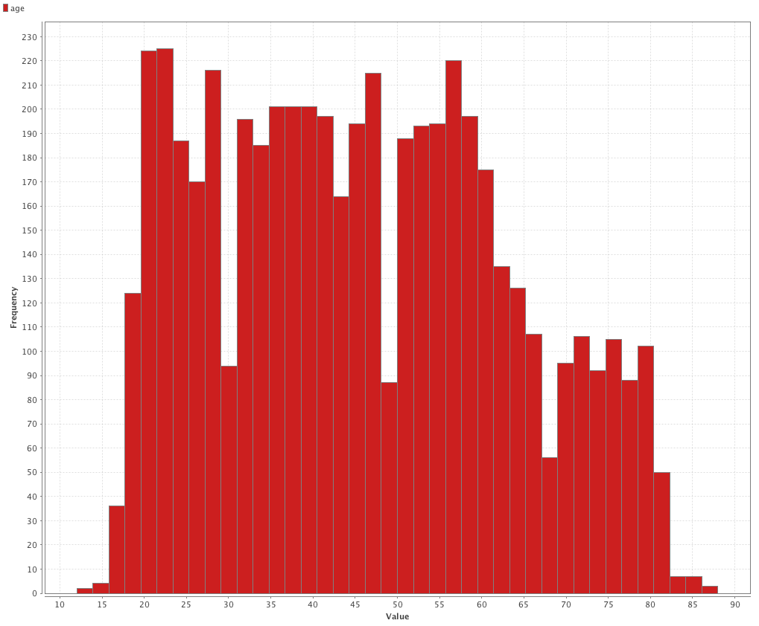
Age distribution

Slide 11
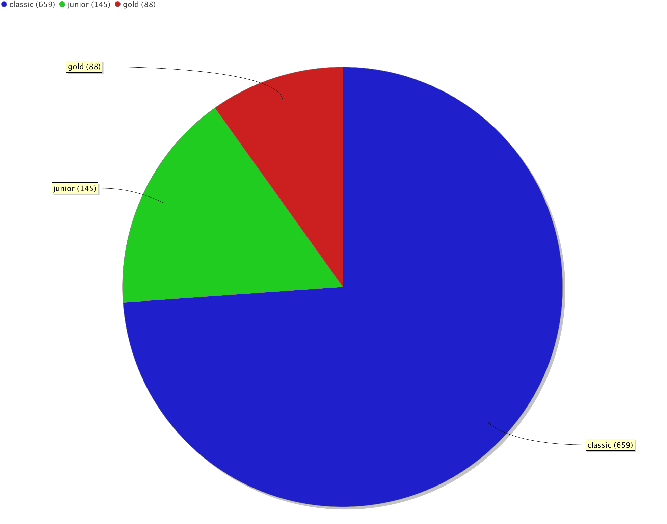
Credit card type distribution

Slide 12
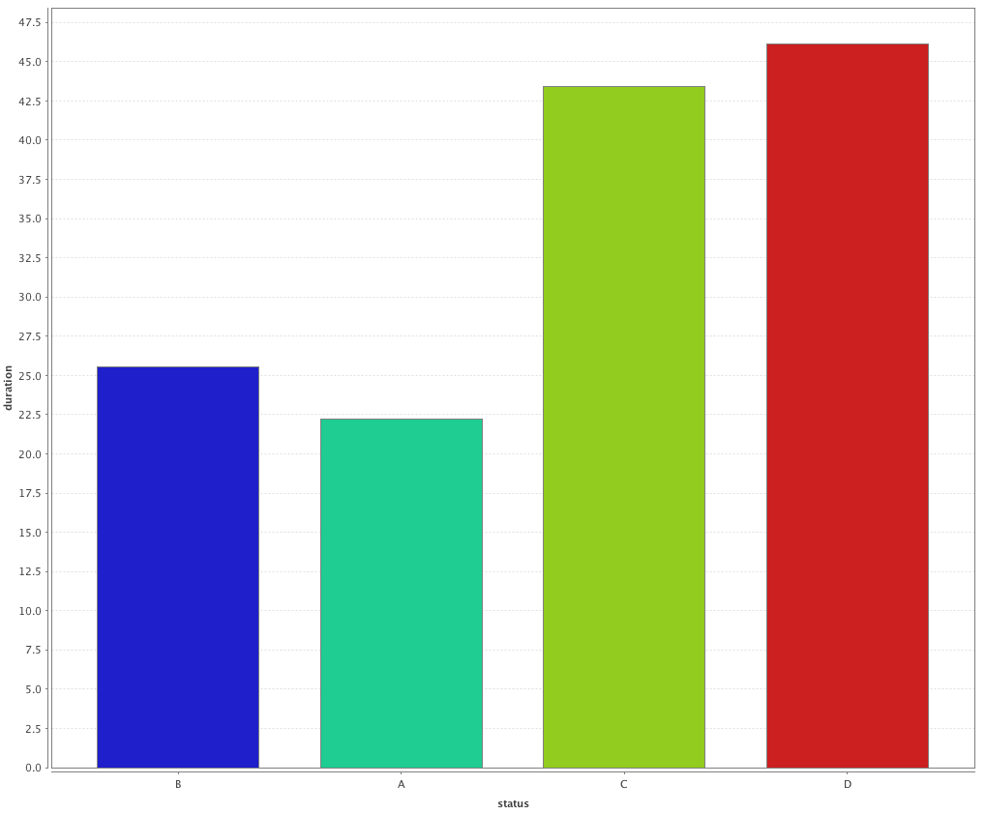
Average loan duration distribution by status

Slide 13
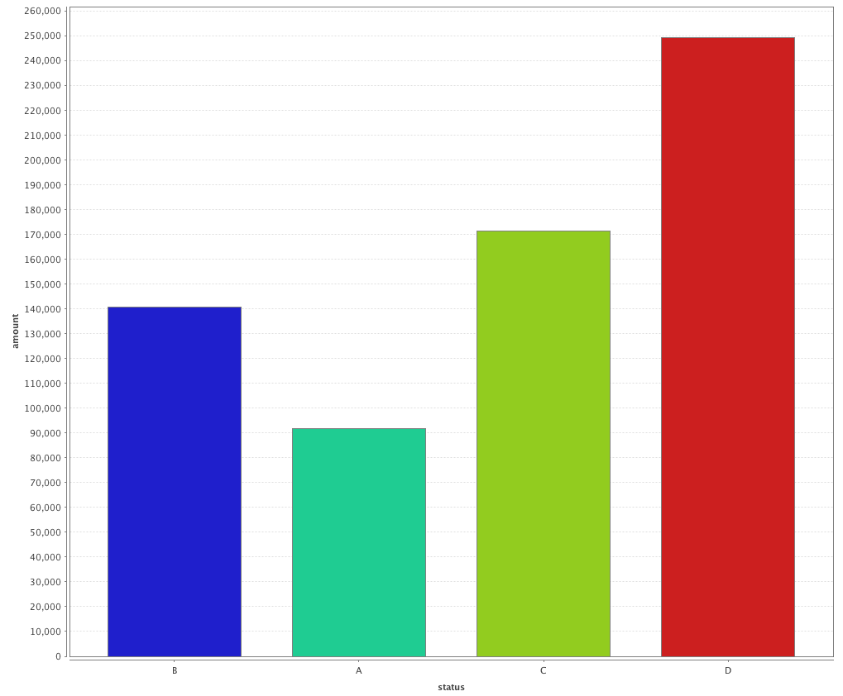
Average loan amount distribution by status

Slide 14
Clustering

Slide 15
Clustering
Attribute | Cluster 1 | Cluster 2 | Cluster 3
Age | 45,60 | 46,25 | 45,41
No. of enterpreneurs per 1000 inhabitants | 160,10 | 112,05 | 115,43
No. of municipalities with inhabitants 2000-9999 | 0,00 | 7,39 | 5,64
No. of municipalities with inhabitants 500-1999 | 0,00 | 23,17 | 26,41
No. of municipalities with inhabitants < 499 | 0,00 | 21,52 | 74,67
No. of municipalities with inhabitants >10000 | 1,00 | 2,24 | 1,42
Ratio of urban inhabitants | 100,00 | 70,42 | 55,75

Slide 16
Predictive Data Analysis

