Slide 1
Banking Data Mining Case Study
Knowledge Extraction and Machine Learning
2015/2016
Ruben Fernando Pinto Cordeiro ei11097@fe.up.pt
Duarte Nuno Pereira Duarte ei11101@fe.up.pt

Slide 2
Outline
Methodology
Understanding the business
Understanding the data
Descriptive data analysis
Predictive data analysis
Conclusions

Slide 3

Methodology

Slide 4
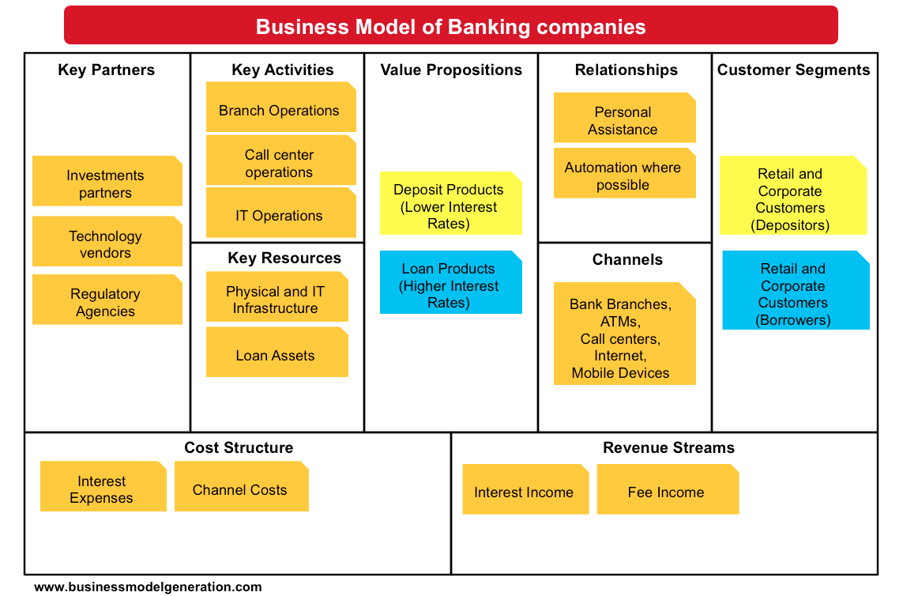
Understanding the business

Slide 5
Understanding the data

Slide 6
Data preparation
Data cleaning
Add labels where missing (district, …);
Extract gender from birth date in the Client relation;
Format dates and numbers;
Data transformation:
Calculate age in the Client relation;
Import raw data into RapidMiner;
Denormalize various relations for the descriptive and predictive analysis algorithms.

Slide 7
Descriptive data analysis

Slide 8
Descriptive data analysis
Segmentation
Primary parameters:
Assets & Liabilities
Geo-demographic data
Profitability
Secondary parameters:
Behavioristic segmentation
Life stage segmentation

Slide 9
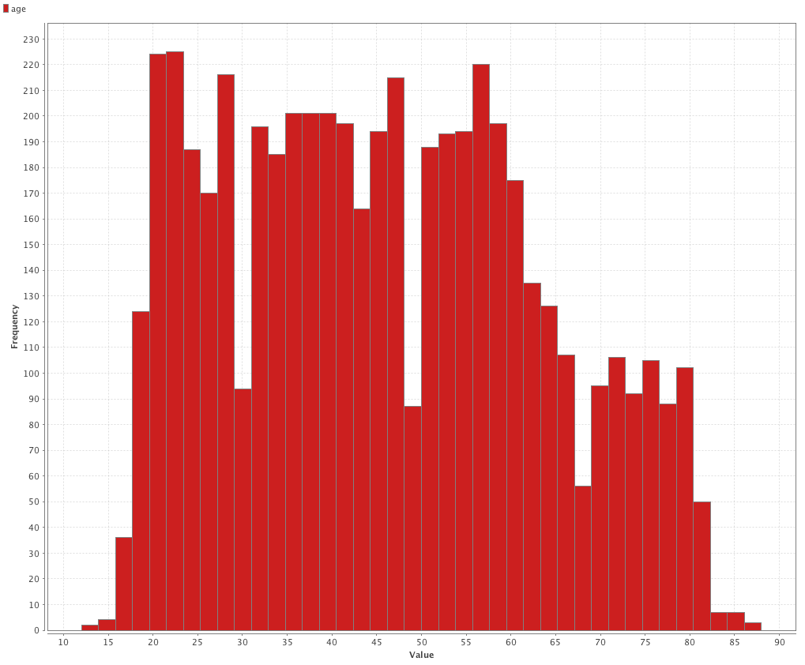
Age distribution

Slide 10
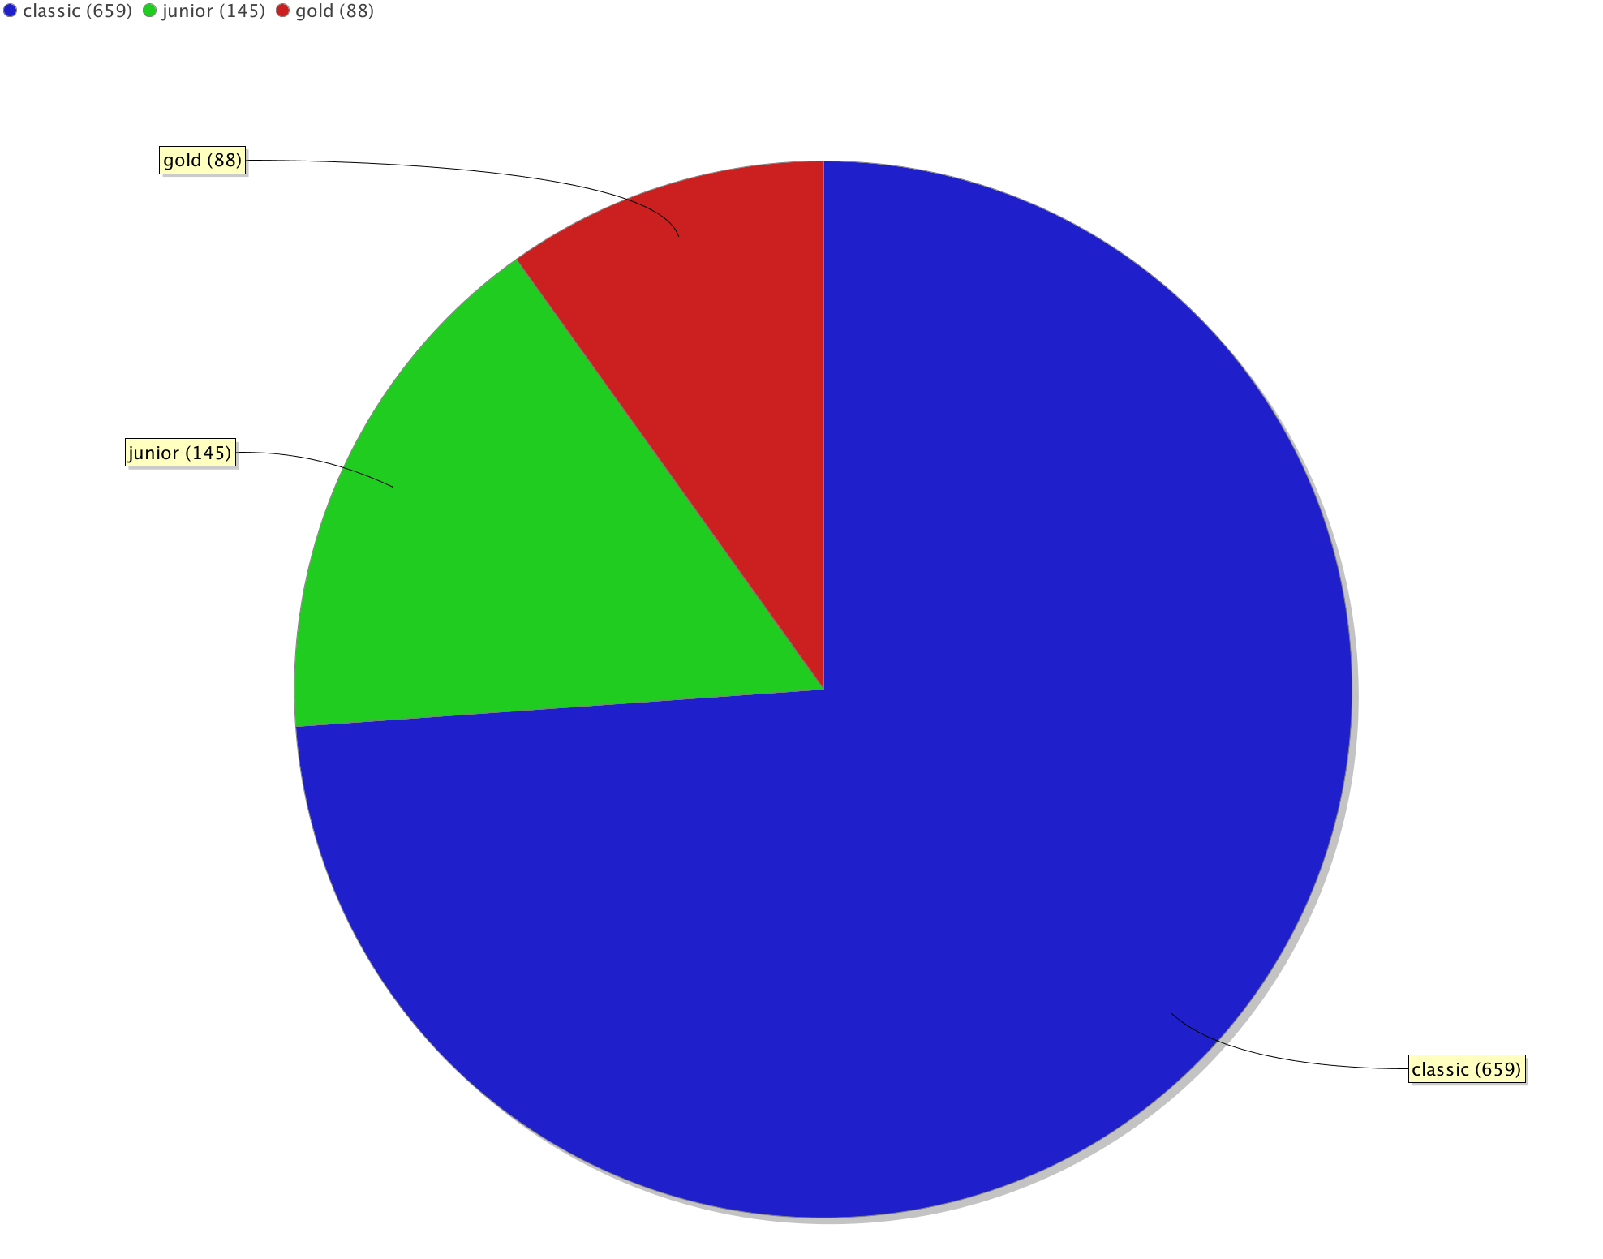
Credit card type distribution

Slide 11
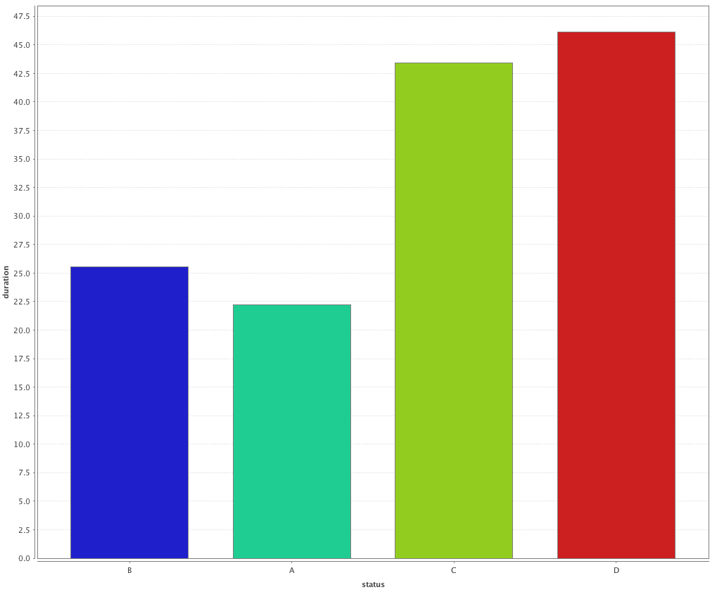
Average loan duration distribution by status

Slide 12
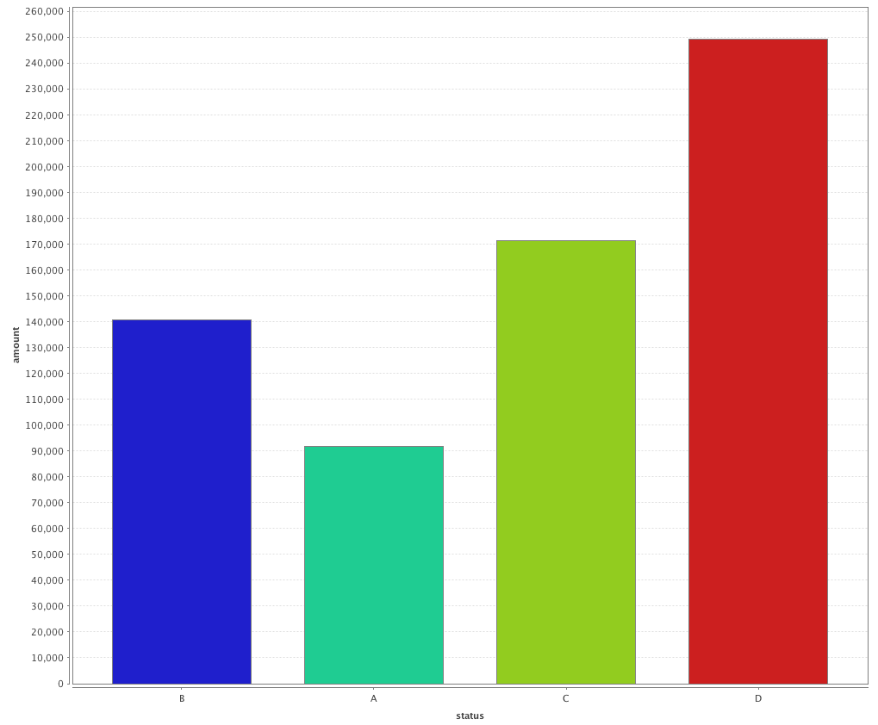
Average loan amount distribution by status

Slide 13
Exploratory data analysis: conclusions
Most of the issued credit cards are classic (649). There are more junior cards (145) than gold cards (88).
Good loans (A, B) tend to be of a lower amount and a shorter duration when compared to bad loans (C, D).

Slide 14
Clustering: Case 1
For the first clustering, the following attributes were pre-computed:
Amount: the total loan amount borrowed by each client;
Duration: the total loan duration by each client;
Payments: the monthly amount of loan payments made by each client;
Average Income: the monthly average income of each client;
Average Withdrawals: the monthly average withdrawals made by each client.

Slide 15
Clustering: Case 1

Slide 16
Clustering: Case 1
With this clustering process, the goal was to segment clients according to their assets and liabilities.
The clients in the Cluster 1 have less purchase power when compared to clients belonging to Cluster 2 and 3.

Slide 17
Clustering: Case 2
Attribute | Cluster 1 | Cluster 2 | Cluster 3
No. of entrepreneurs per 1000 inhabitants | 160,10 | 112,05 | 115,43
No. of municipalities with inhabitants 2000-9999 | 0,00 | 7,39 | 5,64
No. of municipalities with inhabitants 500-1999 | 0,00 | 23,17 | 26,41
No. of municipalities with inhabitants < 499 | 0,00 | 21,52 | 74,67
No. of municipalities with inhabitants >10000 | 1,00 | 2,24 | 1,42
Ratio of urban inhabitants | 100,00 | 70,42 | 55,75

Slide 18
Clustering: Case 2
With this clustering process, the goal was to segment clients according to geo-demographic data.
Clients in Cluster 1 belong to an urban environment with an higher ratio of entrepreneurs.
Clients in Cluster 3 live in a district with the smallest ratio of urban inhabitants.

Slide 19
Predictive Data Analysis

Slide 20
Predictive Data Analysis
The loans dataset is relatively small: 682 loans in total.
The status distribution of the loans is uneven: 606 loans are good, while only 76 loans are bad.
These factors make the prediction of bad loans more difficult, no matter what classification algorithm is used.

Slide 21
Classification algorithms
For the predictive analysis task, two algorithms were used:
Decision trees;
Naïve bayes.

Slide 22
Decision Tree
Given the small dataset, there is a great danger of overfitting the data.
In order to mitigate the risk, the decision tree was pre-pruned, thus reducing the complexity of the final classifier.

Slide 23
Decision Tree
In RapidMiner:
The data was split using the split validation operator: 70% for training and 30% for testing.
The decision tree operator was used:
Criterion: information_gain;
Level of confidence set to 25%;
Applying pruning and prepruning;
Minimal gain set to 4%;
Maximal depth set to 6.

Slide 24
Decision Tree model
The following relations were joined: Client, Account, Loan, Disposition and Transactions.
For this classification, several attributes were pre-computed:
Average(ratio): Average debt-to-income ratio of the client.
Count(sanction_date): Number of sanctions that the client is responsible for. A sanction occurs when the client’s bank account balance reaches negative values.
Amount: the total loan amount borrowed by the client.
Payments: the monthly amount of loan payments made by the client.
Gender: the client’s gender.
VarWD: The monthly average variation of the withdrawals made by the client.

Slide 25
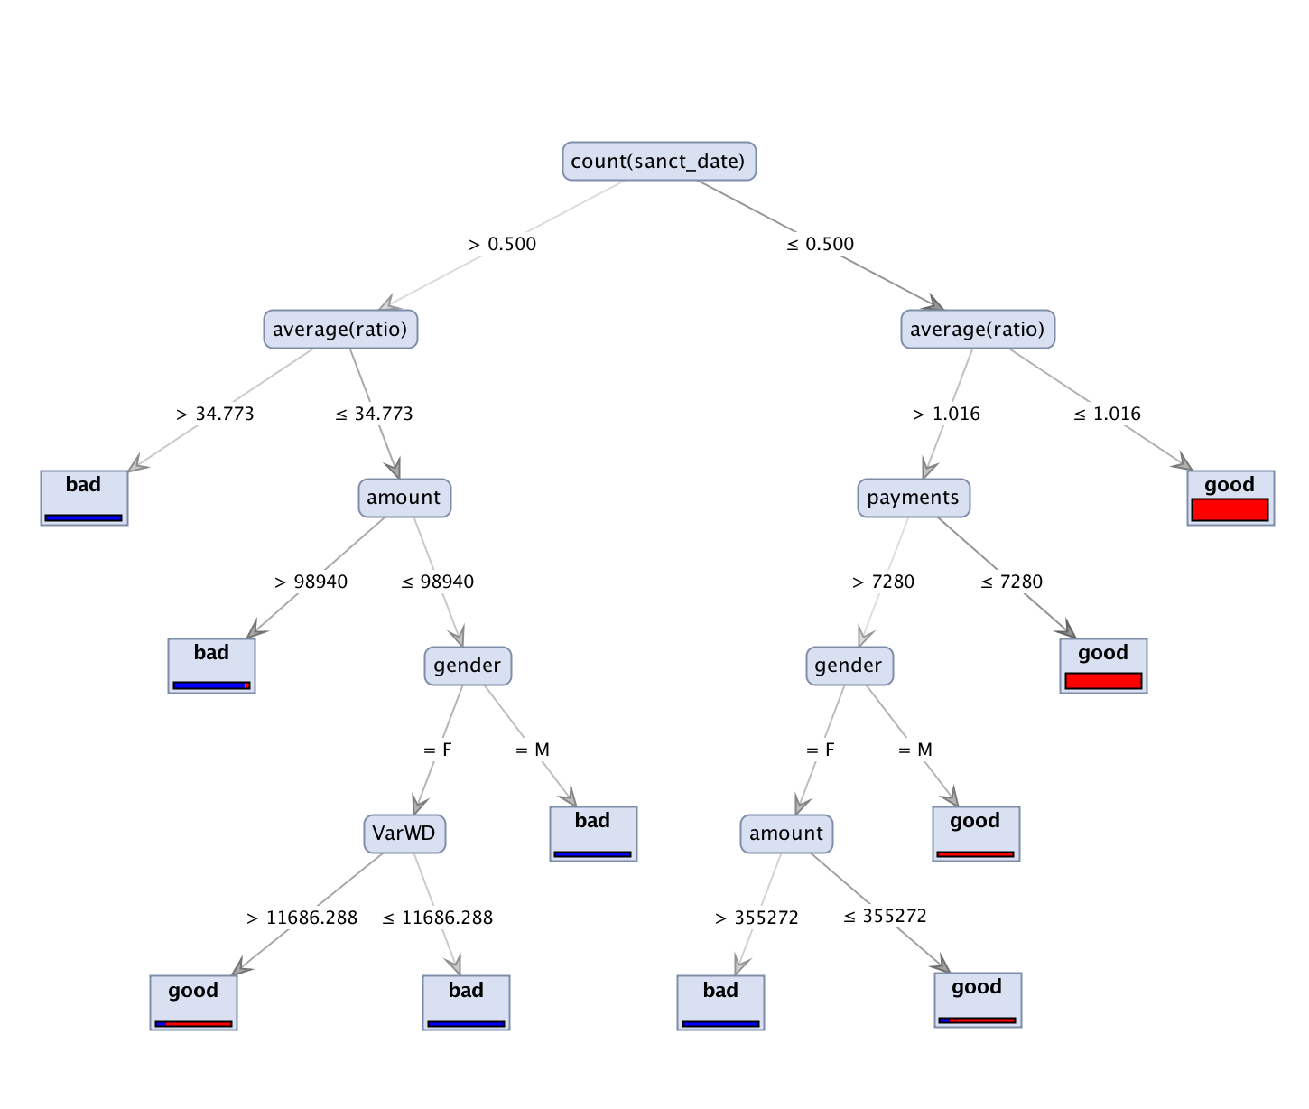
Decision Tree model

Slide 26
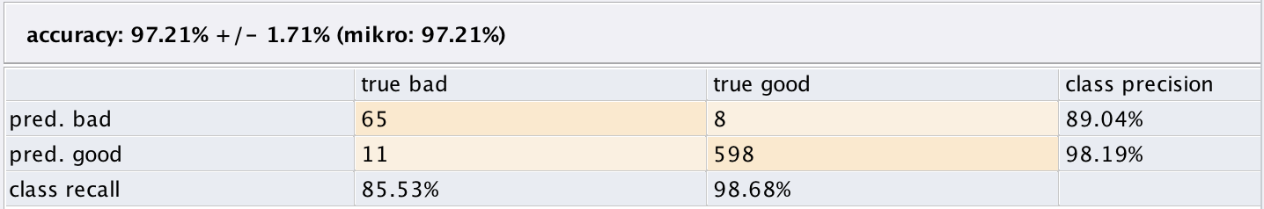
Decision Tree model: evaluation

Slide 27
Naïve Bayes
The following relations were joined: Client, Account, Loan, Disposition and Transactions.
The same pre-computed attributes from the Decision Tree model were used.
In RapidMiner:
The data was split using the split validation operator: 70% for training and 30% for testing.
The Naïve Bayes operator was used:
The laplace correction option was set to true.

Slide 28
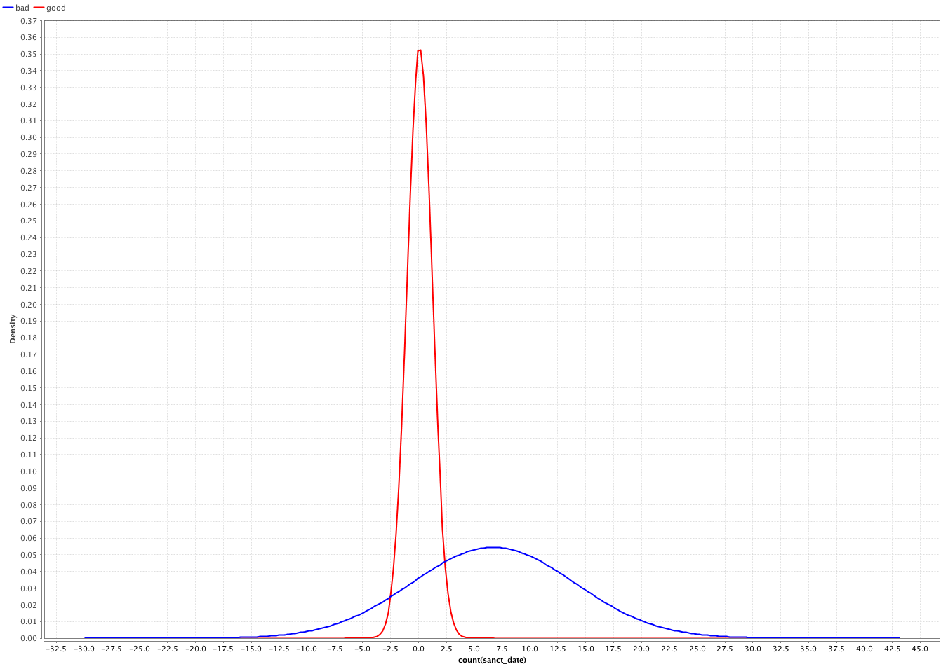
Naïve Bayes model

Slide 29
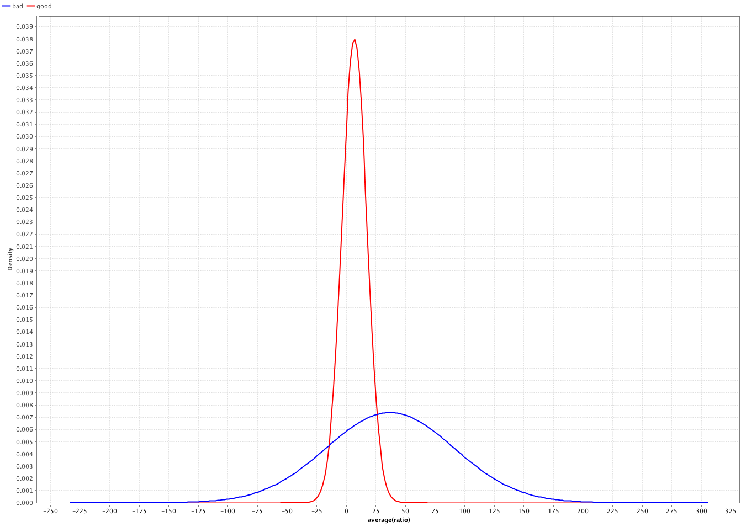
Naïve Bayes model

Slide 30
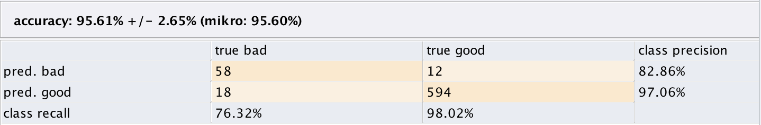
Naïve Bayes model: evaluation

Slide 31
Conclusions and future work
In the context of the descriptive data mining task, clients were segmented according to geo-demographic data and assets and liabilities. Both behavioristic and life stage segmentations were not performed due to lack of data.
In the context of the predictive data mining task, the Decision Tree model has a bigger accuracy when compared to the Naïve Bayes model. However, given the reduced dimension of the dataset, the risk of the overfitting in the Decision Tree model is considerable.

