Slide 1
Framework for Multi-Agent Simulation of User Behaviour in E-Commerce Sites
Final PDIS PResentation
Supervisors
Hugo Sereno Ferreira, FEUP
João Azevedo, ShiftForward
Author
Duarte Duarte

Slide 2
Topics
Context
Objectives
Literature Review
E-commerce Background
Simulation
Probabilistic Models
Methodology & Approach
Work Plan
Annexes

Slide 3
Context
Customers interact with e-commerce websites in different ways
Companies want to optimize success metrics (CTR, CPC, …) for profit
Changing what, how and when content (ads, recommendations, …) is displayed influences customers’ interactions
Summarizing and analysing this behaviour is expensive, hard, tricky, …
Data scientists need to resort to online techniques with a high operational cost
Notes:
A/B testing

Slide 4
Objectives
Design and development of a simulation framework
Given data from website structure and content, usage and user profiles, run a simulation where each entity represents a person interacting with the website
Support extensible models and rules

Slide 5

E-Commerce Background
in shail.me

Slide 6
Customer LifeCycle
E-Commerce Background
Loyalty
Retention
Conversion
Churn
Acquisition
Attrition
Reach
Reactivation
Abandonment
in E-Metrics: Business Metrics for the New Economy

Slide 7
E-Commerce Metrics
E-Commerce Background
Customer Metrics
Recency
Frequency
Monetary Value
Duration
Yield
Promotion Calculations
Acquisition Cost
Cost per Conversion
Net Yield
Connect Rate
Customer Behaviour
Stickiness
Slipperiness
Focus
Velocity
Others
Personalization Index
Life Time Value
Loyalty Value
Freshness Factor
in E-Metrics: Business Metrics for the New Economy

Slide 8

Influencing user Behaviour
E-Commerce Background
in Amazon.com, Nexus 6 product page

Slide 9
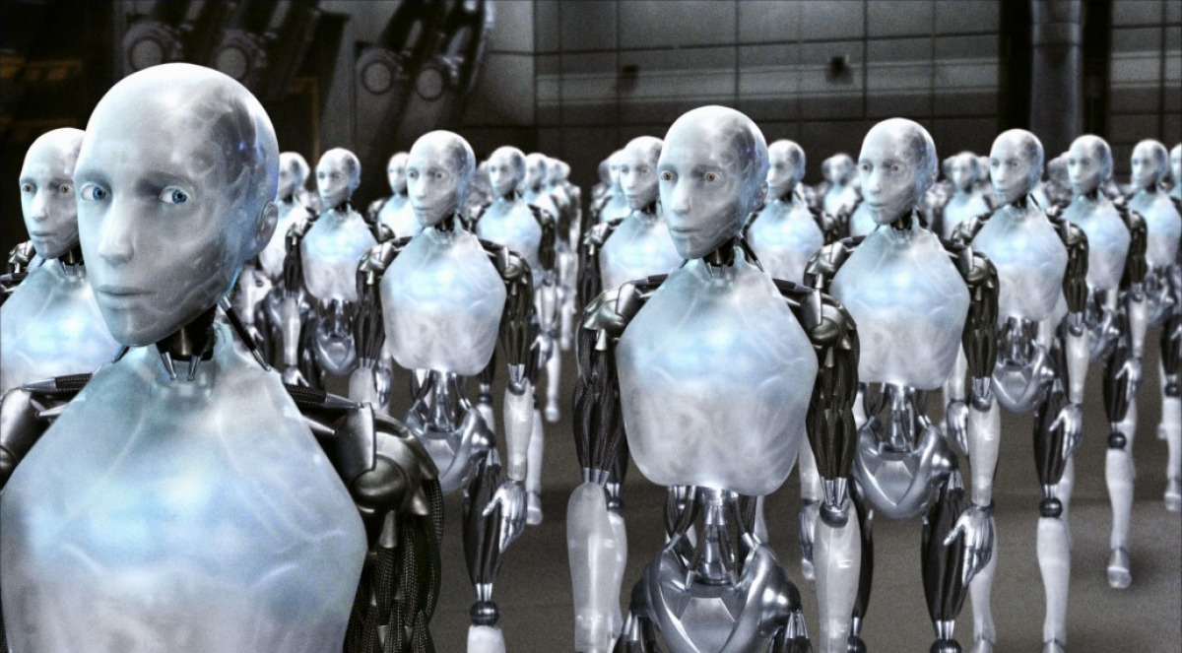
Simulation
Multi-Agent Systems
I, Robot - 20th Century Fox

Slide 10
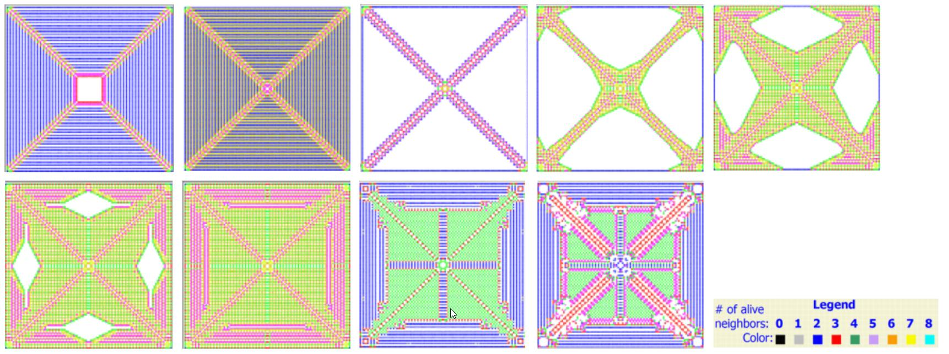
Agent Based Simulation (ABS)
Simulation
Simulating the actions and iteractions of autonomous agents
Individual-based models (IBMs) ← Ecology
Complex Network Modeling Level
Exploratory Agent-based Modeling Level
Descriptive Agent-based Modeling (DREAM)
Virtual Overlay Multiagent system (VOMAS)
[Niazi, M. A. K. (2011). Towards A Novel Unified Framework for Developing Formal , Network and Validated Agent-Based Simulation Models of Complex Adaptive Systems, 275.]
Agents as objects
Emergence
Complexity
Variation patterns of Conway’s Game of Life (Chan et al., 2010)
Notes:
Ecology is the scientific analysis and study of interactions among organisms and their environment.
The Game of Life, also known simply as Life, is a cellular automaton devised by the British mathematician John Horton Conway in 1970.
Complex Network Modeling Level for developing models using interaction data of various system components.
Exploratory Agent-based Modeling Level for developing agent-based models for assessing the feasibility of further research. This can e.g. be useful for developing proof-of-concept models such as for funding applications without requiring an extensive learning curve for the researchers.
Descriptive Agent-based Modeling (DREAM) for developing descriptions of agent-based models by means of using templates and complex network-based models. Building DREAM models allows model comparison across scientific disciplines.
Validated agent-based modeling using Virtual Overlay Multiagent system (VOMAS) for the development of verified and validated models in a formal manner.

Slide 11
System Dynamics (SD)
Simulation
Stocks – basic stores of objects
Flows – movement of objects between stocks
Delays – time between cause and effect
Internal feedback loops
Usually deterministic, macroscopic and continuous
[Maidstone, Robert; 2010; Lancaster Univerisity]
Dynamic Stock and flow diagram
of Adoption model (Sterman, 2001)
Patrhoue, 2009 – software TRUE
Notes:
System dynamics is an approach to understanding the nonlinear behaviour of complex systems over time using stocks and flows, internal feedback loops and time delays

Slide 12
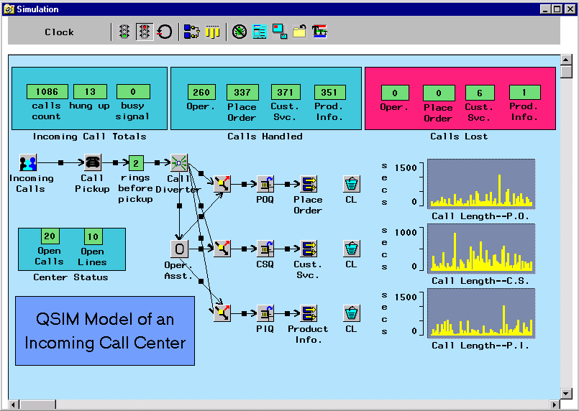
Discrete Event Simulation (DES)
Simulation
Models a sequence of discrete events
Events mark a change of state
Discrete simulation (and time), stochastic and microscopic
Network of queues
Jump to the next chronological event
Execute uncondional events (B type)
Execute conditional events (C type)
[Pidd, 1998]
QSIM Application © SAS Institute Inc.

Slide 13
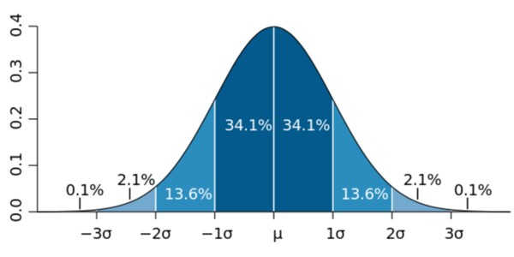
Probabilistic Models
OptionsAnnex.com, 2013; Normal Distribution

Slide 14
Probabilistic Graphical Models
Probabilistic Models
Conditional dependence structure between random variables
Baysian networks
Markov network (Markov random field)
Factor graph
Clique tree
...
A
B
C
D
Example of a graphical model

Slide 15
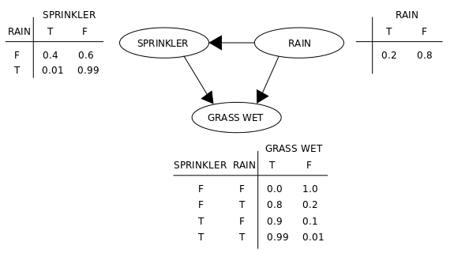

BayESIAN Networks
Probabilistic Models
Directed Acyclic Graph
Random variables with conditional dependencies
Handle incomplete data sets
Combination of domain knowledge and data
[Heckerman, D. (1996). A Tutorial on Learning With Bayesian Networks.
Innovations in Bayesian Networks, 1995(November), 33–82.]
$$P\left(\left.A\right|B\right)=\frac{P\left(\left.B\right|A\right)P\left(A\right)}{P\left(B\right)}$$
Bayes’ Theorem
Example of a baysian network,
AnAj, 2006
Notes:
Domain knowledge -- prior

Slide 16
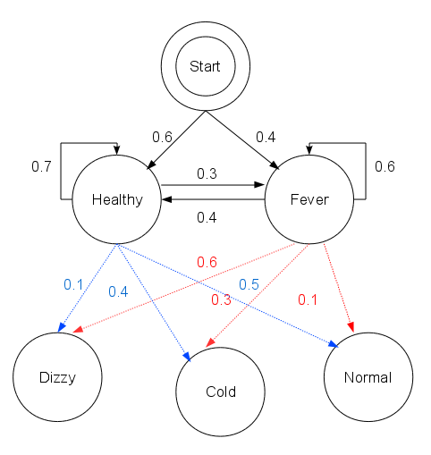
(Hidden) Markov Models
Probabilistic Models
Dynamic Bayesian Networks → model time series
Markov chain → current state independent of previous states (memoryless)
HMMs
Unobserved states
Visible observations
[Rabiner, L. R. (1989). A tutorial on hidden Markov models and selected applications in speech recognition. Proceedings of the IEEE.]
Example of a HMM,
Reelsun, 2012
Notes:
Markov property
states = ('Healthy', 'Fever')
observations = ('normal', 'cold', 'dizzy')
start_probability = {'Healthy': 0.6, 'Fever': 0.4}
transition_probability = { 'Healthy' : {'Healthy': 0.7, 'Fever': 0.3}, 'Fever' : {'Healthy': 0.4, 'Fever': 0.6} }
emission_probability = { 'Healthy' : {'normal': 0.5, 'cold': 0.4, 'dizzy': 0.1}, 'Fever' : {'normal': 0.1, 'cold': 0.3, 'dizzy': 0.6} }

Slide 17
Methodology & Approach
Start with DES with HMM
Observations in HMM → actual interactions of each user (click, buy, leave, ...)
Hidden states → State of mind of the user (likely to buy, not likely, going to leave, ...)
Experiment, analyse and compare multiple models
Testing
Given data from a real website, verify that the simulation is similar to what happened

Slide 18
Work Plan
Done
Literature review regarding e-commerce, simulation and probabilistic models
Initial experiments/prototypes in modelling (e.g implementation of Viterbi algorithm, simple DES)
1 week (15/02 – 19/02)
Dissertation web page
Further initial experiments
4 weeks (19/02 – 17/03)
Basis/foundation of the framework
6 weeks (11/03 – 21/04)
Experimental and iterative scenarios and models
2 weeks (25/04 – 06/05)
Integration with other tools
4 weeks (09/05 – 03/06)
Tests and validation
5 weeks (06/06 - 15/07)
Dissertation writing
Defense and submission

Slide 19
Annexes

Slide 20
Comparison of simulation paradigms
Annexes
System Dynamics (SD) | Discrete-event Simulation (DES) | Agent-based Simulation
System-oriented; focus is on modeling the system observables | Process-oriented; focus is on modeling the system in detail | Individual-oriented; focus is on modeling the entities and interactions between them
Homogenized entities; all entities are assumed have similar features; working with average values | Heterogeneous entities | Heterogeneous entities
No representation of micro-level entities | Micro-level entities are passive ‘objects’ (with no intelligence or decision making capability) that move through a system in a prespecified process | Micro-level entities are active entities (agent) that can make sense the environment, interact with others and make autonomous decisions
Driver for dynamic behavior of system is "feedback loops". | Driver for dynamic behavior of system is "event occurrence". | Driver for dynamic behavior of system is “agents' decisions & interactions".
Mathematical formalization of system is in “Stock and Flow” | Mathematical formalization of system is with “Event, Activity and Process”. | Mathematical formalization of system is by “Agent and Environment”
handling of time is continuous (and discrete) | handling of time is discrete | handling of time is discrete
Experimentation by changing the system structure | Experimentation by changing the process structure | Experimentation by changing the agent rules (internal/interaction rules) and system structure
System structure is fixed | The process is fixed | The system structure is not fixed
Behzad Behdani. 2012. Evaluation of paradigms for modeling supply chains as complex socio-technical systems

Slide 21
Markov Models
Annexes
 | System state is fully observable | System state is partially observable
System is autonomous | Markov chain | Hidden Markov model
System is controlled | Markov decision process | Partially observable Markov decision process

