Slide 1
Framework for Multi-Agent Simulation OF User Behaviour in E-commerce Sites
DISSERTATION Presentation
Supervisors
Hugo Sereno Ferreira, Phd, FEUP
João Azevedo, MSc, ShiftForward
Author
Duarte Duarte, FEUP
13/06/2016

Slide 2
Context & Motivation
Customers interact with e-commerce websites in different ways
Companies want to optimize success metrics for profit
Changing what, how and when content is displayed influences customers’ actions
Summarizing and analysing this behaviour is expensive, hard, tricky, …
Data scientists need to resort to online techniques with a high operational cost

Slide 3
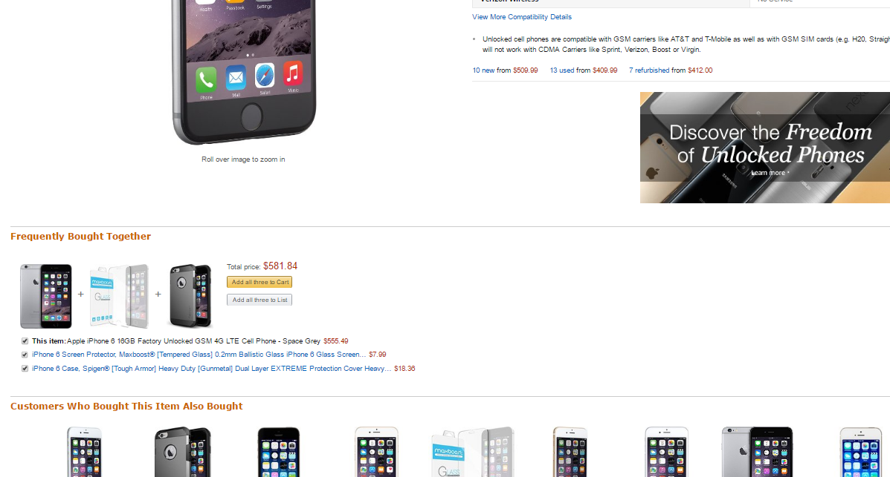
Source: Amazon.com iPhone 6

Slide 4

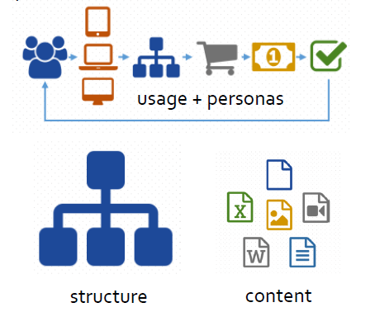


Objectives
Design and develop a simulation framework
Given data from website structure and content, usage and user profiles, run a simulation where each entity represents a person interacting with the website
input
multi-agent simulation
reporting of e-commerce metrics

Slide 5
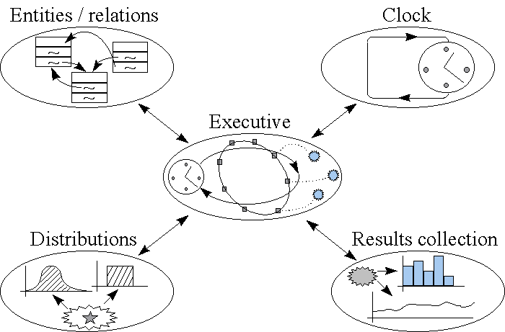
Implementation – Simulation Engine
Discrete Event Simulation – DES
State changes at precise points in time
Kreutzer, 1986

Slide 6
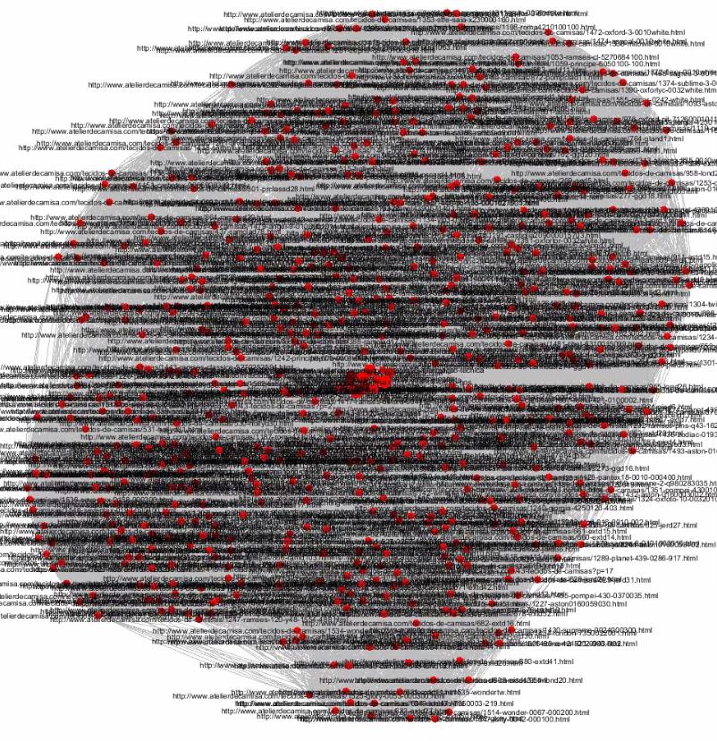
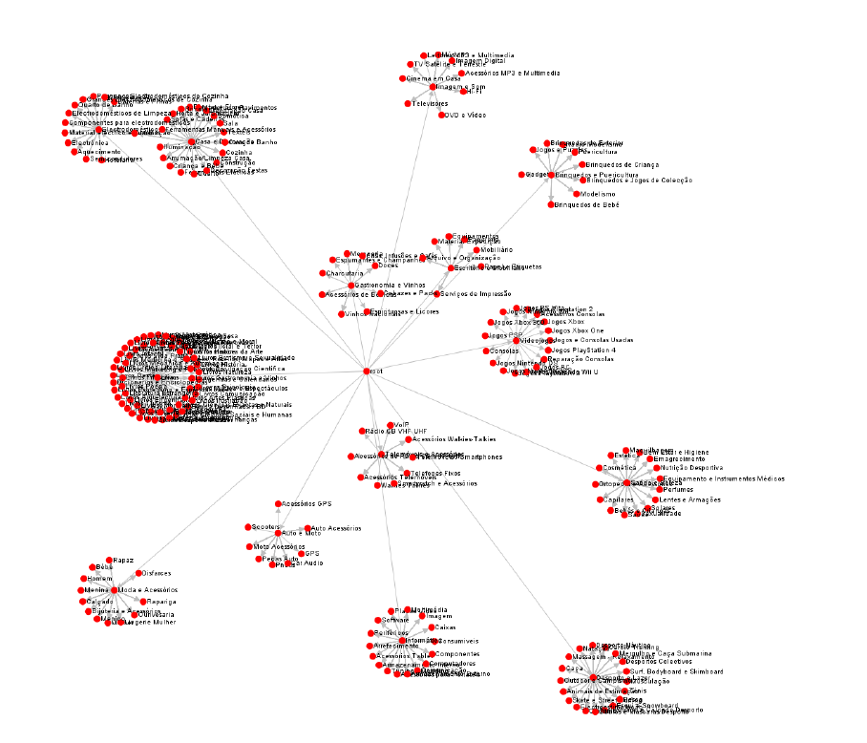
Implementation - Website
Collection of webpages
Each page has:
Type
Tags (categories, …)
Outbound links

Slide 7
Implementation - Agents
Navigation agents
Website agents
Represent users interacting with the website
Emit actions:
Browse
Buy
Add to cart
Checkout
…
Modify pages
Receive navigation agents activity

Slide 8
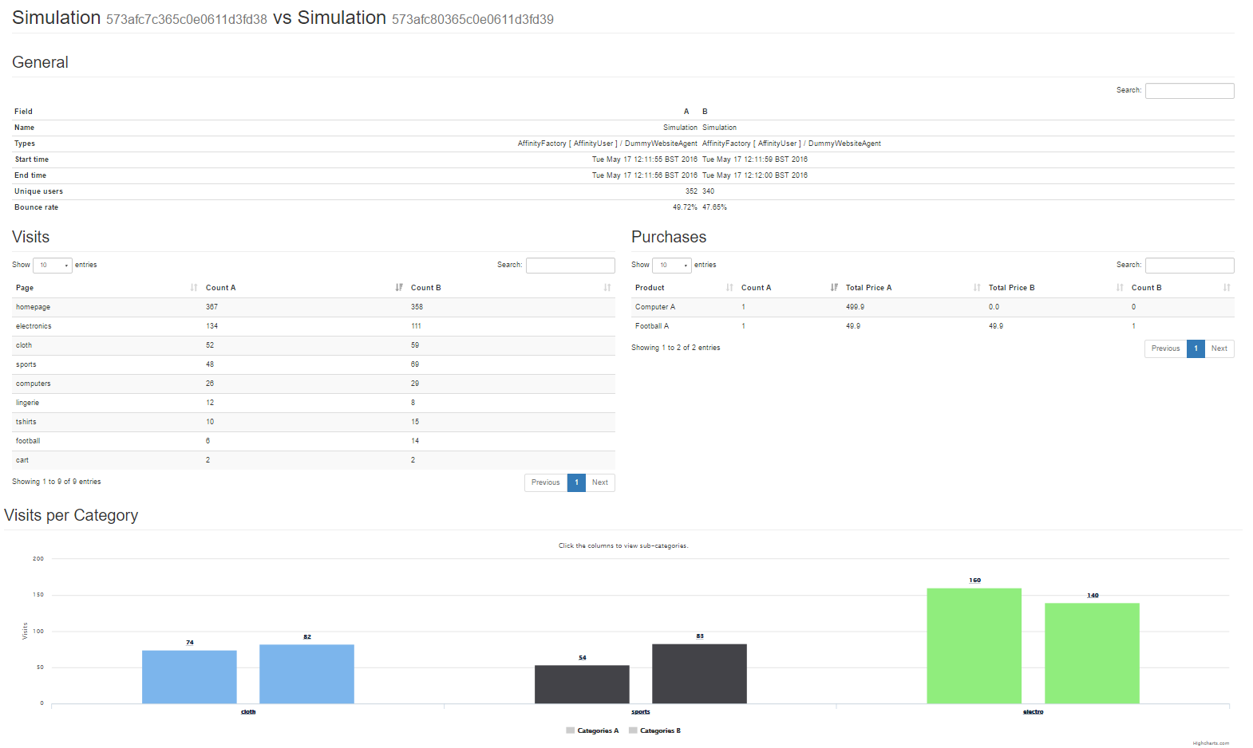
Implementation - Reporting
Analyse results, metrics, statistics
Compare two simulation runs side by side
Metrics:
Bounce rate
Conversion rate
Visits per page
Purchases per product
…

Slide 9
Validation
Fabricated test cases with clear expected results
Real data from actual online stores
How to validate the framework/simulator itself and not the implementation of the agents?

Slide 10
Conclusions
Implementation of the framework capable of running simulation in the presented context
Open source, available at https://github.com/DDuarte/Manchester
Appealing to both academic community and the industry:
Validate and test recommendation engines/algorithms
Run what if scenarios
A/B testing

Slide 11
Future work
Parallel simulator
More metrics and actions
Metrics for website agents
Visual aspects
Submission to the 15th International Conference on Pratical Applications of Agents and Multi-Agent Systems (PAAMS 17 @ Porto)

Slide 12
Thank You
input
multi-agent simulation
reporting of e-commerce metrics

