Slide 1

Great city.
Greater events.
Stay connected.

Slide 2
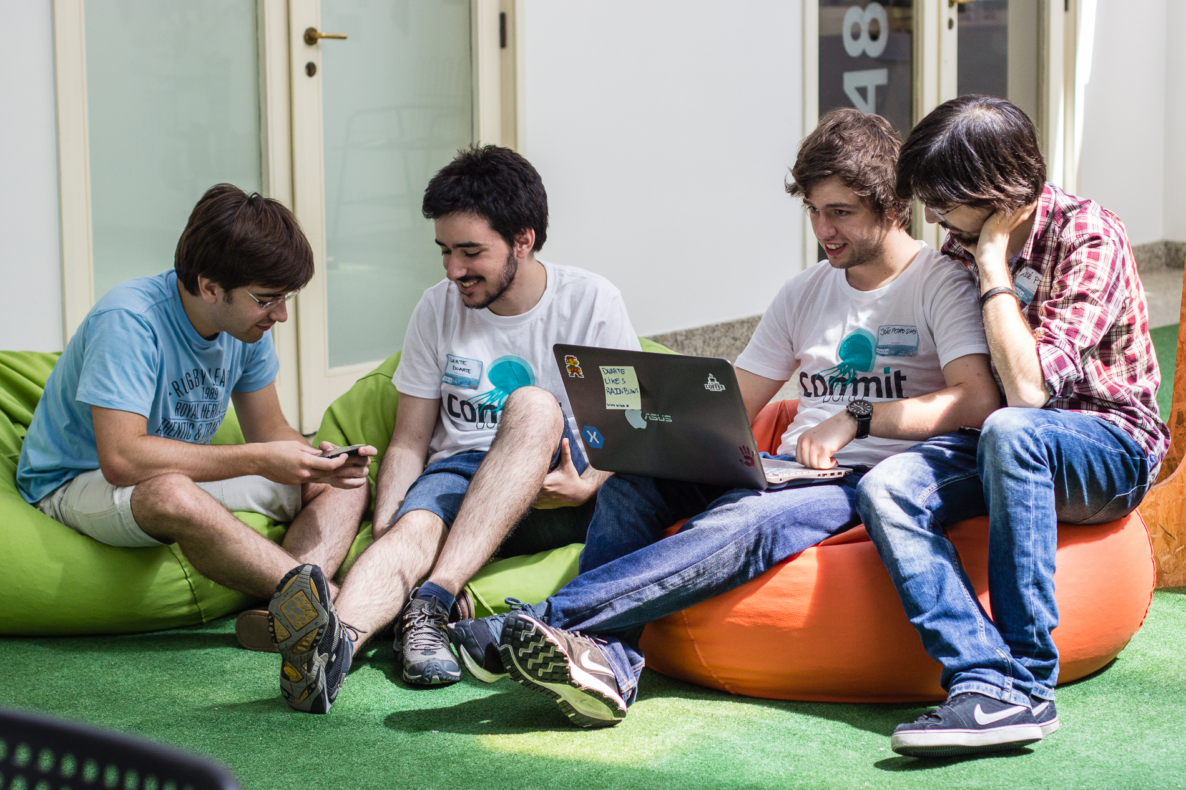
We Are CodeWalkers™
powered by #nosleep

Slide 3
Why?
the bigger the event

Slide 4
Why?
the greater the number of people

Slide 5
Why?
and the greater the mess

Slide 6

A real scenario

Slide 7


How?

Slide 8
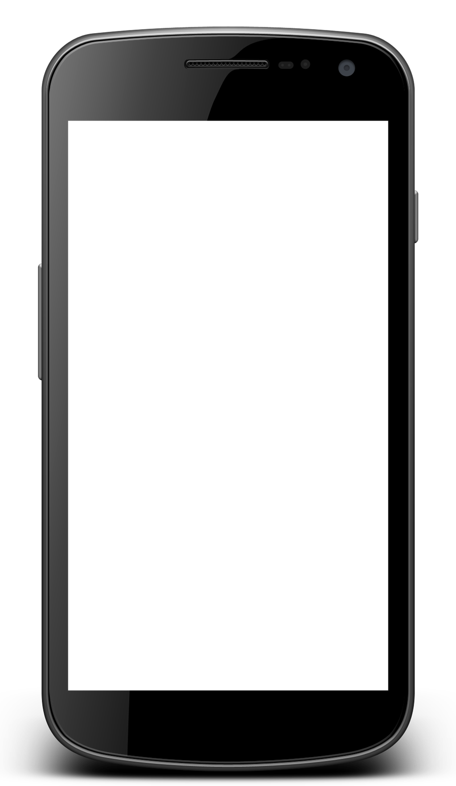
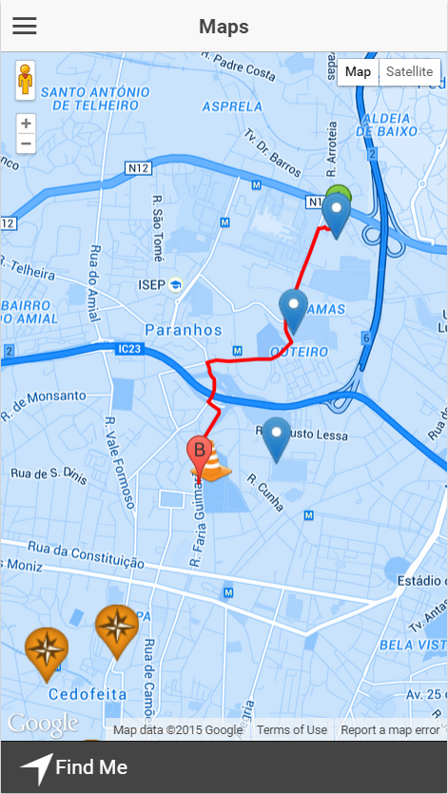
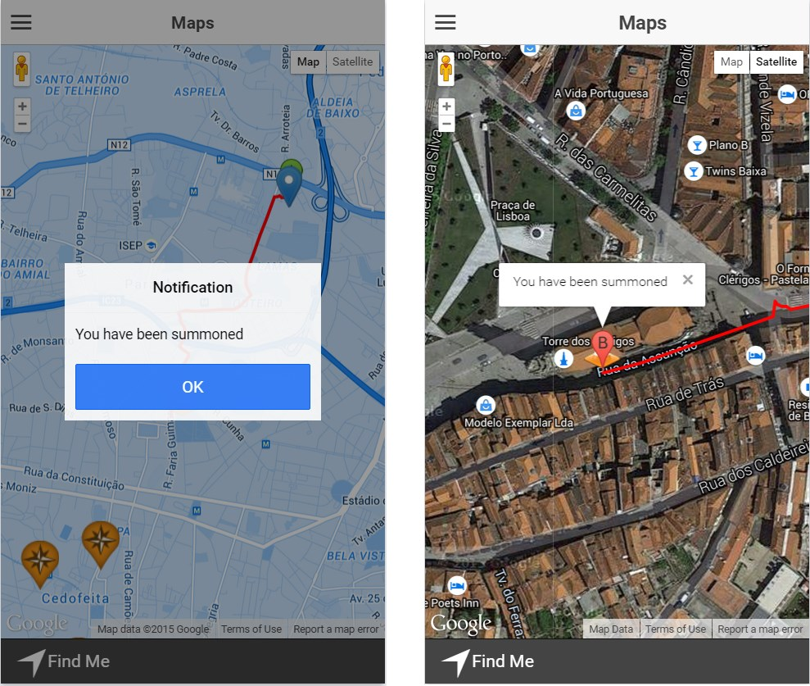
What?

Slide 9
Demonstration
Riley's Rule of Software Demonstrations
The probability of failure of a software demonstration is directly proportional to the product of the number of people attending and the importance of the demo.

Slide 10

Obrigado!
Q & A
github.com/jpdias
github.com/dduarte
github.com/jppinto
github.com/pedro93

