Slide 1
P-FUNDS System Architecture
Frontend, Backend, and Database Communication Flow

Slide 2
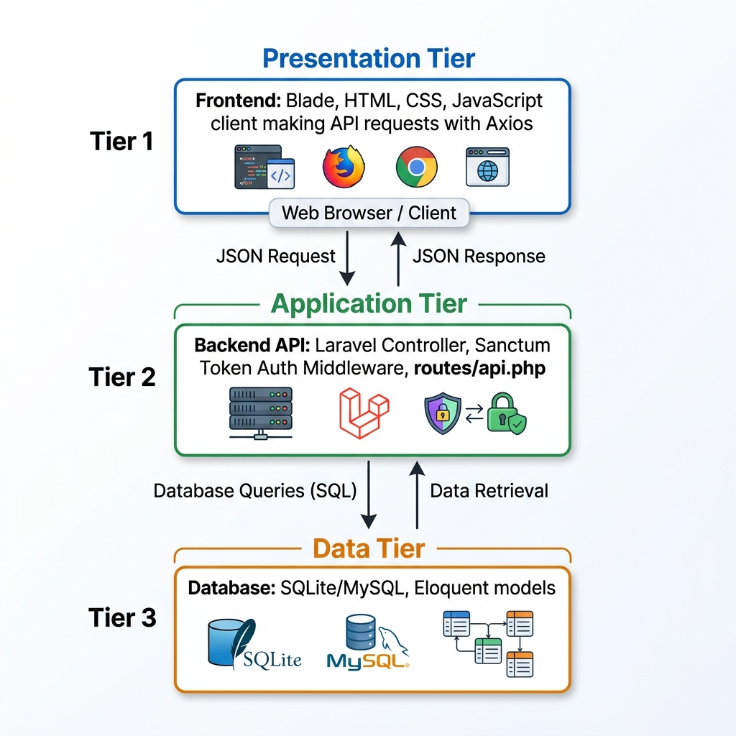
System Communication Flow

Slide 3
🛡️ Frontend Layer (Presentation)
• Visual Layout: HTML layouts rendered dynamically using Laravel Blade templates.
• API Requests: Async calls made using Axios client (configured in api.js) to fetch statistics and manage user sessions.
• Interactive UI Handlers: Real-time chat features are managed via chat.js and incoming notifications via notifications.js.
• Auth Persistence: Login token (pfunds_token) and user role details are cached in browser localStorage.

Slide 4
⚙️ Backend Layer (Application)
• Routing Pipeline: Requests are matched to specific controllers via web.php and api.php routes.
• Sanctum Auth: Intercepts requests, validates Bearer tokens, and maps them to authenticated user sessions.
• Access Control: Custom role validation middleware checks permissions (Creator, Admin, Sponsor, Vetter) before execution.
• Business Logic: V1 Controllers (e.g. AdminProjectController) handle account creation, milestone validation, and file uploads.

Slide 5
🗄️ Database Layer (Storage)
• Eloquent ORM: Translates SQL queries into rich PHP objects, located under the Models directory.
• Storage Engine: SQLite database (default for development) storing user roles, milestones, and audit trails.
• Core Datasets: Stores user records, project configurations, document attachments, deliverables, and chat logs.

