Slide 1

Credit Scoring Model
Exploratory Data Analysis
D.E

Slide 2
📋 Agenda
1. Executive Summary & Key Findings
2. Data Overview & Quality Assessment
3. Univariate Analysis - Feature Distributions
4. Bivariate Analysis - Feature vs Target
5. Multivariate Analysis - Feature Interactions
6. Conclusions & Recommendations

Slide 3
1
Executive Summary

Slide 4
🎯 Key Findings
1
Dataset contains 150,000 borrower records with 11 features
2
Missing values successfully imputed using median and mode method (19.82% in MonthlyIncome)
3
Delinquency history is the strongest predictor of default risk
4
High credit utilization (>80%) significantly increases default probability
5
Age shows U-shaped relationship with default risk

Slide 5
📊 Dataset Overview
Total Records: 150,000 borrowers
Total Features: 11 (10 numerical, 1 target)
Target Variable: SeriousDlqin2yrs (Binary: Default/No Default)
Time Period: 2-year observation window
Data Quality: Missing values in 2 features (handled via imputation)
Feature Categories: Demographics, Financial Metrics, Credit History

Slide 6
2
Data Quality Assessment

Slide 7
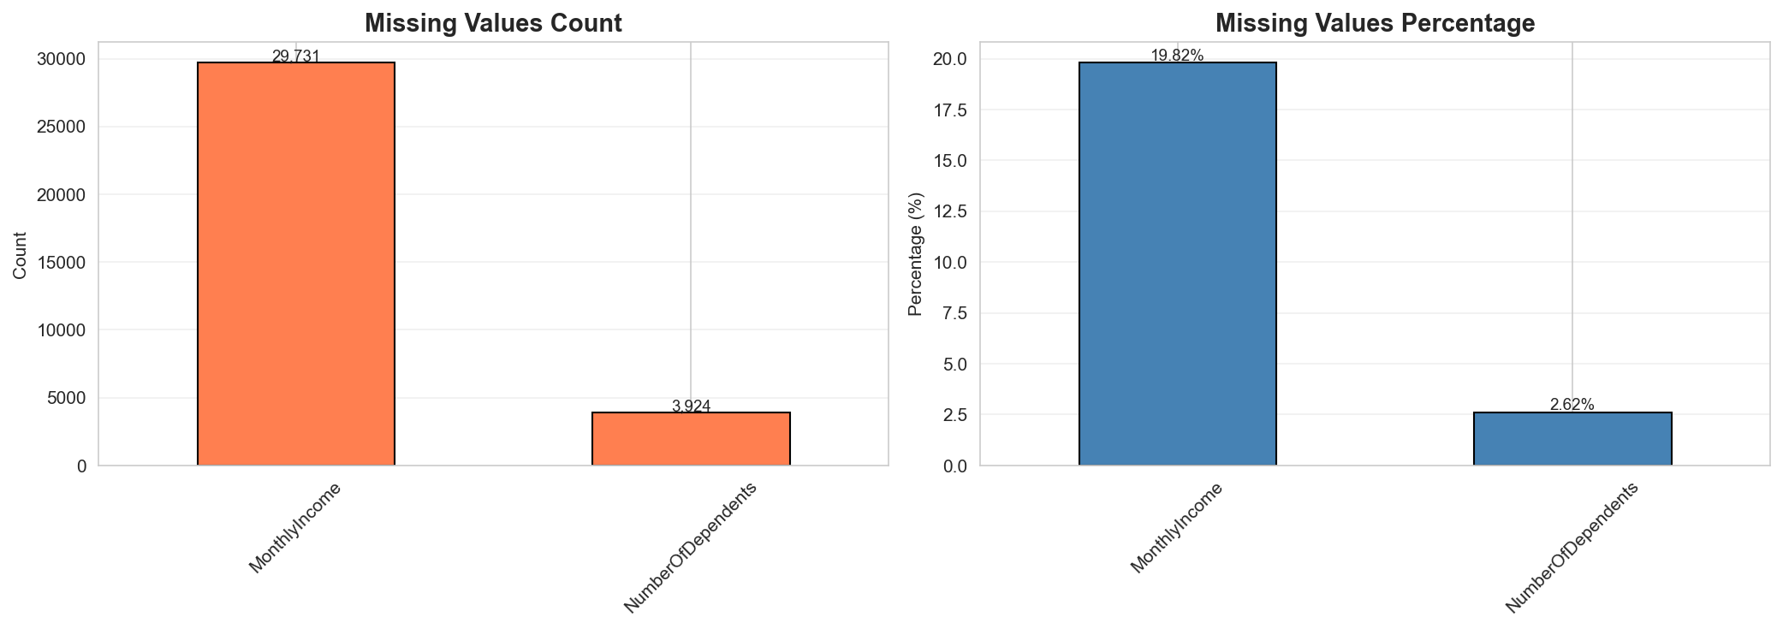
🔍 Missing Values Analysis

Slide 8
💡 Missing Values - Key Insights
MonthlyIncome: 29,731 missing (19.82%)
→ Critical financial indicator requiring imputation
→ Median imputation applied to preserve distribution
NumberOfDependents: 3,924 missing (2.62%)
→ Lower impact on overall data quality
→ Mode imputation maintains demographic patterns
✅ All missing values successfully handled
✅ Zero missing values in cleaned dataset

Slide 9
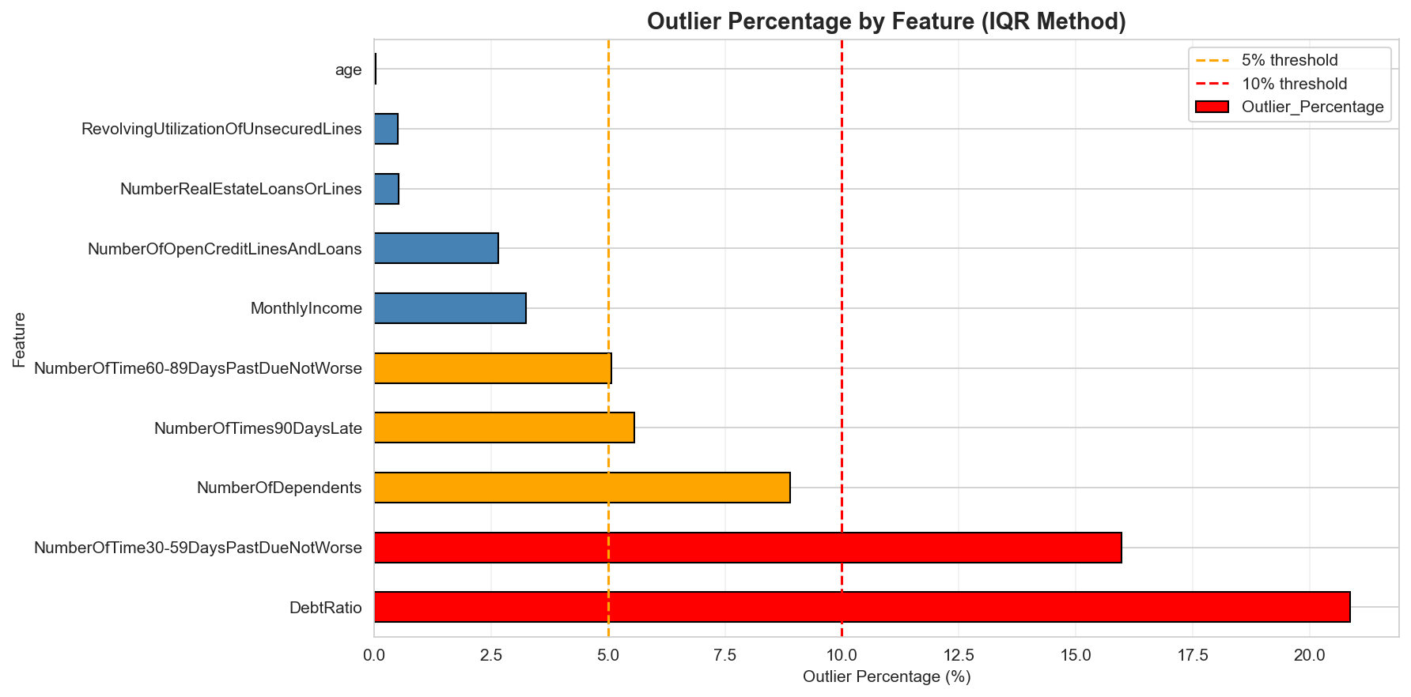
📈 Outlier Detection (IQR Method)

Slide 10
3
Univariate Analysis

Slide 11
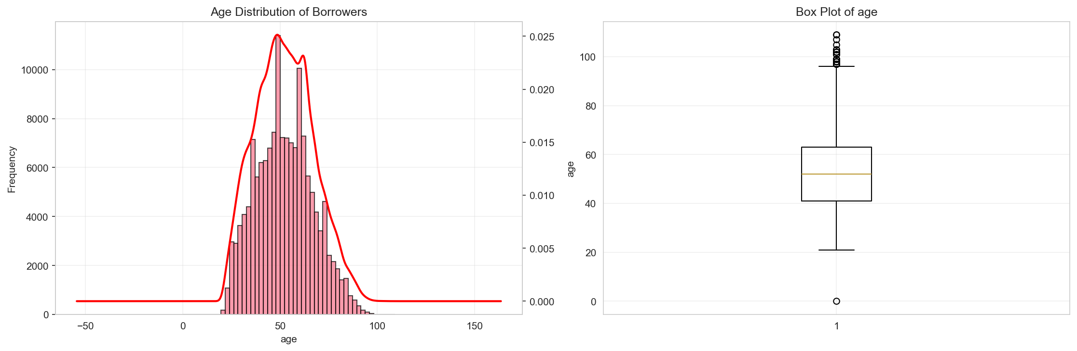
👥 Age Distribution
Peak age range: 45-50 years
Approximately normal distribution
Slight right skew observed
Mature borrower base
Range: 18-109 years

Slide 12
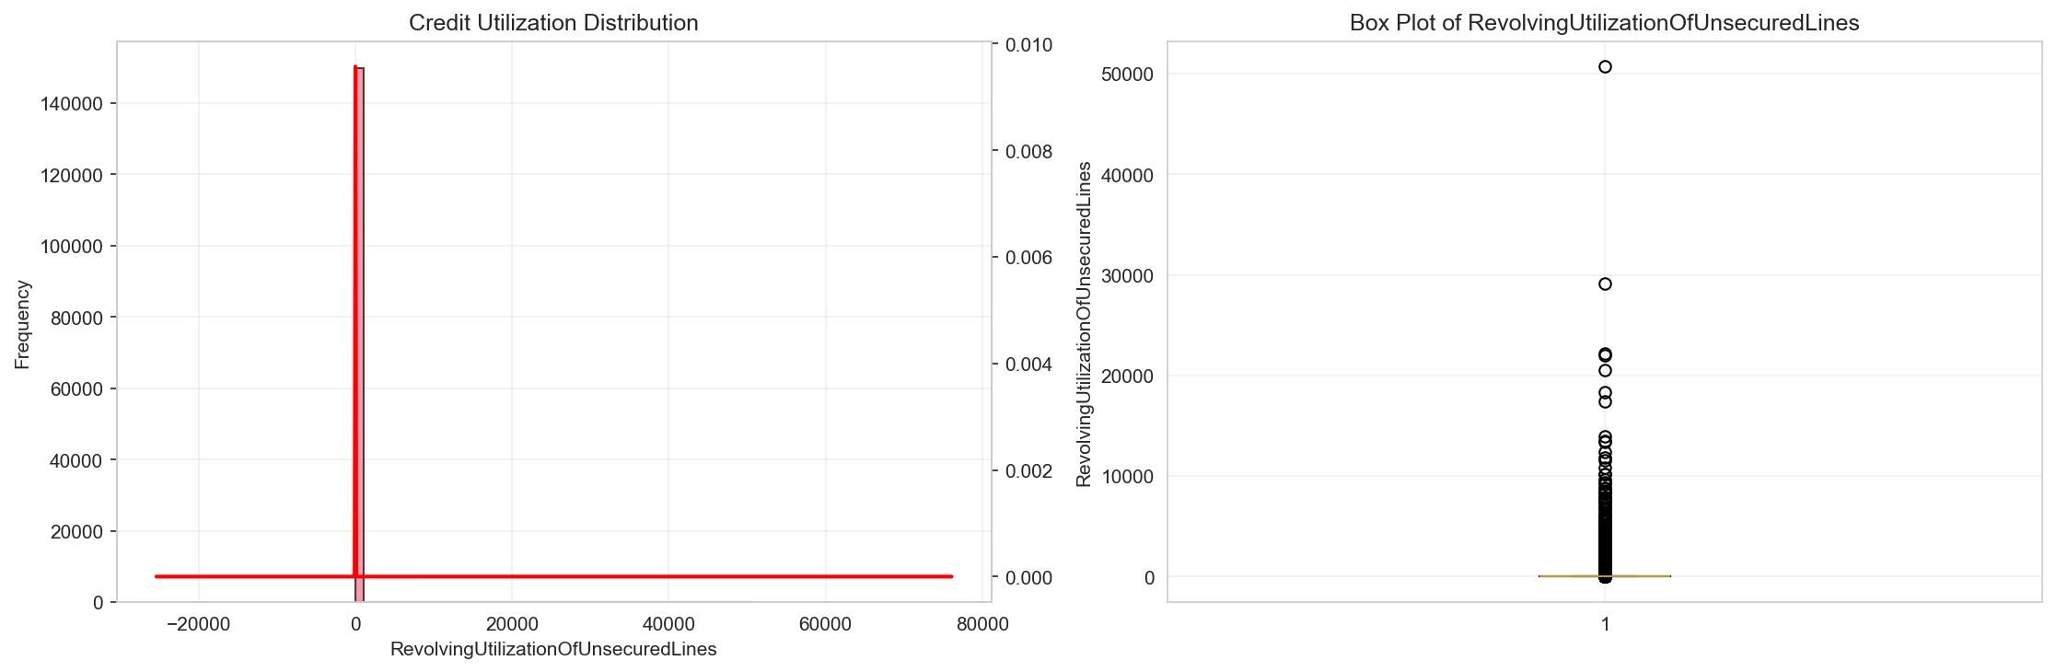
💳 Credit Utilization Distribution
Highly right-skewed distribution
Most borrowers: <50% utilization
Significant portion: >100% utilization
Indicates over-leveraging risk
Key predictor of default

Slide 13
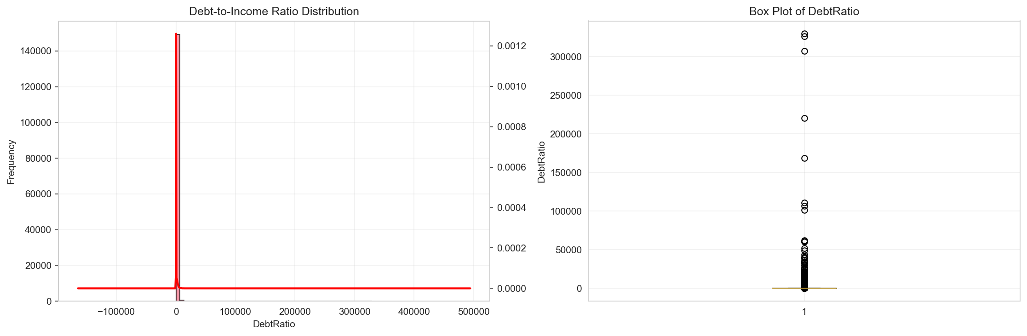
💰 Debt Ratio Distribution
Long-tail distribution
Most borrowers: manageable ratios
Extreme outliers present
High ratios = financial stress
Critical risk indicator

Slide 14
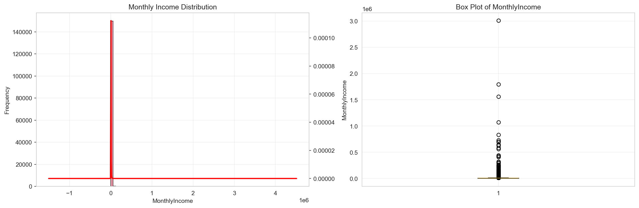
💵 Monthly Income Distribution
Right-skewed distribution
Median: $3,000-$10,000/month
High-income outliers present
Diverse borrower base
Income spans multiple brackets

Slide 15
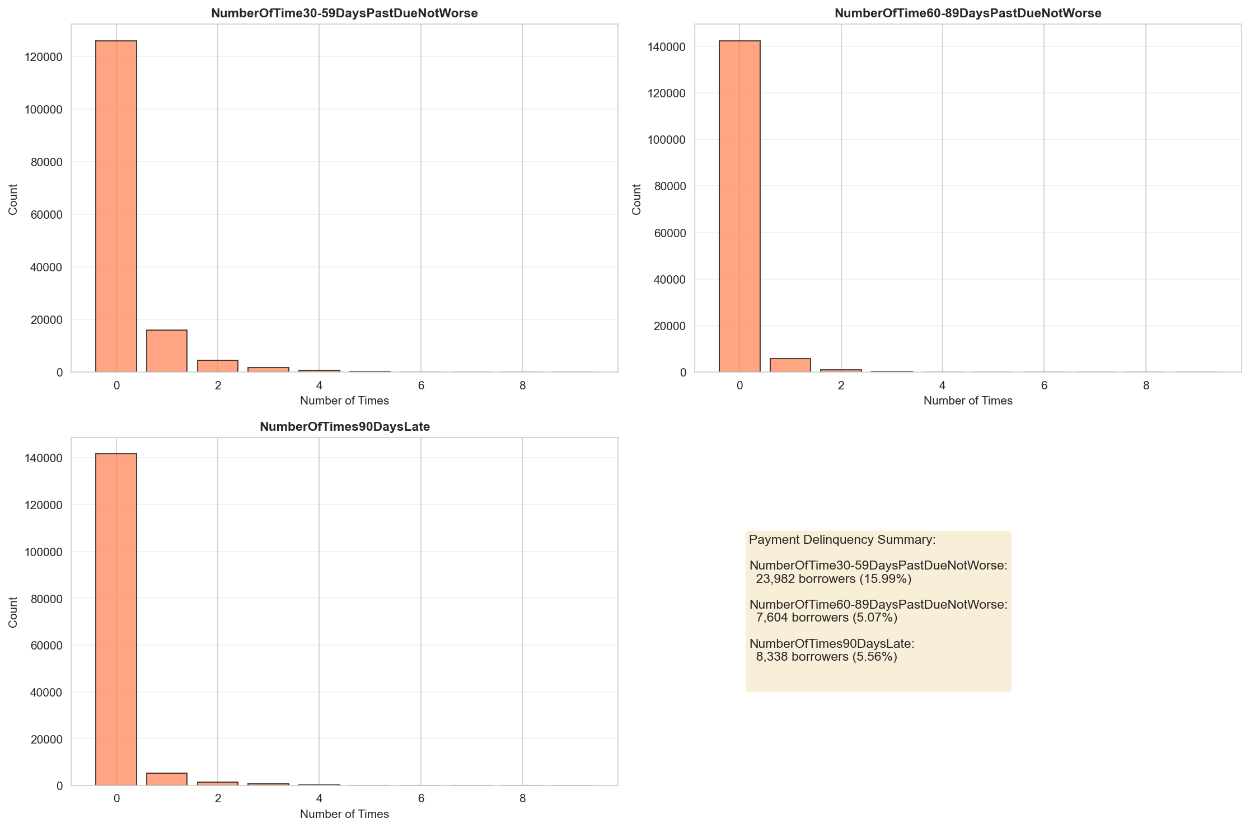
⚠️ Delinquency Patterns

Slide 16
4
Bivariate Analysis

Slide 17
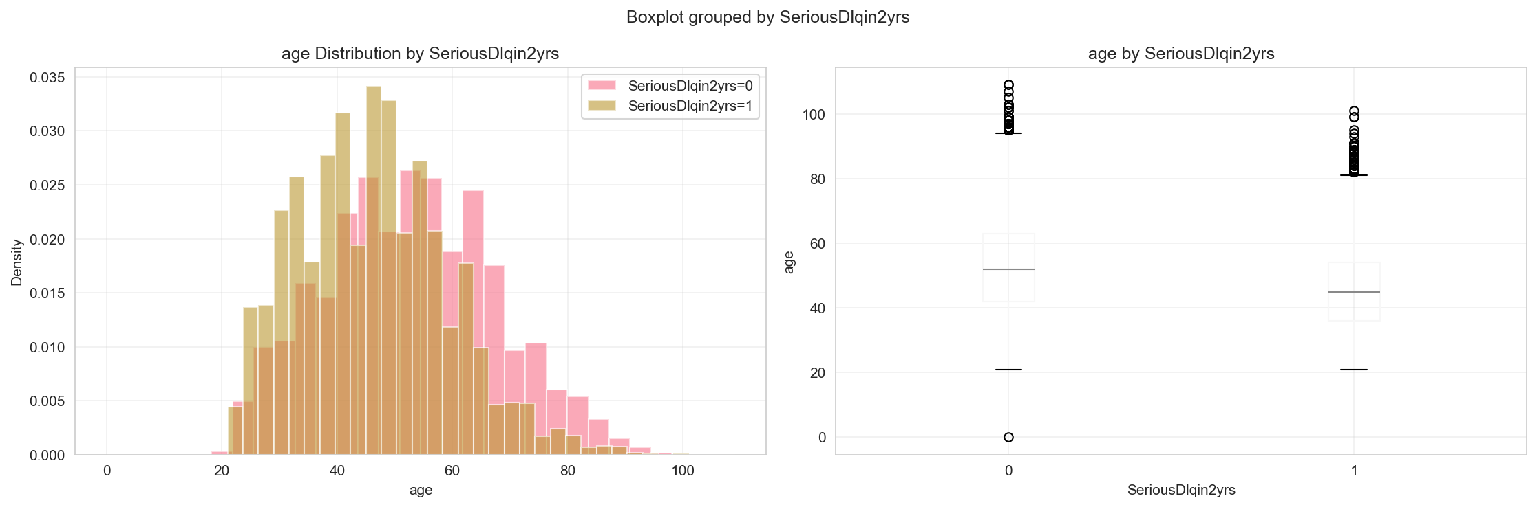
👥 Age vs Default Risk
U-shaped relationship observed
Younger borrowers (<30): Higher risk
Middle-aged (40-60): Lowest risk
Older borrowers (>70): Elevated risk
Financial stability peaks mid-career

Slide 18
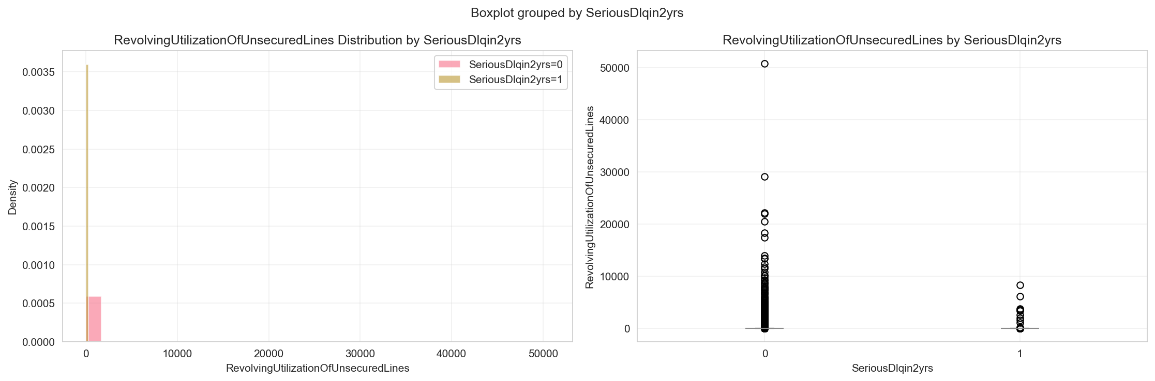
💳 Credit Utilization vs Default Risk
Strong positive correlation
Utilization >80%: High default rates
Clear threshold effect
Over-leveraging = distress signal
Top predictor of default

Slide 19
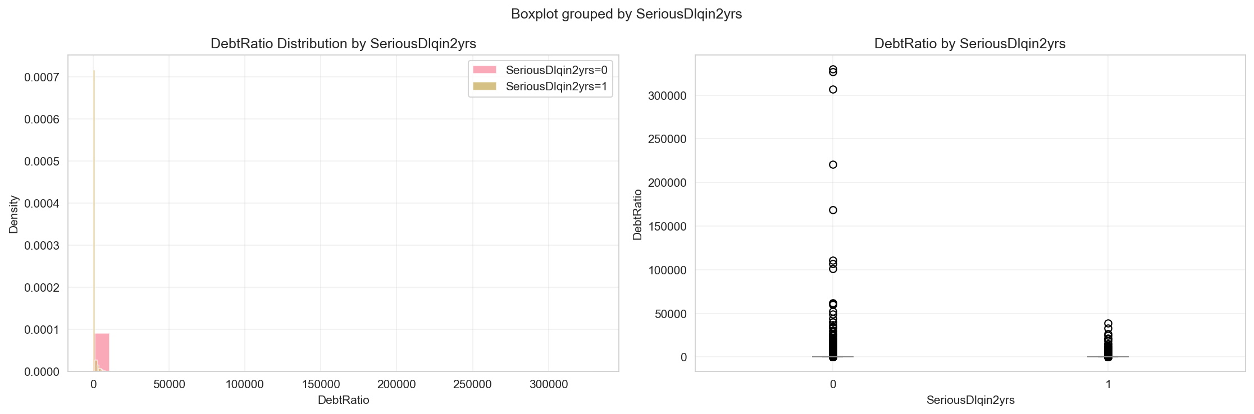
💰 Debt Ratio vs Default Risk
Clear positive relationship
Ratio >0.5: Markedly higher default
Debt burden = critical risk factor
Linear relationship observed
Strong predictive power

Slide 20

💵 Monthly Income vs Default Risk
Inverse relationship
Lower income: Higher default rates
Higher income: Better repayment
Income = protective factor
Socioeconomic indicator

Slide 21
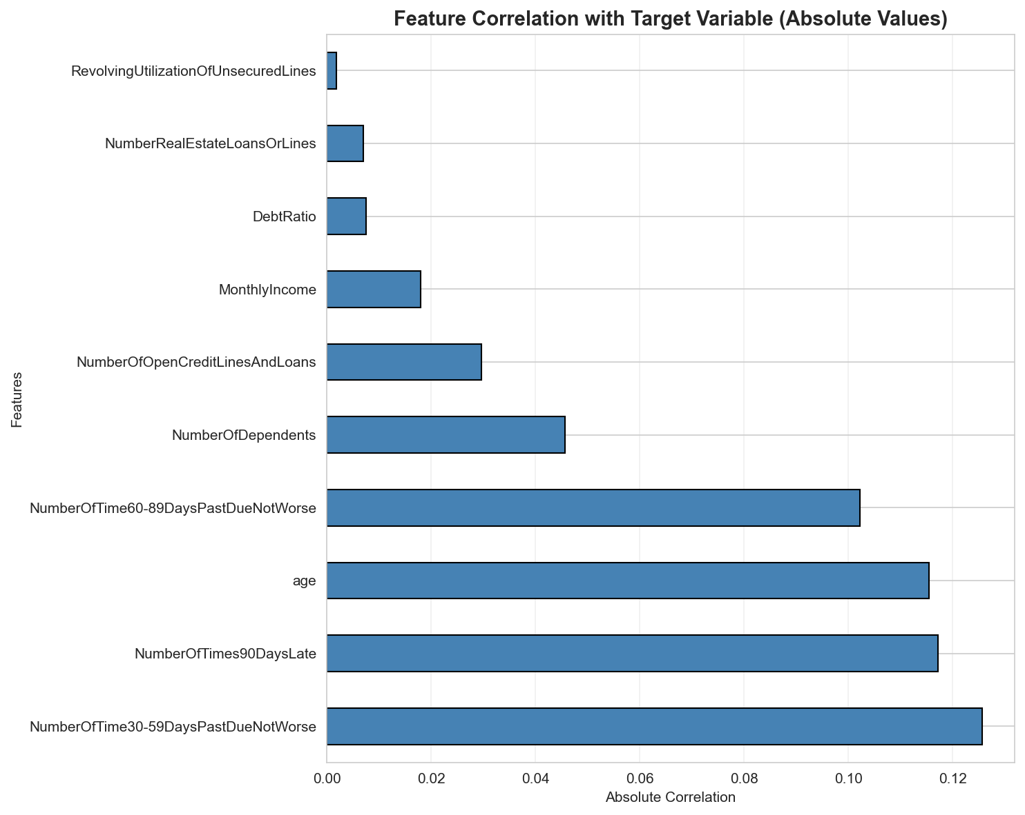
📊 Feature-Target Correlation

Slide 22
5
Multivariate Analysis

Slide 23
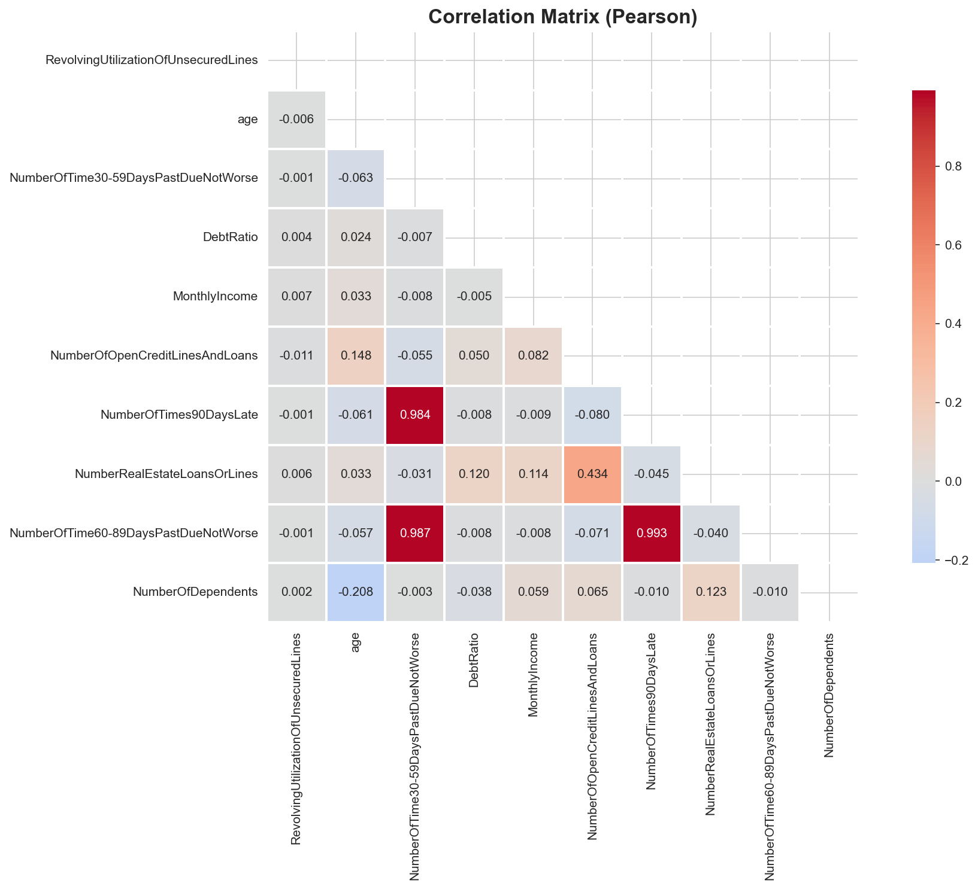
🔗 Feature Correlation Matrix

Slide 24
💡 Correlation Insights
Strong correlations among delinquency features
→ 30-59, 60-89, and 90+ days late highly correlated
→ Suggests multicollinearity - consider feature selection
Moderate correlation: Age & Real Estate Loans
→ Older borrowers tend to have more mortgages
Weak correlation: Monthly Income & other features
→ Income is relatively independent predictor
Target variable: Strongest with delinquency features

Slide 25
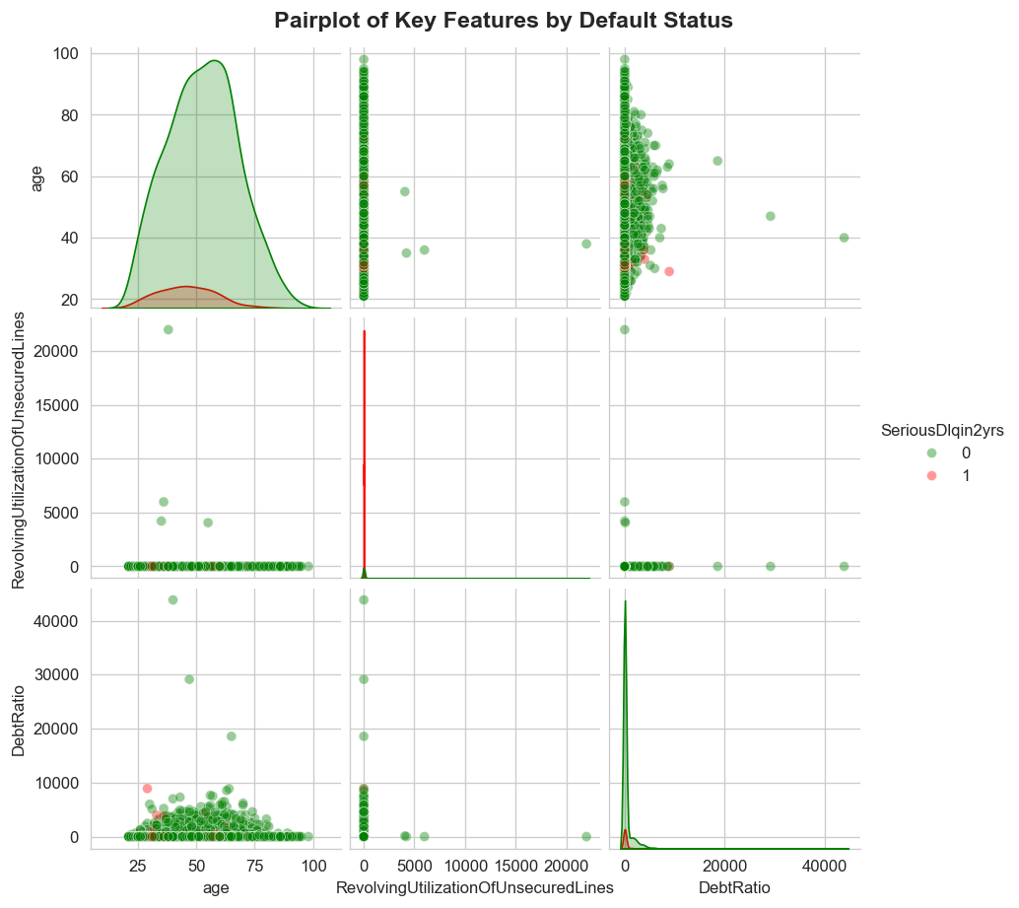
🎨 Pairwise Feature Relationships

Slide 26
6
Conclusions & Recommendations

Slide 27
🎯 Key Findings
1
Delinquency history = strongest default predictor (correlation >0.3)
2
Credit utilization >80% and debt ratio >50% = major risk indicators
3
Age shows non-linear relationship requiring binning or polynomial features
4
Lower income levels associated with increased default probability
5
Feature multicollinearity present - dimensionality reduction recommended

Slide 28
🎯 Model Development Recommendations
Feature Engineering:
• Create interaction terms (debt ratio × income)
• Apply log transformation to skewed features
• Bin age into risk categories
Feature Selection:
• Address multicollinearity in delinquency features
• Use L1 regularization or PCA
Model Training:
• Handle class imbalance (SMOTE, class weights)
• Cross-validation for robust evaluation

Slide 29
🚀 Next Steps
1. Feature Engineering
→ Create derived features based on EDA insights
2. Feature Selection
→ Apply statistical tests and model-based selection
3. Model Development
→ Train multiple algorithms (Logistic Regression, Random Forest, XGBoost)
4. Model Evaluation
→ ROC-AUC, Precision-Recall, Confusion Matrix
5. Model Deployment
→ Production pipeline with monitoring

Slide 30
Thank You!
Questions & Discussion

