Slide 1



FLUX LIGHTS
-BY POWERHOUSE

Slide 2


Powerhouse
FLUX LIGHTS
As India’s traffic is highly unpredictable so we the students of SRMIST RAMAPURAM has found a solution for this problem.
We name this project FLUX LIGHTS as flux means constant movement or constant change so to adapt for the constant change in traffic hence the name FLUX LIGHTS.
In this project’s prototype uses the components “Arduino uno, esp32, ultra sonic sensor”, this will be connected to the traffic lights to work for the unpredictable ongoing traffic and we will connect this model to a app which is used for human intervention in case of dire situation where a computer can’t solve the problem
As we know INDIA is huge country and this will help in the controlling of upcoming traffic easily and less tension to our government and this prototype is adaptive to the density of the traffic hence reduces the time taken for people waiting in each traffic stop
Notes:
1.7.2013
2
‹#›

Slide 3


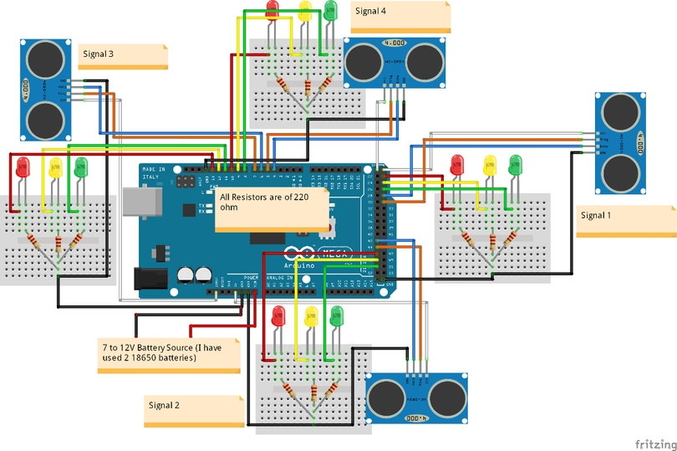
TECHNICAL APPROACH
Technologies to be used:
Ardunio uno
Esp32
Ultra sonic sensor
C++ language
Methodology and process for implementation:

Slide 4
FEASIBILITY AND VIABILITY
It is highly feasible as it is cost effective as it costs like 1000 to 3000 to build one model in 2 week and Arduino excels in reading ultra sonic sensor and esp 32 manages the traffic light monitioring system and the overriding if time recquires it.
Major challenges include inaccuracies for ultra sonic senor form rain, pedestrians, weather, vandalism, power maintance issue.
Overcoming challenges would be using multiple sensor per lane with averaging filters and IR backups weather proof enclosures, solar powered battery systems, secure via HTTPS authentication system and more.

Slide 5
IMPACT AND BENEFITS
Impacts drivers and commuters with 40% reduced travel times, less peak hours frustration like in cities like Delhi Bangalore, Mumbai and priority for emergencies saving lives. Traffic authorities get real time data for monitoring and overrides. Emergency services achieve a faster Reponses, etc.
Socially, it curbs road rage boosts intersection safety, reduce accidents, ensures equity for emergencies transports. Economically deliver fuel savings, productivity from time efficiency, low cost scalability, Environmentally reduces carbon emission, technologically improves IOT analysis, education, smart infrastructure.

Slide 6
RESEARCH AND REFERENCES
www.tinkercad.com
www.arduino.cc
www.blynk.io

Slide 7

THANK YOU
-BY POWERHOUSE

