Slide 1
Design And Analysis of Algorithms
Department of Information Technology
-----Group Members-----
Aditya Singh Machhaiya ( IIT2019111 )
Payili Vangmayi ( IIT2019112 )
Nimish Upadhyay ( IIT2019113 )
ASSIGNMENT-1 (c2) DEMOSTRATION
Under the Supervision of: Dr. Rahul Kala
Under the Mentorship of: Mr. Md Meraz

Slide 2
Problem Statement
“Given a matrix of N rows and M columns, the task is to find the minimum absolute difference between any of the two adjacent elements of an array of size N, which is created by picking one element from each row of the matrix. Note the element picked from row 1 will become arr[0], element picked from row 2 will become arr[1] and so on. Solve using divide and conquer algorithm.”

Slide 3
Example :-
Input : N = 2, M = 2
m[2][2] = { {8,2}
{6,8} }
Output : 0.
Picking 8 from row 1 and picking 8 from row 2, we create an array {8, 8} and minimum difference between any of adjacent element is 0.
Input : N = 3, M = 3
m[3][3] = {{1,2,3}
{4,5,6}
{7,8,9}}
Output : 1.

Slide 4
Some Definititons :-
i)- Divide and Conquer Algorithm:- . A divide-and-conquer algorithm recursively breaks down a problem into two or more sub-problems of the same or related type, until these become simple enough to be solved directly. The solutions to the sub-problems are then combined to give a solution to the original problem
ii)-Binary Search:- binary search is a search algorithm that finds the position of a target value within a sorted array. Binary search compares the target value to the middle element of the array. If they are not equal, the half in which the target cannot lie is eliminated and the search continues on the remaining half, again taking the middle element to compare to the target value, and repeating this until the target value is found. If the search ends with the remaining half being empty, the target is not in the array.

Slide 5
Algorithmic Description
The idea is to sort all rows individually and then do binary search to find the closest element in next row for each element. To do this in an efficient manner, sort each row of the matrix. Starting from row 1 to row N – 1 of matrix, for each element m[i][j] of current row in the matrix, find the smallest element in the next row which is greater than or equal to the current element, say p and the largest element which is smaller than the current element, say q. This can be done using Binary Search. Finally, find the minimum of the difference of current element from p and q and update the variable.

Slide 6
Algorithmic Steps :-
Step 1: taking input about no. of rows and no. of columns and generating input from input generator function storing it in a 2-d matrix.
Step 2 : sorting the rows of the matrix using merge sort which is divide and conquer algorithm.
Step 3 : iterating for every row except the last row ,and finding upper bound for each element of the row which we are iterating.
Step 4 : we will find Upper bound using binary search.
Step 5 : find the answer corresponding the Upper bound and also for upperbound-1 index (if it exist).
Step 6 : check the answer is less than then answer stored earlier ,if yes then store it.

Slide 7
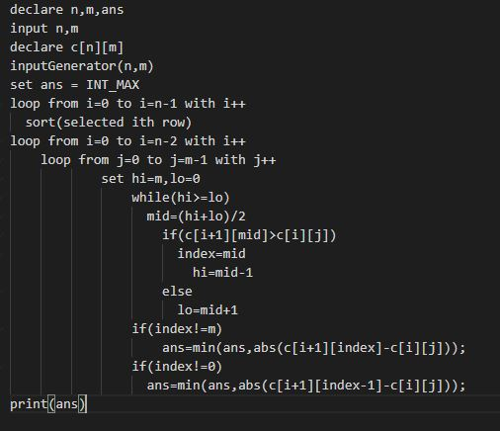
Psuedo Code

Slide 8
Time Complexity
Let t(n,m) be the time complexity of the Upper bound code time complexity for traversing n * m matrix :
O(n ∗ m)
thus,
t(n,m) =O(n ∗ m) + 2 ∗ t(n, m/2)
t(n,m/2) = O(n ∗ m/2) + 2 ∗ t(n, m/4)
t(n,m/4) = O(n ∗ m/4) + 2 ∗ t(n, m/8)
t(n,m/8) = O(n ∗ m/8) + 2 ∗ t(n, m/16)
and so on ....
hence after solving these equations ,
we get t(n,m) = O(n ∗ m ∗ log m)
let T(n,m) be the time complexity of the whole code
TIME COMPLEXITY of merge sort = O(n ∗ m ∗ log m)
hence ,
T(n,m) = O(n ∗ m ∗ log m) + O(n*m*log m)
hence , T(n,m) = O(n ∗ m ∗ log m)

Slide 9
Space Complexity
Let n = no. of rows , m = No. of coloumns
space occupied by the 2-d array : O(n ∗ m)
space complexity of merge sort : O(m)
Total Space complexity : O(n ∗ m) + O(m)
hence , Total Space complexity : O(n ∗ m)

Slide 10
References:-
Introduction to Divide and Conquer Technique:-https://www.geeksforgeeks.org/divide-and-conqueralgorithm-introduction
Introduction to Algorithms by Cormen,Charles,Rivest and Stein. :- https://web.ist.utl.pt/ fabio.ferreira/material/asa

Slide 11
THANK YOU !!

