Slide 1


International Conference on Natural Language Processing and
Computer Vision (ICNPCV)
CUDAnet: A Micro-Footprint, Dependency-Free
Deep Learning Engine for Edge-Native GPU Training
Paper ID: ____
Samartha H V | Chiranth R | Pavithra N
Manipal Institute of Technology Bengaluru, Manipal Academy of Higher Education
Notes:
~20s. Welcome the audience, state your name, and give the one-line hook: 'We built a neural network training engine from scratch in raw CUDA, found a race condition that silently breaks Adam and Momentum on GPUs, and fixed it.'

Slide 2

Contents
• 1. The Problem — Race Conditions in GPU-Parallel Optimizers
• 2. CUDAnet Architecture
• 3. The Fix — Two-Phase Gradient Accumulation (2PGA)
• 4. Experimental Setup
• 5. Results — Optimizer Comparison & Training Speed
• 6. Batch Normalization Interaction
• 7. Edge AI Deployment Case
• 8. Conclusion & Future Work
Notes:
~15s. Quick roadmap: motivate the bug, show the architecture, explain the fix, then results and the edge-deployment payoff.

Slide 3
The Problem: GPU Race Conditions Break Optimizers
• Forward/backward passes across training samples are embarrassingly parallel
• But Momentum and Adam keep persistent optimizer state across steps:
– velocity v_t (Momentum), moments m_t and v_t (Adam)
• Naive parallelization: each of B = 2,048 threads reads, updates, and writes this shared state simultaneously
• If threads i and j read v_t before either writes back — one write silently overwrites the other
• The failure is invisible: the code compiles and runs without error, and SGD (stateless) keeps working — masking the bug
Result: Momentum & Adam collapse from 97.2% → 0.0% accuracy (random chance)
ICNPCV 2026
3
Notes:
~55s. This is the hook of the talk. Emphasize 'silent failure' — it compiles, it runs, loss even goes down sometimes, but accuracy is exactly chance level. Walk through why SGD is immune (no state) but Momentum/Adam are not.

Slide 4
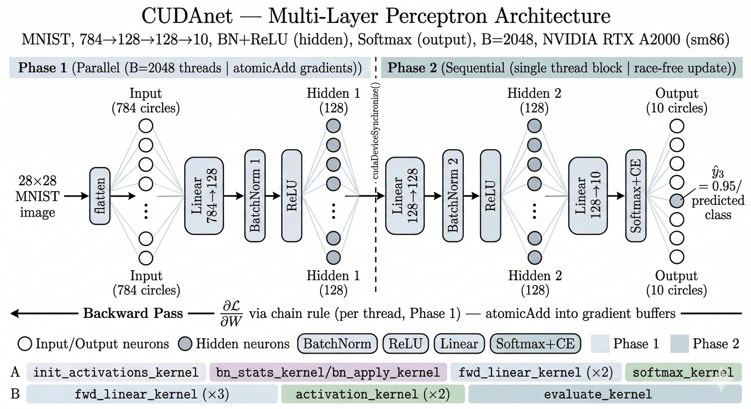
CUDAnet: From-Scratch CUDA MLP Engine
• <2,300 lines of CUDA C — zero external dependencies (no PyTorch / cuBLAS / cuDNN)
• 784 → 128 → 128 → 10, BatchNorm+ReLU hidden layers, Softmax output
• Configurable layers, neurons, batch size, and 3 optimizers (SGD, Momentum, Adam)
ICNPCV 2026
4
Notes:
~50s. Walk left to right: flatten → Linear → BatchNorm → ReLU, repeated, then Softmax+CE. Point out the Phase 1 / Phase 2 split shown here — it previews the fix on the next slides.

Slide 5
Root Cause: Concurrent Writes to Optimizer State
Momentum update, executed by thread i:
v_t^new = β·v_t + ∇W L(i) (each thread reads-modifies-writes the SAME v_t)
• If threads i and j both read v_t before either writes back — one write is lost
• With B = 2,048 threads updating the same buffer, corruption is catastrophic and deterministic
• Adam is worse: two shared moment buffers (m_t, v_t) instead of one
Configuration | Accuracy w/ Race Condition
SGD (stateless) | Unaffected — 94.3%
Momentum | 0.0% (from 97.2%)
Adam | 0.0% (from 97.2%)
BN + Adam + LR | 17.9% (partially masked by BN re-centering)
ICNPCV 2026
5
Notes:
~55s. Emphasize the table: SGD is fine, everything with state is broken. BN+Adam+LR isn't at 0% because BN's normalization partially re-centers the corrupted activations — lucky, not correct.

Slide 6
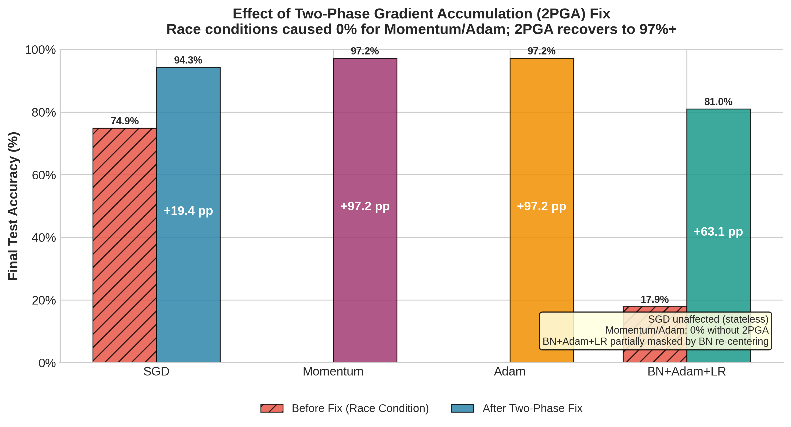
The Fix: Two-Phase Gradient Accumulation (2PGA)
• Phase 1 (parallel):
– every thread computes forward + backward pass, accumulates its gradient into a shared buffer via atomicAdd() — safe, no optimizer state touched
• cudaDeviceSynchronize() — a global barrier
• Phase 2 (sequential, single thread block):
– reads the fully-accumulated gradient once, applies the optimizer update exactly once — no concurrent writers are possible by design
ICNPCV 2026
6
Notes:
~55s. Key line: Phase 2 costs <0.4% of epoch time (18k weights, single block) — correctness is almost free. Point at the chart: Momentum/Adam go from 0% to 97.2%, BN+Adam+LR from 17.9% to 81.0%.

Slide 7
Experimental Setup
• Hardware
– NVIDIA RTX A2000, 12GB (sm_86, Ampere)
– 3,328 CUDA cores, 448 GB/s bandwidth
• Software
– nvcc -arch sm_86 -O2, g++-12
– Driver 535.288.01
• Dataset
– MNIST: 60k train / 10k test, 28×28
– 80/20 split → 48k train / 12k val, 23 mini-batches/epoch
• Model & Training
– 2 hidden layers × 128 neurons, 20 epochs, batch 2,048
– LR: 0.1 (SGD/Momentum), 0.01 (Adam, cosine per-step)
ICNPCV 2026
7
Notes:
~35s. Keep this brisk — it's reference material, not the core story. Mention Xavier init and zero bias init if asked in Q&A.

Slide 8
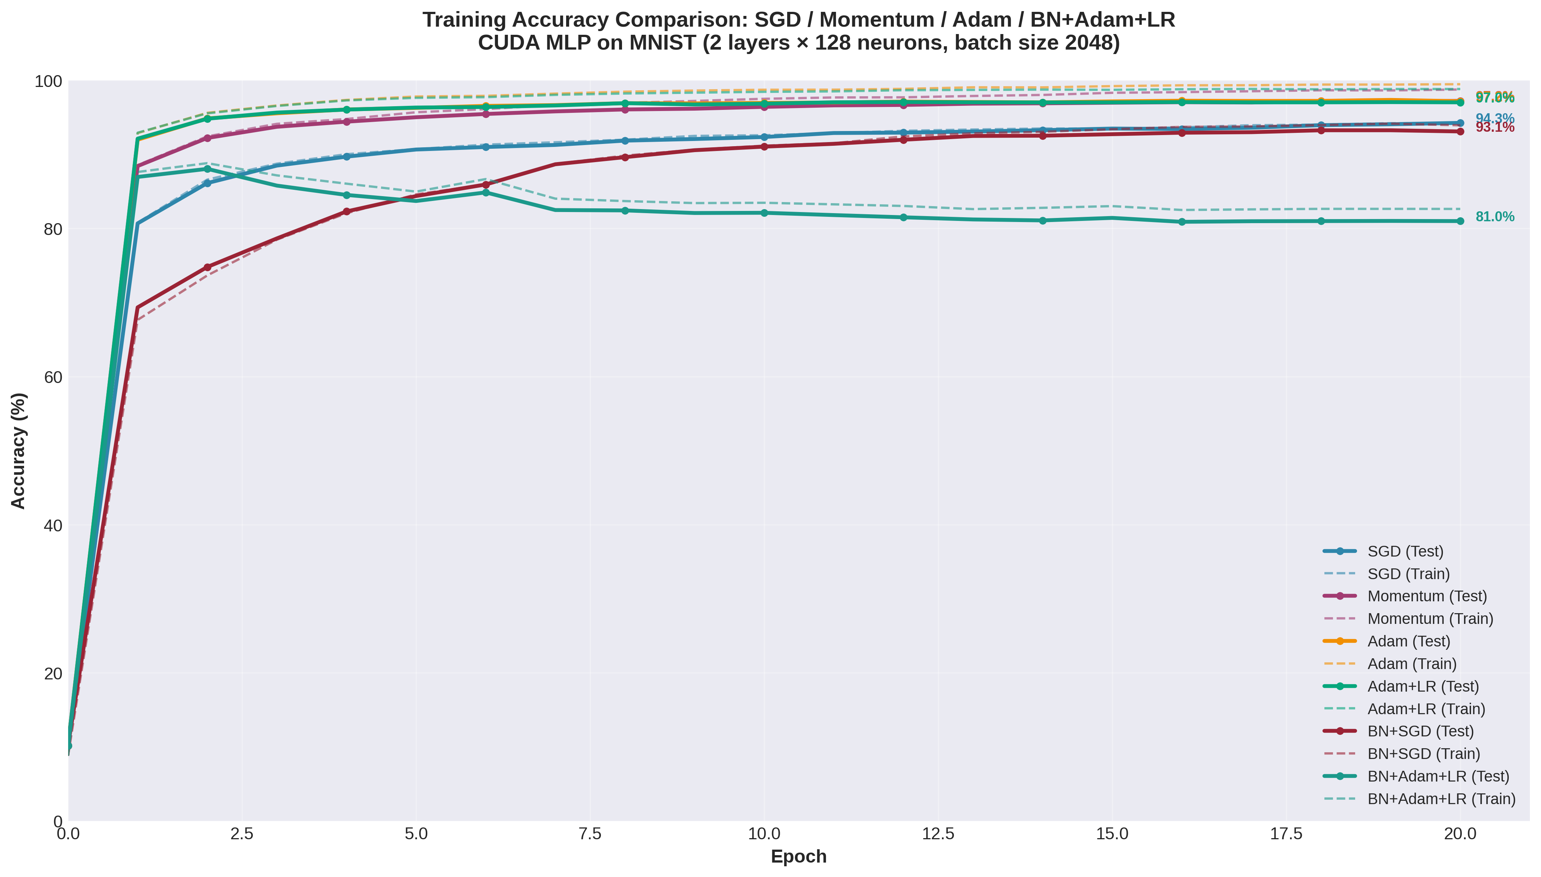
Results: Optimizer Comparison
• Momentum & Adam tie at 97.2%
– (+2.9 pp over SGD)
• Neither works at all without 2PGA
• Adam+LR (cosine): 97.0%
– too few steps (23/epoch) for the schedule to matter much
• BN+Adam+LR is the outlier: 81.0%
– peaks at epoch 2 (88.1%), then decays
ICNPCV 2026
8
Notes:
~50s. Point at epoch 5: Adam/Momentum already >95% while SGD trails at 90.7%. Then point at the teal BN+Adam+LR curve peaking early and eroding — flag that this is investigated on a later slide.

Slide 9
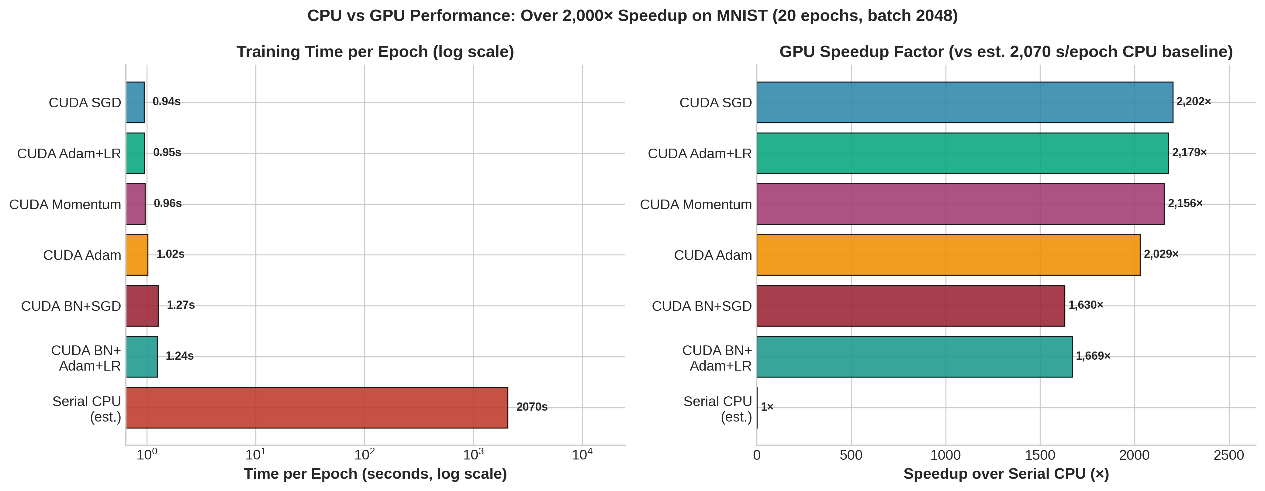
Training Speed: Over 2,000× Faster than CPU
• CUDA SGD: 0.94 s/epoch → 2,202× speedup
• Heaviest config (BN+Adam+LR): 1.24 s/epoch → still 1,669×
• Serial CPU baseline: ~2,070 s/epoch (estimated, 90 s/batch × 23 batches)
ICNPCV 2026
9
Notes:
~40s. Note the CPU number is an estimate, not a full measured run — be upfront if asked. The takeaway: even the most expensive config is >1,600× faster than CPU.

Slide 10
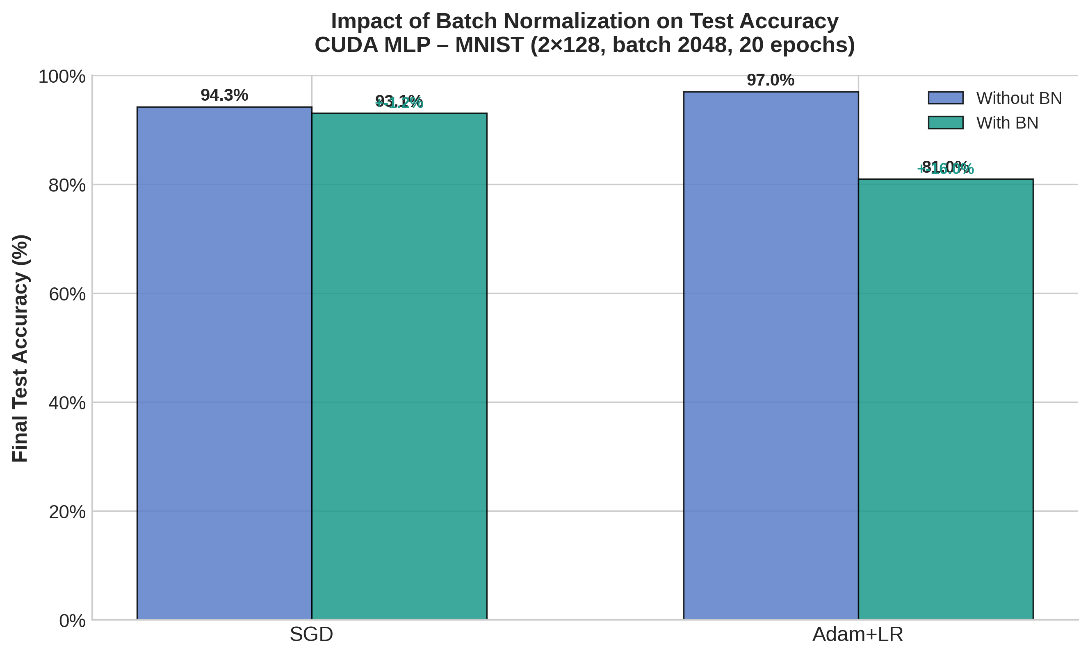
Batch Normalization: A Double-Edged Sword
• BN + SGD:
– −1.2 pp only (93.1% vs 94.3%) — stable at full-dataset scale
• BN + Adam + LR:
– −16.0 pp (81.0% vs 97.0%)
– peaks at epoch 2 (88.1%), then decays
• Root cause:
– Adam’s moment estimates vs. BN’s shifting statistics — competing "moving targets"
– NOT the LR schedule — per-batch cosine fix recovered only +1.1 pp
ICNPCV 2026
10
Notes:
~50s. This is the paper's honest limitation. Be candid: 81% is 'genuinely unsatisfactory' (your own words in the paper) and decoupled BN learning rates are the proposed next step.

Slide 11
Edge AI Case: CUDAnet vs. PyTorch
Metric | CUDAnet | PyTorch
Test Accuracy (20 ep.) | 97.0% | 97.7%
Avg Time / Epoch | ~0.95 s | 0.25 s
Peak VRAM | ~470 KB | 248 MB (527× more)
Install Size | <2 MB | 1.8 GB (900× more)
Runtime Dependencies | libcuda.so | Python + libtorch
Startup Time | <100 ms | ~3–5 s
On Jetson Nano: ~0.4 ms/image inference (≈ 2,500 img/s) — clears the 30 FPS real-time threshold
ICNPCV 2026
11
Notes:
~40s. Frame this as the paper's practical payoff: PyTorch is faster/more accurate on a workstation GPU, but CUDAnet is the only option when the RAM budget is ~2GB total.

Slide 12
Conclusion & Future Work
• 2PGA is general:
– any optimizer with cross-iteration state (Momentum, Adam, RMSProp, LAMB) running data-parallel on a GPU is subject to this race — 2PGA resolves it with zero staleness or locking
• Achieved 97.2% MNIST accuracy (Momentum/Adam) at over 2,000× CPU speedup, in a <2 MB dependency-free binary
• Future work:
– Tensor Core WMMA (FP16/INT8) — expected 2–3× throughput
– Convolutional layers via im2col + GEMM → target >99% on CIFAR-10
– Multi-GPU scaling via NCCL AllReduce on Phase 1 gradients
Thank you — Questions?
Notes:
~40s. Close on the generality claim — 2PGA isn't MNIST-specific or MLP-specific, it's a primitive for any stateful optimizer on any GPU-parallel workload. Then open for Q&A (2 min).

