Slide 1


Smartphone-based Low-cost Simultaneous Localization and Mapping (SLAM) Design Review 3
Prepared by:
Team 11
马晓白 Xiaobai Ma
王康旭 Kangxu Wang
王振凯 Zhenkai Wang
余路炜 Luwei Yu
张智 Zhi Zhang
Prepared for:
Project Sponsor: 2012 Laboratory @ Huawei Technologies Co. Ltd
Project Mentor: Zhijie Wang, Gang Ye

Slide 2
Agenda
Project Introduction
Solution
Concept Generation
User Interface
Demo
Engineering Specifications

Slide 3
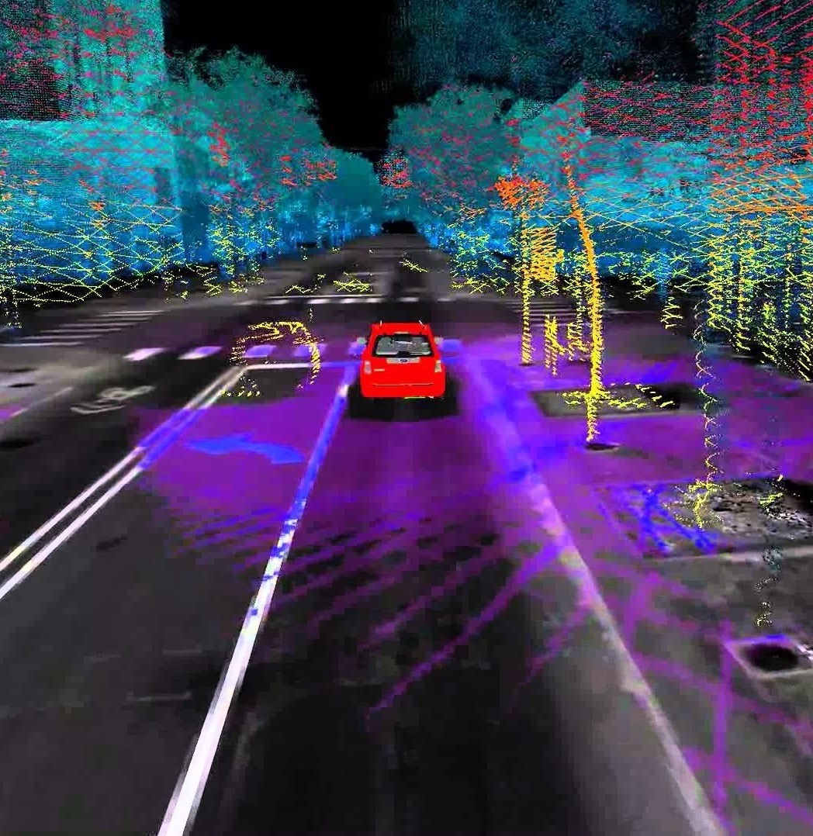
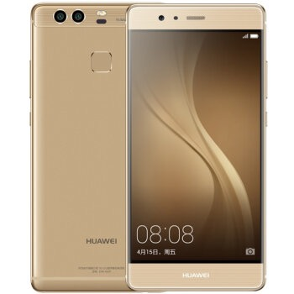
Project Introduction
Smartphone-based SLAM:
Use smartphone to achieve low cost and convenient real-time accurate localization.
https://i.ytimg.com/vi/G6ARrD601Qk/maxresdefault.jpg
http://img10.360buyimg.com/n1/jfs/t1918/169/2366995781/85503/38fffc90/57057f7eN936fd6c0.jpg

Slide 4
Project Introduction
Customer Requirements:
Platform: Huawei P9
Environment: road with dynamic objects
Real-time localization
Latency< 100ms
Error<10cm

Slide 5
Solution

Slide 6
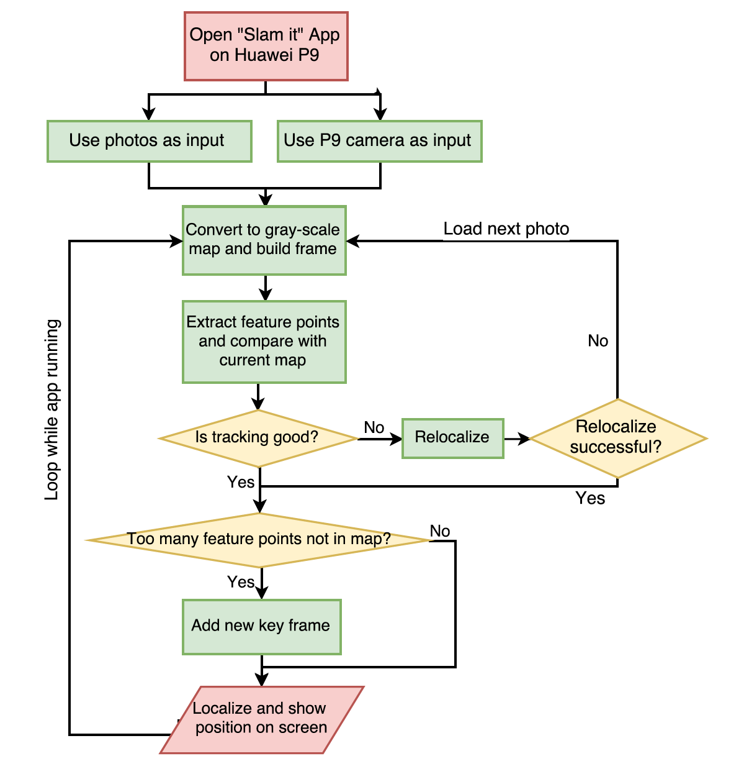
Concept Generation

Slide 7

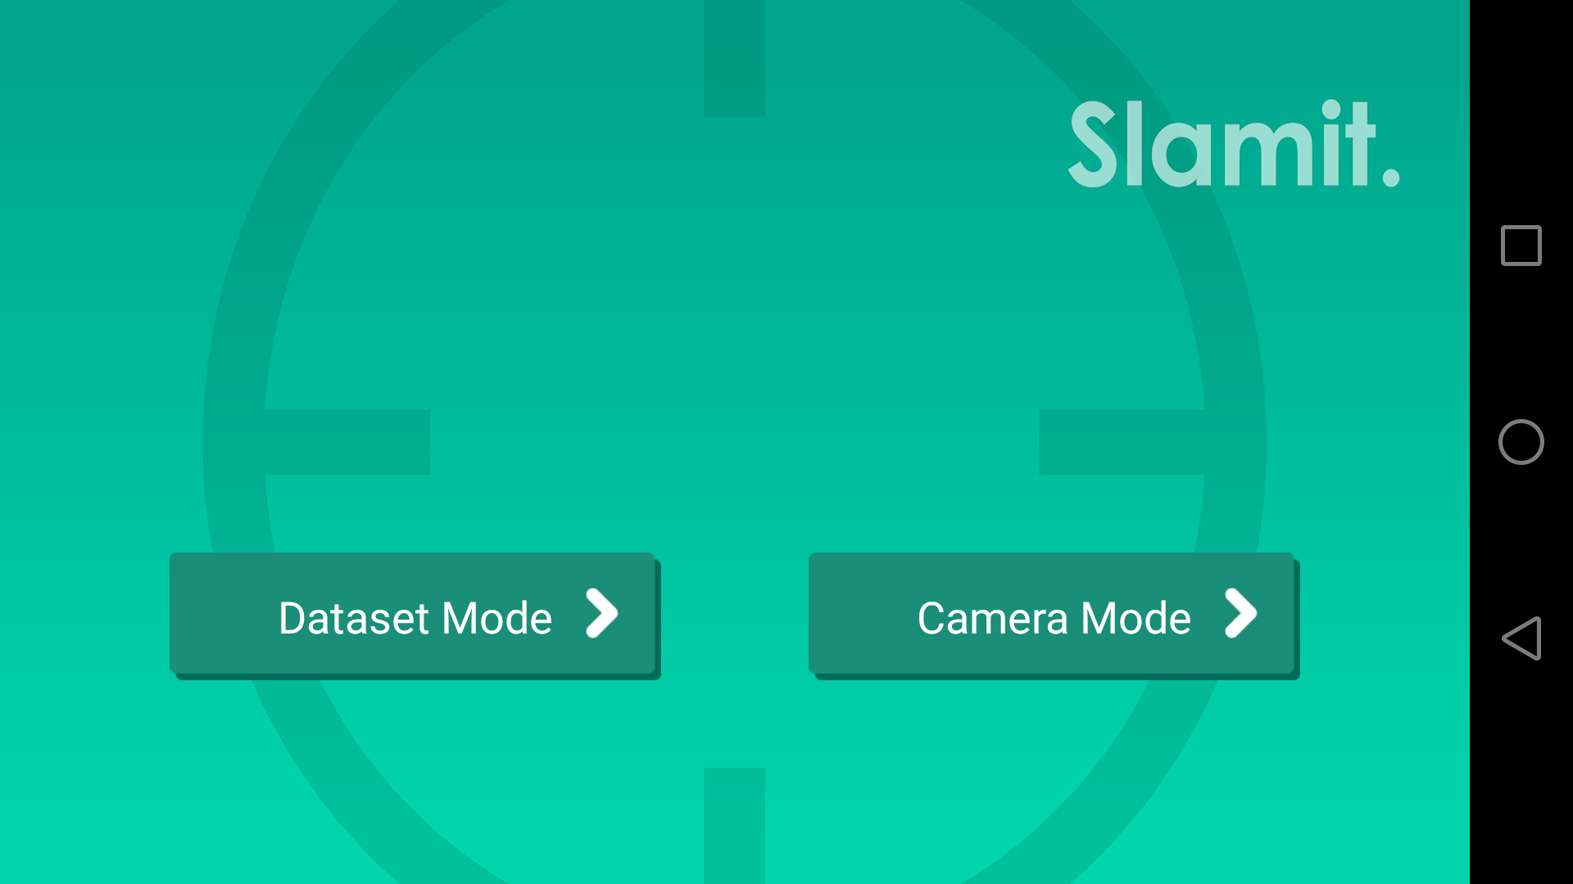
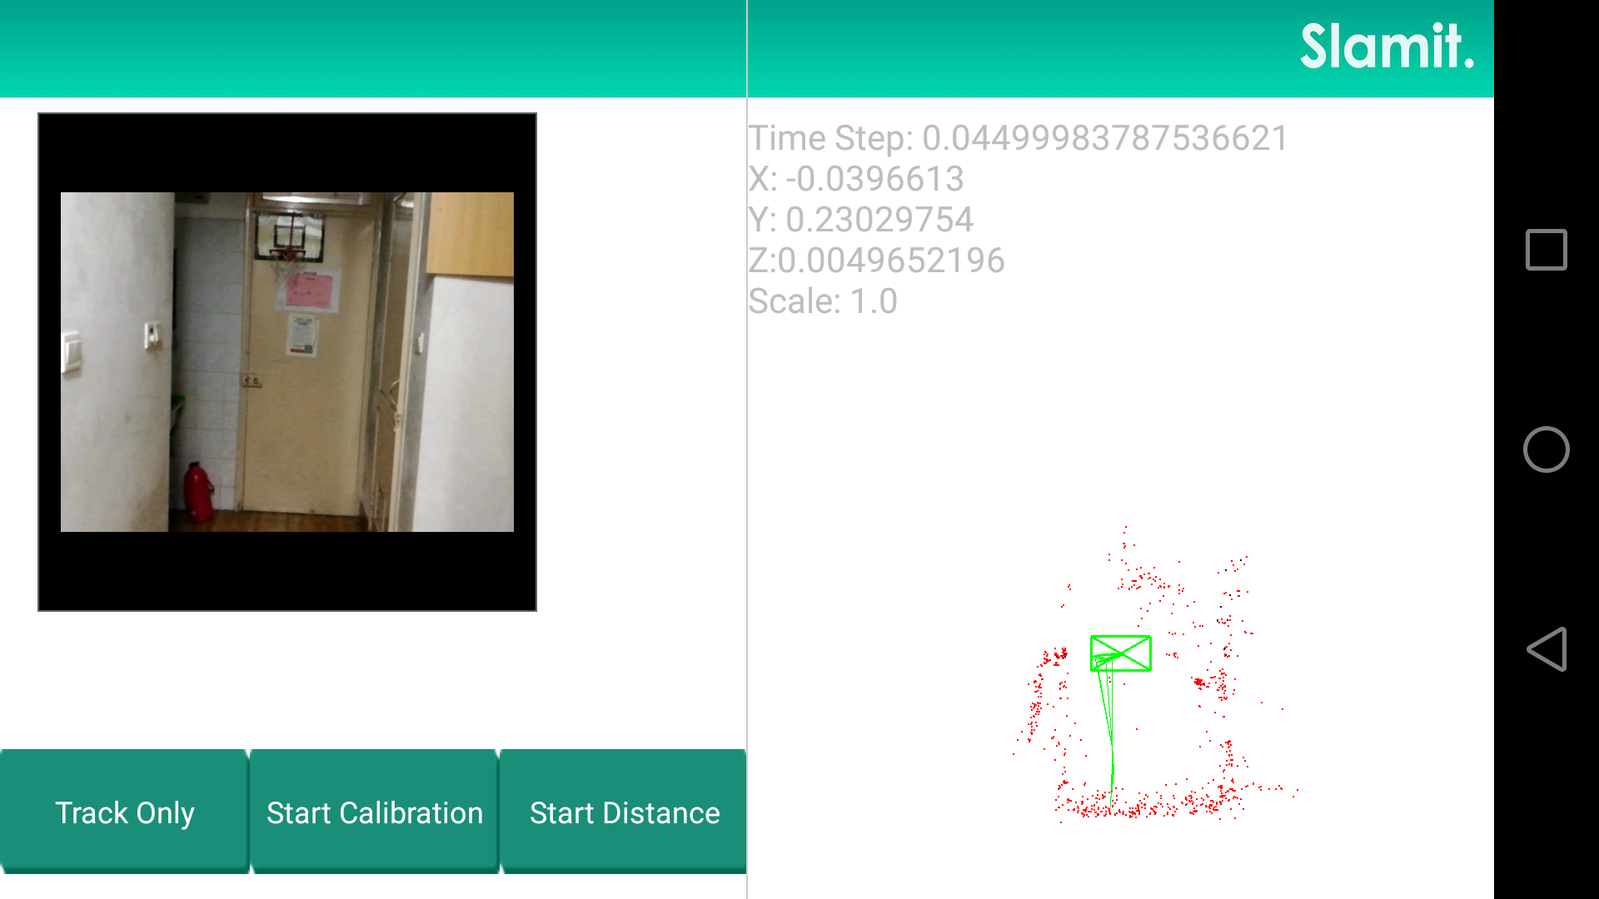
User Interface
Icon
Page 1
Page 2

Slide 8
Demo
Demo video

Slide 9
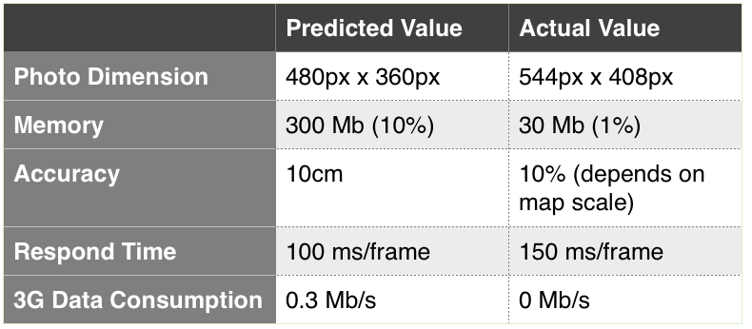
Engineering Specifications

Slide 10
Reference
1.Mur-Artal, Raul, J. M. M. Montiel, and Juan D. Tardos. "ORB-SLAM: a versatile and accurate monocular SLAM system." Robotics, IEEE Transactions on 31.5 (2015): 1147-1163.

Slide 11
Thanks! Q&A

