Slide 1

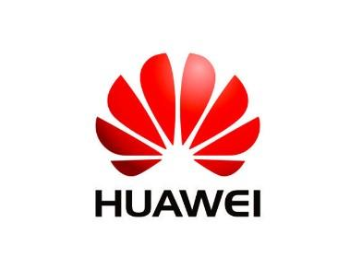
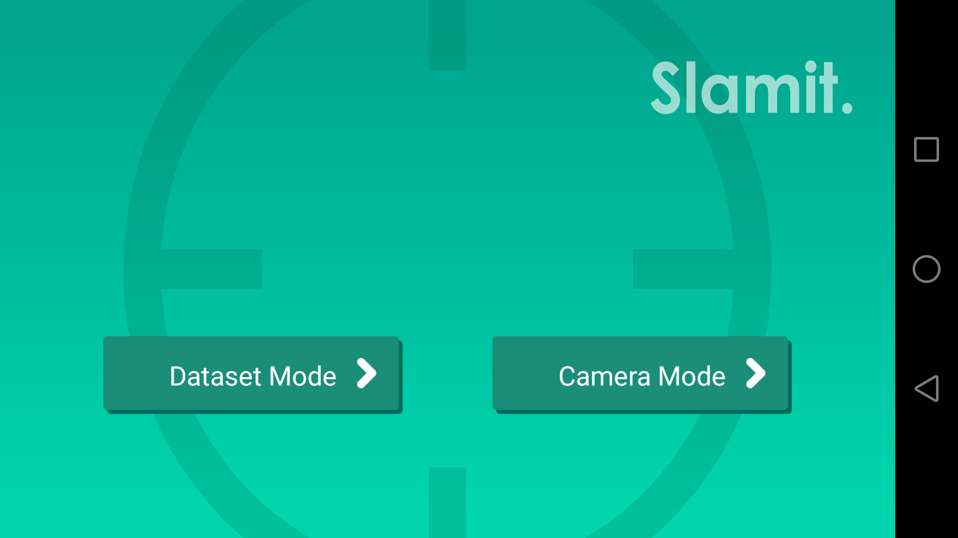
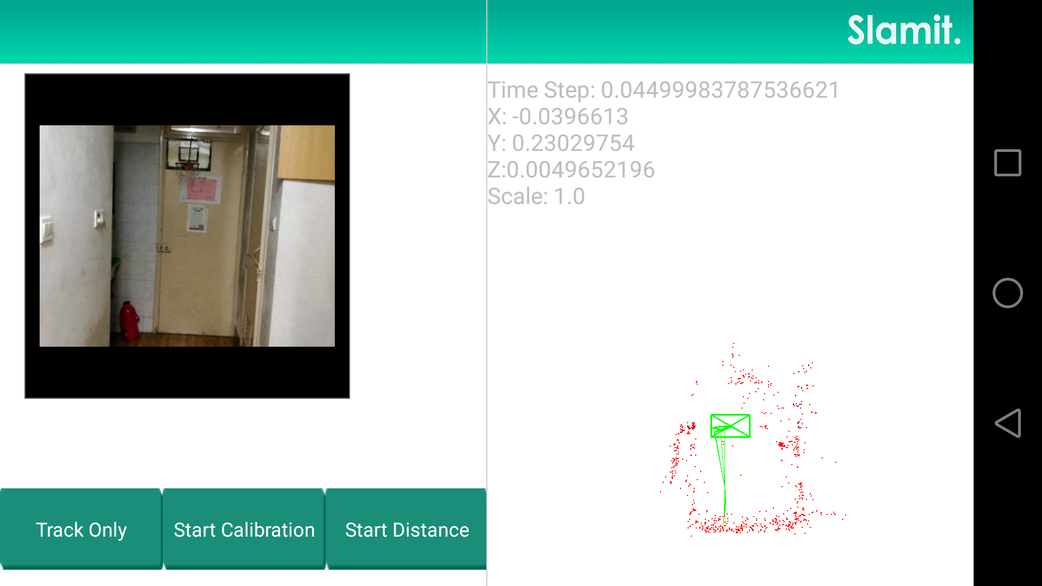
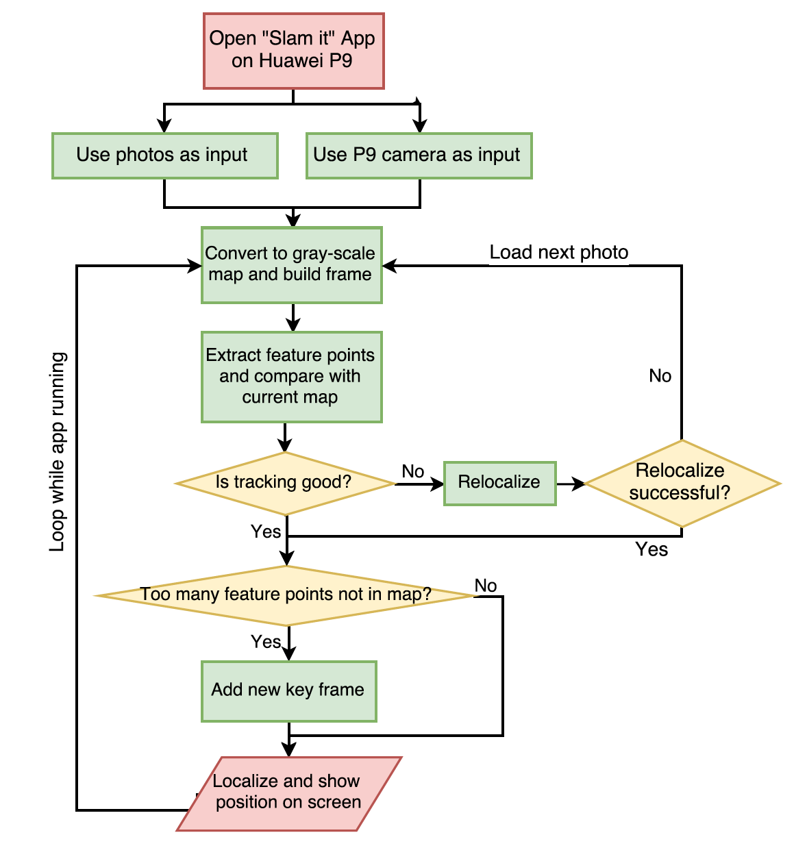
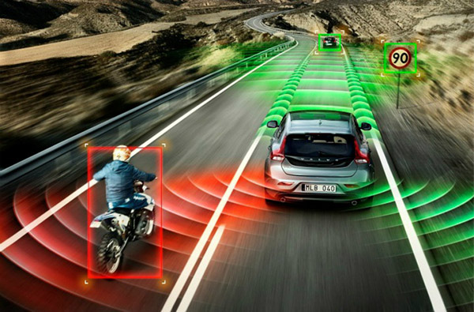
VM450 • Design and Manufacturing III
& VE450 • Major Design Experience
Smartphone-based Low-cost Simultaneous Localization and Mapping (SLAM) Sponsor: Huawei Technology
Team Members: Xiaobai Ma, Kangxu Wang, Zhenkai wang, Luwei yu , Zhi Zhang
Faculty Advisor: Prof. Mian Li Instructor: Chenbin Ma
Problem Statement
The driverless car has been the future direction of the next generation car. A driverless car has to be able to plan routine, self navigate, detect surroundings and avoid collision. All of these functions are based on the premise of accurate localization and mapping. To solve this problem, Car companies are using expansive sensors such as radar and stereo cameras. However, with our application, SLAM it, the problem could be solved only with a powerful smartphone such as Huawei P9.
Fig. 1 driverless car
Concept Generation
We use ORB-SLAM to as our SLAM Algorithm. We build an android app on Huawei P9. It can achieve three functions : Data Collection, Data Fusion, and Mapping. Gyroscope, camera, and accelerometer will be used for data collection. Finally, the position and track will be shown on screen.
Fig. 2 Detailed structure function
Working Description
First, we should open “Slam it” App on Huawei P9. Then we can choose use photos as input or use P9 camera as input. The app will convert these information to gray-scale map and build frame. Next, extract feature points and compare with current map.
Finally, our app can finish localize and show position on screen.
Fig.3 Concept Diagram
App Design
Our team followed the procedures below to design the Android application
Literature research and select ORB-SLAM2
Test the feasibility of ORB-SLAM2 on PC using online datasets
Design and build the app layouts and structures
Port C++ version ORB-SLAM2 as a core module
Add OpenCV as another module
Complete permission requirement for camera and motion sensors
Design and complete the code of data fusion to increase accuracy
Design user interface and test the app
User Interface
Fig.4 Main Interface
Fig.5 Function Interface
Validation
We designed the following process to test our app:
Collect map information and observe the respond time
Test the robustness against moving objects
Calibrate the map scale for several times
Move pre-designed trajectories and compare it with the results on screen
Conclusion
After some experiments, we got the following results:
Average respond time: 200 ms
Average accuracy: 10% (map scale)
3G data consumption: none
App size: 15 Mb
Memory occupation: 30 Mb (1%)
In conclusion, our team has accomplished all the expected functions.
Acknowledgement
Sponsor: 2012 Laboratory @ Huawei Technologies Co. Ltd
Project Mentor: Zhijie Wang
Reference
[1]http://www.cnautonews.com/xw/hy/201512/t20151217_435621.htm

