Slide 1
Persistent Data structure
PROJECT MEMBERS: ANANNYO DEY, SOUMYAJIT RUDRA SARMA , DEBASMIT ROY, KANKO GHOSH AND KUSHAL DAS

Slide 2
1. Try To Keep A Limited Number of Latest Version in Persistence
Because, the PPDS are very memory consuming.

Slide 3

We Have to free up the Least Recent Layers of versions to reinforce the malloc() to allocate unique space from heap area, otherwise the system may abort the process/ malloc() will fail to allocate unique space for new nodes.
START MODULE
Note: This is not an actual diagram
Drawn to illustrate the Huge number of versions
V0
V10
V30
…
1024
1024
V1
V1
V1
‘’’’
A
A
A
A
DEFAULT FIELDS
BACK POINTERS
MODIFICATION LOGS
DEFAULT FIELDS
BACK POINTERS
MODIFICATION LOGS
DEFAULT FIELDS
BACK POINTERS
MODIFICATION LOGS
DEFAULT FIELDS
BACK POINTERS
MODIFICATION LOGS
DEFAULT FIELDS
BACK POINTERS
MODIFICATION LOGS
1
mod(v6, f2, B’)
1
mod(v6, f2, B’)
1
mod(v6, f2, B’)
1
mod(v6, f2, B’)
1
mod(v6, f2, B’)
START
START
START
START
START
…
B
B
B
B
V1024
V2
V2
V2
B’’’’
B
B
B
B
DEFAULT FIELDS
BACK POINTERS
MODIFICATION LOGS
DEFAULT FIELDS
BACK POINTERS
MODIFICATION LOGS
DEFAULT FIELDS
BACK POINTERS
MODIFICATION LOGS
DEFAULT FIELDS
BACK POINTERS
MODIFICATION LOGS
DEFAULT FIELDS
BACK POINTERS
MODIFICATION LOGS
2
mod(v5, f1, 10)
2
mod(v5, f1, 10)
2
mod(v5, f1, 10)
2
mod(v5, f1, 10)
2
mod(v5, f1, 10)
…
A’’’’
A
A
A
A
C’’’'
C
C
C
V3
V3
C
C
DEFAULT FIELDS
BACK POINTERS
MODIFICATION LOGS
DEFAULT FIELDS
BACK POINTERS
MODIFICATION LOGS
3
mod(v9, f1, 30)
3
mod(v9, f1, 30)
B
B
D
We always try to keep latest 1024 versions
In persistence
V4
V4
V4
V4
D
D
D
D
DEFAULT FIELDS
BACK POINTERS
MODIFICATION LOGS
DEFAULT FIELDS
BACK POINTERS
MODIFICATION LOGS
DEFAULT FIELDS
BACK POINTERS
MODIFICATION LOGS
DEFAULT FIELDS
BACK POINTERS
MODIFICATION LOGS
4
mod(v12, f1, 40)
4
mod(v12, f1, 40)
4
mod(v12, f1, 40)
4
mod(v12, f1, 40)
X’
X’
X’
X’
X
X
X
X

Slide 4
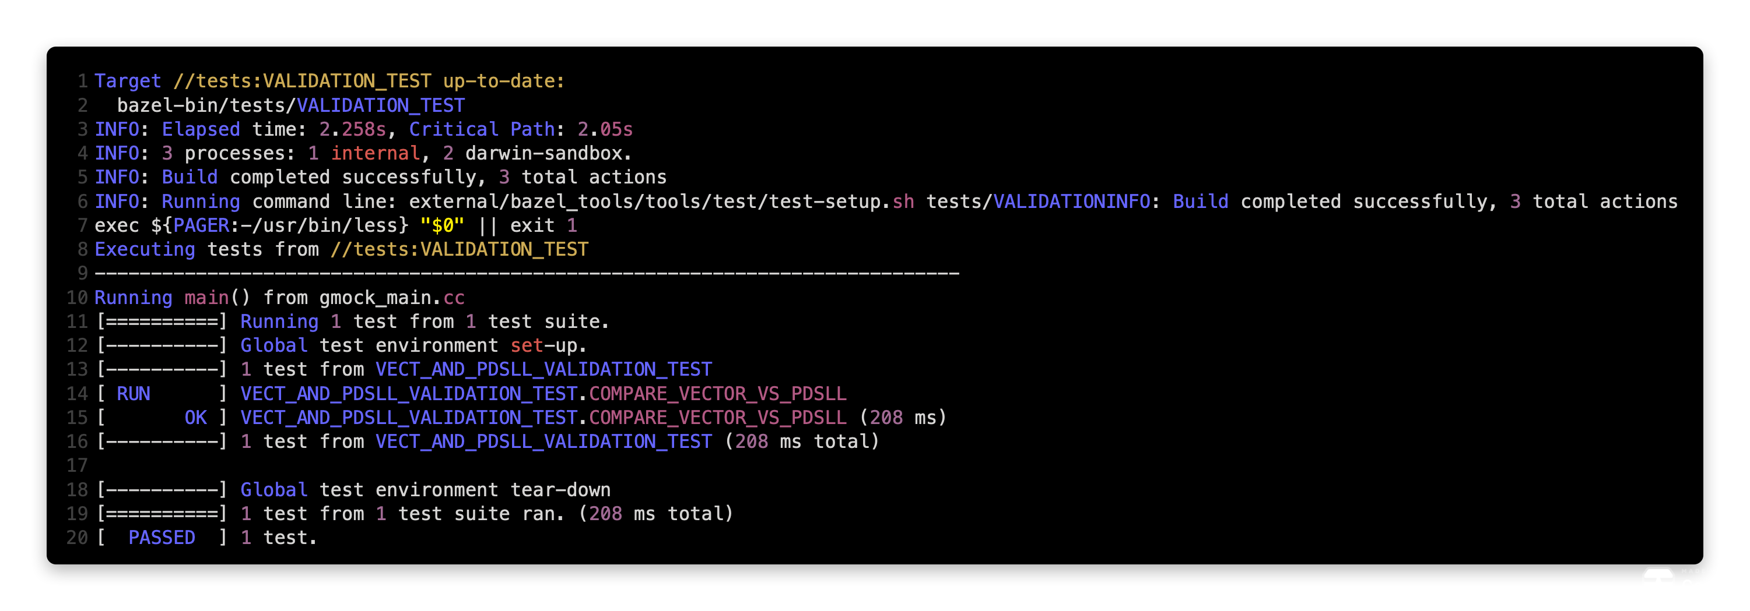
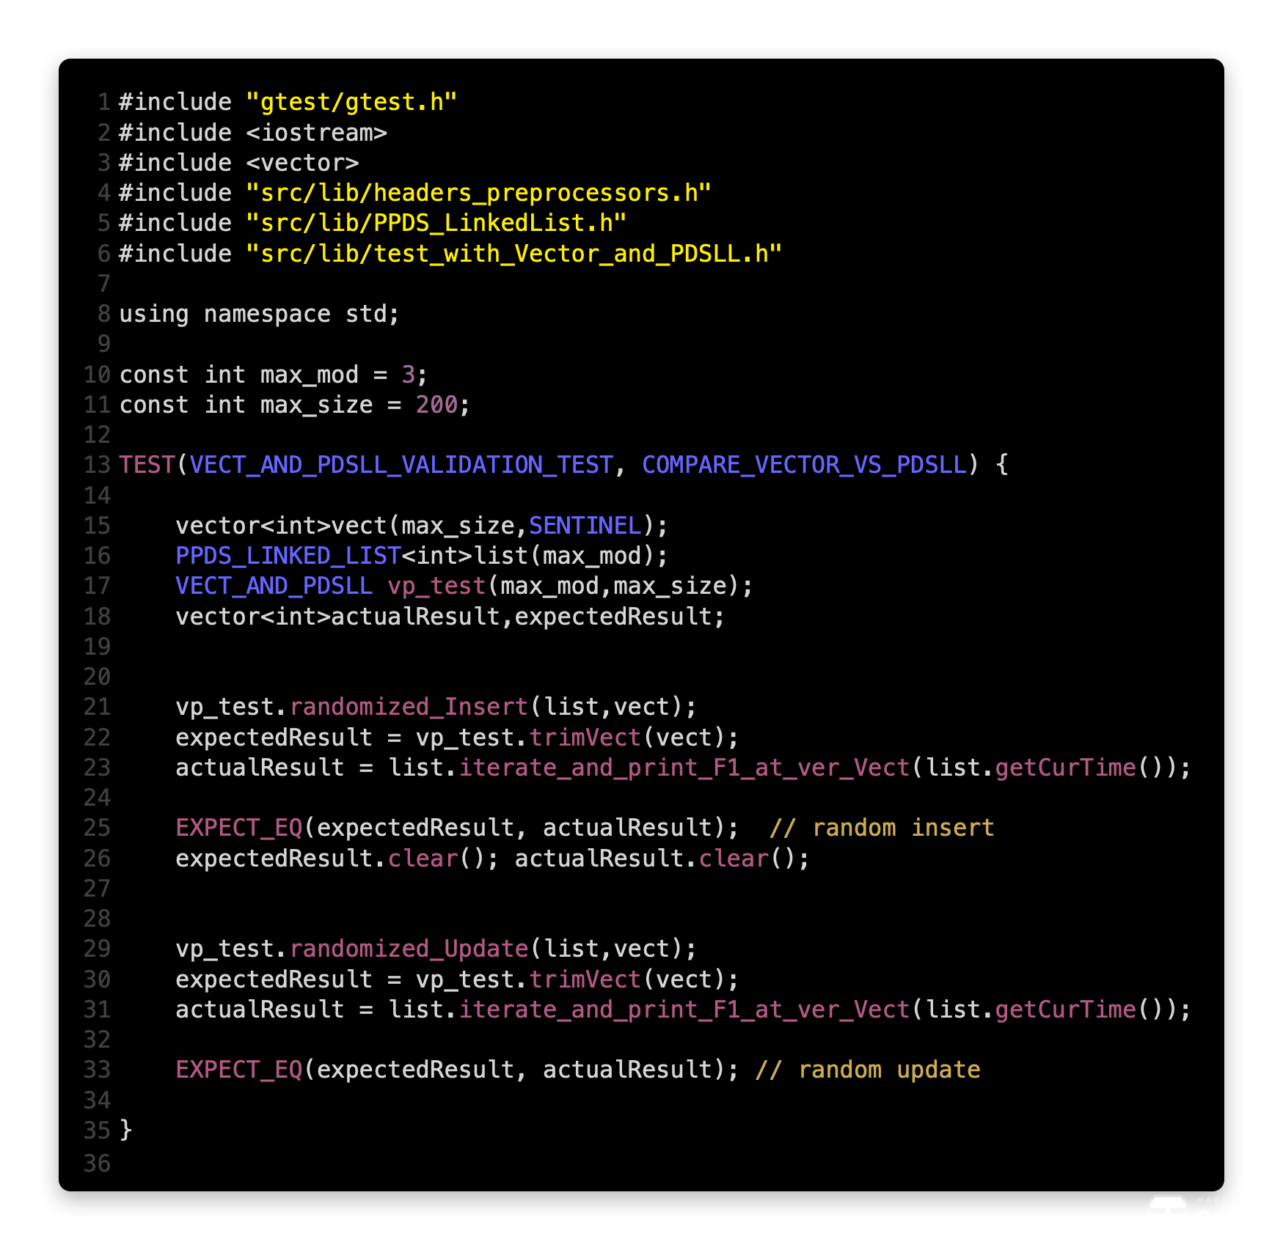
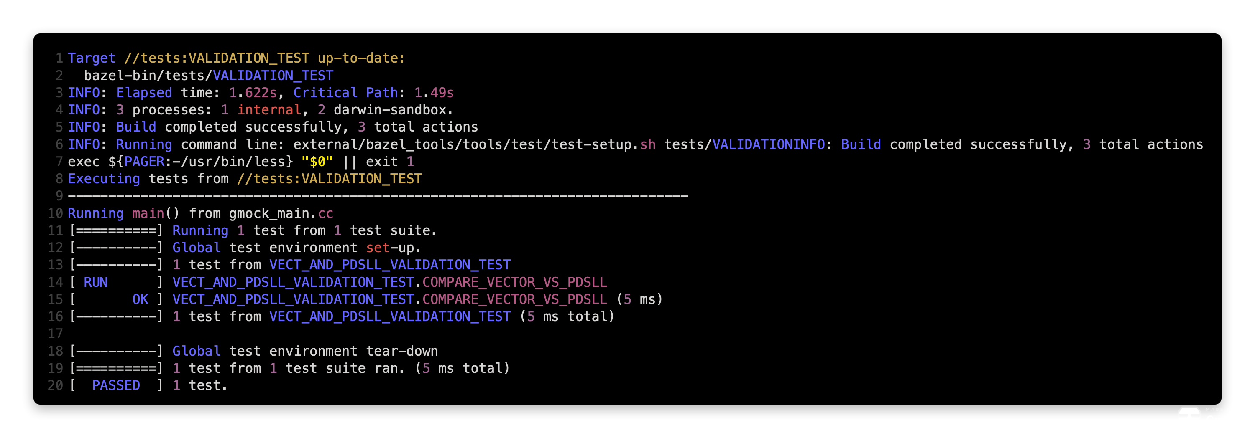
Supporting Code
max_size = 200
Unit Test To Validate The Expected Result And Actual Result
max_size = 2000
These Results Passed

Slide 5
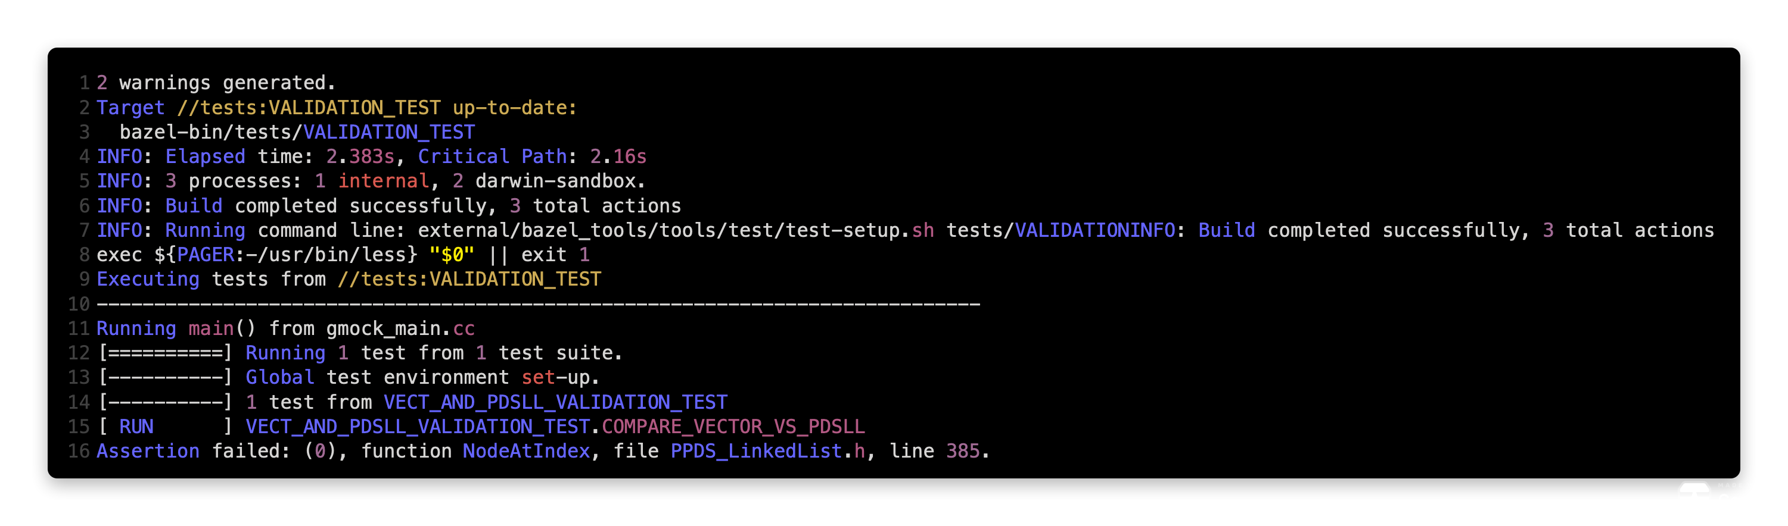
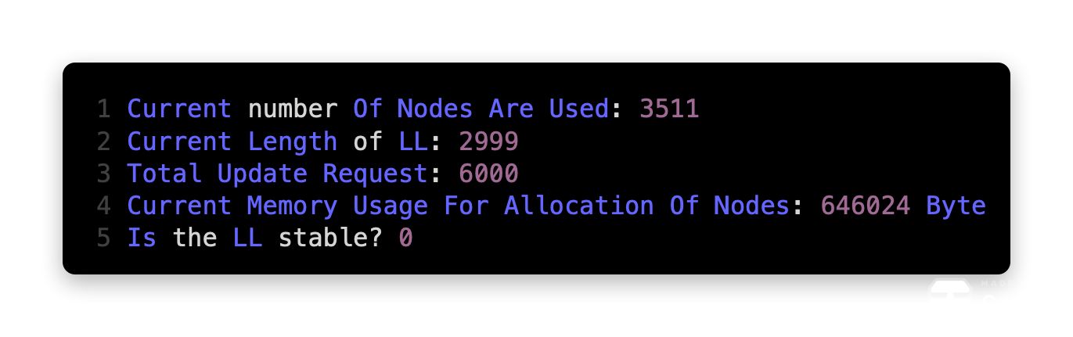
Supporting Code
max_size = 3000
Failed To Validate The Result
We can see that the length of the LL is not 3000 anymore

Slide 6
2. Application in JAVA
The Java programming language is not particularly functional. Despite this, the core JDK package java.util.concurrent includes CopyOnWriteArrayList and CopyOnWriteArraySet which are partial persistent structures, implemented using copy-on-write techniques
Class declaration
public class CopyOnWriteArrayList
extends Object
implements List, RandomAccess, Cloneable, Serializable
1. CopyOnWriteArrayList is a thread-safe variant of ArrayList where operations which can
change the ArrayList (add, update, set methods) creates a clone of the underlying array.
2. CopyOnWriteArrayList is to be used in a Thread based environment where read operations
are very frequent and update operations are rare.
3. Iterator of CopyOnWriteArrayList will never throw ConcurrentModificationException.
4. Any type of modification to CopyOnWriteArrayList will not reflect during iteration since the iterator was created.
5. List modification methods like remove, set and add are not supported in the iteration.
This method will throw UnsupportedOperationException.
null can be added to the list.

Slide 7
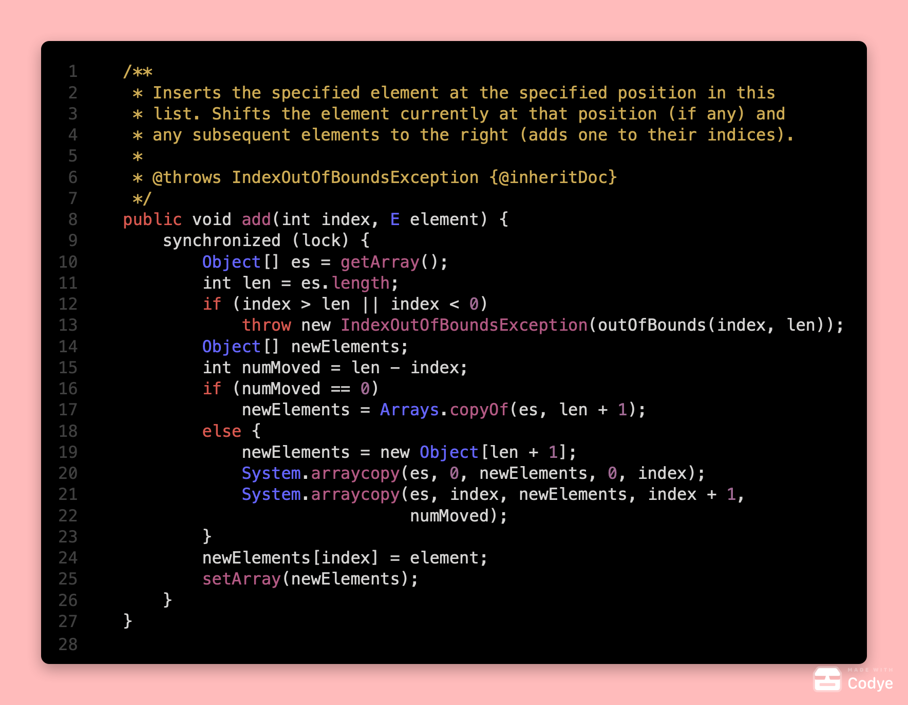
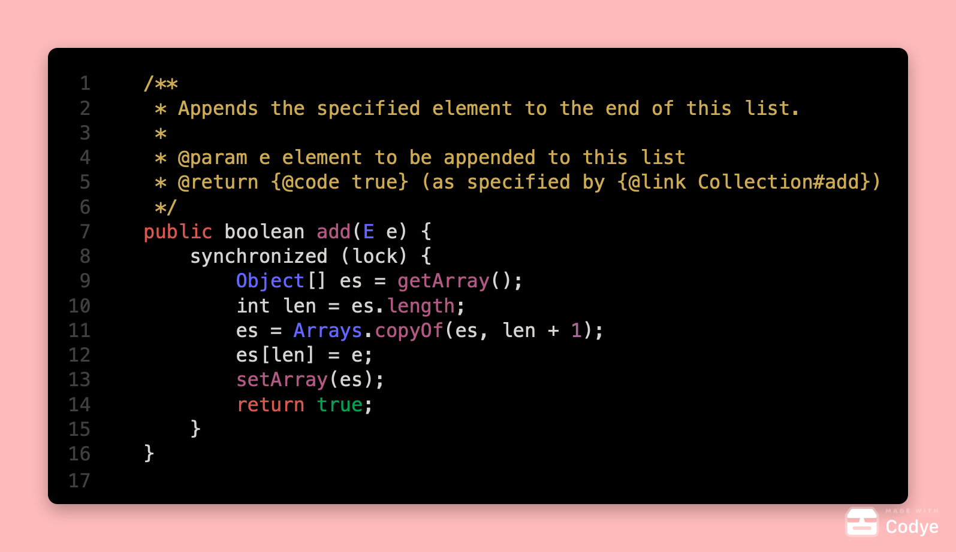
Code Taken From underlying source code of
“CopyOnWriteArrayList” class
Note: We have tried to implement the same
Functionality in C++.
[Code Attached]

Slide 8
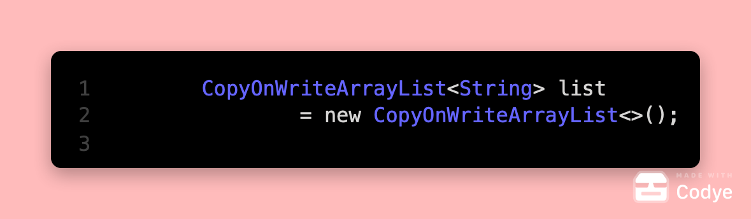
Idea:
1
Array1:
Read Only/ Immutable
V1
1
2
Array2 (Copy):
V2
Thread 1: list.remove(4)
1
2
3
Array3 (Copy):
V3
1
2
3
4
Thread 2: list.add(5)
Array4 (Copy):
V4
Thread Safe
Lock
1
2
3
V5
Array5 (Copy):
UnLock
Thread Safe
Lock
1
2
3
5
Array6 (Copy):
UnLock
V6

Slide 9
3. Application In Clojure
Clojure
Like many programming languages in the Lisp family, Clojure contains an implementation of a linked list, but unlike other dialects its implementation of a Linked List has enforced persistence instead of being persistent by convention.^{[19]} Clojure also has efficient implementations of persistent vectors, maps, and sets based on persistent hash array mapped tries. These data structures implement the mandatory read-only parts of the Java collections framework.^{[20]}
The designers of the Clojure language advocate the use of persistent data structures over mutable data structures because they have value semantics which gives the benefit of making them freely shareable between threads with cheap aliases, easy to fabricate, and language independent.^{[21]}
These data structures form the basis of Clojure's support for parallel computing since they allow for easy retries of operations to sidestep data races and atomic compare and swap semantics.^{[22]}
[Slides in Clojure are attached Separately ]
Extract Taken from wikipedia

