Slide 1
Topic 5
WPAN: Bluetooth

Slide 2
EM Spectrum
ISM band
902 – 928 Mhz
S/W radio
FM radio
TV
2.4 – 2.4835 Ghz
AM radio
TV
cellular
5.725 – 5.85 Ghz
LF
MF
HF
VHF
UHF
SHF
EHF
ν
30kHz
300kHz
3MHz
30MHz
300MHz
3GHz
30GHz
300GHz
10cm
100mm
λ
10km
1km
100m
10m
1m
1cm
X rays
ν
infrared
visible
UV
Gamma rays
1 kHz
1 MHz
1 GHz
1 THz
1 PHz
1 EHz
Propagation characteristics are different in each frequency band

Slide 3
Unlicensed Radio Spectrum
λ
33cm
12cm
5cm
26 Mhz
83.5 Mhz
125 Mhz
902 Mhz
2.4 Ghz
5.725 Ghz
928 Mhz
2.4835 Ghz
5.85 Ghz
cordless phones
baby monitors
Wireless LANs
802.11b
Bluetooth
Microwave oven
ISM band
802.11a
HyperLan
UNII (Unlicensed National Information Infrastructure)

Slide 4
Wireless PAN
WPAN
  Wireless Personal Area Network
WPAN vs. WLAN
  smaller coverage area (~10 m)
  lower data rate (~1 Mbps)
  ad hoc only topology
  lower power consumption (~1mW)
  Asynchronous (Data) & Synchronous (voice) Services available (circuit & packet switching)
  Transceiver is cheaper

Slide 5
Bluetooth Overview
a standard for a small , cheap radio chip to be plugged into computers, printers, mobile phones, etc
it is a cable-replacement technology: new technology using short-range radio links, intended to replace the cable(s) connecting portable and/or fixed electronic devices
Short range (~10 m)
Low power consumption
2.4 GHz (Unlicensed ISM Band)
  Advantage: worldwide availability
  Disadvantage: interfere with IEEE 802.11b products
Voice and data transmission, totally 1 Mbps
Low cost
  less than US$5 for a Bluetooth chip

Slide 6

Overview
Universal short-range wireless capability
Available globally for unlicensed users
Devices within 10 m can share up to 720 kbps of capacity
Supports open-ended list of applications
  Data, audio, graphics, video

Slide 7
Bluetooth Application Areas
Data and voice access points
  Real-time voice and data transmissions
Cable replacement
  Eliminates need for numerous cable attachments for connection
Ad hoc networking
  Device with Bluetooth radio can establish connection with another when in range

Slide 8




Bluetooth
A new global standard for data and voice
Goodbye Cables !

Slide 9
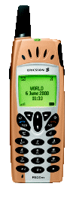
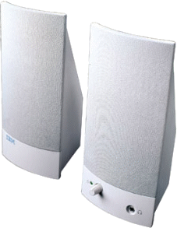


Ultimate Headset

Slide 10




Cordless Computer

Slide 11


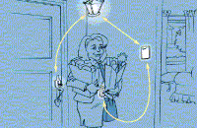

Automatic Synchronization
In the Office
At Home
Entering Home
Leaving Home

Slide 12
Bluetooth Standards Documents
Core specifications
  Details of various layers of Bluetooth protocol architecture
Profile specifications
  Use of Bluetooth technology to support various applications

Slide 13
History
1994 | Initial study started at Ericsson, Sweden.
1998 | Ericsson, Nokia, IBM, Toshiba and Intel formed a Special Interest Group (SIG) to develop a standard.
1999 | First specification was released and accepted as the IEEE 802.15 WPAN standard.
2001 | Bluetooth 1.1 : First specification (Basic Rate), BR – 1Mbps using GFSK
2003 | Bluetooth 1.2: Enhanced Voice, Faster Connect,QoS
2004 | Bluetooth 2.0: Enhanced Data Rate (EDR) – 3 Mb/s using DQPSK & 8DPSK,135 Million devices
2009 | Bluetooth 3.0 : High Speed (HS), Up to 24Mbps using a colocated 802.11 link.

Slide 14

Why is it called “Bluetooth”?
Harald Blaatand
  translated in English means “Bluetooth” (dark complexion)
  A.D. 940-981
  a king of Denmark and Norway (who unified these two countries without cables)
Brought Christianity to Scandinavians to harmonize their beliefs with the rest of Europe.
  symbolize the need for harmony among manufacturers of WPANs around the world.

Slide 15
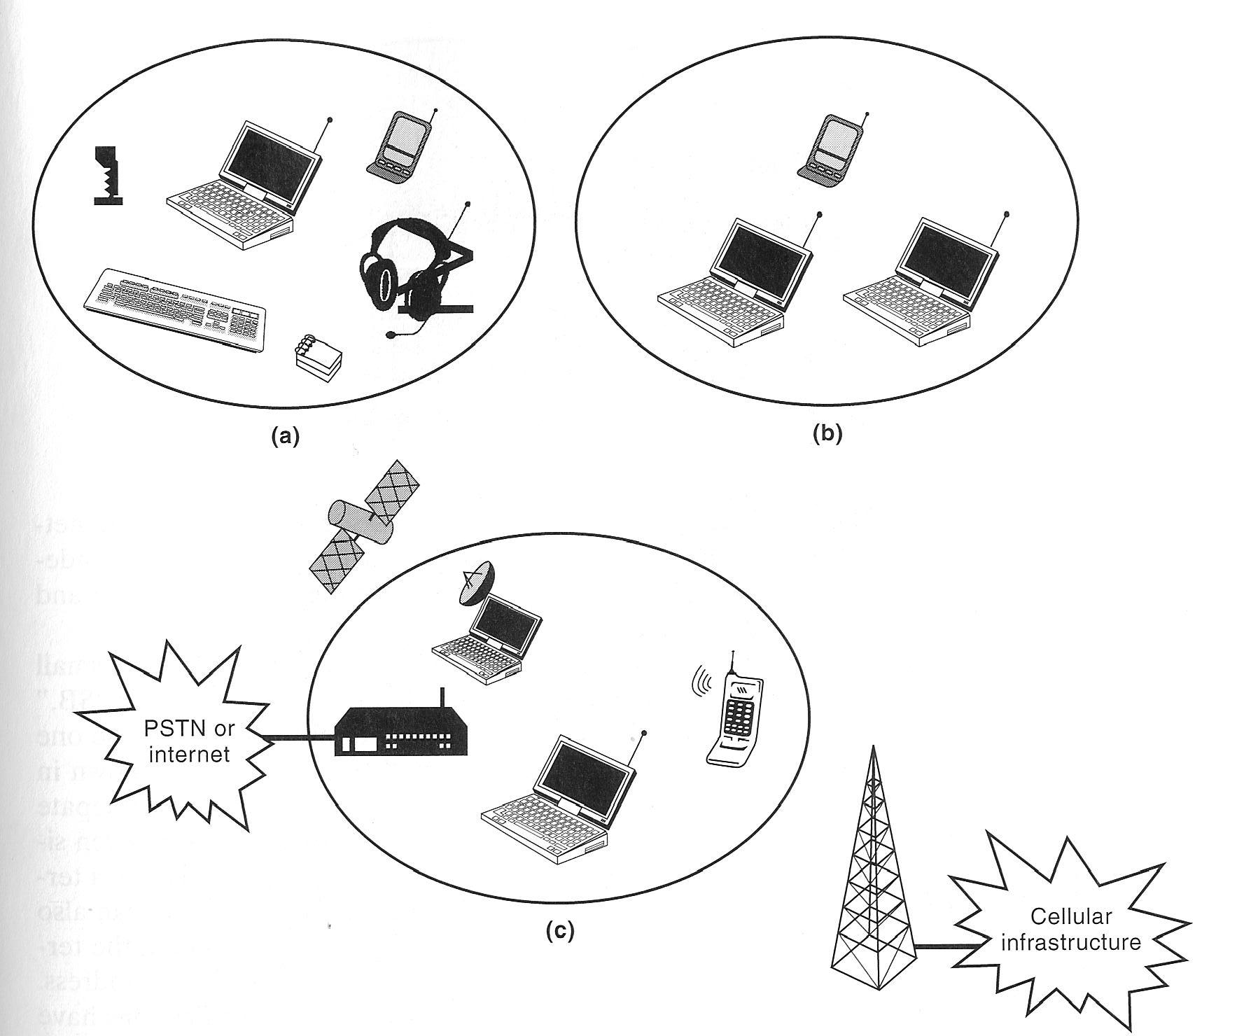
Application Scenarios
Cable Replacement
Ad Hoc Personal Network (e.g. connect multiple users in a conference room)
Integrated Access Point: connect wireless devices to both voice and data backbone infrastructure.

Slide 16
Usage Models
File transfer
Internet bridge
LAN access
Synchronization
Three-in-one phone
  Cordless phone to voice base station, intercom device and cell phone
Headset—act as remote device’s audio I/O interface

Slide 17
Piconets and Scatternets
Piconet
  Basic unit of Bluetooth networking
  1 Master and 1-7 slave devices
  Master determines channel and phase
Scatternet
  Device in one piconet may exist as master or slave in another piconet
  Allows many devices to share same area
  Makes efficient use of bandwidth

Slide 18
Piconet
Before a connection is created, a device is in “standby” mode, periodically listen for messages every 1.28 sec.
Devices are connected in an ad hoc fashion, called piconet.
Each piconet has 1 master and up to 7 slaves.
Other devices within the piconet will be considered “parked”.
Parked devices, as well as the slaves, are synchronized to the master.
P
S
S
M
P
SB
S
P
SB
M = Master
S = Slave
P = Parked
SB = Standby

Slide 19
Scatternet
Linking of multiple co-located piconets through the sharing of common master or slave devices
  A device can be slave in one piconet and master of another
  No device can be master of two piconets
Piconets
P
S
S
S
M
M
P
SB
P
M=Master
S=Slave
P=Parked
SB=Standby
S
P
SB
SB
S

Slide 20
Protocol Architecture
Bluetooth is a layered protocol architecture
  Core protocols
  Cable replacement and telephony control protocols
  Adopted protocols
Core protocols
  Radio
  Baseband
  Link manager protocol (LMP)
  Logical link control and adaptation protocol (L2CAP)
  Service discovery protocol (SDP)

Slide 21
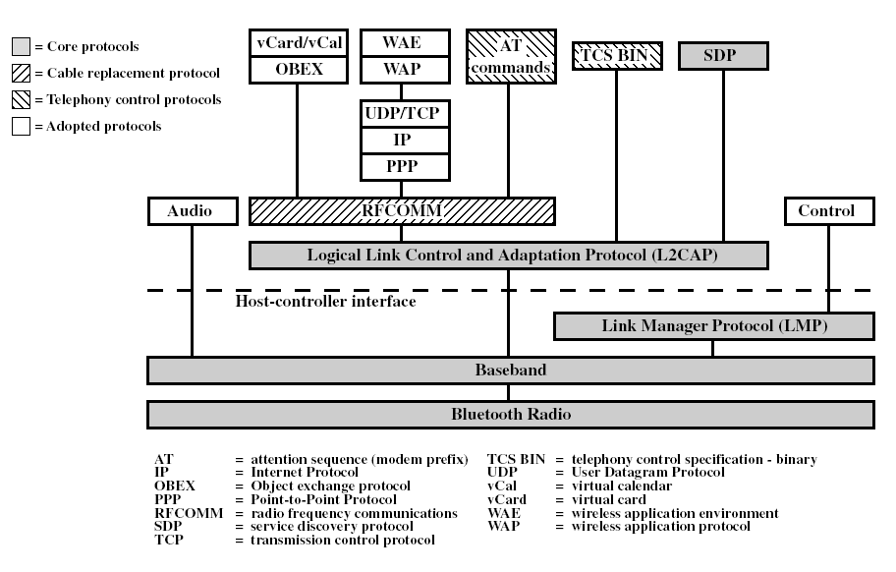
Protocol Architecture
Core Protocols

Slide 22
Protocol Architecture
Cable replacement protocol
  RFCOMM
Telephony control protocol
  Telephony control specification – binary (TCS BIN)
Adopted protocols
  PPP
  TCP/UDP/IP
  OBEX
  WAE/WAP

Slide 23
Core Protocols
Radio
  Physical layer aspects, e.g. frequency hopping, modulation, transmit power
Baseband
  Link control at bit and packet level, e.g. coding, encryption
  Provides two types of physical links, SCO and ACL.
Link Manager Protocol (LMP)
  Link setup and ongoing link management
Logical Link Control and Adaptation Protocol (L2CAP)
  Provide services to upper layer protocols (e.g. packet segmentation and assembly).
Service Discovery Protocol
  Discover available services and connects two or more devices to support a service such as faxing, printing, etc.

Slide 24
RADIO
Three Classes of Transmitters:
Class 1
  Output power: 1 mW – 100 mW
  Range: up to 100 m
  Power control is mandatory
Class 2
  Output power: 0.25 mW – 2.4 mW
  Range: 10 m
  Power control is optional
Class 3
  Output power: 1 mW
  Range: 0.1 – 10 m

Slide 25
MAC mechanism
FH-TDMA/TDD
  Time Division Duplex
  Hopping sequence shared with all devices on piconet
Piconet access:
  Bluetooth devices use time division duplex (TDD)
  Access technique is TDMA
  FH-TDD-TDMA
Polling
  Master polls the slaves for transmission
  No collision/interference within a piconet

Slide 26
Frequency Hopping
Provides resistance to interference and multipath effects
Provides a form of multiple access among co-located devices in different piconets.
Totally, 79 frequencies for hopping
  Each of bandwidth 1 MHz
  2402 + k MHz, k = 0, 1, ..., 78
ALL devices on a piconet follow the SAME frequency hopping sequence.
  1600 hops per second
  Therefore, each frequency is occupied for a duration of 625 μsec., called a slot.

Slide 27
Hopping Sequence
Every Bluetooth device has
  a unique device ID (48 bits Bluetooth address)
  a clock
Master gives its device ID and clock to its slaves
  Hopping pattern: determined by device ID
  Timing in hopping pattern: determined by clock
All slaves synchronizes to the master

Slide 28
Polling for Transmission
The MASTER polls the SLAVES according to certain rules
- e.g. round robin
P
S
S
M
P
SB
S
Time Division Duplex (TDD)
  When a master is transmitting, the slave is receiving and cannot transmit.
P
SB

Slide 29
Piconet basic polling scheme (RR)
Master
Slave 1
Slave 2
Slave n
Notes:
Here we see a basic piconet RR policy polling scheme
The master polls with a 1-slot packet. Slave 1 responds with a 3-slot packet. The master now polls slave 2 with a 5-slot packet and slave 2 responds with 1-slot packet and so on until the master finish polling all the slaves in the piconet and returns to poll slave 1

Slide 30
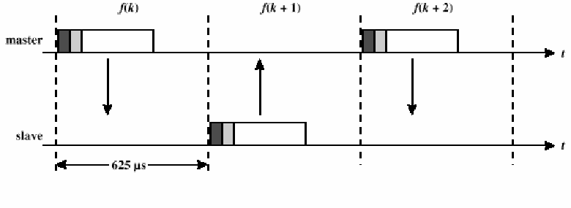
Alternate Transmission
Master transmits on even numbered slots
Slave transmits on odd numbered slots
A slave can transmit only if the master has just transmitted to this slave
f(k): the frequency used in slot k according to the hopping sequence.

Slide 31
Physical Links
Two types of links can be established between a master and a slave.
Synchronous Connection Oriented (SCO)
  For delay-sensitive traffic, e.g. voice
  Slots are reserved at regular intervals
  Master can support three simultaneous links
  Basic unit of reservation is two consecutive slots (one in each direction).
Asynchronous ConnectionLess (ACL)
  For best-effort traffic, e.g. data
  Use variable packet size (1,3,5 slots) to support asymmetric bandwidth
  Only single ACL link can exist

Slide 32
Example
SCO
ACL
SCO
ACL
SCO
ACL
SCO
ACL
MASTER
f₀
f₄
f₆
f₈
f₁₂
f₁₄
f₁₈
f₂₀
SLAVE 1
f₁
f₇
f₉
f₁₃
f₁₉
SLAVE 2
f₅
f₁₇
f₂₁
A multislot packet is transmitted using the same frequency until the entire packet has been sent.
In the next slot after the multislot packet, the frequency is chosen according to the original hopping sequence.
Therefore, two (for 3 slot packet) or four (for 5 slot packet) hop frequencies have been skipped.

Slide 33
Frame Format
Synchronization, paging and inquiry
Identify packet type and carry control information
Carry information bits
72
54
0-2744
bits
access code
packet header
payload
4
64
4
3
4
1
1
1
8
bits
preamble
sync.
(trailer)
AM address
type
flow
ARQN
SEQN
HEC
Active Member Address:
Up to 7 active slaves;
000 reserved for broadcast
Parity Check for the header
Packet Types
Status Reports

Slide 34
Packet Types
Control packets
  Four different types (ID, NULL, FHS, POLL)
SCO
  Three different types (HV1, HV2, HV3)
  64 kbps voice with different error protection
ACL
  Six different types (DM1, DM3, DM5, DH1, DH3, DH5)
  Different error protection and different data rates
Integrated
  Carries both voice and data (DV)
Others : AUX1 like DH1 but without CRC and 30 bytes long.

Slide 35
Control/system Packets
ID: Contains Device Access or Inquiry Access Code. Used for paging, inquiry, and response
NULL: Channel Access Code and Packet Header Used for acknowledgement and buffer flow control
POLL: Similar to NULL packet but a slave response is required upon reception
FHS: Contains Bluetooth device address and the clock information of sender, used in piconet set up and hop synchronization

Slide 36
Bluetooth Packet Fields
Access code – used for timing synchronization, offset compensation, paging, and inquiry (IAC, DAC & CAC)
Packet Header – used to identify packet type and carry protocol control information
Payload – contains user voice or data and payload header, if present

Slide 37
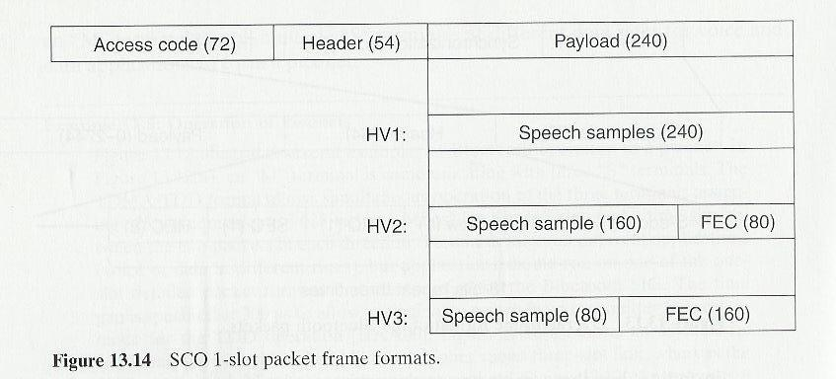
SCO Packet Frame Formats
No. of bits
High-quality Voice
Three different types
Forward Error Correction

Slide 38
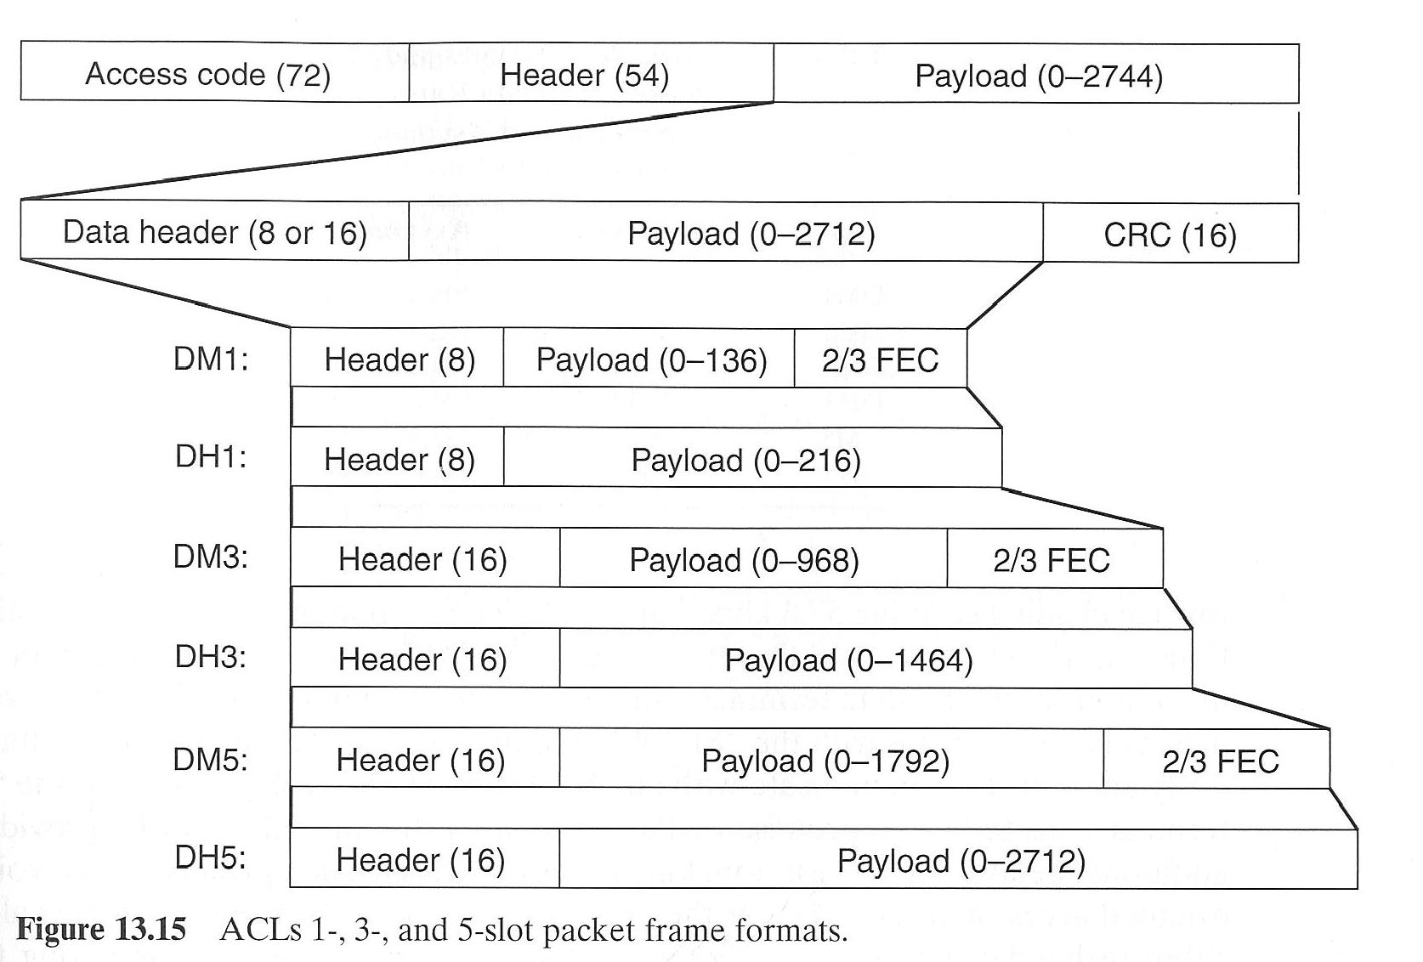
ACL Packet Frame Formats
Ckt settling time (in μsec) for 1 slot, 3 slots and 5 slots are 259, 253 and 255 respectively
Data Medium
Data High
Six different types

Slide 39
Example: Data Rate of DH1
Suppose that there is 1 master and 1 slave. What is the data rate of DH1 packets in each direction?
Solution:
  216 bits per slot
  800 slots per second (every other slot) in each direction
  Data rate = 216 (bits/slot) × 800 (slots/sec)
  = 172.8 Kbps

Slide 40
ACL Packet Types and
Associated Data Rates
Type | Symmetric | Asymmetric
DM1 | 108.8 | 108.8 | 108.8
DH1 | 172.8 | 172.8 | 172.8
DM3 | 256.0 | 384.0 | 54.4
DH3 | 384.0 | 576.0 | 86.4
DM5 | 286.7 | 477.8 | 36.3
DH5 | 432.6 | 721.0 | 57.6

Slide 41
Types of Access Codes
Channel Access Code (CAC):
  Identifies a piconet, this code is used with all traffic exchanged on a piconet
Device Access Code (DAC):
  Used for signaling, e.g. paging and response to paging
Inquiry Access Code (IAC):
  General Inquiry Access Code (GIAC): Common to all Bluetooth devices
  Dedicated Inquiry Access Code (DIAC): Common to a class of Bluetooth devices
  Inquiry process: “finds” BT devices in range

Slide 42
Access Code
Preamble – used for DC compensation
  0101 if LSB of sync word is 0
  1010 if LSB of synch word is 1
Sync word – 64-bits, derived from:
  7-bit Barker sequence (1110010)
  Lower address part (LAP)
  Pseudonoise (PN) sequence
Trailer (optional, if Packet header is used) – 4 bits
  0101 if MSB of sync word is 1
  1010 if MSB of sync word is 0

Slide 43
Packet Header Fields
AM_ADDR – 3 bits, contains “active mode” address of one of the slaves
Type – 4-bits, identifies type of packet
Flow – 1-bit flow control
ARQN – 1-bit acknowledgment
SEQN – 1-bit sequential numbering schemes
Header error control (HEC) – 8-bit error detection code
Total 18 bits → 54 bits thro 1/3 FEC

Slide 44
Payload Format (only for data pkt!)
Payload header
  L_CH field – identifies logical channel (at L2CAP)
  Flow field – used to control flow at L2CAP level
  Length field – number of bytes of data
Payload body – contains user data
CRC – 16-bit CRC code

Slide 45
Error Correction Schemes
1/3 rate FEC (forward error correction)
  Used on 18-bit packet header and voice field in HV1 packet. (Triplicate each individual bit).
2/3 rate FEC
  Used in DM data packets, data fields of DV packet, FHS packet and HV2 packet. (Hamming code with parameters (15,10)).
ARQ (to implement 1 bit SW protocol)
  Used with DM and DH packets (together with CRC)

Slide 46
ARQ Scheme Elements
Error Detection – destination detects errors (through CRC), discards packets
Positive Acknowledgment – destination returns positive acknowledgment
Retransmission after Timeout – source retransmits if packet unacknowledged
Negative Acknowledgment and Retransmission – destination returns negative acknowledgement for packets with errors, source retransmits

Slide 47
Connection Management

Slide 48
States of a Bluetooth device
standby
Unconnected
inquiry
page
Connecting
transmit
AMA
connected
AMA
Active
park
PMA
hold
AMA
sniff
AMA
Power saving
Standby: do nothing
Inquire: search for other devices
Page: connect to a specific device
Connected: participate in a piconet
Park: release AMA, get PMA
Sniff: listen periodically, not each slot
Hold: stop ACLs, SCO still possible, possibly
participate in another piconet

Slide 49
Establishing a Connection
Standby
  Devices not connected in a piconet are in standby mode
Inquiry
  A device sends an inquiry message to locate other devices within communication range.
    That device becomes Master
  Timing and Device ID of other devices are sent to the Master
    Those devices become Slaves
Page
  The Master sends its timing and Device ID to the slaves using a page message.
  A piconet is established and communication session takes place

Slide 50
Power Saving Modes
Hold
  No data is transmitted
  The device may connect to another piconet
Sniff
  The device listens to the piconet at reduced intervals
Park
  The device gives up its Active Member address but remains synchronized to the piconet
  It does not participate in the traffic but check on broadcast messages.

Slide 51
Connection Management
Channel Control

Slide 52
Logical Channels
Link control (LC)
Link manager (LM)
User asynchronous (UA)
User isochronous (UI)
Use synchronous (US)

Slide 53
Channel Control
States of operation of a piconet during link establishment and maintenance
Major states
  Standby – default state
  Connection – device connected

Slide 54
Channel Control
Interim substates for adding new slaves
  Inquiry – device has issued an inquiry for identity of devices within its range (Master)
  Inquiry scan – device is listening for an inquiry (Slave)
  Inquiry response – device receives an inquiry response
  Page – device issued a page (used by Master)
  Page scan – device is listening for a page (Slave)
  Master response – Master receives a page response from slave
  Slave response – Slave responds to a page from master

Slide 55
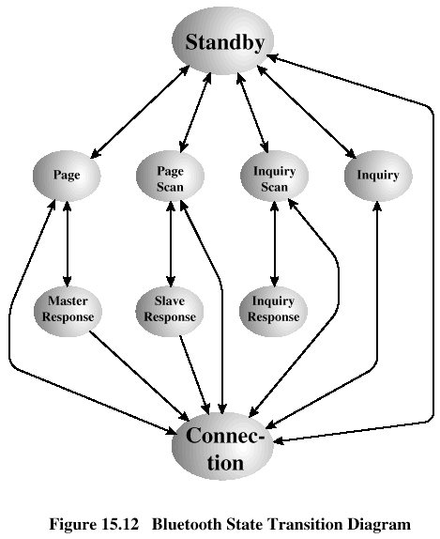
State Transition Diagram

Slide 56
Inquiry Procedure
Potential master identifies devices in range that wish to participate
  Transmits ID packet with inquiry access code (IAC)
  Occurs in Inquiry state
Device receives inquiry packet
  Enter Inquiry Response state
  Returns FHS packet with Device Address and Timing information
  Moves to page scan state

Slide 57
Page Procedure
Master uses Devices address to calculate a page frequency-hopping sequence (specific to a probable slave)
Master pages with ID Packet and device access code (DAC) of specific slave
Slave responds with DAC ID Packet
Master responds with its FHS Packet (DAC)
Slave confirms receipt with DAC ID Packet
Slaves moves to Connection state
Master assigns AMA and Sends POLL packet using CAC & slave sends NULL Packet

Slide 58
Slave Connection State Modes
Active – participates in piconet
  Listens, transmits and receives packets
Sniff – only listens on specified slots
Hold – does not support ACL packets
  Reduced power status
  May still participate in SCO exchanges
Park – does not participate on piconet
  Still retained as part of piconet

Slide 59
Bluetooth Audio
Voice encoding schemes:
  Pulse code modulation (PCM)
  Continuously variable slope delta (CVSD) modulation
Choice of scheme made by link manager
  Negotiates most appropriate scheme for application

Slide 60
Bluetooth Link Security
Elements:
  Authentication – verify claimed identity
  Encryption – privacy
  Key management and usage
Security algorithm parameters:
  Unit address
  Secret authentication key
  Secret privacy key
  Random number

Slide 61
LMP PDUs
General response
Security Service
  Authentication
  Pairing
  Change link key
  Change current link key
  Encryption

Slide 62
LMP PDUs
Time/synchronization
  Clock offset request
  Slot offset information
  Timing accuracy information request
Station capability
  LMP version
  Supported features

Slide 63
LMP PDUs
Mode control
  Switch master/slave role
  Name request
  Detach
  Hold mode
  Sniff mode
  Park mode
  Power control

Slide 64
LMP PDUs
Mode control (cont.)
  Channel quality-driven change between DM and DH
  Quality of service
  Control of multislot packets
  Paging scheme
  Link supervision

Slide 65
Link Manager Protocol
Applications
IP
SDP
RFCOMM
Control
Data
Setup and management
of Baseband connections
Piconet Management
Link Configuration
Security
Audio
L2CAP
Link Manager
LMP
Baseband
RF

Slide 66
Piconet Management
Attach and detach slaves
Master-slave switch
Establishing SCO links
Handling of low power modes ( Sniff, Hold, Park)
Paging
m
s
s
req
s
Master
Slave
response

Slide 67
Low power mode (hold)
Hold offset
Slave
Hold duration
Master

Slide 68
Low power mode (Sniff)
Sniff offset
Sniff duration
Slave
Sniff period
Master
Traffic reduced to periodic sniff slots

Slide 69
Low power mode (Park)
Slave
Beacon instant
Master
Beacon interval
Power saving + keep more than 7 slaves in a piconet
Give up active member address, yet maintain synchronization
Communication via broadcast LMP messages

Slide 70
Bluetooth Security

Slide 71
Bluetooth Identifiers
Device Address, 48 bits
Private Authentication Key, 128 bits
Private Encryption Key, 8 to 128 bits
RAND, 128 bits

Slide 72
Bluetooth Security Modes
Security Mode 1
  non-secure
Security Mode 2
  service-level
  after channel establishment
Security Mode 3
  link-level
  prior to channel establishment

Slide 73
Bluetooth Security Levels
Devices can be either
  Trusted or
  Untrusted
Service
  Authorization and Authentication
  Authentication Only
  Open to all devices

Slide 74
Bluetooth Unit Key, K_{A}
Unit Key
  K_{A}=E₂₁( Device Address_{A} , Random Number_{A})
  Usually fixed for the lifetime of the device and Private to the device

Slide 75
Pairing (key distribution)
Pairing is a process of establishing a trusted secret channel between two devices (i.e. construction of initialization key, K_{init})
K_{init} is then used to distribute unit keys or combination keys
PIN +
Claimant
address
PIN +
Claimant
address
Verifier
Random number
Claimant
challenge
Random
number
Random
number
response
accepted
Kinit
Kinit

Slide 76
Bluetooth Initial Key Generation: K_{init}
Verifier sends Claimant a random number IN_RAND
Verifier computes K_{init} from E₂₂(IN_RAND, PIN)
K_{init} is temporary link key
PIN can be
  Fixed in simple device
  Keyed in by user (typically 4 digits)
  Generated by user device

Slide 77
Bluetooth Authentication
Device A generates AU_RAND and sends it to Device B
Device B sends Device Address_{B} to Device A
Device A and Device B both compute SRES and ACO from SAFER+ based MAC function E₁(K_{init}, AU_RAND, Device Address_{B} )
Device B sends SRES_{B} to Device A
If SRES_{A} equals SRES_{B}, then devices are authenticated

Slide 78
Bluetooth Link Key, K_{link}
Two types of link keys ( K_{link} )
Unit key of one of the devices
  Unit A computes K = K_{A} XOR K_{init} and sends K to Unit B
  Unit B computes K_{A} = K XOR K_{init}
  K_{A} is used as link key
Key derived from both unit keys
  Unit A generates LK_RAND_{A}, sends it to Unit B and computes LK_K_{A} = E₂₁(LK_RAND_{A}, Device Address_{A} )
  Unit B generates LK_RAND_{B}, sends it to Unit A and computes LK_K_{B} = E₂₁(LK_RAND_{B}, Device Address_{B})
  Both units compute each other’s key and the link key K_{AB}= LK_K_{A} XOR LK_K_{B}

Slide 79
Bluetooth Encryption Key, K_{C}
K_{C} = E₃( EN_RAND_{A}, K_{link}, COF )
Ciphering Offset Figure (COF)
  Authenticated Ciphering Offset (ACO) or
  For broadcast, Device Address concatenated with itself

Slide 80
Bluetooth Encryption, K_{cipher}
K_{cipher} = E₀( Device Address_{A}, clock_{A}, K_{C} )
Data is exclusive-OR’ed with K_{cipher} before transmission and after reception

Slide 81
Bluetooth Security Issues
Privacy
  Devices can be closely tracked
Only devices are authenticated, not users
Key variables exchanged in the clear
Link key a shared secret among too many
  A, B use A’s unit key as the link key
  B can later use A’s unit key and a faked address to eavesdrop on traffic

Slide 82
Link Manager Protocol Summary
Device 1
Device 2
L2CAP
L2CAP
LMP
Data link
LMP
Baseband
Baseband
Physical
Piconet management
Link configuration
  Low power modes
  QoS
  Packet type selection
Security: authentication and encryption

Slide 83
L2CAP
Applications
Logical Link Control and
Adaptation Protocol
IP
SDP
RFCOMM
Data
L2CAP provides
  Protocol multiplexing
  Segmentation and Re-assembly
  Quality of service negotiation
Audio
L2CAP
Link Manager
Baseband
RF

Slide 84
Why baseband isn’t sufficient
IP
RFCOMM
IP
RFCOMM
Multiplexing
demultiplexing
MTU
reliable*, flow controlled
Baseband
in-sequence, asynchronous link
Baseband packet size is very small (17min, 339 max)
No protocol-id field in the baseband header
Notes:
Baseband provides hard coded choices for ARQ and FEC. How good those choices are in providing good quality of service. Would it be better to provide more flexibility to the higher layers?

Slide 85
Need a multiprotocol encapsulation layer
IP
RFCOMM
IP
RFCOMM
unreliable,
no integrity
reliable*, in-order,
flow controlled, ACL link
Desired features
Protocol multiplexing
Segmentation and re-assembly
Quality of service
What about
Reliability?
Connection oriented or connectionless?
integrity checks?
Notes:
Baseband provides hard coded choices for ARQ and FEC. How good those choices are in providing good quality of service. Would it be better to provide more flexibility to the higher layers?
If we were to define another adaptation layer on top of SCO link, what would it look like?
What problem you’ll run into if you try to use L2CAP segmentation/reassembly over multihop links? Ans: L2CAP fragments have no-id. It is impossible to distinguish one fragment from the other.
What is the use of the flow-control bit in the ACL payload header? How is it different from the Flow bit in the baseband header?
How about ARQ at L2CAP layer and no reliability at Baseband?

Slide 86
Segmentation and reassembly
Length
Payload
Baseband
packets
CRC
CRC
CRC
start of
L2CAP
continuation
of L2CAP
continuation
of L2CAP
cannot cope with re-ordering or loss
mixing of multiple L2CAP fragments not allowed
If the start of L2CAP packet is not acked, the rest should be discarded
min MTU = 48
672 default
Notes:
Min MTU = 48 equals two DH1 packets. 27 + 27 – 6 (l2cap header) = 48.
Default MTU = 672 equals two DH5 packets. 339 + 339 – 6 = 672.
Analyze how well links be utilized for different combinations of higher layer MTU, negotiated L2CAP MTU, and choice of packet types.

Slide 87
Multiplexing and Demultiplexing
IP
RFCOMM
IP
RFCOMM
Circuit or connection-less ?
Why is L2CAP connection oriented ?
Baseband is polling based
Bandwidth efficiency
  - carry state in each packet Vs. maintain it at end-points
Need ability for logical link configuration
  MTU
  reliability (Flush timeout option)
  QoS (token bucket parameter negotiation)
Notes:
Evaluate design choices of L2CAP.
Simplicity was one of the goals, but was it achieved?
Parameter negotiation adds complexity and extra round trips. Since memory and processing are becoming cheap, it is not clear if the flexibility offered by parameter negotiation buys anything at all.
MTU, reliability, and QoS should be link properties, not per L2CAP connection properties. I wonder how often different protocols will use different params for L2CAP connection.

Slide 88
L2CAP Channels
Length
CID
Payload
signaling
channel
Slave #1
01
01
master
Slave #3
01
01
CID
CID
CID
CID
CID
CID
data
channel
CID
01
Signaling channel CID
does not uniquely
determine the identity
of the source L2CAP entity
Signaling channel for
1) connection establishment
2) channel configuration
3) disconnection
CID
01
Slave #2

Slide 89
L2CAP connection: an example
Initiator
Target
L2CAP_ConnectReq
Establishment
L2CAP_ConnectRsp
L2CAP_ConfigReq
Configuration
L2CAP_ConfigRsp
MTU, QoS
reliability
L2CAP_ConfigReq
L2CAP_ConfigRsp
Data transfer
Termination
L2CAP_DisconnectReq
L2CAP_DisconnectRsp

Slide 90
L2CAP Packet Format (Connectionless)
2
2
2+
0 – 64K
Length
DCID
PSM
Payload
Not fully developed yet.

Slide 91
Bluetooth Service Discovery Protocol
Applications
IP
SDP
RFCOMM
Data
Audio
L2CAP
Link Manager
Baseband
RF

Slide 92
Example usage of SDP
Establish L2CAP connection to remote device
Query for services
  search for specific class of service, or
  browse for services
Retrieve attributes that detail how to connect to the service
Establish a separate (non-SDP) connection to use the service

Slide 93
Serial Port Emulation using RFCOMM
Applications
IP
SDP
RFCOMM
Data
Serial Port emulation on top of a packet oriented link
Similar to HDLC
For supporting legacy apps
Audio
L2CAP
Link Manager
Baseband
RF

Slide 94
Serial line emulation over packet based MAC
RFCOMM
RFCOMM
L2CAP
L2CAP
Design considerations
  framing: assemble bit stream into bytes and, subsequently, into packets
  transport: in-sequence, reliable delivery of serial stream
  control signals: RTS, CTS, DTR

Slide 95
IP over Bluetooth V 1.0
Applications
IP
SDP
RFCOMM
Data
GOALS
Internet access using cell phones
Connect PDA devices & laptop computers to the Internet via LAN access points
Audio
L2CAP
Link Manager
Baseband
RF

Slide 96
L2CAP
Provides a link-layer protocol between entities with a number of services
Relies on lower layer for flow and error control
Makes use of ACL links, does not support SCO links
Provides two alternative services to upper-layer protocols
  Connectionless service
  Connection-mode service

Slide 97
L2CAP Logical Channels
Connectionless
  Supports connectionless service
  Each channel is unidirectional
  Used from master to multiple slaves
Connection-oriented
  Supports connection-oriented service
  Each channel is bidirectional
Signaling
  Provides for exchange of signaling messages between L2CAP entities

Slide 98
L2CAP Packet Fields for Connectionless Service
Length – length of information payload, PSM fields
Channel ID – 2, indicating connectionless channel
Protocol/service multiplexer (PSM) – identifies higher-layer recipient for payload
  Not included in connection-oriented packets
Information payload – higher-layer user data

Slide 99
Signaling Packet Payload
Consists of one or more L2CAP commands, each with four fields
  Code – identifies type of command
  Identifier – used to match request with reply
  Length – length of data field for this command
  Data – additional data for command, if necessary

Slide 100
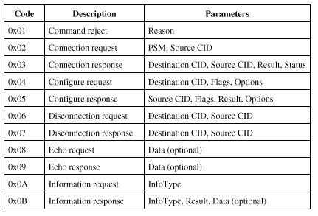
L2CAP Signaling Command Codes

Slide 101
L2CAP Signaling Commands
Command reject command
  Sent to reject any command
Connection commands
  Used to establish new connections
Configure commands
  Used to establish a logical link transmission contract between two L2CAP entities

Slide 102
L2CAP Signaling Commands
Disconnection commands
  Used to terminate logical channel
Echo commands
  Used to solicit response from remote L2CAP entity
Information commands
  Used to solicit implementation-specific information from remote L2CAP entity

Slide 103
Flow Specification Parameters
Service type
Token rate (bytes/second)
Token bucket size (bytes)
Peak bandwidth (bytes/second)
Latency (microseconds)
Delay variation (microseconds)

Slide 104
Interference
Bluetooth and IEEE 802.11

Slide 105
Interference
Both Bluetooth and IEEE 802.11 operates in 2.4 GHz.
These devices interfere with each other when they are co-located.
An analysis of the interference between these system is needed.

Slide 106
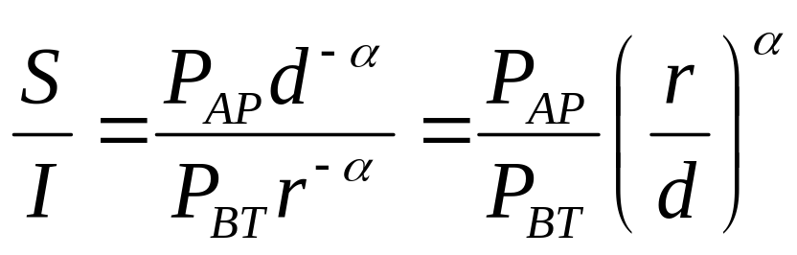
SIR at FHSS IEEE 802.11 MS
Suppose both systems hop to the same frequency.
r
802.11 MS
BT-1
d
BT-2
802.11 AP

Slide 107
Example: Interference Range
Assume:
  SIR is required to be greater than 10 dB.
  α = 2, d = 20 m.
  P_{AP} = 100 mW, P_{BT} = 1 mW.
What is the interference range of the FHSS IEEE 802.11 MS?
  i.e. the minimum r such that the MS can receive correctly

Slide 108
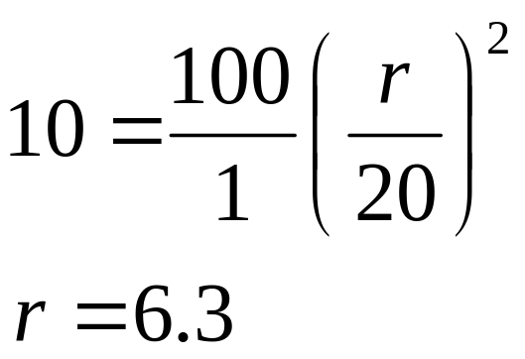
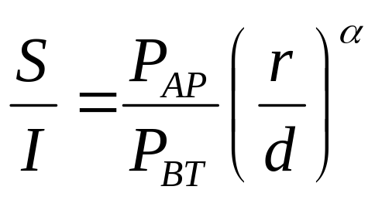
Solution
A Bluetooth device that is closer than 6.3 m to the MS will interfere and destroy the received packets.

Slide 109
Summary: Mobility and Data Rate
terminal
mobility
fast
GSM, IS-95
3G Cellular
mobile
WLAN
slow
portable
WPAN
fixed
bit
rate
10 kbps
100 kbps
1 Mbit/s
10 Mbit/s
100 Mbit/s

Slide 110
References
K. Pahlavan and P. Krishnamurthy, Principles of wireless networks: a unified approach, Prentice Hall, 2002.
J. Schiller, Mobile communications, Addison-Wesley, 2004.

