Slide 1
Topic 6
Mobile IP

Slide 2
Outline
How to support Internet mobility?
  by Mobile IP.
Our discussion will be based on IPv4 (the most widely used version).

Slide 3
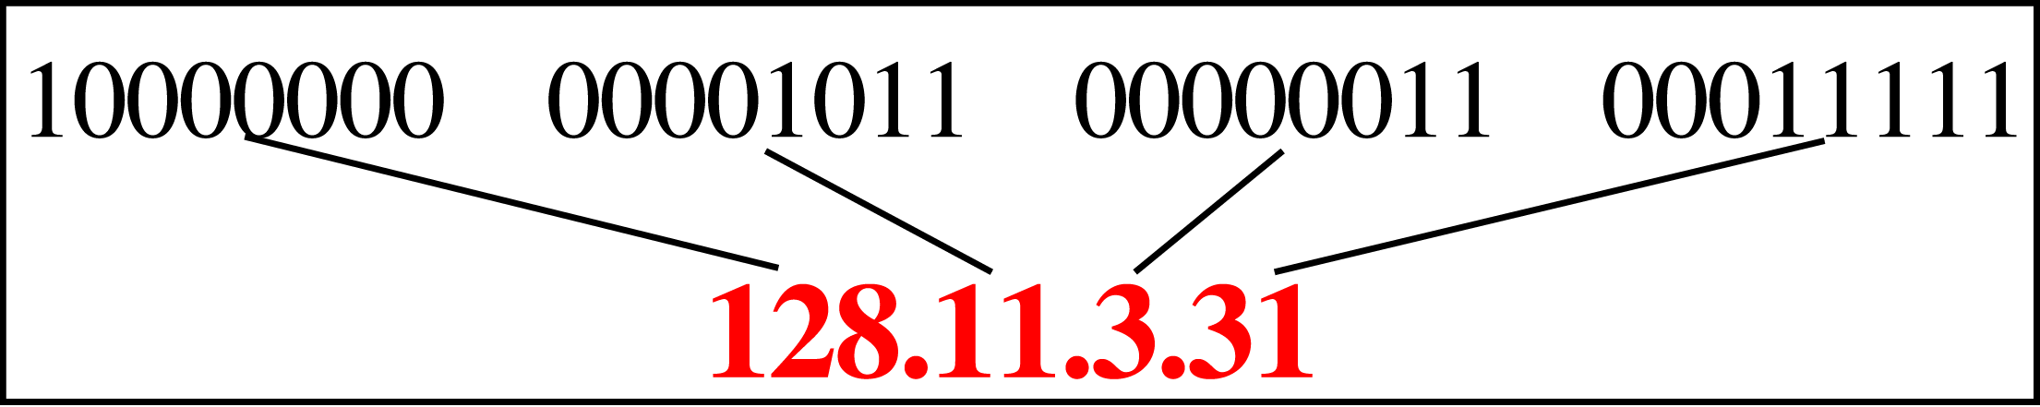
IP Address
IP address is a 32-bit number assigned to each network interface (NIC) of a node.
Nodes (such as routers) with multiple network interfaces have multiple IP addresses.
IP Address in Dotted-Decimal Notation

Slide 4
Network Prefix; Host Portion
An IP address has two components
  Network prefix
    Identifying a link (subnet)
    Identical for all nodes attached to the same link (subnet)
    IP Packets are routed based on their Network Prefix (or Subnet Prefix)
  Host portion
    Identifying a specific host or router connected to that link (subnet)
Example: 129.61.18.26, prefix length = 24
  Network prefix = 129.61.18
  Host portion = 26

Slide 5
Routing Table
Host 1
Router A
Router B
Router C
a
Host 1 wants to forward a packet to 7.7.7.1
Rules for Routing:
1. Compare the left-most Prefix-Length bits of each Target with the IP destination address.
2. Choose the matching route with the largest Prefix-Length.
Host 1’s routing table
Target / Prefix-Length | Next Hop | Interface
7.7.7.99 / 32 | router A | a
7.7.7.0 / 24 | router B | a
0.0.0.0 / 0 | router C | a
Default route

Slide 6

Host 1 wants to forward a packet to Host 4
Ethernet B
Network Prefix = 2.0.0
Ethernet A
Network Prefix = 1.0.0
High-Speed Fiber Backbone
Network Prefix = 3.0.0
Host 3
Host 4
Router B
b
b
Host 1
Host 2
b
3.0.0.253
c
2.0.0.3
2.0.0.4
Router A
2.0.0.253
a
a
a
c
Host 5
1.0.0.1
1.0.0.2
1.0.0.254
3.0.0.254
c
3.0.0.252
b
b
Router C
4.0.0.5
Host 1’s routing table
Target/Prefix-Length | Next Hop | Interface
1.0.0.0 / 24 | “direct” | a
0.0.0.0 / 0 | 1.0.0.254 | a
4.0.0.252
Ethernet C
Network Prefix = 4.0.0

Slide 7
Host 1 wants to forward a packet to Host 4
Ethernet B
Network Prefix = 2.0.0
Ethernet A
Network Prefix = 1.0.0
High-Speed Fiber Backbone
Network Prefix = 3.0.0
Host 3
Host 4
Router B
b
b
Host 1
Host 2
b
3.0.0.253
c
2.0.0.3
2.0.0.4
Router A
2.0.0.253
a
a
a
c
Host 5
1.0.0.1
1.0.0.2
1.0.0.254
3.0.0.254
c
3.0.0.252
b
b
Router A’s routing table
Target/Prefix-Length | Next Hop | Interface
1.0.0.0 / 24 | “direct” | a
3.0.0.0 / 24 | “direct” | c
2.0.0.0 / 24 | 3.0.0.253 | c
4.0.0.0 / 24 | 3.0.0.252 | c
Router C
4.0.0.5
4.0.0.252
Ethernet C
Network Prefix = 4.0.0

Slide 8
Host 1 wants to forward a packet to Host 4
Ethernet B
Network Prefix = 2.0.0
Ethernet A
Network Prefix = 1.0.0
High-Speed Fiber Backbone
Network Prefix = 3.0.0
Host 3
Host 4
Router B
b
b
Host 1
Host 2
b
3.0.0.253
c
2.0.0.3
2.0.0.4
Router A
2.0.0.253
a
a
a
c
Host 5
1.0.0.1
1.0.0.2
1.0.0.254
3.0.0.254
c
3.0.0.252
b
b
Router B’s routing table
4.0.0.5
Target/Prefix-Length | Next Hop | Interface
1.0.0.0 / 24 | 3.0.0.254 | c
2.0.0.0 / 24 | “direct” | b
3.0.0.0 / 24 | “direct” | c
Router C
4.0.0.252
Ethernet C
Network Prefix = 4.0.0

Slide 9
Host 1 wants to forward a packet to Host 4, by this time Host 4 has moved to Ethernet C
Ethernet B
Network Prefix = 2.0.0
Ethernet A
Network Prefix = 1.0.0
High-Speed Fiber Backbone
Network Prefix = 3.0.0
Host 3
?
Router B
b
Host 1
Host 2
b
3.0.0.253
c
2.0.0.3
Router A
2.0.0.253
a
a
a
c
Host 5
Host 4
1.0.0.1
1.0.0.2
1.0.0.254
3.0.0.254
c
b
3.0.0.252
b
b
Router B’s routing table
4.0.0.5
2.0.0.4
Target/Prefix-Length | Next Hop | Interface
1.0.0.0 / 24 | 3.0.0.254 | c
2.0.0.0 / 24 | “direct” | b
3.0.0.0 / 24 | “direct” | c
Router C
4.0.0.252
Ethernet C
Network Prefix = 4.0.0

Slide 10
Problem
(in using mobile computers without using additional mechanism for mobility support)
The packet is undeliverable
  Host 4 is not connected to Ethernet B. It is connected to Ethernet C, which makes it’s IP address to be topologically incorrect.
Router B will then send a Host Unreachable error message back to Host 1.
Q: How to solve it?

Slide 11
Solution 1: Host-Specific Route
Place host-specific routes in the routing tables of Routers A, B, and C as follows:
Target/Prefix-Length | Next Hop | Interface
2.0.0.4 / 32 | 3.0.0.252 | c
Is this a good solution?
Router A
Router B
Target/Prefix-Length | Next Hop | Interface
2.0.0.4 / 32 | 3.0.0.252 | c
Problems:
Fast updation of Routing tables is a problem.
Routing table explosion
Router C
Target/Prefix-Length | Next Hop | Interface
2.0.0.4 / 32 | “direct” | b

Slide 12
Solution 2: Change IP Address
Simply change the IP address of host 4, as it moves from Ethernet B to Ethernet C. That is assigning a topologically correct IP address.
For example, Dynamic Host Configuration Protocol (DHCP) can be used to acquire a new IP address.
To solve the problem of finding a MN which has changed its IP address, domain name (logical name) of the MN should be used.
Q: Is this a good solution?
Problems:
  Frequent updates in DNS required (expensive, specially when caching is used to improve scalability)
  Higher layer protocols like TCP rely on IP addresses, so changing IP address means breaking the ongoing TCP connection and reestablishing a TCP connection with new IP address (mobile node have to notify all the communication partners about this new IP address)
  Permanent IP address can not be used ( A permanent IP address which can be used for quick reachability of a node and emergency communication )

Slide 13
Solution 3: Mobile IP
A standard proposed to solve the problem of Internet mobility.
It allows the mobile node to use two IP addresses:
  a fixed Home Address (For Identification of the node)
  a Care-of Address that changes at each new point of attachment (For Locating the node)

Slide 14
Requirements for Mobile IP
Transparency:
  Mobility should remain transparent for higher layer protocols and applications
  Higher layers should continue to function even if the MN has changed its POA
  Applications/higher layer protocols may notice a lower b/w and higher delay
  Some applications/protocols are designed to be ‘mobility-aware’ for performance enhancement
Compatibility
  The installed base of TCP/IP based networks/nodes is huge. So, Mobile IP should not introduce change in existing applications and n/w protocols.
  It should require no changes to software of non-mobile hosts/routers
  Should be integrated into existing OS
  Routers within the Internet should not require other s/w
  End systems enhanced with mobile IP should be able to comm with systems without mobile IP
  Requires no modifications to IP addresses or IP address format

Slide 15
Requirements for Mobile IP(Cont’d)
Scalability and Efficiency:
  Enhancing IP for mobility must not generate too many new messages flooding the whole network
  Mobile IP should be scalable over a large number of potential participants in the whole internet
Security
  All the messages related to the management of Mobile IP are to be authenticated
  IP layer must be sure that if it forwards a packet to a mobile node, this node receives the packet (to guarantee that IP address of the receiver is correct)
  It can not prevent fake IP address and /or other attack

Slide 16
Mobile IP Features
Allows a host to be reachable at the same address, even if it changes its location
Makes it seems as one network extends over the entire Internet
Continuous connectivity, Seamless roaming
even while network applications are running
Fully transparent to the user

Slide 17
Entities and Relationships
Mobile Node “visiting” a foreign link
Mobile Node “at home”
Foreign Agent
Foreign Link
Home Link – the link having the same network prefix as the node’s IP address
Home Agent – a router on the mobile node’s home link.
Foreign Link
Foreign Agent

Slide 18
Care-of Address
Two conceptual types of care-of addresses
  Foreign agent care-of address
  Collocated care-of address

Slide 19
Foreign Agent Care-of Address
IP address of a foreign agent which has an interface on the foreign link/subnet.
  The foreign agent may have more than one IP address; hence, the network-prefix need not equal the network prefix of the foreign link
The same address can be shared by many mobile nodes simultaneously.

Slide 20
Collocated Care-of Address
An IP address temporarily assigned to a MN.
  It can be used by only one mobile node at a time.
The network prefix must equal the network prefix of the foreign link.
It might be used by a MN in situations where no FAs are available.

Slide 21
Three Mechanisms for Mobile IP
Agent Discovery
Registration
Routing

Slide 22
1. Agent Discovery
Home Agents (HAs) and Foreign Agents (FAs) periodically broadcasts Agent Advertisements.
  e.g. once every few seconds
  If the mobile node does not want to wait for the periodic advertisement, it can broadcast Agent Solicitations that will be answered by any foreign agent that receives it.
MNs determine whether they have moved from one link/subnet to another. (How?)
( From lifetime field of Agent Advertisement & Network prefix )

Slide 23
Automatic Home Agent Address Discovery
MN sends a Registration Request as home network directed broadcast (network-prefix.11111…1)
HAs reply with a negative Registration Reply (registration denied)
MN learns HA address from the negative Registration reply, and initiates an actual registration

Slide 24
Move Detection
Agent Advertisement has a Lifetime field.
  specify how soon a mobile node should expect to hear another advertisement from that same agent.
If the MN fails to hear an advertisement from that agent within the specified Lifetime, then it assumes that it has moved to a different link.
If the MN hears an advertisement with a different network prefix, MN detects existence of a new link/subnet.

Slide 25
Care-of Address
A MN connected to a foreign link acquires a FA care-of-address from the Agent Advertisements.
  If multiple care-of-addresses are listed, any one of them can be used.
If a FA is unavailable, the MN obtains a collocated care-of address by Dynamic Host Configuration Protocol (DHCP).

Slide 26
DHCP
Goal
  allow host to dynamically obtain its IP address from network server when it joins a network
A client-server protocol
4-way handshake

Slide 27



DHCP Client-Server Scenario
223.1.1.1
DHCP
223.1.2.1
server
223.1.1.2
223.1.1.4
223.1.2.9
223.1.2.2
E
arriving DHCP
client needs
address in this
network
223.1.1.3
223.1.3.27
223.1.3.1
223.1.3.2
DHCP relay agent (typically a router) for 223.1.1 and 223.1.3.
It knows the address of a DHCP server for these networks.

Slide 28
Broadcast Address: 255.255.255.255
UDP port 67
What is source address?
DHCP server: 223.1.2.5
arriving
client
DHCP discover
src : 0.0.0.0, 68
dest.: 255.255.255.255,67
yiaddr: 0.0.0.0
transaction ID: 654
Allocates an IP address and set the time for which the address will be valid.
DHCP offer
src: 223.1.2.5, 67
dest: 255.255.255.255, 68
yiaddrr: 223.1.2.4
transaction ID: 654
Lifetime: 3600 secs
Choose an offer if more than one server replies.
DHCP request
src: 0.0.0.0, 68
dest:: 255.255.255.255, 67
yiaddrr: 223.1.2.4
transaction ID: 655
Lifetime: 3600 secs
time
DHCP ACK
src: 223.1.2.5, 67
dest: 255.255.255.255, 68
yiaddrr: 223.1.2.4
transaction ID: 655
Lifetime: 3600 secs

Slide 29
Packets used for Agent Discovery
Agent advertisement
  ICMP message with type field=9 (router discovery)
  Also contain a mobility agent advertisement extension with the following fields (type =16)
    Home agent bit (H) : indicates the agent is a home agent
    Foreign agent bit (F): ………………….. Foreign Agent
    Registration reqd bit (R ): MN in this n/w must register with a FA (can not use DHCP). B (Busy)
    M (Minimal),G (Generic routing Encap) encapsulation bits: whether a form of encap other than IP-in-IP will be used.
    COA: a list of IP addresses
Agent Solicitation : ICMP with type=10

Slide 30
Agent Advertisement
0
7
8
15
16
23
24
31
ICMP Router Discovery Protocol
(IRDP: RFC 1256)
Type = 16
Length = 6 + 4 * #COAs
R: Registration required
B: Busy, no more registrations
H: Home agent
F: Foreign agent
M: Minimal encapsulation
G: GRE
r: Sent as 0, ignored on reception
T: FA supports reverse tunneling
reserved: Sent as 0,
ignored on reception
Type
Code
Checksum
#addresses
Addr. size
Lifetime
Router address 1
Preference level 1
Router address 2
Preference level 2
. . .
Type
Length
Sequence number
Registration Lifetime
R
B
H
F
M
G
r
T
reserved
zero or more COAs
. . .
Notes:
Same as ICMP Router Advertisement/Solicitation but TTL 1 and DestIP is multicast, 224.0.0.1 (all systems on this link) or 255.255.255.255 (limited broadcast)
Type: 9 = advertisement, 10 = solicitation
Code: 0 = advertising agent is fully capable router, 16 = only just Mobile IP agent
Type 9
Code 0
Checksum The 16-bit one's complement of the one's complement sum of the ICMP message, starting with the ICMP Type. For
computing the checksum, the Checksum field is set to 0.
Num Addrs The number of router addresses advertised in this message.
Addr Entry Size The number of 32-bit words of information per each router address (2, in the version of the protocol described here).
Lifetime The maximum number of seconds that the router addresses may be considered valid.
Router Address[i] The sending router's IP address(es) on the i = 1..Num Addrs interface from which this message is sent.
Preference Level[i] The preferability of each Router Address[i] i = 1..Num Addrs as a default router address, relative to other router
addresses on the same subnet. A signed, twos-complement value; higher values mean more preferable.
Agent Advertisement: a beacon that is sent at a defined interval
Agent Solicitation = ICMP router solicitation with TTL = 1 (Node sent to Router to led Router sent advertisement)
Length = 6 +4*#COAs (6 = the number of bytes in the sequence number + another 4)
Sequence Number = the count of Agent Advertisement messages sent since the agent was initialized
Registration Lifetime: (second) 0xffff = infinity
Prefix Length Extension:
Type = 19 and Prefix Length = Network prefix lengths are specified for each respective router address listed in IRDP extension
Challenge Extension:
Type = 24 and Challenge = pseudorandom challenge that provides replay protection at FA

Slide 31
2. Registration
Registration is the process by which a mobile node (MN)
  requests routing services from a foreign agent (FA);
  informs its home agent (HA) of its current care-of address (COA);
  renews a registration which is due to expire;
  deregisters when it returns to its home link.

Slide 32
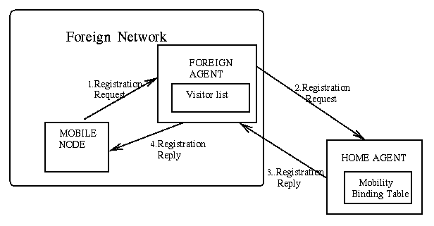
Registration Process

Slide 33
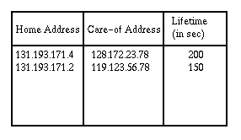
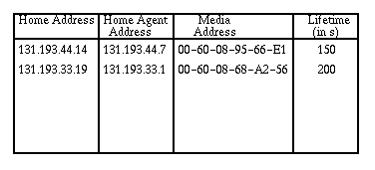
Tables maintained on routers
Mobility Binding Table
  Maintained on HA of MN
  Maps MN’s home address with its current COA
Visitor List
  Maintained on FA serving an MN
  Maps MN’s home address to its MAC address and HA address

Slide 34
UDP packets used in Registration
Source Port
Destination Port = 434
Length
Check Sum
UDP
Registration Request
S: Simultaneous Binding
B: Broadcast receive
D: Decapsulation
T: Reverse Tunneling
Registration Reply
0
7
8
15
16
23
24
31
Type = 1
S
B
D
M
G
r
T x
Lifetime
Home address
Home agent
COA
Identification
Extensions . . .
0
7
8
15
16
31
Type = 3
Code
Lifetime
Home address
Home agent
Identification
Extensions . . .
Notes:
Identification Unique identification to match the RRP to the RRQ, and unique identification of the Mobile Node
S: A Mobile Node is requesting the use of simultaneous bindings. This requires the Home Agent to duplicate all packets and forward them to
multiple CoAes. (without packet lost)
B: A Mobile Node is requesting that broadcast datagrams from its Home Network be delivered to it.
D: The Mobile Node is specifying that it can perform the Mobile IP tunnel decapsulation, that is, the Mobile Node is using a CCoA and, thus, is
the tunnel endpoint.
M: The Mobile Node is requesting that the Home Agent use minimal encapsulation, as defined in RFC 2004, instead of IP-in-IP encapsulation for
the Mobile IP tunnel.
G: The Mobile Node is requesting that the Home Agent use GRE, as defined in RFC 1701, instead of IP-in-IP encapsulation for the Mobile IP
tunnel.
r: Sent as zero; ignored on reception. SHOULD NOT be allocated for any other uses.
T: The Mobile Node is requesting reverse tunneling for packets originated by the Mobile Node.
x: Sent as zero; ignored on reception.
Registration Reply:
UDP fields: Source Port <variable>
Destination Port Copied from the source port of the corresponding Registration Request
Code: A value indicating the result of the Registration Request. See below for a list of currently defined Code values.
Identification: A 64-bit number used for matching Registration Requests with Registration Replies, and for protecting against replay attacks of
registration messages. The value is based on the Identification field from the Registration Request message from the mobile node,
and on the style of replay protection used in the security context between the mobile node and its home agent (defined by the
mobility security association between them, and SPI value in the authorization-enabling extension).
0 registration accepted
1 registration accepted, but simultaneous mobility bindings unsupported
[40] Reynolds, J. and J. Postel, "Assigned Numbers", STD 2, RFC 1700, October 1994.

Slide 35
Agent Advertisement & Mobile IP registration
Home Agent:
128.119.40.7
Foreign Agent:
COA: 79.129.13.2
Visited N/w:
79.129.13/24
MN:
128.119.40.186
ICMP agent adv.
COA: 79.129.13.2
……………….
Registration Req.
COA: 79.129.13.2
HA: 128.119.40.7
MN: 128.119.40.186
Lifetime: 9999 (requested) (0 dereg.)
Identification: 714
………………
Registration Req.
COA: 79.129.13.2
HA: 128.119.40.7
MN: 128.119.40.186
Lifetime: 9999 (requested)
Identification: 714
Encapsulation format …………
Registration Request is sent as UDP with port no 434
S, B, D (decap by MN),
Registration Reply
time
COA: 79.129.13.2
HA: 128.119.40.7
MN: 128.119.40.186
Lifetime: 4999 (Actual)
Identification: 714
Encapsulation format …………
Registration Reply
COA: 79.129.13.2
HA: 128.119.40.7
MN: 128.119.40.186
Lifetime: 4999 (Actual)
Identification: 714
…………

Slide 36
Scenario 1: Registering Foreign Agent Care-of Address
The mobile node, with the assistance of a foreign agent, sends a Registration Request with the care-of address information.
1
2
Mobile Node “visiting” a foreign link
Home Agent
Foreign Agent
4
3
When the home agent receives this request, it adds the necessary information to its routing table, and sends a Registration Reply back to the mobile node.

Slide 37
Scenario 2: Registering Collocated Care-of Address
1. Registration Request
Mobile Node “visiting” a foreign link
Home Agent
2. Registration Reply

Slide 38
Scenario 3: Deregistration
Mobile Node returns to its home link
1. (de-)Registration Request
Home Agent
2. (de-)Registration Reply

Slide 39
Authentication
The HA must be certain that registration was originated by the MN and not by some other malicious node.
Registration of the CoA requires authentication.
  The mobile node needs to prove its identity to its home agent.
  It is done by making use of a secret key known only to the MN and its HA.
  Uses keyed MD5 with key length 128 bits (SPI)
  Uses timestamp or pseudo random no (reg. req id) to safeguard replay attack.

Slide 40
3. Routing
Different Scenarios:
Correspondent Node → Mobile Node
  With a FA
  Without a FA
Mobile Node → Correspondent Node

Slide 41
How to Send Packets from CN to a Mobile Node?
Mobile Node
Foreign Agent
Home Agent
CN sends a packet with:
Source address | Correspondent’s IP address
Destination address | Mobile’s Home IP address
Correspondent

Slide 42
Packets (destined for MN’s Home IP) received on Home Network
If the HA is the gateway host then picking up packets destined for the MN is trivial
If the HA is not the gateway host then the proxy ARP must be used. The HA pretends to be MN and responds to requests for MN’s PHY address (e.g. Ethernet address) with its own PHY address
ARP caches on all hosts have to be updated upon registration of the MN (through gratuitous ARP)

Slide 43
Tunneling to the Care-of Address
HA intercepts packets destined to the MN’s home address and tunnels them to the MN’s care-of address.
Mobile Node “visiting” a foreign link
Foreign Agent
Tunnel
Home Agent
FA removes original packet from the tunnel and delivers the original packet to the MN over the foreign link/subnet.

Slide 44
IP in IP Encapsulation
Ipsrc = Original Sender Ipdes = Destination’s Home Address
Original IP packet
Header
Payload
The home agent inserts a new IP header, or tunnel header, in front of the IP header of any datagram addressed to the mobile node’s home address.
Ipsrc = Home Agent Ipdes = Mobile node’s Care-of Address
Outer Header
Encapsulating IP packet
Header
Payload
Outer Payload

Slide 45
IP-in-IP-encapsulation
Repetition of almost all identical fields except a few
adds more overhead but can handle incoming fragmentation
original IP
header
original data
new IP header
new data
outer header
Inner header
original data
ver.
IHL
DS (TOS)
length
IP identification
flags
fragment offset
TTL
IP-in-IP
IP checksum
IP address of HA
Care-of address COA
ver.
IHL
DS (TOS)
length
IP identification
flags
fragment offset
TTL
Protocol
IP checksum
IP address of CN
IP address of MN
TCP/UDP/ ... payload
Notes:
Note: **Don’t fragment field** on outer header or if set, enabling tunnel path MTU discovery

Slide 46
Minimal Encapsulation
ver.
IHL
DS (TOS)
length
IP identification
flags
fragment offset
TTL
min. encap.
IP checksum
IP address of HA
care-of address COA
Protocol
S
reserved
IP checksum
IP address of MN
original sender IP address (if S=1)
TCP/UDP/ ... payload
Avoid repetition of identical fields
adds less overhead but needs a complete IP packet before encapsulation
Notes:
Protocol: Copied from the Protocol field in the original IP header.
Original Source Address Present (S):
0 The Original Source Address field is not present. The length of the minimal tunneling header in this case is 8 octets.
1 The Original Source Address field is present. The length of the minimal tunneling header in this case is 12 octets.
Reserved: Sent as zero; ignored on reception.
Header Checksum: The 16-bit one's complement of the one's complement sum of all 16-bit words in the minimal forwarding header. For purposes of computing the checksum, the value of the checksum field is 0. The IP header and IP payload (after the minimal forwarding header) are not included in this checksum computation.
Original Destination Address: Copied from the Destination Address field in the original IP header.
Original Source Address: Copied from the Source Address field in the original IP header. This field is present only if the Original Source Address Present (S) bit is set.

Slide 47
How to Send Packets to a Correspondent Node?
Mobile Node
Foreign Agent
Home Agent
Simply use the Correspondent’s IP address as the destination address.
Correspondent Node
How about the source address? Original IP address? Or Care-of Address?
Original IP address of MN is not topologically correct source address in Foreign n/w. Similarly, COA is not topologically correct source address in Home n/w.

Slide 48
Triangle Routing
Mobile Node “visiting” a foreign link
Foreign Agent
Home Agent
Problems: Delay & unnecessary n/w loads in CN to HN and HN to FN.
Why doesn’t the MN inform the CN of its CoA and have it tunnel directly to the MN?
Correspondent Node

Slide 49
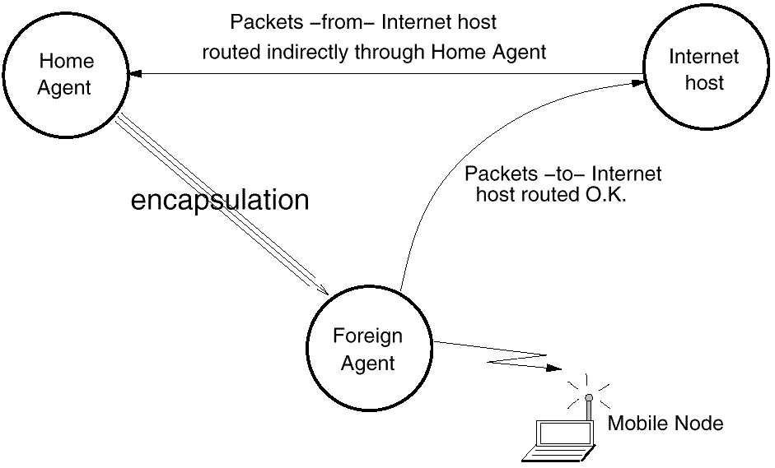
Triangle Routing
    Triangle routing is undesirable because
    HA is the bottleneck, and extra delays
    more network load, and sensitivity to network partition
    In case of reverse tunneling, the situation is even worse
    ⇒ Route optimization: Get binding to the CN

Slide 50
(Smooth) Handoff
Mobile host moves along subnetworks, from FA to FA.
Packets already in flight to old FA are lost after handoff to new FA
Route optimization allows old FA to forward packets to new care-of address

Slide 51
Route Optimization (1)
  Get binding to relevant correspondent hosts for optimal routing:
    Binding Warning (FA → HA/CN): If a node decapsulates a packet for an MN, but it is not the current FA for this MN then that FA sends binding warning to HA/CN. Finally, CN is informed by HA with a fresh “binding update” with correct COA.
    Binding Request (CN → HA) : If a CN wants to know the current COA of an MN. HA checks if MN allows to reveal its location.
    Binding Update (HA → CN): if the MN allows, HA can send the current COA of the MN. HA may request an ACK for this. CN stores the binding in a “binding cache”.
    Binding Acknowledge (optional, CN → HA ): if requested, returns this after receiving a “binding update”.
  Security association between CN and HA is needed for authentication

Slide 52
Route Optimization (2)
Get binding to old FA for smooth handoff:
  previous FA notification extension (MN → new FA)
  binding update (new FA → old FA)
  binding acknowledge (old FA → new FA)
  Binding warning (old FA → CN/HA), to inform that CN has a outdated binding cache.
  MN and FA need to exchange registration key for authentication
  last resort: special tunnel (old FA tunnels packet back to the HA)

Slide 53
Reverse tunneling
Firewalls: Ingress/outgress packet filter (topologically correct source address)
Multicast : Only possible in home network.
TTL: To make mobile IP transparent to user hosts.
(reverse tunneling represents only one hop from foreign network to home network)

Slide 54
Simultaneous Bindings
  A Mobile Node may register multiple bindings simultaneously
  The Home Agent makes multiple copies of packets destined for the mobile host, and tunnels a copy to each care-of address
  Simultaneous bindings may be used to
    facilitate seamless hand-off
    avoid too frequent registrations

Slide 55
Mobility for IPv6
  All nodes can handle bindings
    No triangular routing
  Binding updates are carried in Destination Option
    Small overhead for distributing bindings
  Mobile host can create its own care-of address using link-local address and automatic address configuration (combine advertised subnet prefix with own hardware address)
    No need for foreign agent

Slide 56
Conclusion
  Mobile IP consists of 3 parts:
    Advertising Care-of Addresses
    Registration
    Tunneling
  Mobility will be an important feature of the next generation Internet (Mobile Internet)
  Other solutions exist:
    cellular solution (HLR / VLR)
    application specific solutions (e.g., SIP)
    but Mobile IP provides global,
    application independent Internet mobility

Slide 57
Optimized Routing
Mobile Node “visiting” a foreign link
Foreign Agent
Home Agent
This is potentially more efficient in terms of delay and resource consumption.
Why is it not used?
Correspondent

Slide 58
Main Obstacle: Security
A bad guy sends a fake registration to the correspondent
Mobile Node “visiting” a foreign link
Foreign Agent
Home Agent
Correspondent
It is impractical to distribute keys between a mobile node and every other node with which it might correspond.

Slide 59
References
J. D. Solomon, Mobile IP: the Internet unplugged, Prentice Hall, 1998.
C. E. Perkins, “Mobile networking through mobile IP,” IEEE Internet Computing, pp. 58-69, Jan/Feb, 1998.

