Slide 1
Topic 7
Wireless TCP

Slide 2
This topic includes:
Introduction to TCP
  Congestion Control Mechanisms
TCP over wireless networks
  I-TCP
  Snoop
  M-TCP
  Fast retransmit/recovery
  Transmission Time-out Freezing
  Selective Retransmission
  T-TCP etc

Slide 3
Internet Protocol (IP)
Network layer protocol
Data delivery is unreliable:
  Packets may be delivered out-of-order
  Packets may be lost
  Packets may be duplicated

Slide 4
Transmission Control Protocol (TCP)
Transport layer protocol
Reliable, ordered delivery
  Reliability achieved by retransmissions
  Correct ordering achieved by buffering at the receiver
End-to-end control
  Implements congestion control
  ACK sent to the TCP sender confirms delivery of data received by the TCP receiver

Slide 5
TCP Basics

Slide 6
Sequence Numbers
TCP assigns byte sequence numbers
  For illustrative purpose, we assign packet sequence numbers in our examples.
Cumulative acknowledgement
  In our notation, ACK i acknowledges receipt of packets through packet i
  e.g. ACK 10 means that packets …8, 9, 10 are all acknowledged.

Slide 7
Acknowledgements
A new ACK is generated on receipt of a new in-sequence packet
40
39
38
37
33
34
35
36
41
40
39
38
34
35
36
37
i
data
i
ACK

Slide 8
Delayed Acknowledgements
An ACK is delayed until
  another packet is received, or
  delayed ACK timer expires (200 ms typical)
Reduces ACK traffic
New ACK not produced
on receipt of packet 36,
but on receipt of 37
40
39
38
37
33
35
41
40
39
38
35
37

Slide 9
Duplicate Acknowledgements
A duplicate ACK is generated whenever an
out-of-order segment arrives at the receiver
40
39
38
37
34
36
42
41
40
39
36
36
Dup. ACK
on receipt of 38
(Above example assumes delayed acks)

Slide 10
Duplicate Acknowledgements
Duplicate ACKs are not delayed
Duplicate ACKs may be generated when
  a packet is lost, or a packet is delivered out-of-order (OOO)
40
39
37
38
34
36
41
40
39
37
36
36
Dup. ACK
On receipt of 38

Slide 11
Another Example
40
39
37
38
34
36
New ACK
New ACK
41
40
39
37
34
36
36
New ACK
New ACK
Dup ACK
42
41
40
39
36
36
38
New ACK
Dup ACK
New ACK

Slide 12
Window Based Flow Control
Sliding window protocol
Congestion Window
  determined by the sender, based on feedback from the network
Packet 9 has to wait
Sender’s window
1
2
3
4
5
6
7
8
9
10
11
12
13
ACKs received
Not transmitted

Slide 13
Sliding Window
Sender’s window
1
2
3
4
5
6
7
8
9
10
11
12
13
ACK 5
1
2
3
4
5
6
7
8
9
10
11
12
13
Sender’s window

Slide 14
TCP Congestion Control
Two Mechanisms:
Slow Start and Congestion Avoidence
  based on Retransmission TimeOut (RTO)
Fast Retransmit and Fast Recovery
  based on duplicate acknowledgements
These two mechanisms can be used together.

Slide 15
Detecting Segment Loss Using RTO
At any time, TCP sender sets retransmission timer for only one segment
If ACK for the timed segment is not received before timer goes off, the segment is assumed to be lost
RTO dynamically calculated

Slide 16
TCP Round Trip Time and RTO
Q: How to set the RTO value?
longer than round trip time (RTT)
too short: premature timeout
  unnecessary retransmissions
too long: slow reaction to segment loss

Slide 17
Setting the value of RTO
RTO = mean_RTT + “safety margin”
  since RTT will fluctuate around the mean
Large variation in mean_RTT implies large safety margin.
RTO = mean_RTT + 4 mean_deviation

Slide 18
Mechanism 1
“probing” for usable bandwidth:
  ideally: transmit as fast as possible (cwnd as large as possible) without loss
  increase cwnd until loss (congestion)
  loss: decrease cwnd, then begin probing (increasing) again
two “phases”
  slow start
  congestion avoidance
important variables:
  cwnd: congestion window size
  ssthresh: defines threshold between slow start phase, and congestion avoidance phase

Slide 19

Slow Start
Slowstart algorithm
Host A
Host B
initialize: cwnd = 1
for (each new ACK)
cwnd += 1
until (loss event OR
cwnd > ssthresh)
one segment
RTT
two segments
four segments
cwnd starts from 1 (slow start)
It grows exponentially with time (not so slow!)
-- factor of 2 per RTT if every packet ack’d
time

Slide 20
Congestion Avoidance
Congestion avoidance
/* slowstart is over */
/* cwnd > ssthresh */
Until (timeout occurs) {
every cwnd segments ACKed:
cwnd++
}
ssthresh = cwnd/2
cwnd = 1
perform slowstart
AIMD: additive increase,
multiplicative decrease
increase cwnd by 1 per RTT
decrease ssthresh by a factor of 2 on loss event

Slide 21
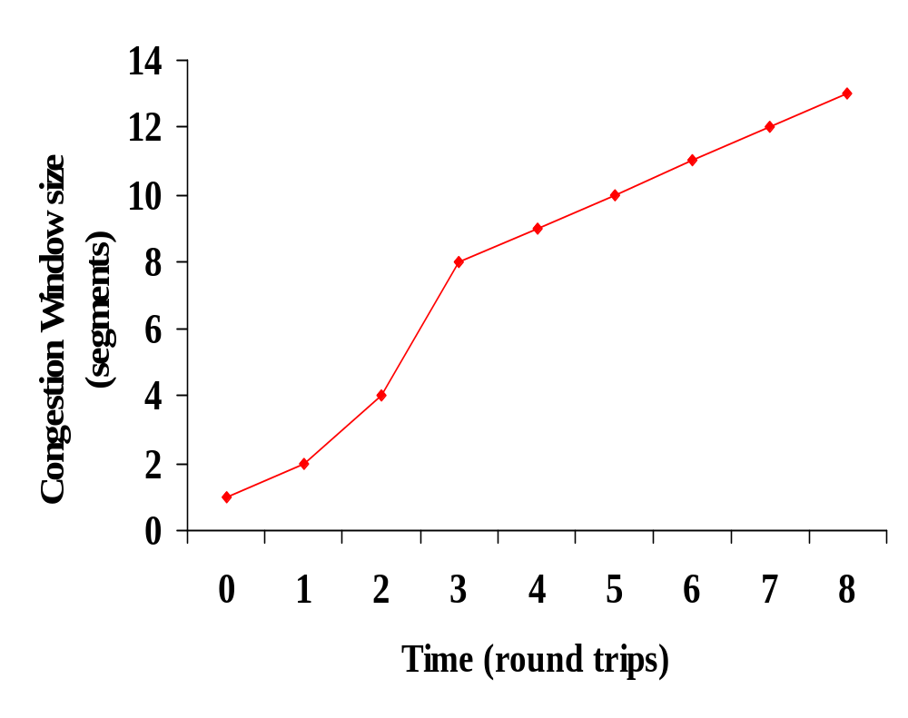
Example
Congestion
avoidance
ssthresh
Slow start
This example assumes that ACKs are not delayed

Slide 22
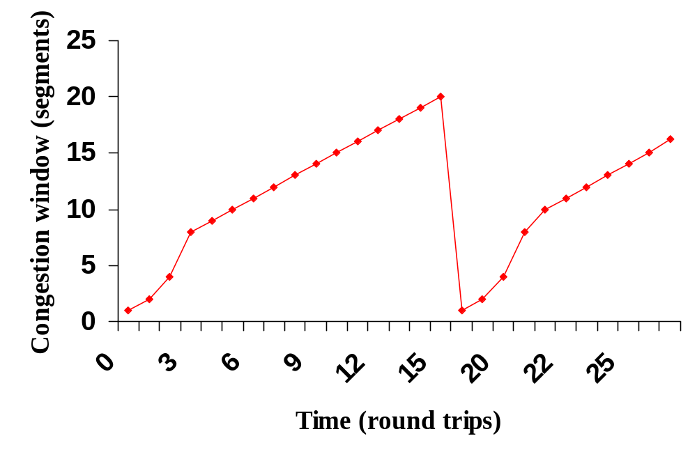
Example
After timeout
cwnd = 20
threshold = 10
threshold = 8

Slide 23
Mechanism 2
Timeouts can take too long
Q: How to initiate retransmission sooner?
Ans: Fast retransmit
  Retransmit a packet when Dup ACKs are received.

Slide 24
Detecting Packet Loss by Dup ACKs
Dup ACKs may be generated due to
  packet loss, or
  out-of-order packet delivery
TCP sender assumes that a packet loss has occurred if it receives three Dup ACKS consecutively (i.e. a total of 4 ACKS to the same packet).
3 Dup ACKs are generated if a packet
is delivered at least 3 places beyond its
in-sequence location
12
8
11
10
9
7

Slide 25
Congestion Control – Dup ACKs
Fast retransmit occurs when 3 Dup ACKs returned.
Timeout vs. Dup ACKs
  timeout occurs when no more packets get through the network
    slow start follows timeout
  when a packet is lost, but later packets get through
    no need to slow start (too conservative)
    Fast recovery is performed.

Slide 26
Fast Recovery
Fast Recovery avoids the initial slow-start process
Main idea:
  Retransmit the lost packet
  Cut cwnd in half
  Increase cwnd linearly

Slide 27
Fast Recovery
When the third Dup ACK arrives,
  ssthresh = cwnd / 2
  retransmit the missing segment (fast retransmit)
  cwnd = ssthresh + 3
  (Adding 3 accounts for the no. of segments that have left the network.)
Each time an additional Dup ACK arrives,
  cwnd ++
When a new ACK comes:
  cwnd = ssthresh
  Enter congestion avoidance (no slow start)

Slide 28
TCP over Wireless

Slide 29

The Scenario
Wireless last hop
Internet
TCP over ad hoc networks is not considered in our lecture.

Slide 30
Why is wireless different?
Can we simply use the traditional TCP over a wireless link?
If there is a packet loss, slow start and retransmit.
It works well in fixed networks, and may also work well in wireless ones.

Slide 31
Packet Loss in Wired & Wireless Networks
Wired Networks
  Packet loss is due to buffer overflow at routers (i.e. congestion)
Wireless Networks
  Packet loss is due to bit errors.
  If number of errors is small, they may be corrected by an error correction code.
  Otherwise, the packet will be discarded

Slide 32
Reasons for Bit Errors
In a wireless environment, errors may occur
  due to interference from other users (e.g. in CDMA systems)
  due to noise
  due to fading

Slide 33
Error due to Interference
Interference from other users is an indication of congestion.
If such interference causes transmission errors, it is appropriate to reduce congestion window
  TCP works properly in this case

Slide 34
Error due to Noise
Bit errors in different packets are typically independent.
Example: While packet i is in error, packet i+1, i+2, i+3, ... may be received correctly.
  Dup ACKs may be generated
  Fast Recovery initiated
  Reduction in Congestion Window
    unnecessary and reduce throughput

Slide 35
Errors due to Fading
If wireless link remains unavailable for extended duration, consecutive packets may be lost (this is called burst error),
  e.g. driving through a tunnel
Timeout results in slow start
Congestion window reduces to 1
  unnecessary and reduce throughput

Slide 36
Impact of Transmission Errors
TCP cannot distinguish between packet losses due to congestion and transmission errors
  Sometimes, unnecessarily reduces congestion window
  Throughput suffers
We consider the cases where reducing congestion window is an inappropriate response

Slide 37
TCP Problems with Wireless
Packet loss in wireless networks typically due to…
  Bit errors due to wireless channel impairments
  Handoffs due to mobility
  Possibly congestion, but not often
As we’ve seen, TCP assumes packet loss is due to…
  Congestion in the network
  Packet reordering, but not often
In a wireless network, TCP congestion avoidance can be triggered by packet loss
  TCP’s mechanisms do not respond well to packet loss due to bit errors or handoffs
  Performance of TCP-based applications can suffer

Slide 38
More TCP Problems with Wireless
Bursts of errors may occur due to low signal strength or longer period of noise
  More than one packet lost in TCP
  More likely to be detected as a timeout ⇒ enter slow start!
Delay is often very high
  Round-trip time can be very long and variable
  TCP’s timeout mechanisms may not work well
  Problem get intensified by link-level retransmission
Links may be asymmetric
  Delayed ACKs in the slow direction can limit throughput in the fast direction

Slide 39
Influences of mobility on TCP
TCP assumes congestion if packets are dropped
  typically wrong in wireless networks, here we often have packet loss due to transmission errors
  furthermore, mobility itself can cause packet loss, if e.g. a mobile node roams from one access point (e.g. foreign agent in Mobile IP) to another.
The performance of an unchanged TCP degrades severely
  however, TCP cannot be changed fundamentally due to the large base of installation in the fixed network, TCP for mobility has to remain compatible
  the basic TCP mechanisms keep the whole Internet together

Slide 40
Various Schemes
Link-layer approach (not TCP-aware)
End-to-End Approach
Split connection approach
  e.g. I-TCP, SRP
TCP-Aware link layer
  e.g. Snoop

Slide 41
Link-Layer approach
Hide losses not due to congestion from the sender by making link appear to be more reliable
  Link-level automatic retransmission request (ARQ)
  Forward error correction (FEC) codes
  Hybrid ARQ and FEC
Advantages
  Requires no change to existing sender behavior
  Matches layered protocol model
Problem
  Interactions with TCP, e.g., faster retransmission by TCP can be triggered by excessive delays due to link-level timeout and retransmission

Slide 42
Link-Layer approach (Cont’d)
Negative interactions with TCP can be reduced by making the link-level protocol TCP-aware
  Example: Snoop TCP

Slide 43
End-to-End Protocols
Make TCP sender aware that some losses are not due to congestion and, thus, avoid congestion control when not needed
Use selective acknowledgement (SACKs) for “fine-grained” error recovery
  SACK RFC
Use explicit loss notification (ELN) to distinguish between congestion and other losses

Slide 44
End-to-End Protocols (Cont’d)
Advantages
  Maintains end-to-end semantics of TCP
  Introduces no extra overhead at base stations for protocol processing or handoff
Disadvantages
  Requires modified TCP
  May not operate efficiently, e.g., for packet reordering versus packet loss

Slide 45
Split Connection Approach
A TCP connection is split into two parts
  one on the wired part
  one over wireless part
FH-MH = FH-BS + BS-MH
FH
BS
MH
Fixed Host
Base Station
Mobile Host

Slide 46
Split Connection Approach (Cont’d)
Split connection results in independent flow control for the two parts
Flow/error control protocols, packet size, timeouts, may be different for each part
FH
BS
MH
Fixed Host
Base Station
Mobile Host

Slide 47
Split Connection Approaches (Cont’d)
Indirect TCP (I-TCP)
  FH - BS connection : standard TCP
  BS - MH connection : standard TCP
Selective Repeat Protocol (SRP)
  FH - BS connection : standard TCP
  BS - MH connection : selective repeat protocol on top of UDP
Which one is better?

Slide 48
Advantages
BS-MH connection can be optimized, independent of FH-BS connection
  Different flow / error control on the two connections
Local recovery of errors
  Faster recovery due to relatively shorter RTT on wireless link
Good performance achievable using appropriate BS-MH protocol

Slide 49
Disadvantages
End-to-end semantics of TCP violated
  ACK delivered to sender, before data delivered to the receiver
  may result in loss of data
Example:
  The sender does not buffer 40, 39 after receiving ACK 40.
  If BS fails, packet 40, 39 will be lost
39
40
38
37
FH
BS
MH
40
36

Slide 50
Disadvantages
Cannot be applied if data and ACKs traverse different paths (ACK does not go through the BS)
Example: data on a satellite wireless hop, ACKs through another channel
BS
data
FH
MH
ACK

Slide 51
Indirect TCP: Overview
Standard TCP
Wired
Network
Fixed
Host
TCP
Proxy
Mobile
Host
Standard
TCP
“Wireless” TCP*
Indirect TCP
(* Normal TCP or modified transport protocol)

Slide 52
Indirect TCP: Handoff
An AP or router can act as a Mobile IP FA and as the TCP proxy for Indirect TCP (I-TCP)
If the mobile host moves to a different FA, a handoff is needed for Mobile IP
If the mobile host moves to a different proxy, a handoff of the full TCP state is needed for I-TCP
  Buffered data
  Sequence numbers
  Port

Slide 53
Indirect TCP: Advantages
Does not require changes to TCP at the hosts in the fixed network
Errors from the wireless link are corrected at the TCP proxy and, thus, do not propagate through the fixed network
New protocol affects only a limited part of the Internet
Optimizations possible over wireless link
  Variance in delay between proxy and mobile host may be small, permitting optimized TCP
  Opportunity for header compression, etc.
  Opportunity for a different transport protocol

Slide 54
Indirect TCP: Disadvantages
Loss of TCP’s end-to-end semantics
  What happens if the proxy or the mobile host fails?
Handoff overhead can be significant
  higher latency possible due to buffering of data within the foreign agent and forwarding to a new foreign agent
Overhead at the proxy for per packet processing (up to TCP and back down)
TCP proxy must be trusted
  Obvious opportunities for snooping and denial of service
  End-to-end IP-level privacy and authentication (e.g., using IPSec) must terminate at the proxy

Slide 55
Indirect TCP: Wireless Transport
I-TCP as originally proposed uses TCP as the wireless transport protocol
  Timeouts at the wireless sender may stall the original sender on the fixed network
Selective acknowledgement protocols have been shown to provide better performance
  Better suited to wireless link with higher error rate

Slide 56
Snoop TCP: Overview
Provide reliable link layer that is TCP aware
  Snoop agent at the AP or FA
  Buffers data at the ends of the links for retransmissions (instead of going back to TCP end points)
  “Snoops” on acknowledgements and filters duplicate acknowledgements
Standard TCP
Wired
Network
Fixed
Host
Snoop
Agent
Mobile
Host

Slide 57
Snoop Protocol
Link Layer Protocol (but TCP aware)
  end-to-end semantics retained (a feature of TCP)
  soft state at base station, instead of hard state
  Fast local retransmission in case segs lost in Wireless link between BS and MH by data buffering at BS. (BS → MH)
  Lost of data seg detected thro absent of ack or presence of duplicate acks.

Slide 58
Snoop Protocol
Buffers data packets at BS
  to allow link layer retransmission
When Dup ACKs are received by BS from MH (indicating pkt loss), retransmit on wireless link, if the packet is present in buffer
Prevents fast retransmit at TCP sender (FH) by dropping the Dup ACKs at BS
Detect gap in seq nos in TCP segs from MH to FH by BS, and send NACK to MH. Then MH sends missing seg immediately. (MH → BS)
BS may discard duplicate pkts to MH for which MH had already sent ack.

Slide 59
Snoop: Example
35
38
Data buffered at BS
36
37
40
39
38
37
FH
BS
MH
34
36
Example assumes delayed ack - every other packet ack’d

Slide 60
Snoop : Example
35
38
36
39
37
41
40
39
38
34
36

Slide 61
Snoop : Example
37
40
38
39
42
41
40
39
36
36
Dup ACK
Duplicate acks are not delayed

Slide 62
Snoop : Example
37
40
38
41
39
43
42
41
40
36
36
36
Dup ACKs

Slide 63
Snoop : Example
Dup ACK triggers retransmission of packet 37 from BS
37
40
38
41
39
42
44
43
37
41
FH
BS
MH
36
36
Discard
Dup ACK
BS needs to be TCP-aware to be able to interpret TCP headers
36

Slide 64
Snoop : Example
37
40
43
38
41
39
42
45
44
42
37
36
36
36
36

Slide 65
Snoop : Example
37
40
43
38
41
44
39
42
46
45
43
42
36
41
TCP sender does not
fast retransmit
36
36
36

Slide 66
Snoop : Example
37
40
43
38
41
44
39
42
45
47
46
44
43
41
36
36
36
36

Slide 67
Snoop : Example
42
45
Packet 41 and before can be removed from buffer at BS
43
46
44
48
47
45
44
FH
BS
MH
41
43
36
36
36
36

Slide 68
Advantages
High throughput can be achieved
End-to-end semantics of TCP retained
Soft state at base station
  loss of the soft state affects performance, but not correctness

Slide 69
Disadvantages
Link layer at BS needs to be TCP-aware
Not useful if TCP headers are encrypted (IPsec)
NACKs from BS to MH means, TCP in MH should understand selective acknowledgement.
Cannot be used if TCP data and TCP ACKs traverse different paths

Slide 70
Mobility and handoff
Hand-offs may result in temporary loss of route to MH
  with non-overlapping cells, it may be a while before the mobile host receives a beacon from the new BS
While routes are being reestablished during handoff, MH and old BS may attempt to send packets to each other, resulting in loss of packets

Slide 71
Impact of handoff
Split connection approach
  hard state at base station must be moved to new base station
Snoop protocol
  soft state need not be moved
  while the new base station builds new state, packet losses may not be recovered locally

Slide 72
Handoff issues
During the long delay for a handoff to complete
  a whole window worth of data may be lost
After handoff is complete
  acks are not received by the TCP sender
Sender eventually times out, and retransmits
  If handoff still not complete, another timeout will occur
Performance penalty
  Time wasted until timeout occurs
  Window shrunk after timeout

Slide 73
Mobile TCP (M-TCP)
Special handling of lengthy and/or frequent disconnections
M-TCP splits as I-TCP does
  unmodified TCP for FH to Supervisory host SH (like BS)
  optimized TCP for SH to MH, does not use slow start but BM
Supervisory Host (Foreign Agent)
  no caching, no retransmission, assumes low BER on wireless link
  monitors all packets, if no ACKs received for some time - disconnection detected
    set advertised window size to 0
    sender automatically goes into persistent mode
    Old or new SH reopen the window
  Sender does not send any data in persistent mode
    except when persist timer goes off
  When a +ve window advertisement is received, sender exits persistent mode
  On exiting persist mode, RTO and cwnd are same as before entering the persistent mode

Slide 74
Mobile TCP (M-TCP)
Advantages
  maintains end-to-end semantics by forwarding ACK of MH to FH by SH,
  supports disconnection (by shrinking the window size to 0, avoids retrans, slow start),
  no buffer forwarding (lost pkts will automatically be retransmitted by the sender)
Disadvantages
  loss on wireless link propagated into fixed network (FH), it assumes low BER
  adapted TCP on wireless link (Modification of TCP in MH to provide Bandwidth Manager in n/w)

Slide 75
Fast retransmit/fast recovery
Change of foreign agent often results in packet loss
  TCP reacts with slow-start although there is no congestion
Forced fast retransmit
  as soon as the mobile host has registered with a new foreign agent, the MH sends duplicated acknowledgements on purpose
  this forces the fast retransmit mode at the communication partners
  additionally, the TCP on the MH is forced to continue sending with the actual window size and not to go into slow-start after registration
Advantage
  simple changes result in significant higher performance
Disadvantage
  further mix of IP and TCP (to detect when there is a new registration), no transparent approach

Slide 76
Transmission/time-out freezing
(MAC layer solution)
Mobile hosts can be disconnected for a longer time
  no packet exchange possible, e.g., in a tunnel, disconnection due to overloaded cells or mux. with higher priority traffic
  TCP disconnects after time-out completely
TCP freezing
  MAC layer is often able to detect interruption in advance
  MAC can inform TCP layer of upcoming loss of connection
  TCP stops sending, but does not now assume a congested link
  MAC layer signals again if reconnected
Advantage
  scheme is independent of data
Disadvantage
  TCP on mobile host has to be changed, mechanism depends on MAC layer

Slide 77
Selective retransmission
TCP acknowledgements are often cumulative
  ACK n acks correct and in-sequence receipt of packets up to n^{th} packet
  if single packets are missing, quite often a whole packet sequence beginning at the gap has to be retransmitted (go-back-n), thus wasting bandwidth
Selective retransmission as one solution
  RFC 2018 allows for acknowledgements of single packets, not only acknowledgements of in-sequence packet streams without gaps
  sender can now retransmit only the missing packets
Advantage
  much higher efficiency
Disadvantage
  more complex software in a receiver, more buffer needed at the receiver

Slide 78
Transaction oriented TCP
TCP phases
  connection setup, data transmission, connection release
  using 3-way-handshake needs 3 packets for setup and release, respectively
  thus, even short messages need a minimum of 7 packets!
Transaction oriented TCP
  RFC1644, T-TCP, describes a TCP version to avoid this overhead
  connection setup, data transfer and connection release can be combined
  thus, only 2 or 3 packets are needed
Advantage
  efficiency
Disadvantage
  requires changed TCP
  mobility no longer transparent

Slide 79
References
William Stallings, “High-speed networks and Internets: performance and quality of service,” 2nd edition, Prentice Hall, 2002.
J. Schiller, “Mobile Communications”, 2nd edition, PEA, 2004
A. Bakre & B. R. Badrinath, “I-TCP: indirect TCP for mobile hosts,” Proc. ICDCS, pp. 136-143, May 1995.
H. Balakrishnan, S. Scshan, and R. Kats, “Improving reliable transport and handoff performance in cellular wireless networks,” ACM Wireless Networks, vol. 1, Dec. 1995.

