Slide 1
PROJECT PRESENTATION
ON
REAL-TIME SALES ANALYSIS DATA PLATFORM
Presented By-
TIPU RAJ
(Aspirant Data Engineer)
SKILLED IN:- Microsoft Azure Data Factory, Azure Databricks, Azure Synapse Analytics , SQL Server, SQL, Python, Microsoft Power Bi, GitHub

Slide 2
AIM OF THE PROJECT
To ingest the incremental Data from the Multiple sources into Data lake(ADLS Gen2) Dynamic container.
Performing ETL & managing Multiple Pipelines for Data orchestration.
Transforming & analyzing the data using Big Data Tool(Databricks).
Need to ingest the data into SQL Data warehouse.
Automate data workflows for real time incoming Data everyday.
Integrate the Data warehouse to Power BI for Dashboard creation for business solutions.

Slide 3



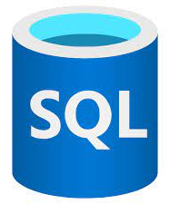
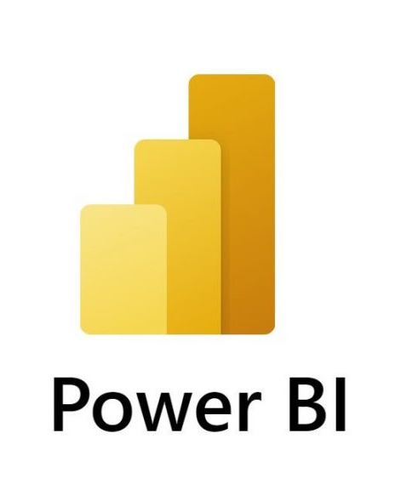
Introduction
Azure service is one stop shop that includes all the essential tools for the Orchestration for Data like Data Factory(ADF), Databricks for Analysis which is in-demand big data tool, even we can Monitor our work that gives an edge over all other Resources. It also provides the code free environment to overcome the complexity for coding, also it provides very efficient integration with other resources like SQL databases, Spark pools, Power BI with higher scalability along with reasonable pricing tiers and consumption base model.

Slide 4

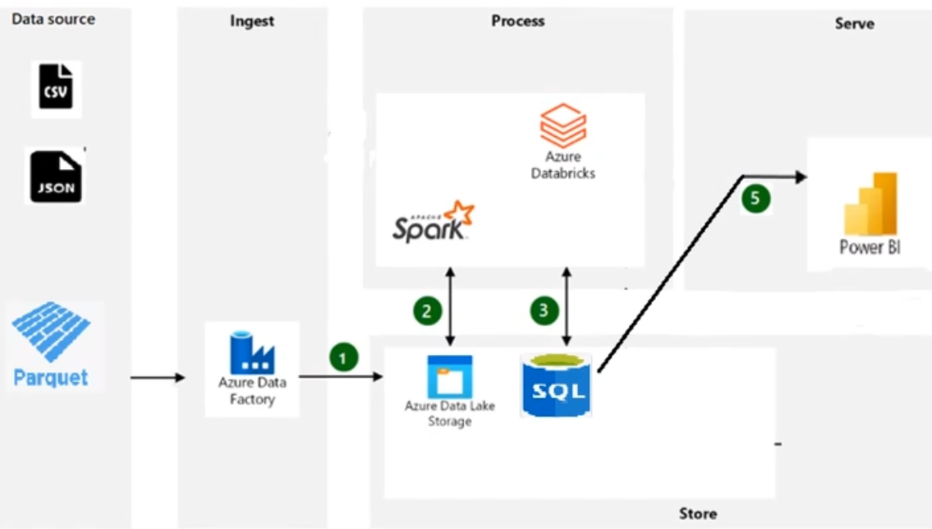
Architecture Diagram

Slide 5
prerequisites
Microsoft Azure account.
ADLs Gen 2 storage.
Azure Data Factory(ETL).
Azure Databricks(Big Data Tool).
SQL Database(Data Warehouse).
Power BI.

Slide 6
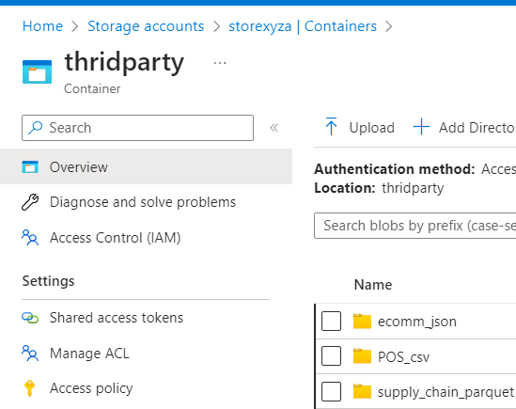
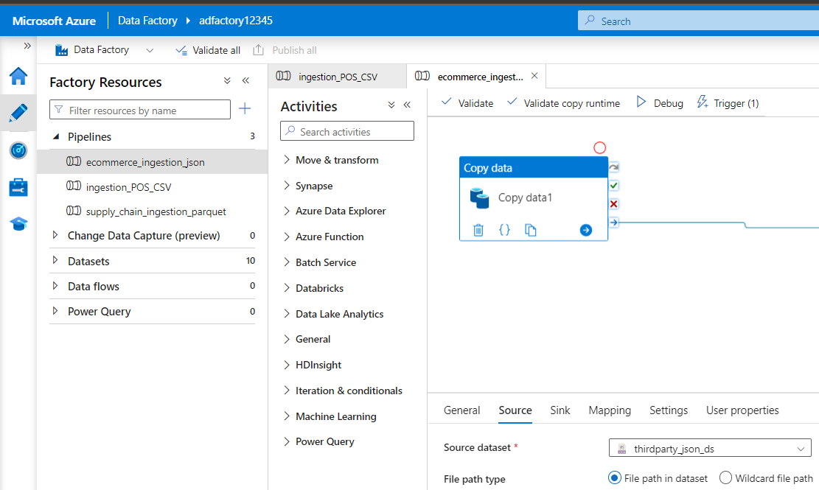
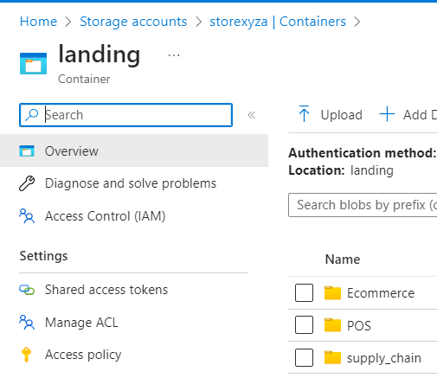
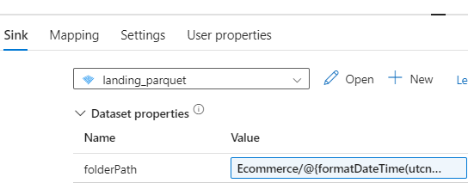
IngestING data into DATA LAKE STORAGE USING ADF.
I have Multiple Data sources in JSON, CSV & Parquet file format which is daily uploaded by the Third party(Company itself). By using Azure Data Factory, I am going to ingest the data into the Data lake container(landing) also make it dynamic using Parameterization because I want Data to get saved date wise automatically at midnight with the help of Daily Trigger.
Here, I created linked Service for ADLs Gen 2
Source format is JSON
Sink location am using Parquet file format; it is faster, consume minimal space and best for big data processing.
After adding the sink location, I opened the dataset and assigned the folder dynamic to get the data automatic every day.

Slide 7
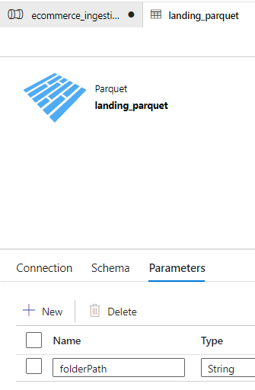
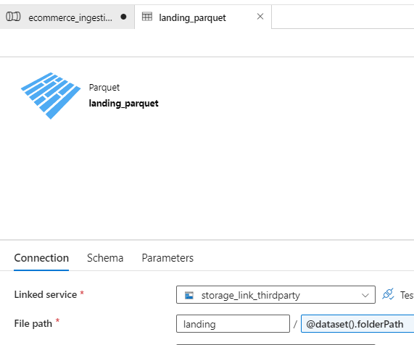
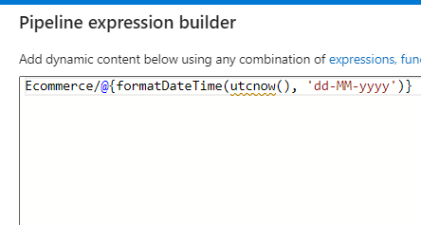
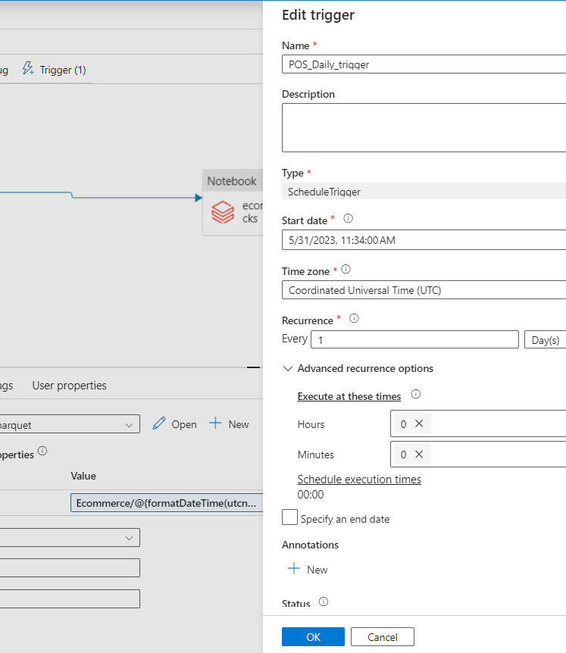
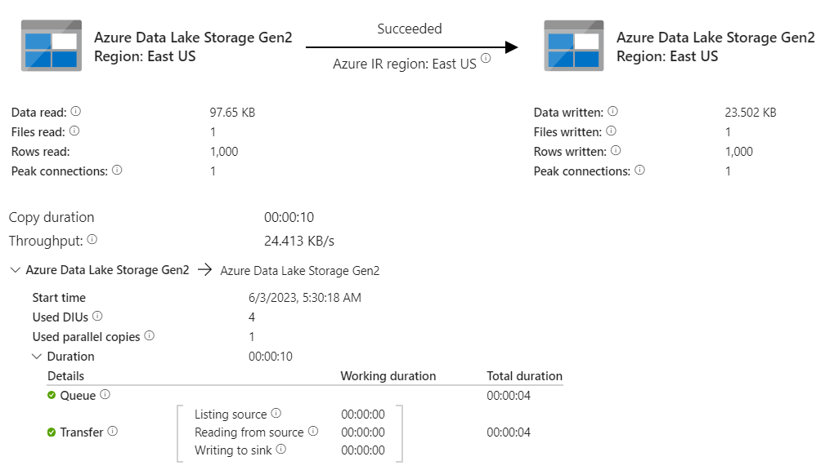
Assigning the incoming dataset path dynamic
At the end scheduled a daily trigger to run pipeline & get the data automatically
After opening the dataset, I defined the parameters as “folderPath” after that clicked on connection.
Adding Dynamic content directory where data get saves date wise daily.
Assigning value to the folderPath in the expression builder.
Data is copied into the data lake storage successfully.
Finally, I commenced debug to run the pipeline
Now we will repeat the process for data orchestration with rest of the third-party data.

Slide 8
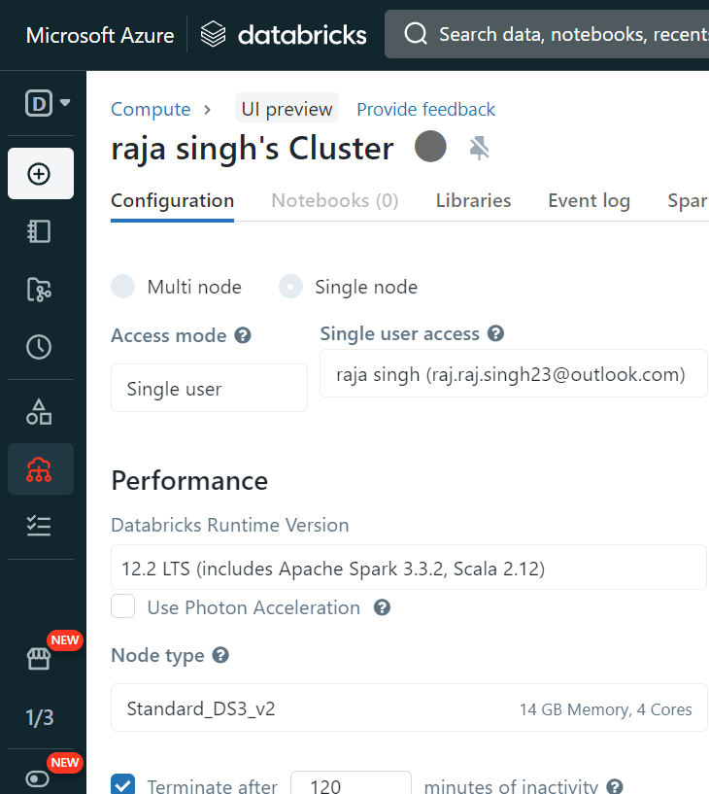
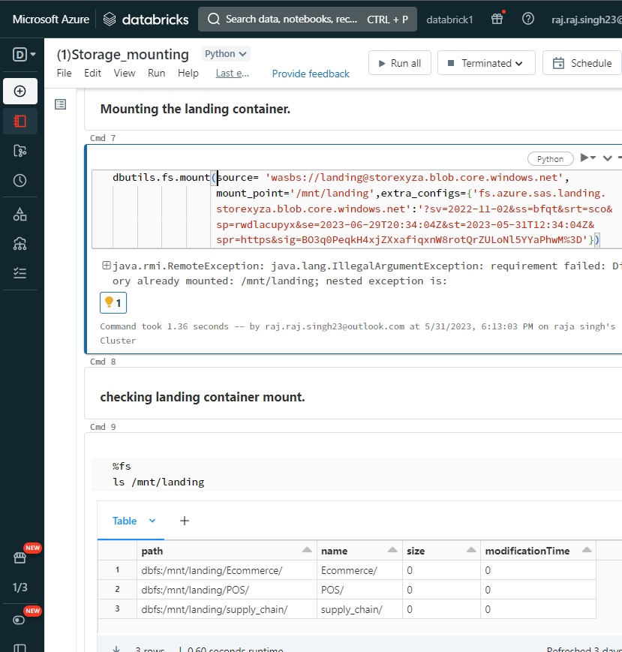
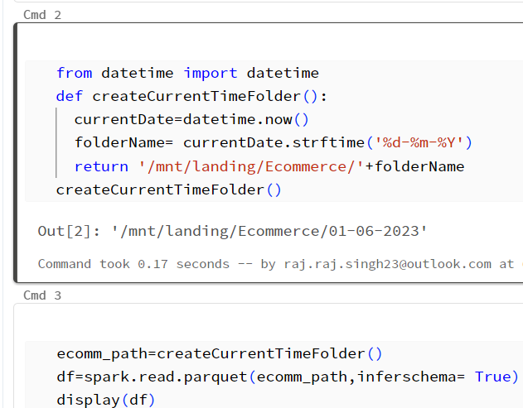
TRANSFORMING & ANALYZING DATA USING DATABRICKS.
Next step is performing data transformations on the ingested data clean, preprocess, and transform the data into a format suitable for analysis and downstream consumption using amazing big data tool(Databricks).
Configured single user working cluster as per my requirement also we can scale our cluster anytime.
Mounted the storage account & Performed various analysis to clean the data, created data frame.
written and optimize Spark code in languages such as Python & SQL to perform complex calculations and other data manipulations.
Cluster Created
Mounted Storage
Mounted dynamic container

Slide 9
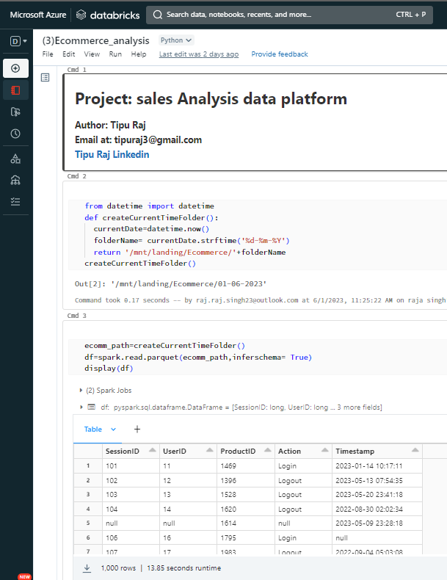
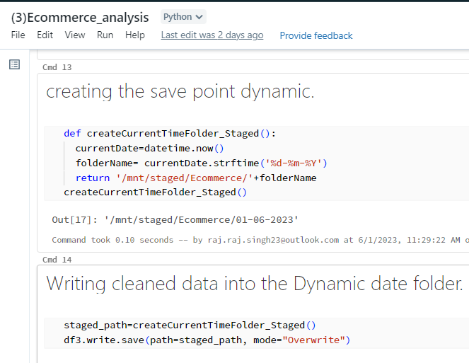
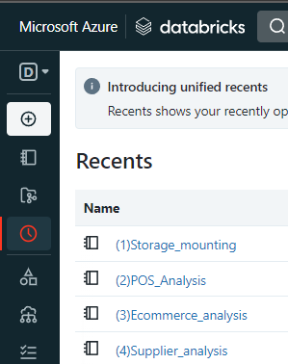
After analysis,
Must save data into dynamic landing container
Repeat the process for rest of the landing container
data
Performed Analysis in notebook
Writing the data to storage
Performed analysis for rest of the data
After Data Transformation, I attached the Databricks Notebook to the copy activity into Data Factory.
Further, I attached the notebook to another copy activity to ingest the data into SQL Data Warehouse.
Applied the process with all the data pipelines and automated the process with the same which I
used during data ingestion using trigger and parameterization.

Slide 10
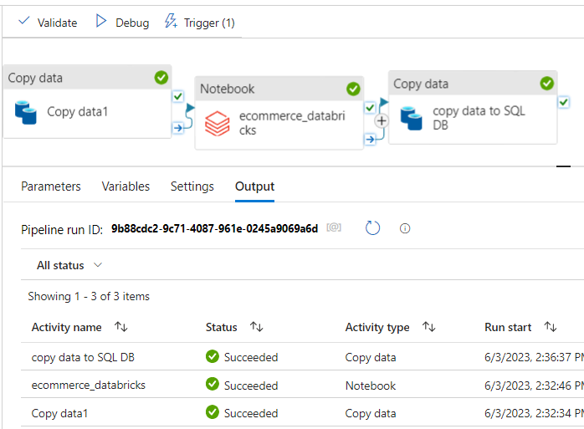
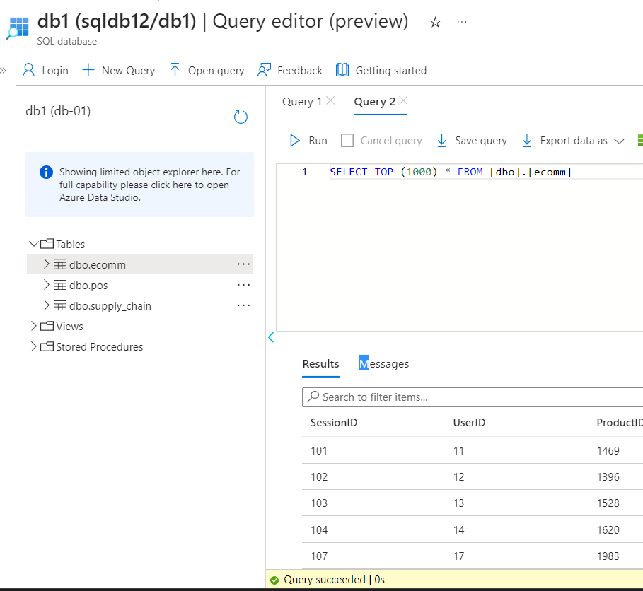
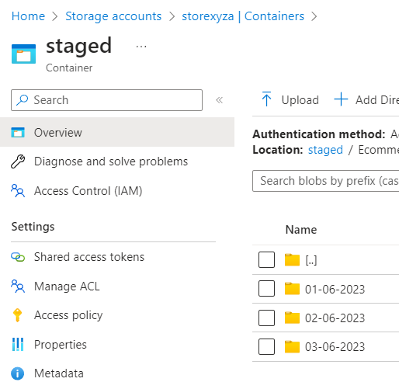
INGESTING STAGED CONTAINER’S DATA INTO SQL DATA WAREHOUSE.
Our automated pipeline is working fine. Data is getting saved every day.
This is the final Automated data pipeline which will run daily and perform all the operations. Further it will be saved in data warehouse, and I did same with rest of the pipelines as well.
Now I can check the data into SQL database or in Azure Data Studio.
After data orchestration, I opened the SQL query editor to query my whole data. Now, the is ready for downstream consumption like SQL server, Power BI for business insights, etc.

Slide 11
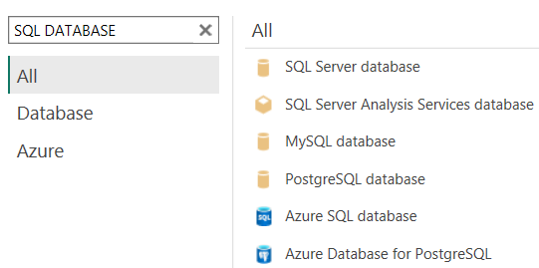
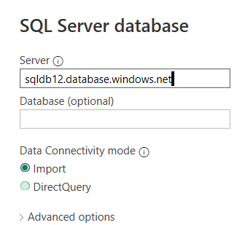
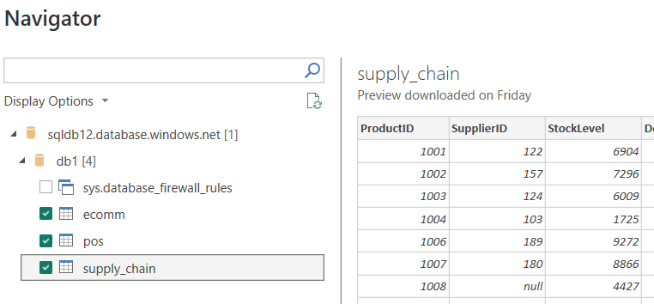
INTEGRATING POWER BI WITH SQL DATA WAREHOUSE FOR BUSINESS INSIGHTS.
By using Power BI, I connected the SQL database by using the server id and the login credentials.
Using server id to fetch the data
get data using SQL DATABSE
All data is ready to load
CONCLUSION:-
This project is centered around designing, building, and maintaining data pipelines and infrastructure to enable efficient data processing, transformation, analysis and Load. Working with various tools and technologies, such as Azure Data Factory, Databricks, to ingest, transform, and store data in a way that is scalable, performant, and secure.
Finally, integrated with Powe BI to gain the business requirements and translate them into robust data solutions. In addition, ensuring data quality, integrity, and governance throughout the data lifecycle.

Slide 12
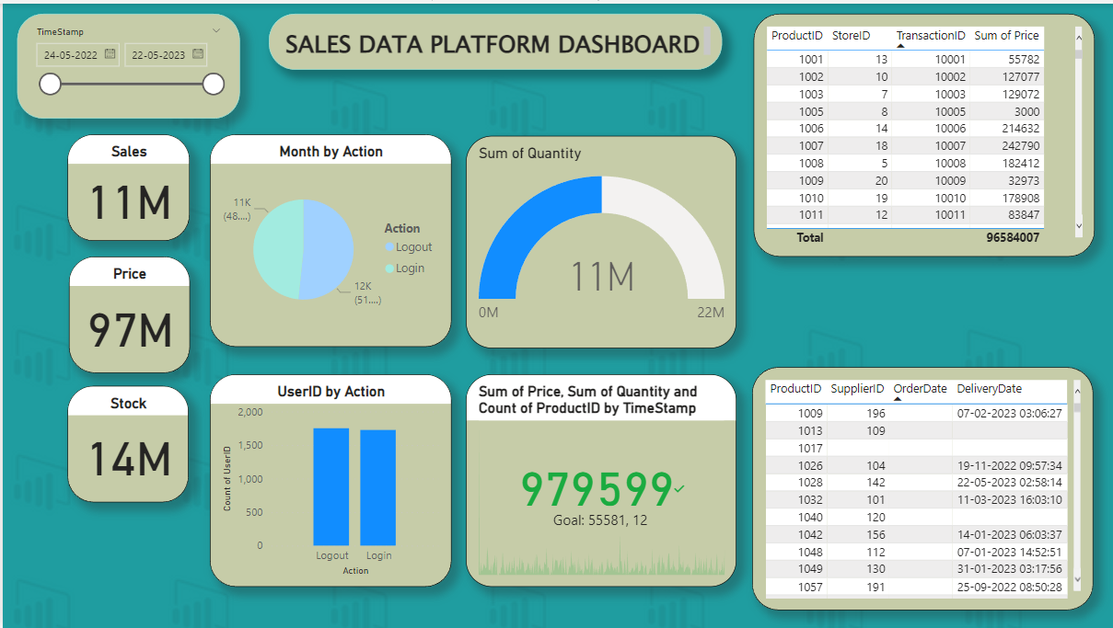
DASHBOARD REPRESENTATION USING POWER BI FOR BUSINESS INSIGHTS

