Slide 1
Computer Networking Tools and Testing Device
By: Christian Rapal

Slide 2
Overview
Tools:
Tools are particularly important in construction work. They are primarily used to put things together or to take them apart. Tools are often classified as hand tools and power tools. Hand tools include all non-power tools.
Testing device:
Used to create signals and capture responses from electronic devices, to prove proper operation or trace faults.

Slide 3
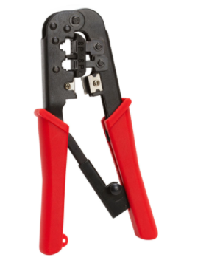
Computer networking tools
*Crimping Tools
- A crimping tool is one of the most crucial network connecting tools. In order to connect a connector to the cable, you will need a tool to crimp or connect. Known as the crimping tool, this tool is used to connect RJ-45, RJ-11 and other connectors to the end of a cable. Some crimping tools have a built-in wire cutter near the handle. This wire cutter can be used to cut a phone cable or a Cat5 cable.

Slide 4
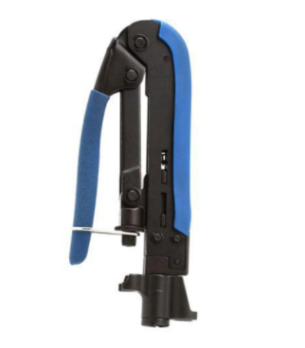
Computer networking tools
*COAXIAL COMPRESSION TOOL
- The coaxial cable is the cable that includes the outer metal that does the conducting. A central conducting core ensures that the metal is insulated. High frequency signals are transmitted through this coaxial cable line. A coaxial compression tool is a useful device that uses connectors to properly compress the coaxial cable. The side of the cable wire will enable you to know which type of cable it is.

Slide 5
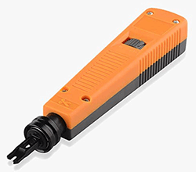
Computer networking tools
*PUNCH DOWN TOOL
- The punch down tool is also known as the Krone tool. It is small tool that is used most frequently by network troubleshooting technicians. The basic purpose of a punch down tool is to insert wires into various devices like punch down blocks, patch panels, surface mount boxes, and more with the help of insulation-displacement connectors.

Slide 6
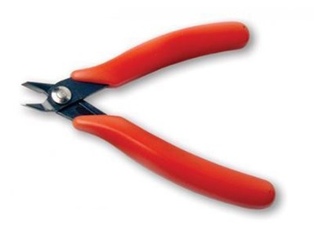
Computer networking tools
*Cutters, Scissors,Pliers
- Pliers are made in various shapes and sizes and for many uses. Some are used for gripping something round like a pipe or rod, some are used for twisting wires, and others are designed to be used for a combination of tasks including cutting wire.

Slide 7
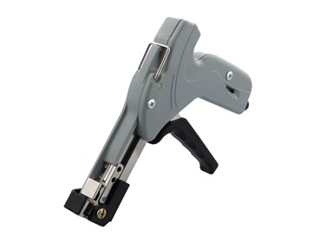
Computer networking tools
*Cable tie tools
- Cable tie guns are used to precisely tension ties that hold cables together. These tools are designed to provide the ideal solution for tensioning and cutting cable ties for very specific tasks. Cable tie guns eliminate any sharp ends and help users with the bundling processing.

Slide 8
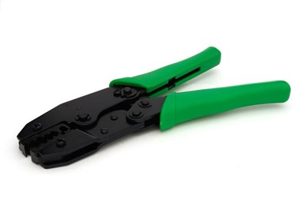
Computer networking tools
*Fiber optic tools
- Fiber optic tools are various types used in the fiber optic installation and maintenance works. There are splicing fiber optic tools, test fiber optic tools and cleaning fiber optic tools. Splicing fiber optic tool is used in the fiber optic splicing which is to melt the bare optical fiber together.

Slide 9
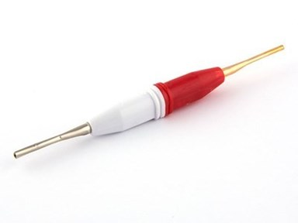
Computer networking tools
*Insertion-Extraction Tools
- Insertion, Extraction tool is a device used to place or remove a contact within a housing of a connector.

Slide 10
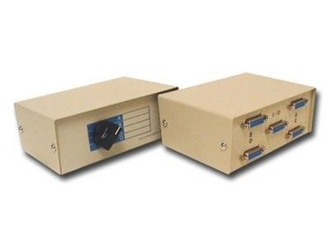
Computer networking tools
*Manual/Automatic Switch Boxes
- A manual transfer switch allows you to start a generator and restore power to predetermined circuits when utility power fails. This is a reliable, simple, and cost-effective method to provide building owners with a high level of safety and security.

Slide 11
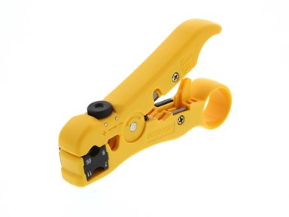
Computer networking tools
*Strippers
- Wire strippers resemble a pair of pliers or scissors. Most wire strippers are capable of performing several different tasks, but their primary purpose is to strip the insulation off of the end of wires. This is accomplished with slotted cutting blades located in the jaws of the stripper.

Slide 12
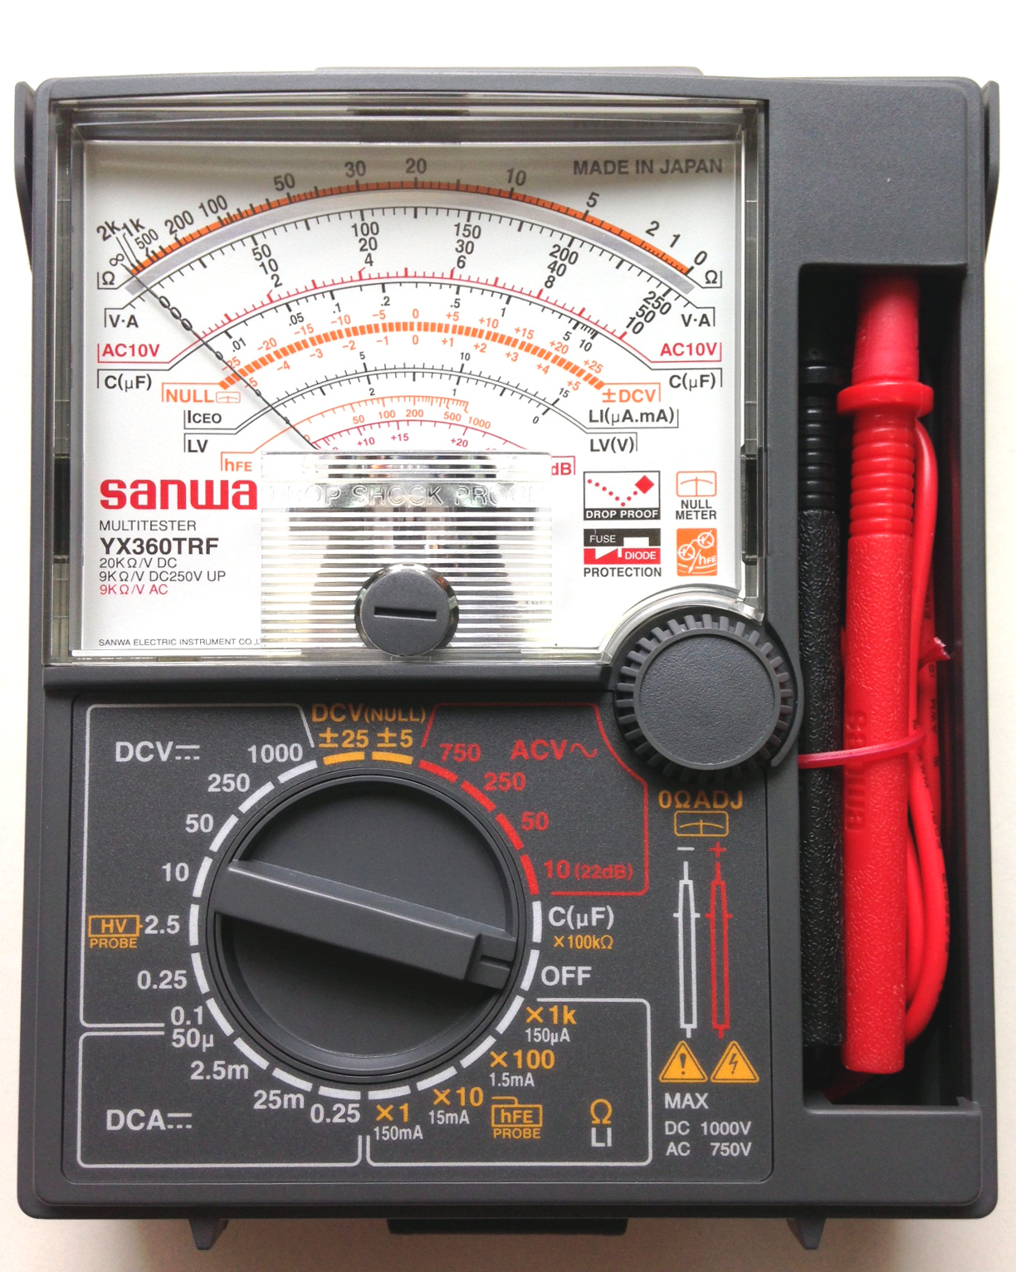
Testing tools
*Multitester
- A multitester also known as VOM(volt-ohm milliammeter) is an electronic measuring instrument that combines several measurement functions in one unit. A typical multimeter can measure voltage, current and resistance.

Slide 13
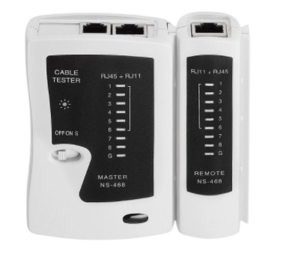
Testing tools
*Network Cable Tester
- A network cable tester is a useful device that allows you to check the continuity of the cable to figure out if the signal is strong enough to get through to the network. This helps to eliminate cable connectivity issues while troubleshooting the problems.

