Slide 1


Technological University of the Philippines - Cavite Campus
CQT. Ave. Salawag, Dasmariñas City, Cavite
Department of Industrial Technology
“TECHNOLOGICAL UNIVERSITY OF THE PHILIPPINES-CAVITE WEB-BASED APPOINTMENT SYSTEM”
Joseph John T. Azupardo
Melisa E. Manalili
Kazzeah Mae Nicole T. Permejo
BET major in Computer Engineering Technology

Slide 2
Technological University of the Philippines - Cavite Campus
Department of Industrial Technology
Bachelor of Engineering Technology
Objectives of the Study
General
Aims to develop an efficient web-based appointment system for TUPC departments.
Specific
Design and develop a web-based application system to manage, track, evaluate, book, and approve appointments
1.1 A function that will enable the admin department to manage and track the appointments.
1.2 A function that will enable the user to book an appointment and evaluate the performance of the system thru CSS form.
1.3 A process that will allow the security department to access the approved appointments list.

Slide 3
Technological University of the Philippines - Cavite Campus
Department of Industrial Technology
Bachelor of Engineering Technology
Parameters to be checked or to gathered:
Admin Department Accounts
User Accounts
Selection Type of User
Number of Appointments
Approved Appointments
Date and Time
Purpose of Appointments
Customer Satisfaction Survey
Customer Satisfaction Rating
Customer Feedback

Slide 4
Technological University of the Philippines - Cavite Campus
Department of Industrial Technology
Bachelor of Engineering Technology
Objectives of the Study
Specific
2. To test and accomplish at least 80% of the web-based appointment system functionality, by the accurate data of the appointments.
3. Evaluate the system with the following criteria: functionality, accuracy, reliability and efficiency to attain 3.5 rating for each category and at least 4.5 overall means.

Slide 5




Technological University of the Philippines - Cavite Campus Department of Industrial Technology
Bachelor of Engineering Technology
Scope
The research specifically focuses in the web-based appointment system of the tup cavite campus only where in:
a. Students of the university can:
Create an account
Able to choose their preferred date and time of the appointment
Receive an email for the confirmation of the appointment
b. Admin Department of the university can:
Able to set their availability date and time
Approve and manage pending appointments
Provide the CSS (Customer Service Satisfaction)
Departments/Offices
DIT, DED, DMS, DLA, DOE, OAA, OCL, ORE, UITC and SECURITY DEPT.
c. TUPC Security Department can;
Manage the appointments per day

Slide 6
Technological University of the Philippines - Cavite Campus Department of Industrial Technology
Bachelor of Engineering Technology
Limitation
Limited number of appointment per day
This system is for student services only.
Strictly one account per department.
Specific Department

Slide 7
Technological University of the Philippines - Cavite Campus
Department of Industrial Technology
Bachelor of Engineering Technology
Conceptual Model of the Study
(Design-Thinking Model)
Empathize | Define | Ideate | Prototype | Test
Students Admin departments Personal experience of researches testing the web-based online appointment Through experience, observation and survey | Having trouble where to find to book an appointment Walk in Teachers or admin are not available | To have a proper appointments To lessen the walk in To create a web-based system that is only for the appointments | AIO touchscreen for checking of appointments Web-based for the appointment system | Functionality Reliability Accuracy Efficiency

Slide 8
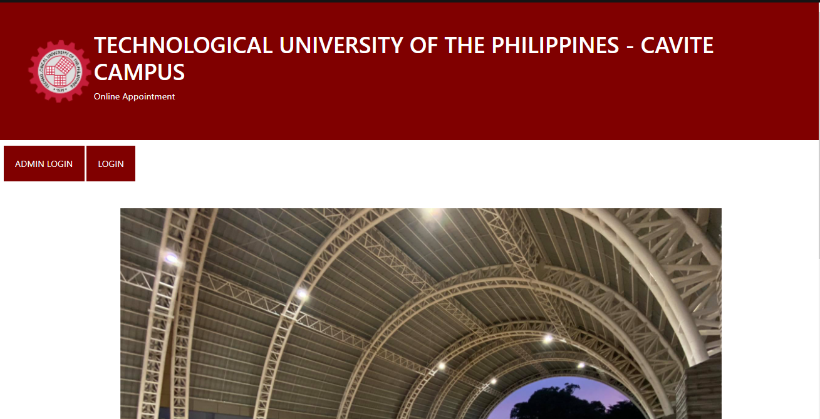
Technological University of the Philippines - Cavite Campus
Department of Industrial Technology
Bachelor of Engineering Technology
DESIGN (GUI)
FEATURE 1: LANDING PAGE

Slide 9
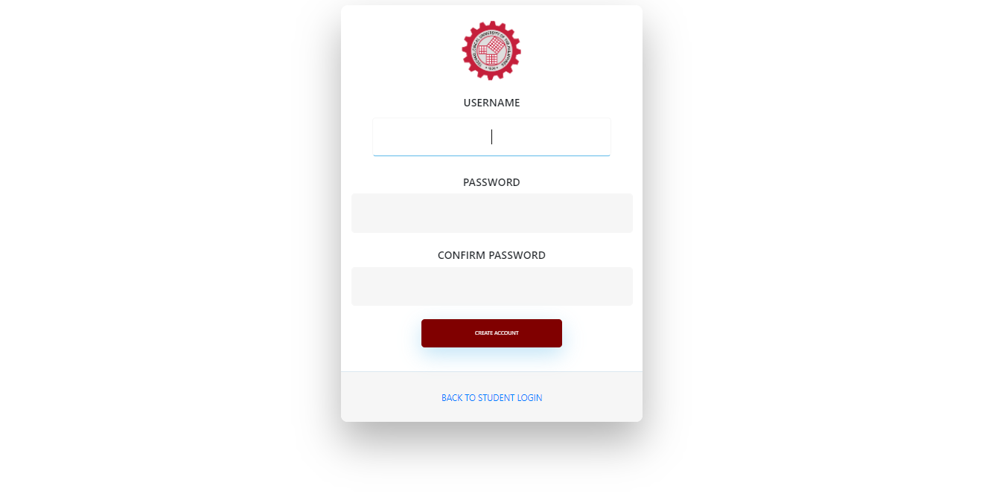
Technological University of the Philippines - Cavite Campus
Department of Industrial Technology
Bachelor of Engineering Technology
DESIGN (GUI)
FEATURE 2: USER SIGN UP PAGE

Slide 10
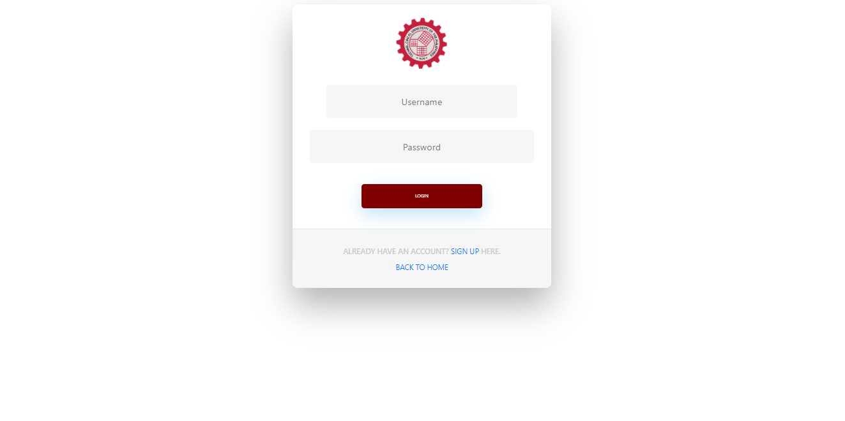
Technological University of the Philippines - Cavite Campus
Department of Industrial Technology
Bachelor of Engineering Technology
DESIGN (GUI)
FEATURE 3: USER LOGIN PAGE

Slide 11
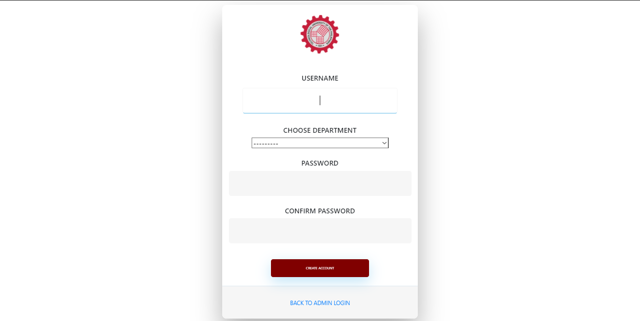
Technological University of the Philippines - Cavite Campus
Department of Industrial Technology
Bachelor of Engineering Technology
DESIGN (GUI)
FEATURE 4: ADMIN DEPARTMENT SIGN UP PAGE

Slide 12
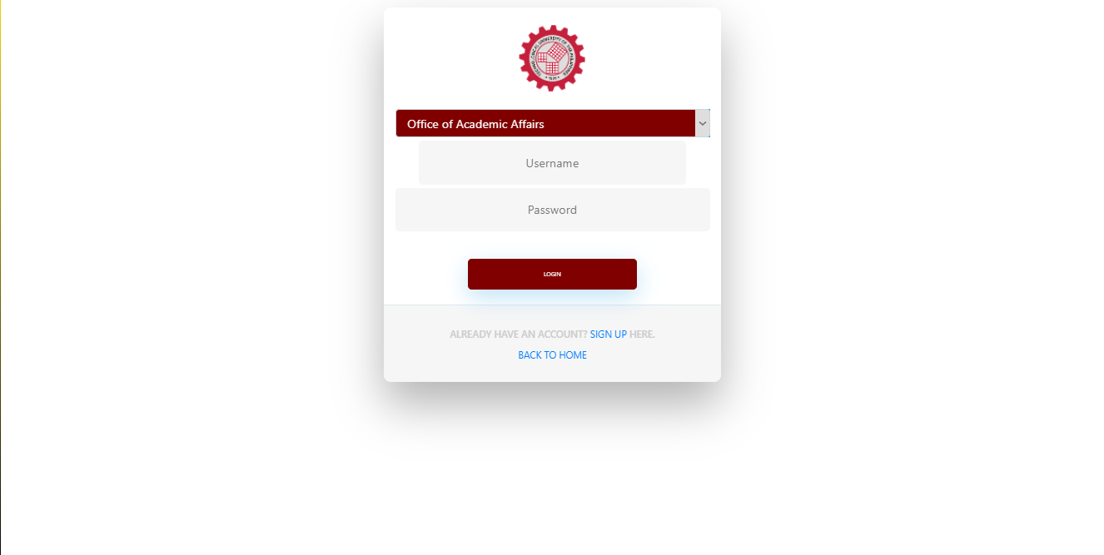
Technological University of the Philippines - Cavite Campus
Department of Industrial Technology
Bachelor of Engineering Technology
DESIGN (GUI)
FEATURE 5: ADMIN DEPARTMENT LOGIN PAGE

Slide 13
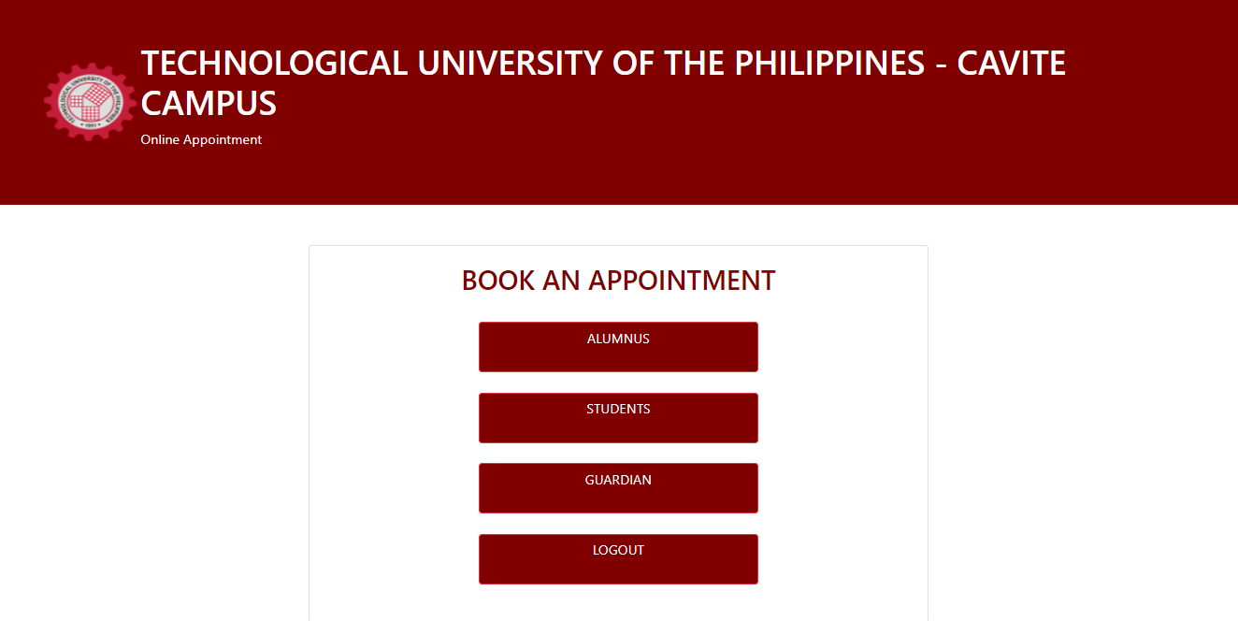
Technological University of the Philippines - Cavite Campus
Department of Industrial Technology
Bachelor of Engineering Technology
DESIGN (GUI)
FEATURE 6: BOOK AN APPOINTMENT PAGE

Slide 14
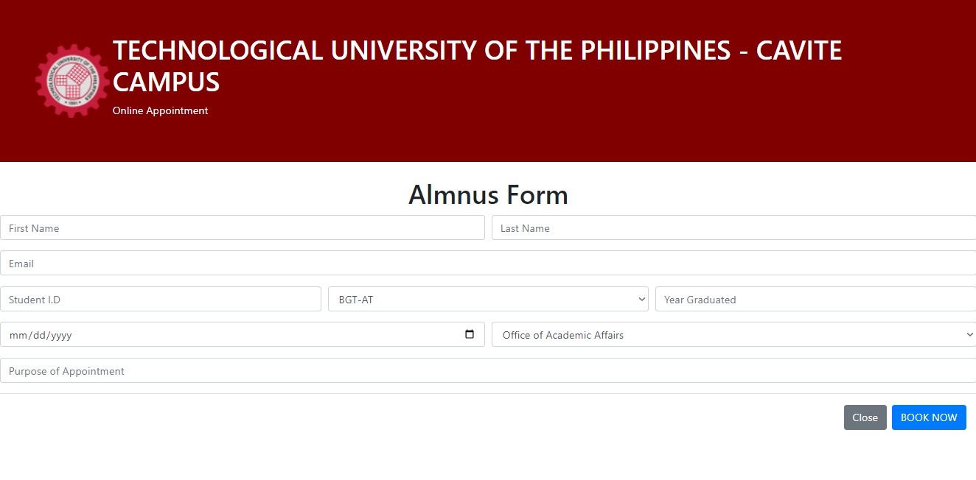
Technological University of the Philippines - Cavite Campus
Department of Industrial Technology
Bachelor of Engineering Technology
DESIGN (GUI)
FEATURE 7: ALUMNUS FORM PAGE

Slide 15
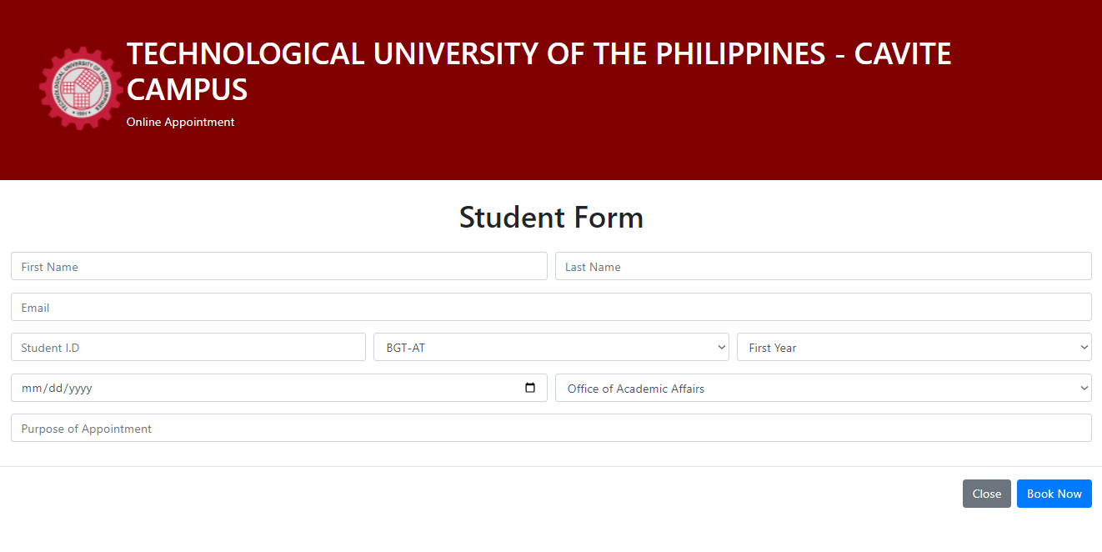
Technological University of the Philippines - Cavite Campus
Department of Industrial Technology
Bachelor of Engineering Technology
DESIGN (GUI)
FEATURE 8: STUDENT FORM PAGE

Slide 16
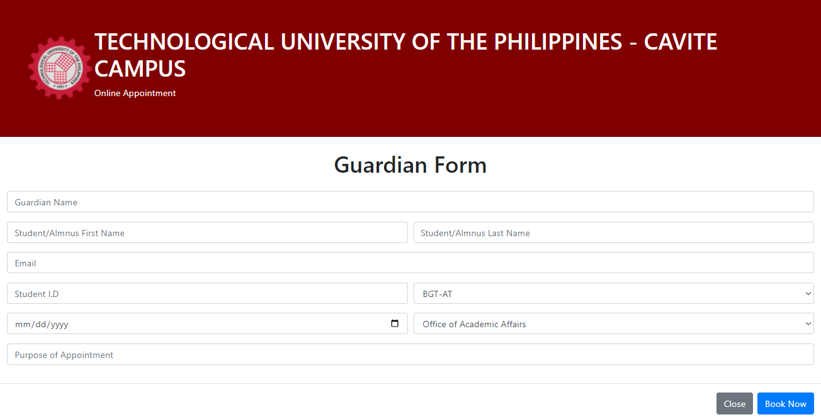
Technological University of the Philippines - Cavite Campus
Department of Industrial Technology
Bachelor of Engineering Technology
DESIGN (GUI)
FEATURE 9: GUARDIAN FORM PAGE

Slide 17
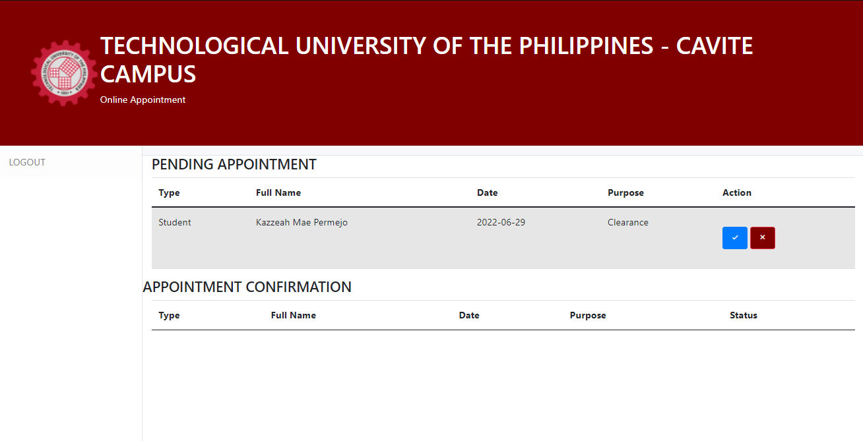
Technological University of the Philippines - Cavite Campus
Department of Industrial Technology
Bachelor of Engineering Technology
DESIGN (GUI)
FEATURE 10: ADMIN DEPARTMENT PAGE

Slide 18
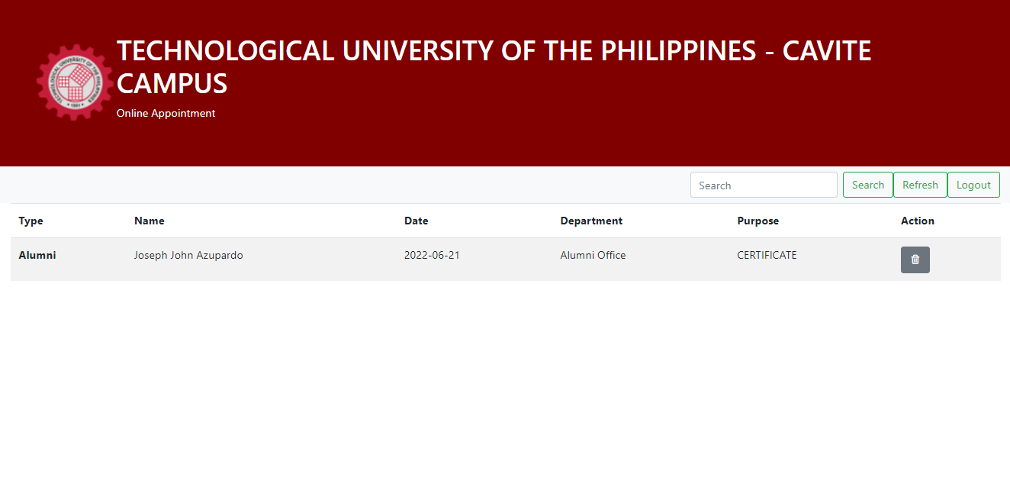
Technological University of the Philippines - Cavite Campus
Department of Industrial Technology
Bachelor of Engineering Technology
DESIGN (GUI)
FEATURE 11: SECURITY DEPARTMENT PAGE

Slide 19
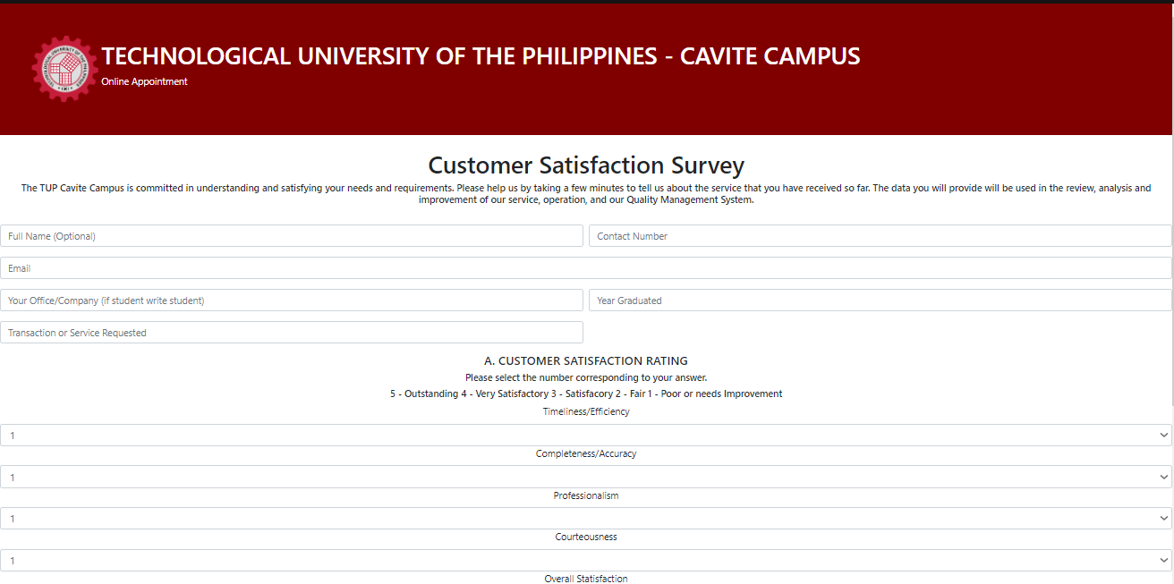
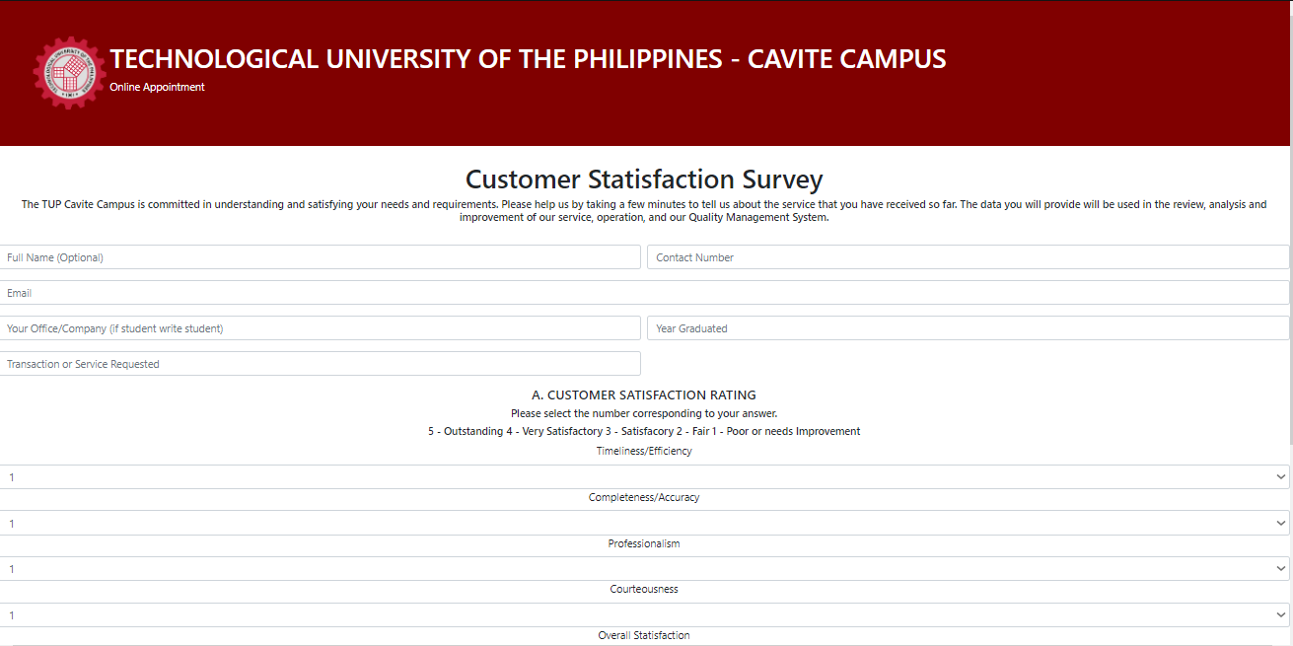
Technological University of the Philippines - Cavite Campus
Department of Industrial Technology
Bachelor of Engineering Technology
DESIGN (GUI)
FEATURE 11: CUSTOMER SATISFACTION SURVEY Part 1

Slide 20
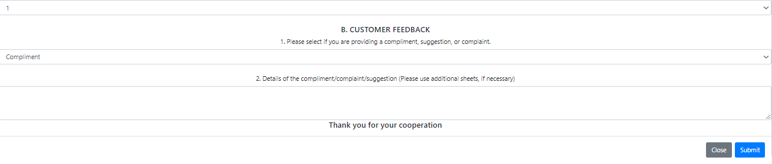
Technological University of the Philippines - Cavite Campus
Department of Industrial Technology
Bachelor of Engineering Technology
DESIGN (GUI)
FEATURE 11: CUSTOMER SATISFACTION SURVEY Part 2

Slide 21

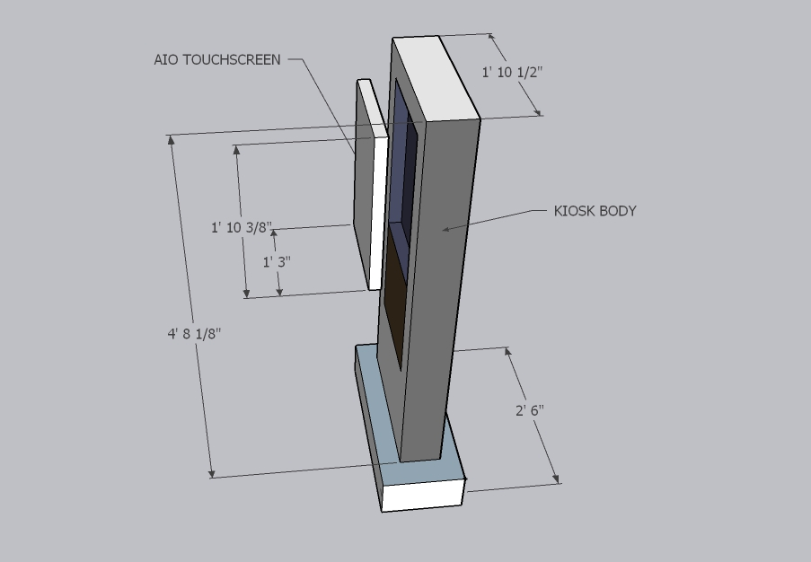
Technological University of the Philippines - Cavite Campus
Department of Industrial Technology
Bachelor of Engineering Technology
Design
FRONT VIEW

Slide 22
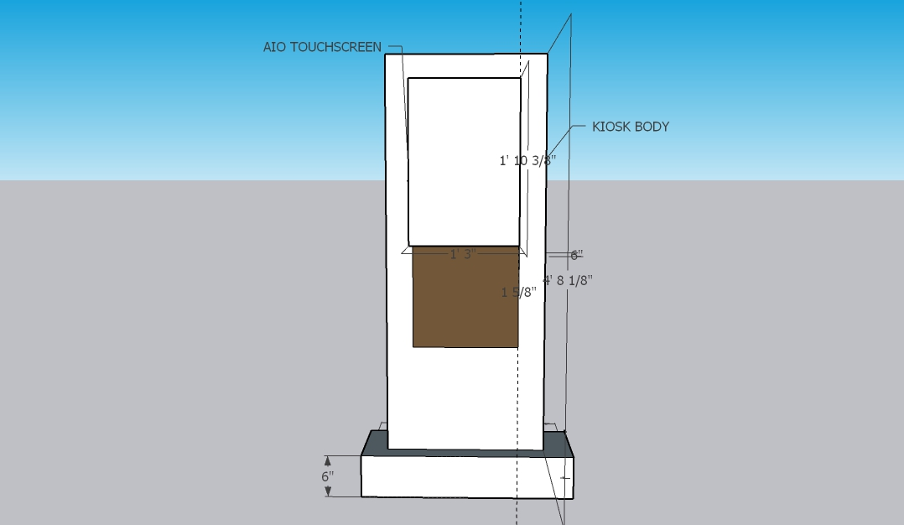
Technological University of the Philippines - Cavite Campus
Department of Industrial Technology
Bachelor of Engineering Technology
Design
FRONT VIEW WITH MEASUREMENT

Slide 23
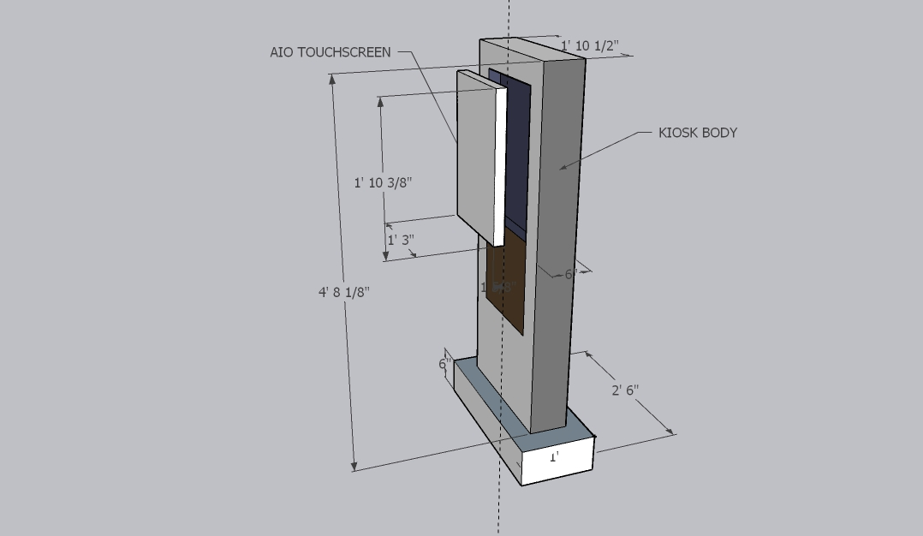
Technological University of the Philippines - Cavite Campus
Department of Industrial Technology
Bachelor of Engineering Technology
Design
EXPLODED VIEW | SIDE VIEW

Slide 24
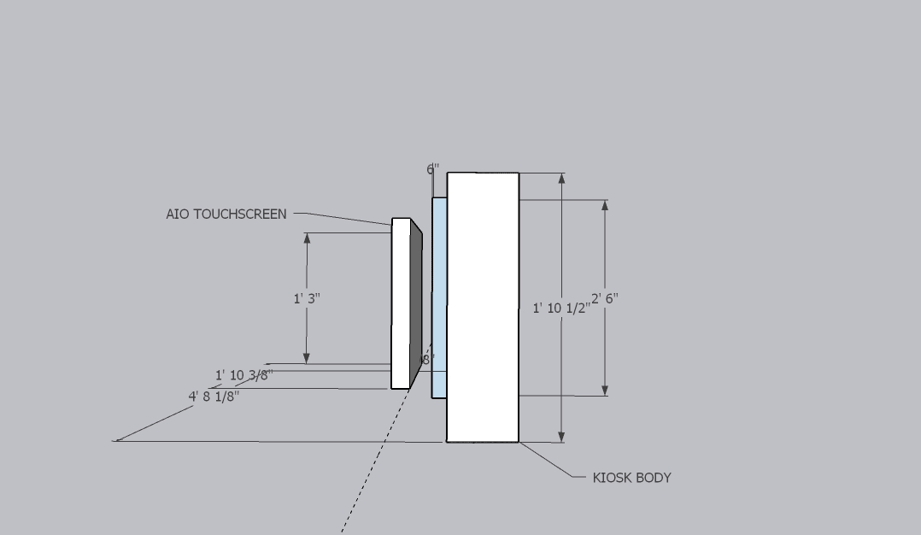
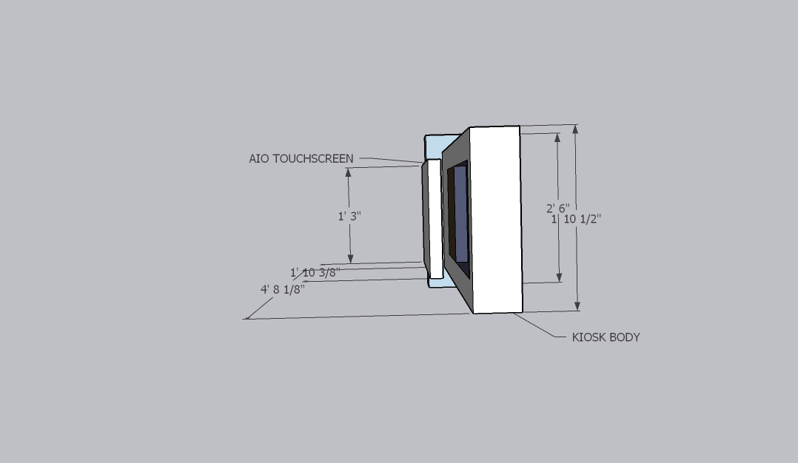
Technological University of the Philippines - Cavite Campus
Department of Industrial Technology
Bachelor of Engineering Technology
Design
EXPLODED VIEW | TOP VIEW

Slide 25
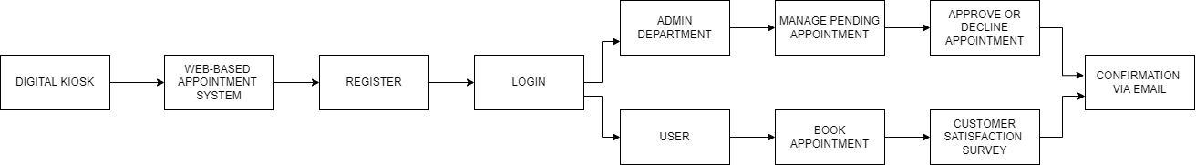
Technological University of the Philippines - Cavite Campus
Department of Industrial Technology
Bachelor of Engineering Technology
Design
BLOCK DIAGRAM

Slide 26
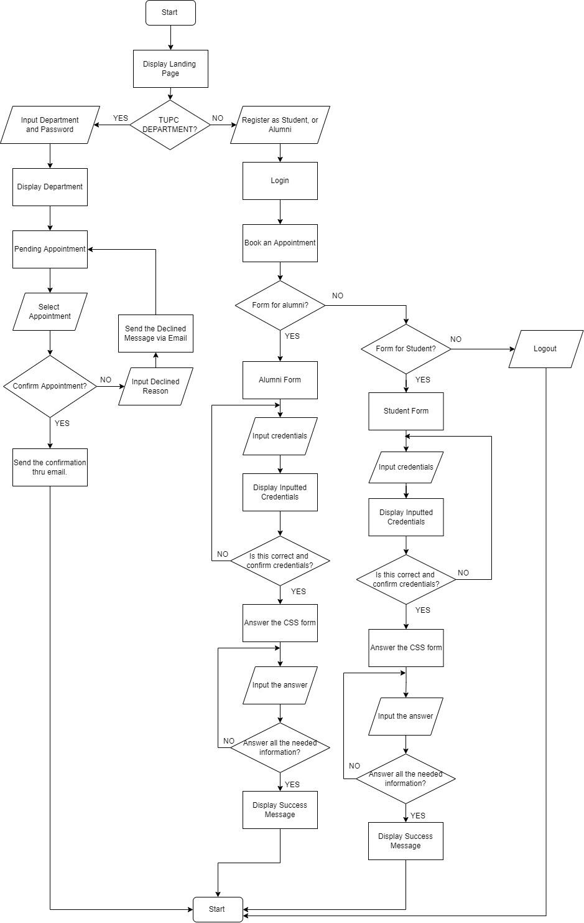
Technological University of the Philippines - Cavite Campus
Department of Industrial Technology
Bachelor of Engineering Technology
Design
FLOW CHART

Slide 27
Technological University of the Philippines - Cavite Campus
Department of Industrial Technology
Bachelor of Engineering Technology
Thank You for
Listening

