Slide 1

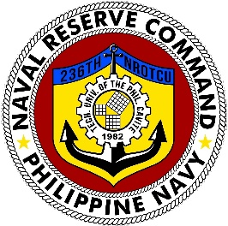
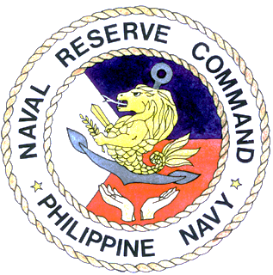
Naval Reserve Center-National Capital Region
Department of Naval Science and Tactics
236TH NAVAL RESERVE OFFICER TRAINING CORPS UNIT
Technological University of the Philippines-Cavite
Carlos Q. Trinidad Avenue, Salawag, Dasmarinas City, Cavite
CERTIFICATE OF COMPLETION
is hereby awarded to
Christian C. Rapal
for having satisfactorily completed the prescribed
Program of Instruction (POI) of MS1 and MS2 for Basic
NAVAL RESERVE OFFICERS TRAINING COURSE (NROTC)
Given this 2nd day of July 2021 at TUP-Cavite, Carlos Q. Trinidad Avenue, Salawag, Dasmarinas City, Cavite
Dry seal/
Stamp
CDR JERMIAS AHMED A SIBAL PN REMEDIOS H FALLESGON _ 236-20-0001 __
Commandant Registrar Control Number

