Slide 1
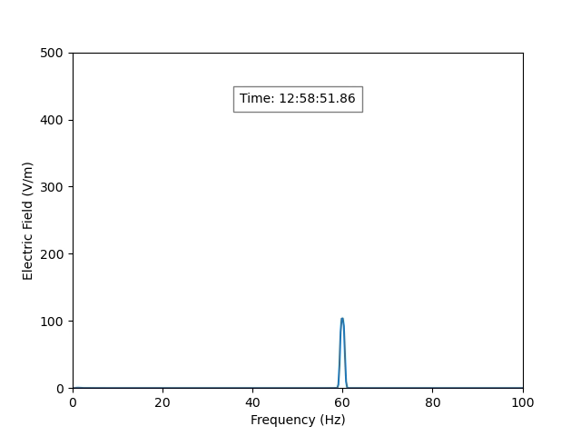
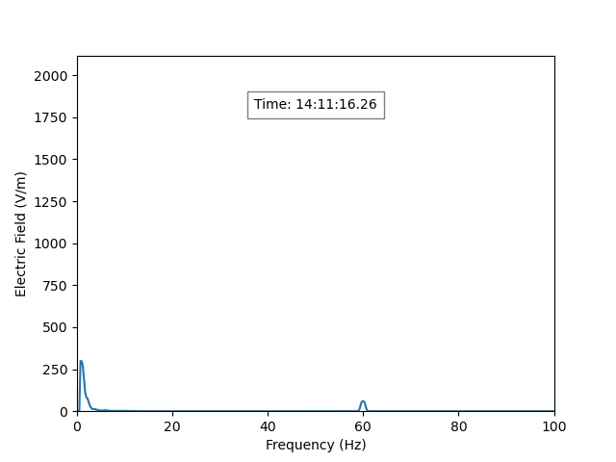
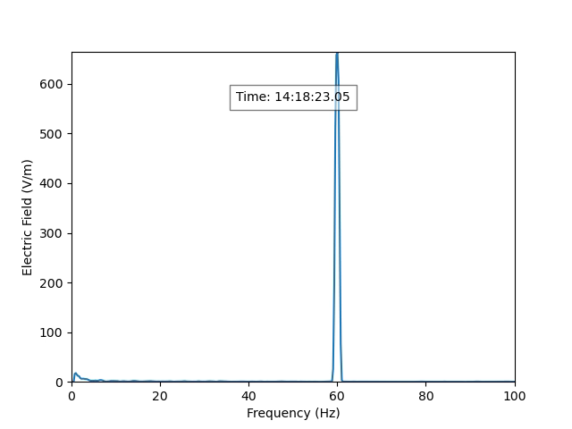
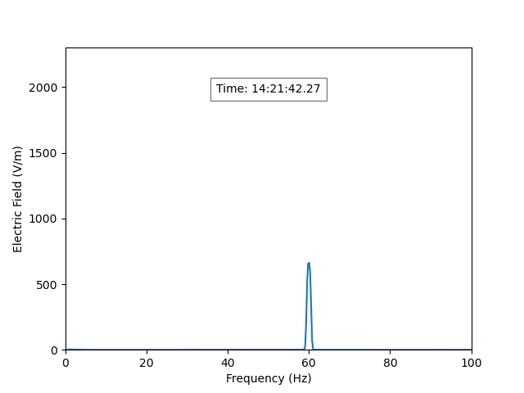
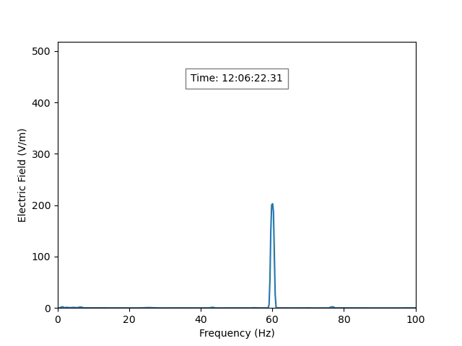
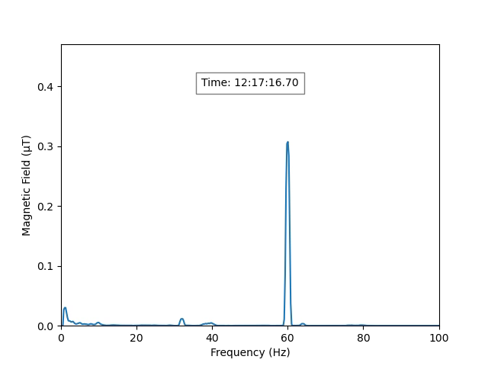
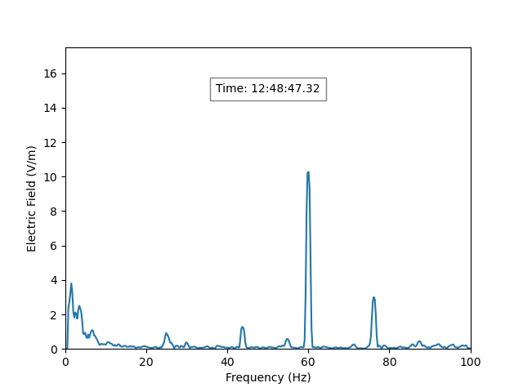
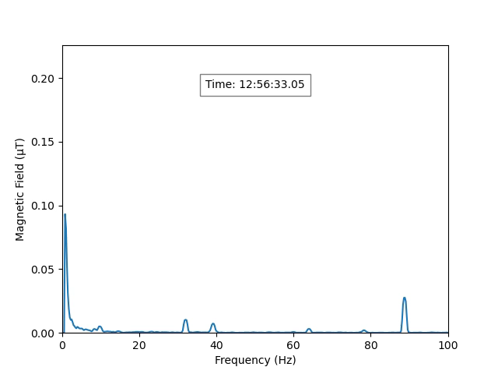
EMF Ground Probe - Rental
Jan 18, 2023 – AC line
E-field
E-field
E-field
E-field
Next to Substation
Beneath T-line
kV/m setting
Beneath T-line
100 kV/m setting
Beneath T-line
kV/m setting
Max E = 650 or 2000 V/m depending on setting
*The manual said to use the lower setting unless it saturates
Jan 19, 2023 – AC & DC line
E-field
H-field
E-field
H-field
Driving away from DC
Driving toward DC
Driving away from DC
Driving toward DC
Along Side AC line
Miles from AC line
Max E = 500 V/m @ 60 Hz, 17 V/m @ DC, Max H = 0.475 uT @ DC

