Slide 1
Dance Diet System Architecture
Client, backend, and AI server integration overview Professor submission deck
This deck summarizes the current repository split and the planned AI integration path based on the implemented codebase.

Slide 2
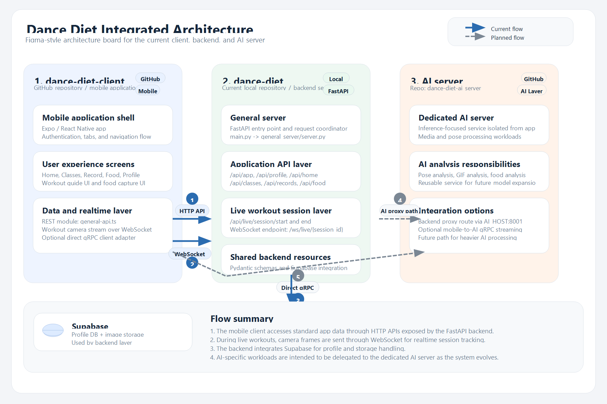
Integrated Architecture Diagram
Current flows are solid lines. Planned extension paths are dashed lines.

