Slide 1



Networking and Communications Association
Department of Networking and Communications
SRM IST

Slide 2
About NWC
The ‘Department of Networking and Communications’ or NWC is a student association formed exclusively for the Specializations in Information Technology, Internet of Things, Computer Networking, Cybersecurity, and Cloud Computing of the Computer Science Engineering branch under the umbrella of 'School of Computing'.

Slide 3
Vision & Objective
NWC aims to develop virtuous students with a diverse approach that would showcase their holistic development. The department comprises industrially and academically sound faculty members led by a very proficient President, Ms M. Safa. The department's research focuses on developing new and creative ideas that manifest students’ zeal to achieve higher in life. Using technical methodologies, the organisation concentrates on providing insights into the future scope of development or improving the pre-existing ones.

Slide 4
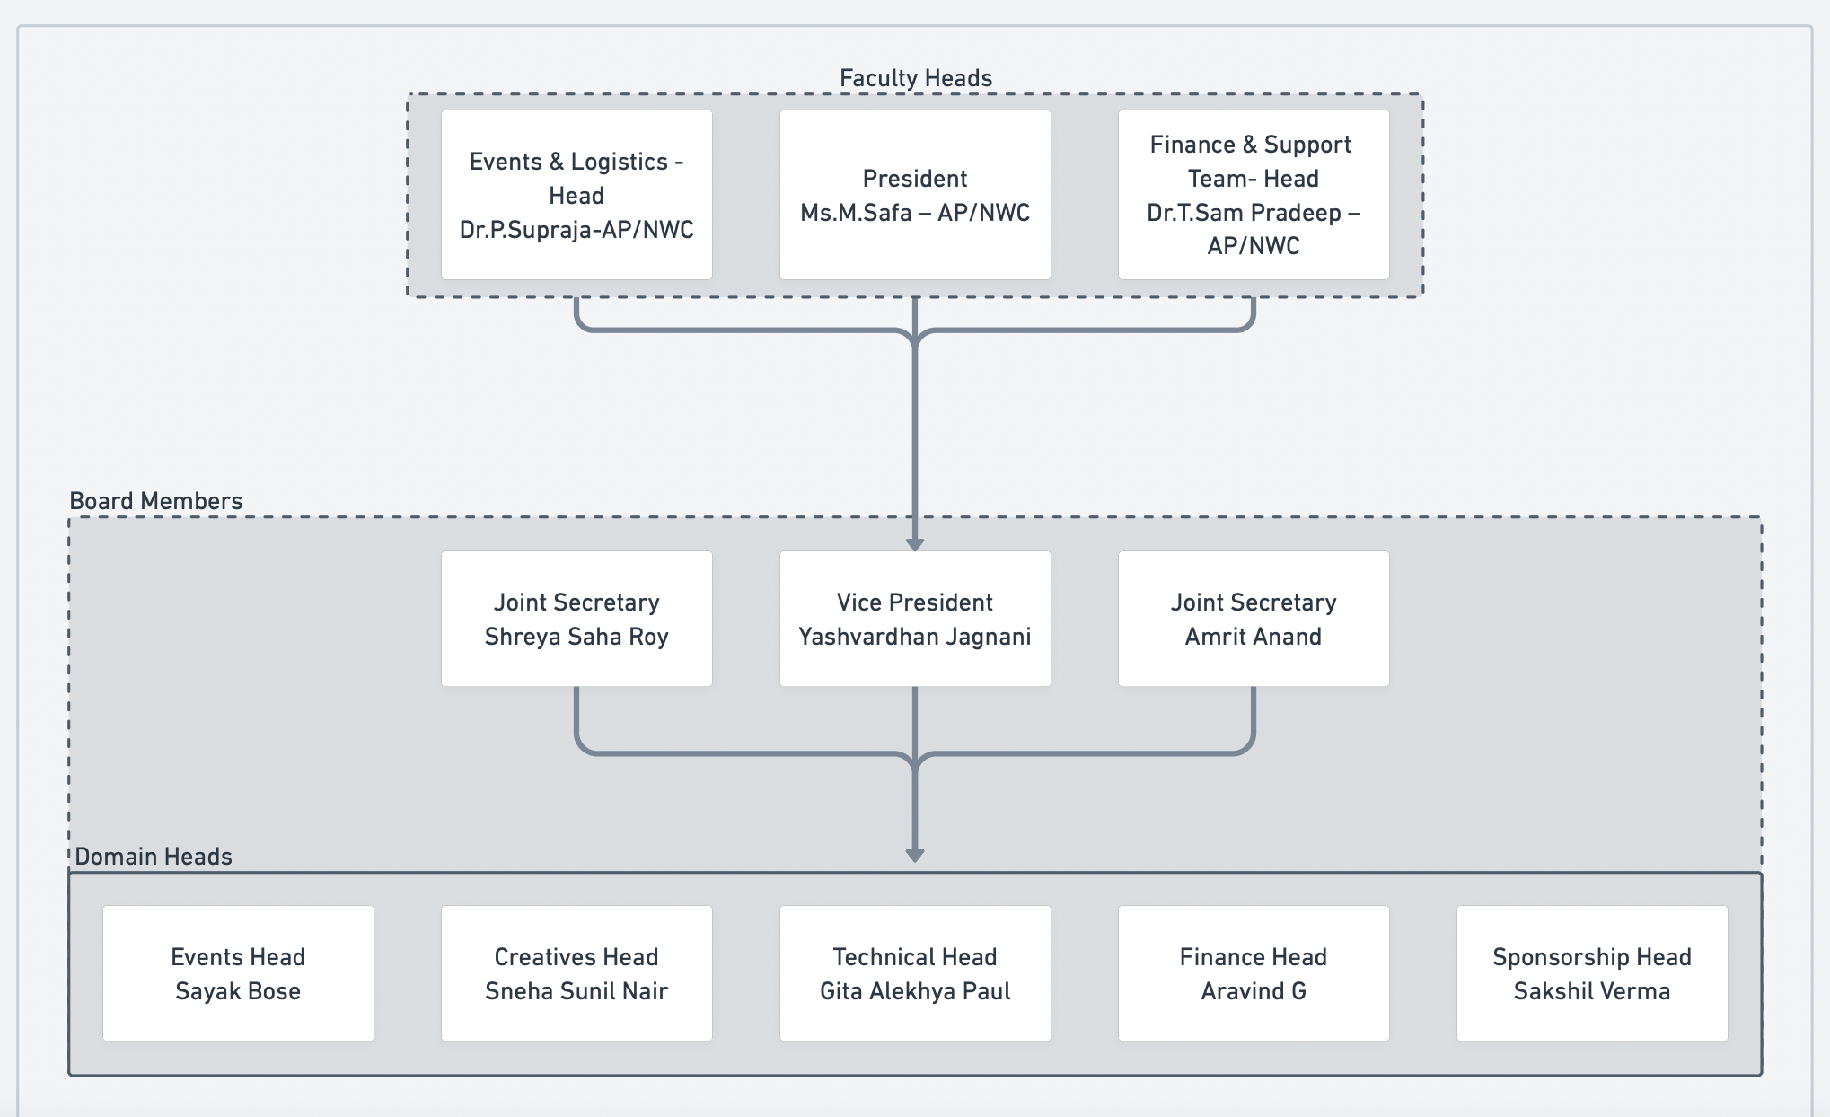
Team Structure

Slide 5




Thank You...
@nwcsrmist
/company/nwcsrmist/
nwc.srmist@gmail.com
@nwcsrmist

