Slide 1
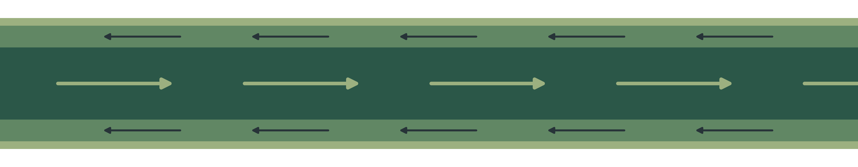
MICROSCALE TRANSPORT PROCESSES · TERM PAPER
Micro Heat Pipes and Vapour Chambers
Liquid return in the wick and vapour flow in a thin core
Debanshu Ghosh · Roll No. 23CH3FP56
Department of Chemical Engineering, IIT Kharagpur
Notes:
TIME: 8 s (running total 0:08)
SAY: "Vapour chambers are the thin sheets that spread heat inside a phone. I will cover two transport questions about them."

Slide 2
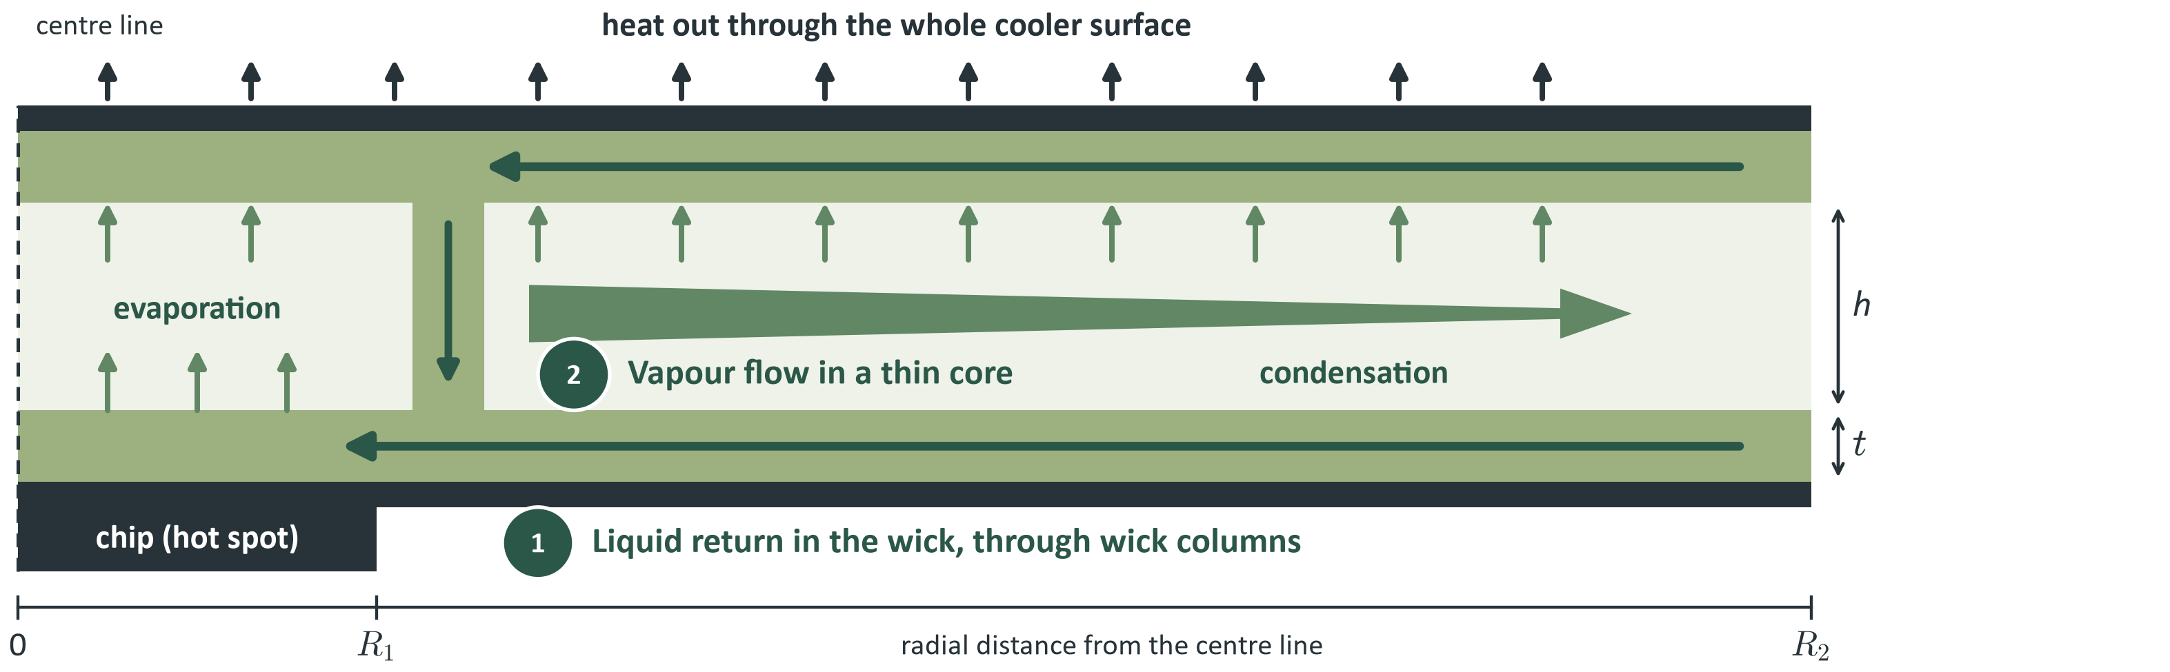
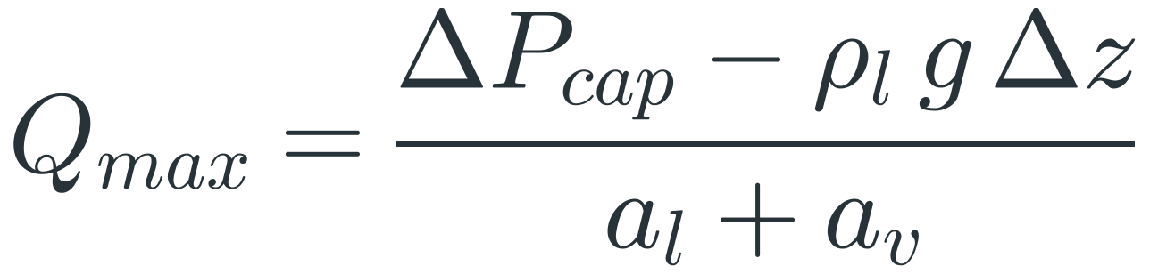
A capillary pump must beat every loss in the loop
OVERVIEW
The pressure budget
So the heat load has a ceiling (capillary limit)
Notes:
TIME: 28 s (running total 0:36)
SAY: "Heat evaporates water at the chip. Vapour flows through the core, condenses over the cooler surface, and the liquid returns through a porous wick. The only pump is the wick itself. So capillary pressure must beat the liquid loss, the vapour loss and gravity, and that sets a maximum heat load. My two topics are two terms of this one equation: the liquid return, and the vapour core."
ABOUT THE PICTURE
It is a half section through the centre of a disc-shaped chamber, the geometry of the model. The dashed left edge is the centre line, the chip sits under the centre (radius R1) and the rim is at R2. Heat enters through the bottom wall at the chip and evaporates liquid from the bottom wick. Vapour flows outward and condenses over the whole cooler top surface, mostly near the chip, so the arrow narrows; that is where the heat leaves. The condensate returns through the top wick, runs down the wick columns and joins the bottom wick, which carries it back to the evaporator.
HOW THE FORMULA COMES
1. Pressure around the closed loop must balance. Only the meniscus raises pressure; everything else loses it: ΔP_cap ≥ ΔP_l + ΔP_v + ΔP_g.
2. Mass flow from an energy balance: ṁ = Q/h_fg. At 5 W and h_fg = 2.358 MJ/kg, ṁ = 2.1 mg/s.
3. Both flow losses are laminar, so linear in ṁ and hence in Q. Write ΔP_l = a_l Q and ΔP_v = a_v Q, where a is a flow resistance in Pa/W.
4. Gravity: ΔP_g = ρ_l g Δz. Substitute with equality and solve for Q: Q_max = (ΔP_cap − ρ_l g Δz)/(a_l + a_v).
IF ASKED
Numbers use saturated water at 60 °C and an illustrative disc: R1 = 5.64 mm (10 × 10 mm source), R2 = 48 mm (same area as a 60 × 120 mm sheet). They are not measured device data.

Slide 3
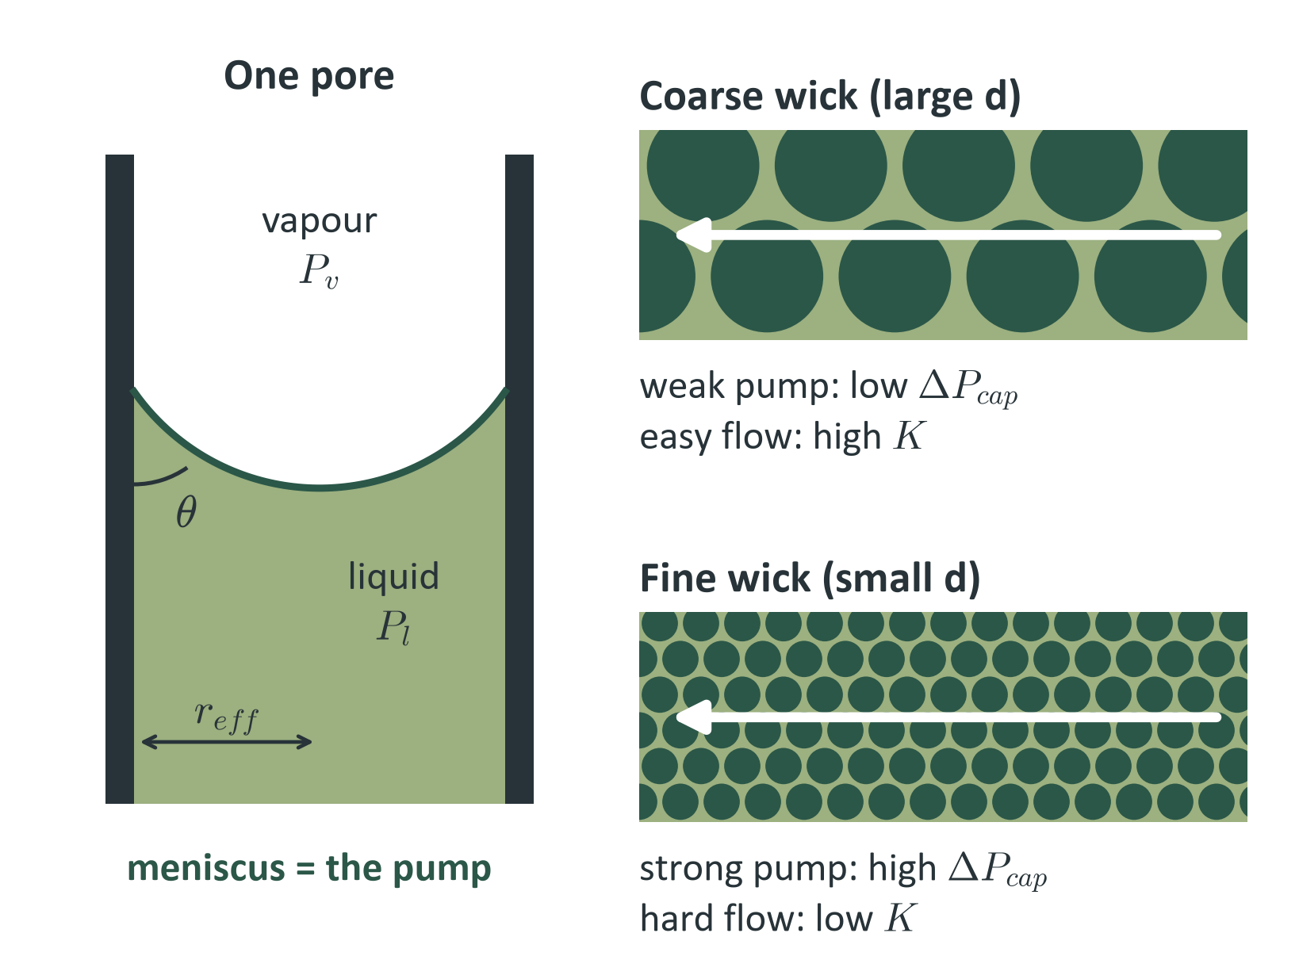
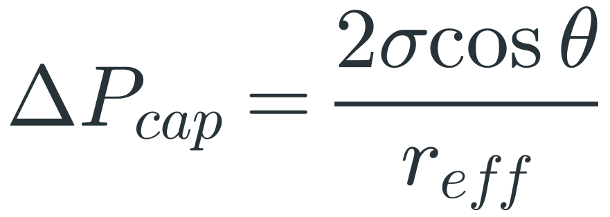
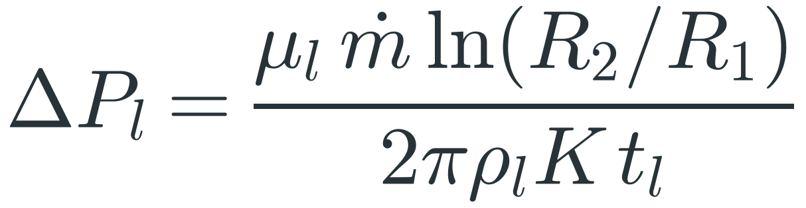
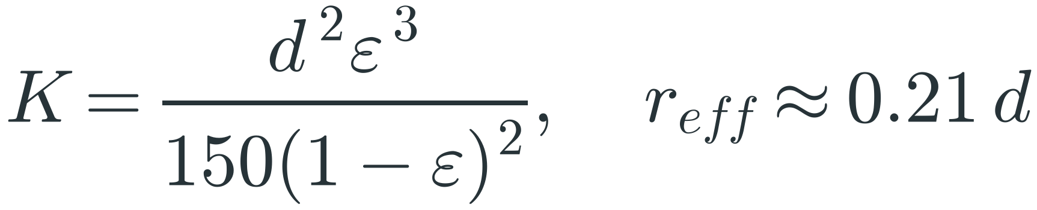
Finer pores pump harder but resist flow far more
TOPIC 1 · LIQUID RETURN IN THE WICK
Pump: Young–Laplace
Loss: radial Darcy flow
Permeability: Kozeny–Carman
5×
25×
pump pressure
10 µm vs 50 µm powder
liquid resistance
10 µm vs 50 µm powder
Notes:
TIME: 34 s (running total 1:10)
SAY: "The meniscus in each pore is the pump, and Young–Laplace says its pressure goes as one over pore radius. But the liquid also has to flow through the wick, and Darcy's law gives that loss. Permeability goes as particle size squared, so one length sets both. Going from 50 to 10 micron powder gives 5 times the pump pressure but 25 times the liquid resistance. So the best wick is the coarsest one with enough margin."
HOW THE FORMULAS COME
Young-Laplace: a spherical interface of radius R has a pressure jump 2σ/R. In a pore of radius r_eff the meniscus meets the wall at contact angle θ, so geometry gives R = r_eff/cos θ. Hence ΔP_cap = 2σ cos θ / r_eff.
Water at 60 °C: σ = 0.0662 N/m. For θ = 0 and r_eff = 10.5 µm: 2(0.0662)/10.5e-6 = 12.6 kPa.
Darcy in radial flow: Darcy's law is dP/dr = μ_l u / K. Mass conservation across a cylinder of radius r through total wick thickness t_l gives ṁ = ρ_l u (2π r t_l), so u = ṁ/(2π ρ_l r t_l).
Substitute: dP/dr = μ_l ṁ / (2π ρ_l K t_l r). Integrate from R1 to R2, where ∫dr/r = ln(R2/R1). Hence ΔP_l = μ_l ṁ ln(R2/R1) / (2π ρ_l K t_l).
Here t_l = 2t because there is a wick on each wall.
Kozeny-Carman: treat the pores as bundled tubes with Hagen-Poiseuille flow, using the hydraulic diameter of a packed bed, ∝ ε d/(1−ε). This gives K = d²ε³/[150(1−ε)²]. With ε = 0.5, K = d²/300. Rule of thumb for sintered spheres: r_eff ≈ 0.21 d.
THE 5× AND 25×
ΔP_cap ∝ 1/d, so 50 → 10 µm gives ×5 (12.6 → 63.0 kPa). K ∝ d², so a_l goes ×25 (82 → 2055 Pa/W). The liquid-only limit goes as ΔP_cap·K ∝ d, so finer alone loses.
IF ASKED
Darcy and Kozeny-Carman are continuum models and need a wick many particles thick. A 50 µm layer of 50 µm powder is about one particle thick, so treat this case as an order-of-magnitude estimate. Contact-angle drift matters too: θ = 60° halves ΔP_cap.

Slide 4
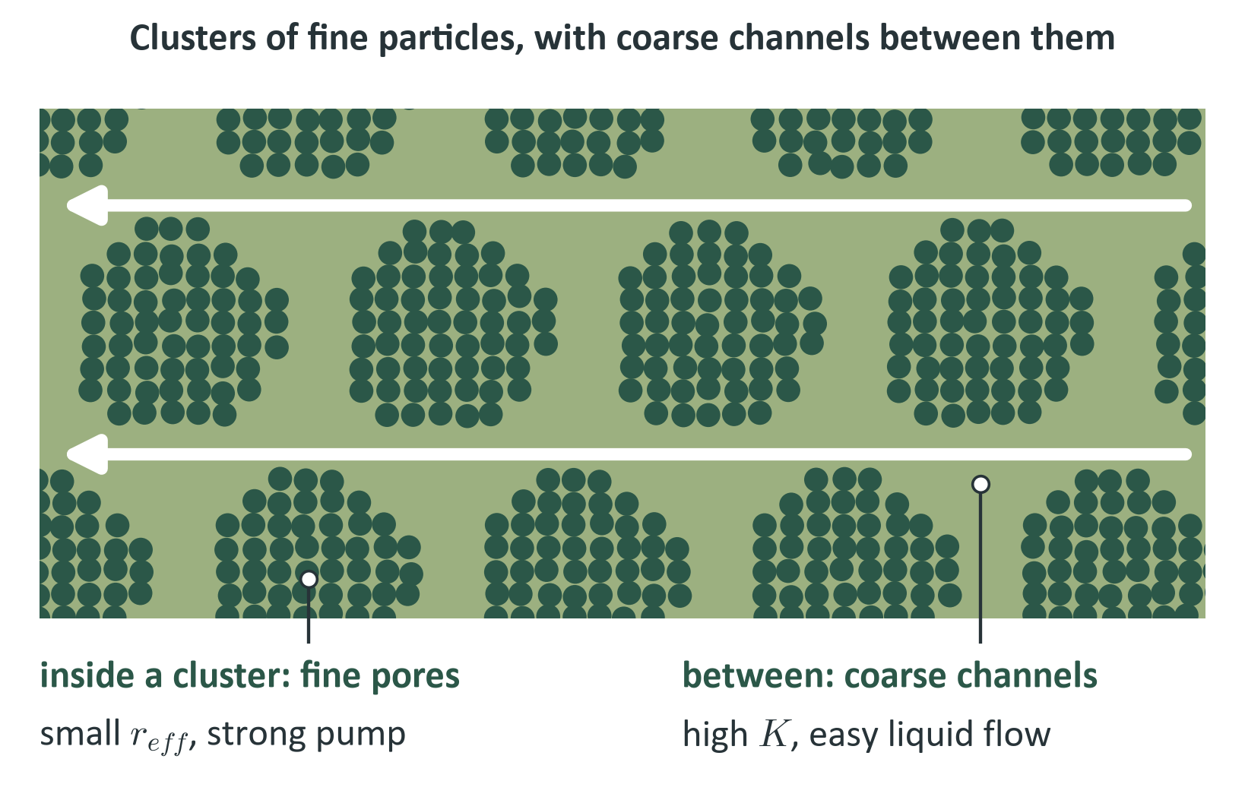
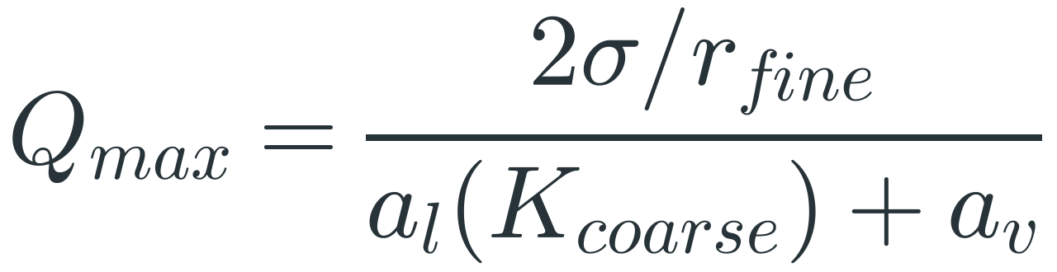
Biporous wicks separate the pump from the flow path
TOPIC 1 · BIPOROUS WICK
Each from its own scale
37%
Upper bound, not a prediction: it assumes the fine and coarse regions do not interfere.
lower surface ΔT in a
simulation (Patankar 2016)
Notes:
TIME: 24 s (running total 1:34)
SAY: "A biporous wick escapes that trade-off. Fine pores inside clusters set the pump pressure, and coarse channels between clusters carry the flow. In my idealised estimate the limit rises from 50 or 38 watts to about 161, as an upper bound. In Patankar's simulation, a biporous condenser wick cut the peak-to-mean surface temperature difference by 37 percent."
HOW THE FORMULA COMES
Start from Q_max = ΔP_cap/(a_l + a_v). In a single-pore-size wick, r_eff and K both come from the same d. A biporous wick lets each come from its own length scale:
• ΔP_cap = 2σ/r_fine, because the smallest menisci at the evaporator set the pump.
• a_l uses K_coarse, because the liquid takes the easiest path through the channels.
THE THREE BARS (h = 100 µm, 2 × 50 µm wick, a_v = 144 Pa/W)
Fine: r = 5 µm, ΔP_cap = 26.5 kPa, K = 1.76e-12 m² (d = 23 µm), a_l = 389 Pa/W. Q = 26480/(389+144) = 50 W.
Coarse: r = 21 µm, ΔP_cap = 6.3 kPa, K = 3.33e-11 m² (d = 100 µm), a_l = 20.5 Pa/W. Q = 6305/(20.5+144) = 38 W.
Biporous: fine ΔP_cap with coarse K. Q = 26480/(20.5+144) = 161 W.
IF ASKED
Why an upper bound? It assumes the regions do not interfere and it borrows K from 100 µm particles, which would not fit in a 50 µm layer. Channels also take up volume and break the conduction path. The lesson is the principle, not the number.
Be exact about the 37%: it is a simulation, it is the condenser surface peak-to-mean temperature difference, and it is relative to a monolithic wick (Patankar, Weibel and Garimella 2016). Experiments on biporous evaporator wicks: Semenic and Catton 2009.

Slide 5
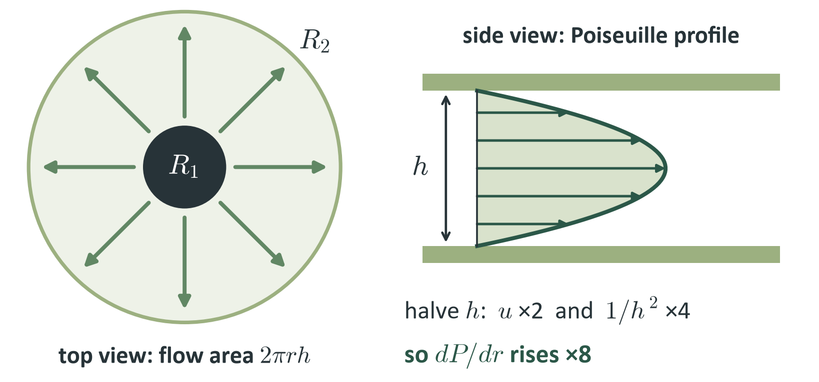
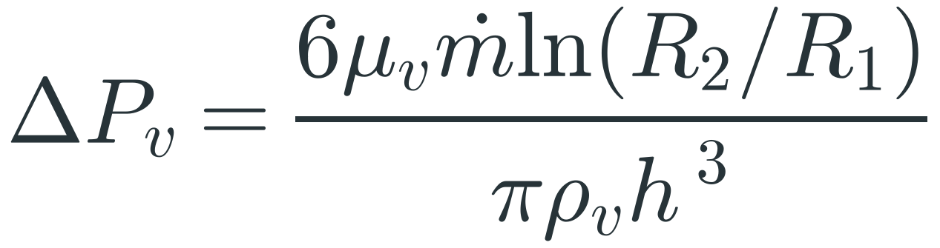
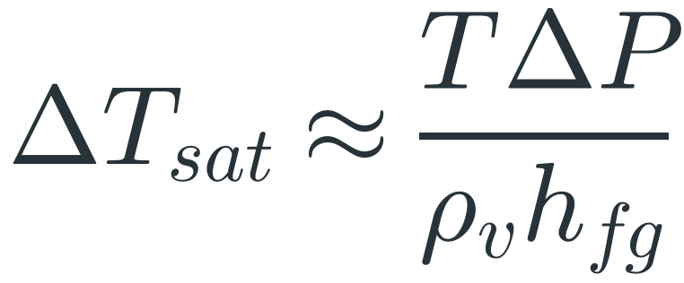
Halve the gap: 8× the drop, and copper catches up
TOPIC 2 · VAPOUR FLOW IN A THIN CORE
Radial Poiseuille flow
Clausius–Clapeyron
Copper ÷ chamber: same thickness, source and rim
27×
28×
12×
≈2×*
400 µm
200 µm
100 µm
50 µm *trend
Notes:
TIME: 34 s (running total 2:08)
SAY: "Vapour spreads radially in a thin slit, which is Poiseuille flow, so the pressure drop goes as one over h cubed. Halve the gap and it is eight times worse. In saturated vapour that pressure drop is a temperature drop, about 1.1 kelvin per kilopascal. Against a copper sheet of the same thickness, at 5 watts, the chamber is about 28 times better at 200 microns, but only about 2 times better at 50. Thin cores erase the advantage."
HOW THE FORMULAS COME
Plane Poiseuille flow between plates a gap h apart: the mean velocity is u = (h²/12μ)(−dP/dr), so dP/dr = −12 μ_v u / h².
Mass conservation for radial flow: the flow area at radius r is 2π r h, so u = ṁ/(ρ_v 2π r h). Velocity falls as 1/r.
Substitute: dP/dr = −[12 μ_v / h²]·[ṁ/(2π ρ_v r h)] = −6 μ_v ṁ / (π ρ_v h³ r).
Integrate from R1 to R2: ΔP_v = 6 μ_v ṁ ln(R2/R1) / (π ρ_v h³).
Where the h³ comes from: one power from velocity (u ∝ 1/h) and two from the wall shear (dP/dr ∝ u/h²). So halving h gives 2 × 4 = 8.
Clausius-Clapeyron: dP/dT = h_fg/(T v_fg). With v_fg ≈ 1/ρ_v this is dP/dT = ρ_v h_fg / T. Rearranged for small drops: ΔT_sat ≈ T ΔP / (ρ_v h_fg).
Water at 60 °C: 333.15/(0.1304 × 2.358e6) = 1.08e-3 K/Pa = 1.08 K/kPa.
WORKED EXAMPLE (5 W, h = 100 µm)
ṁ = 5/2.358e6 = 2.12e-6 kg/s; ln(R2/R1) = ln(48/5.64) = 2.14. ΔP_v = 6(1.08e-5)(2.12e-6)(2.14)/[π(0.1304)(1e-4)³] = 718 Pa, so ΔT = 0.78 K.
THE COPPER COMPARISON (bar chart)
Copper sheet: a solid copper sheet of the same total thickness H = h + 2 wicks + 2 walls (80 µm each) carries the same 5 W radially from the source (R1) to the rim (R2). Heat balance Q = −k (2π r H) dT/dr gives ΔT_Cu = Q ln(R2/R1) / (2π k H), with k = 400 W/m K.
At h = 200 µm, H = 0.46 mm: ΔT_Cu = 5 × 2.14 / (2π × 400 × 0.00046) = 9.3 K.
Chamber: ΔT = vapour + wick + interface. At 200 µm that is 0.097 + 0.016 + 0.215 = 0.33 K (wick conduction from a Maxwell estimate, k about 160 W/m K; interface from kinetic theory with an assumed accommodation coefficient of 0.1).
Ratios, copper ÷ chamber: 400 µm 27×, 200 µm 28×, 100 µm 12×, 50 µm about 2× (trend only).
Why it collapses: the copper sheet gets only mildly worse as it thins (H falls from 0.66 to 0.31 mm), while the chamber's vapour drop grows as 1/h³.
IF ASKED
Validity checks at 100 µm: Mach = 0.010, so incompressible. Knudsen = 0.0077 (mean free path 0.77 µm), so continuum and no slip.
The 50 µm chamber value is marked * because its vapour pressure drop (5.7 kPa) is above 20% of P_sat (19.95 kPa), where the linear relation stops being valid (below about 56 µm at 5 W). Read it as a trend.
The model assumes all vapour reaches R2. Real vapour condenses along the way, so the true drop is lower by an order-one factor. Support pillars would raise it.
A micro heat pipe is the one-dimensional version of the same physics; this comparison uses the flat chamber geometry.

Slide 6
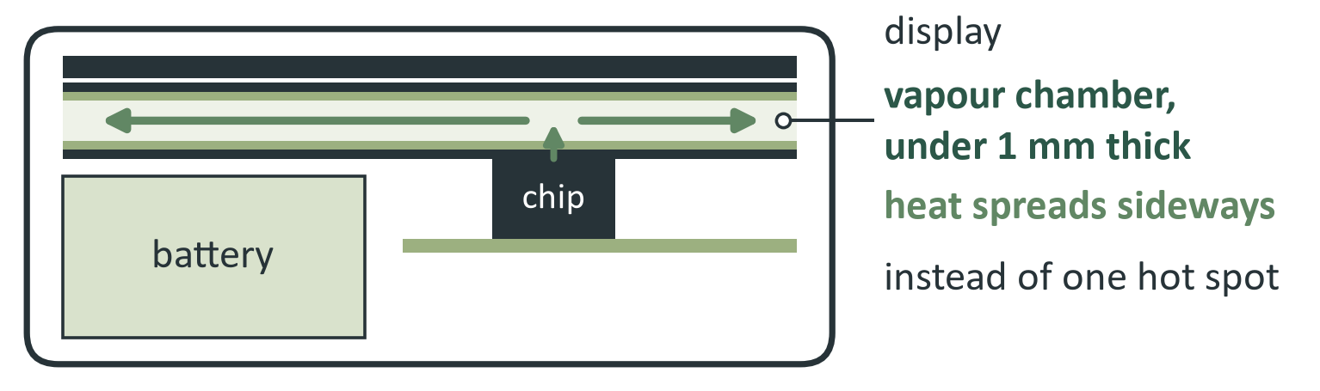
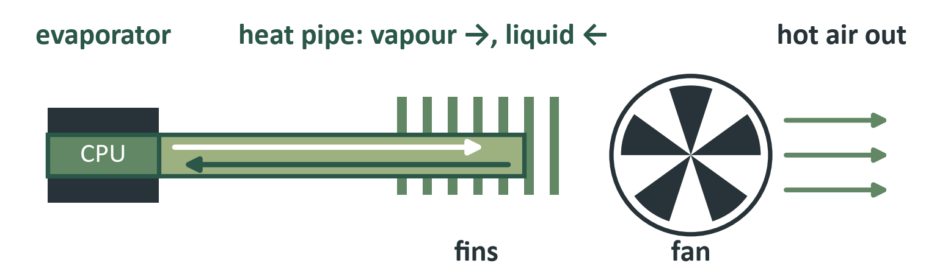
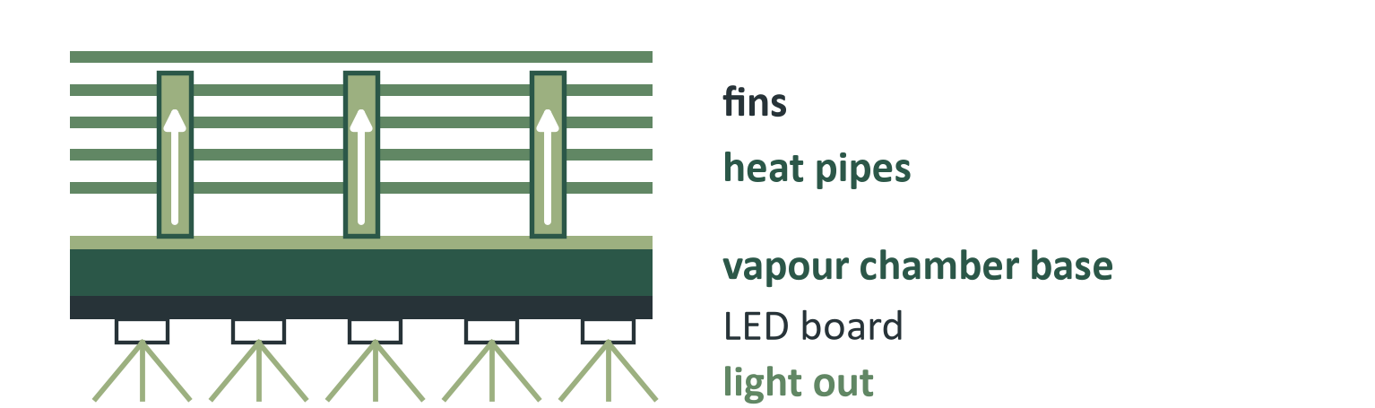
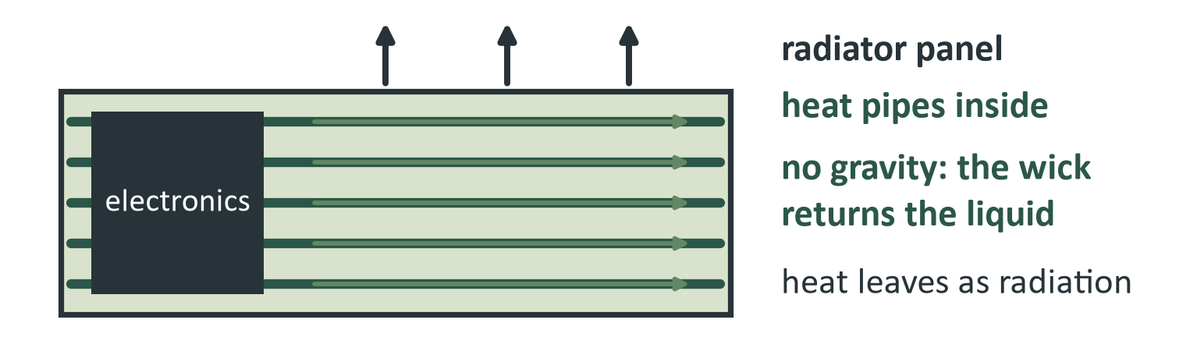
Where heat must move with no pump
APPLICATIONS
Smartphone · chamber under the display
Laptop · heat pipe to the fan
Limit: the vapour core, under 1 mm thick (topic 2)
Limit: liquid return along a long wick (topic 1)
High-power LED lamp · chamber base, heat pipes
Satellite radiator panel · no gravity needed
Limit: the wick must keep up at the hot spot (topic 1)
In zero gravity the gravity term in the budget is zero
Notes:
TIME: 28 s (running total 2:36)
SAY: "Where does this matter? In a phone, a vapour chamber under the processor, under a millimetre thick. In a laptop, heat pipes carry heat from the chip to the fan. In high-power LED lamps, a heat pipe lifts the heat off the board into the fins. And on satellites, heat pipes in the radiator panels work with no gravity at all, because the wick, not gravity, brings the liquid back. In every case the same two limits apply: the wick and the vapour core."
ABOUT THE DRAWINGS
They are schematic layouts of the usual arrangement, not specific products.
Phone: side view. The chip's heat enters the vapour chamber under the display and spreads sideways, so the hot spot is flattened. The chamber is under 1 mm thick, which is why the vapour core (topic 2) is the tight limit.
Laptop: top view. A heat pipe carries heat from the CPU to a finned sink; the fan blows air through the fins. Vapour goes to the cold end, liquid returns through the wick (topic 1).
LED lamp: side view. The LED board sits on a vapour-chamber base that spreads the hot spot; heat pipes lift the heat into the fin stack.
Satellite: top view of a radiator panel. Heat pipes embedded in the panel spread the electronics' heat across it, and the panel radiates it to space. With no gravity the pressure budget has no gravity term, and the wick alone returns the liquid.
IF ASKED
Phones, laptops, LED lighting and spacecraft panels are all standard uses of heat pipes and vapour chambers. The paper's own case is the phone. I did not model the other three; they show where the same two limits appear.

Slide 7
Two results, and where they come from
REFERENCES
DasGupta & Ganguly. Microscale Transport Processes, course notes, IIT Kharagpur.
Faghri (2012). Review and advances in heat pipe science and technology. J. Heat Transfer 134(12), 123001.
Weibel & Garimella (2013). Recent advances in vapor chamber transport characterization. Adv. Heat Transfer 45, 209–301.
Semenic & Catton (2009). Experimental study of biporous wicks for high heat flux applications. IJHMT 52, 5113–5121.
Patankar, Weibel & Garimella (2016). Patterning the condenser-side wick in ultra-thin vapor chamber heat spreaders. IJHMT 101, 927–936.
Peterson (1994). An Introduction to Heat Pipes: Modeling, Testing, and Applications. Wiley.
Faghri (1995). Heat Pipe Science and Technology. Taylor & Francis.
1
Wick
One length sets pump and resistance; biporous wicks separate them
2
Vapour
ΔPᵥ ∝ 1/h³, so thin cores become the bottleneck
Calculated values are illustrative (water at 60 °C, disc geometry). Full list in the term paper.
Notes:
TIME: 8 s (running total 2:44)
SAY: "So: one length sets the wick, and h cubed sets the vapour limit. Thank you."
The whole script runs about 2:44 at 150 words a minute, which leaves a margin inside 3:00. If you run over, drop the 37% sentence on the biporous slide first, then the saturated-vapour sentence on the vapour slide.

