Slide 1
MICROSCALE TRANSPORT PROCESSES · TERM PAPER
Micro Heat Pipes and Vapour Chambers for Smartphone and Chip Cooling
A critical look at capillary-driven two-phase heat transport: the science, the simplifications, where they fail
Debanshu Ghosh · Roll No. 23CH3FP56
Department of Chemical Engineering, IIT Kharagpur
Notes:
Introduce yourself and the topic in one sentence: this talk is about how a sheet of water and copper thinner than a coin spreads heat in a phone, and what the physics of that tells us about transport at the microscale. Say that the focus is the science, not products. About 30 seconds.

Slide 2
A phone is limited by skin temperature, not by the chip
up to 34%
≈ 12 fps
≈ 50 °C
performance lost to thermal throttling in popular apps
frame-rate penalty in one game on the same phone
package temperature reached when throttling was switched off
Measured on a Nexus 6P (Bhat et al., DATE 2019)
• Heat made here: a few mm² of silicon. Heat leaves through: the whole back of a sealed, fanless phone.
• So the real job is: spread heat sideways, quickly, in a sheet under ~1 mm thick, with no moving parts.
Debanshu Ghosh · 23CH3FP56 · Chemical Engineering, IIT Kharagpur
2
Notes:
Bhat et al. measured a Nexus 6P. The thermal governor cut performance by up to 34% in popular apps, about 12 frames per second in one game; without throttling the package reached about 50 C. The point: the heat is made in a few square millimetres but must leave through the whole back of a sealed, fanless phone. So the task is spreading heat sideways, fast, in a body under a millimetre thick. Pumped microchannel cooling (Tuckerman and Pease) works but needs a pump; plain copper cannot spread enough when it is this thin. That is the gap vapour chambers fill. (Source: Bhat et al. 2019, DATE; Garimella et al. 2008.)

Slide 3
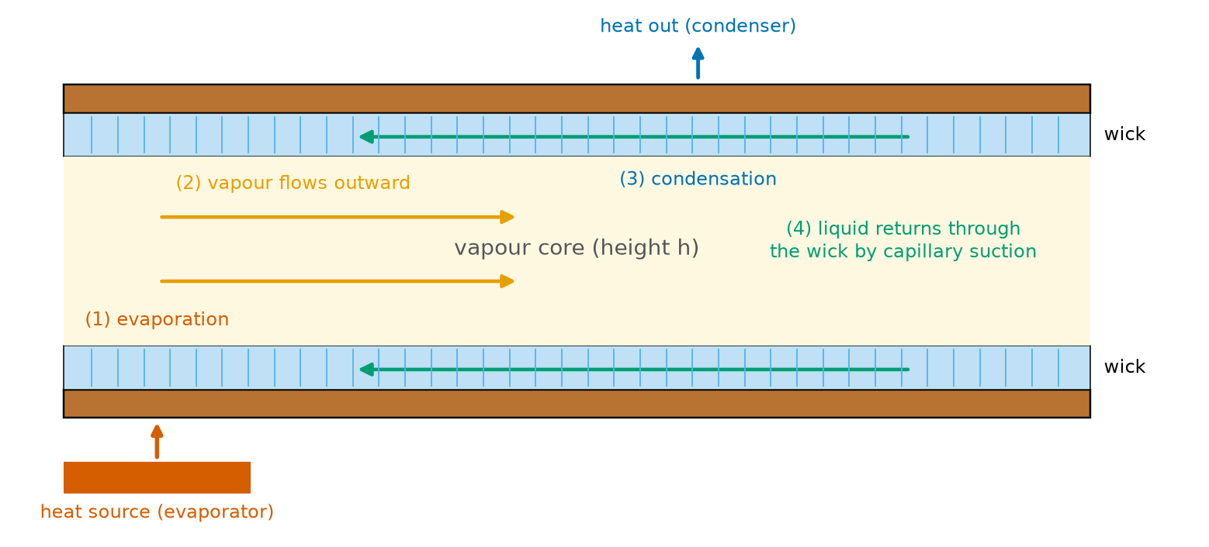
Idea: carry heat as latent heat in a sealed loop of water and vapour
• 1 water evaporates at the hot spot
• 2 vapour flows through the thin core
• 3 it condenses where it is cooler
• 4 liquid returns through the wick, driven by capillary suction
• Numbers: 2.36 MJ per kg, so 5 W needs only 2.1 mg/s
Debanshu Ghosh · 23CH3FP56 · Chemical Engineering, IIT Kharagpur
3
Notes:
Walk through the four numbered steps. Evaporation at the hot spot, vapour flows outward through the thin core, condensation at the cool region, liquid returns through the wick by capillary suction. Because each kilogram of water carries 2.36 MJ, a mass flow of only about 2 milligrams per second moves 5 W. No pump: the wick itself is the pump. A micro heat pipe is the one-dimensional version; the vapour chamber is the flat two-dimensional one.

Slide 4
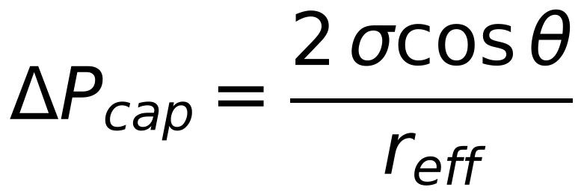
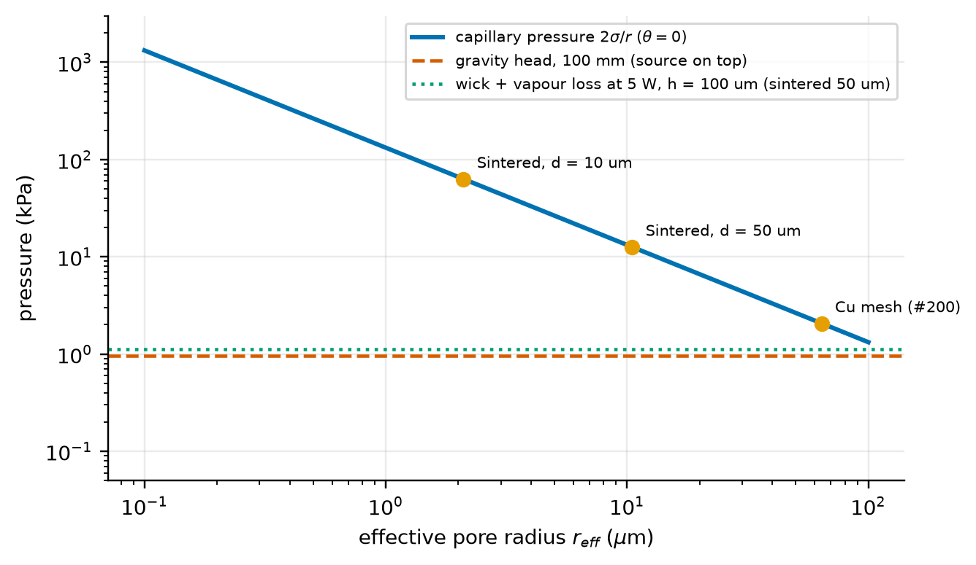
Smaller pores pump harder, and gravity stops mattering
• Pressure ∝ 1/r: 64 µm pore → 2.1 kPa; 10 µm → 13 kPa; 1 µm → 130 kPa
• Bond number: 0.0058 at 200 µm, so gravity is negligible inside the sheet
• But over the length: lifting 100 mm costs 0.96 kPa; coarse mesh keeps only ~2× margin
Debanshu Ghosh · 23CH3FP56 · Chemical Engineering, IIT Kharagpur
4
Notes:
Young-Laplace: a meniscus in a pore of radius r supports a pressure difference of 2 sigma cos theta over r. Pressure grows as 1/r. For water at 60 C, a 64 micron mesh pore gives about 2 kPa, a 10 micron pore about 13 kPa, a 1 micron pore about 130 kPa. The Bond number rho g h squared over sigma is 0.15 at 1 mm and 0.006 at 200 microns, so gravity cannot rearrange liquid inside the sheet. Gravity still acts over the length: lifting water 100 mm costs 0.96 kPa, which fine wicks cover easily and coarse mesh only with about a factor of two to spare. Assumptions: spherical meniscus, constant contact angle, uniform pores, pure liquid.

Slide 5
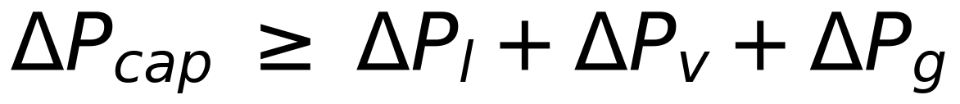
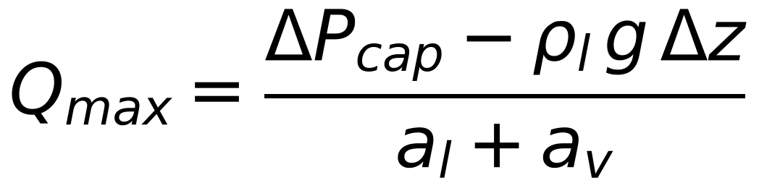
One idea organises everything: the pressure budget
ΔP_cap: the pump
a_l: liquid resistance
a_v: vapour resistance
set by pore size and wetting (slide 4)
set by wick permeability and thickness (slides 6–7)
set by core thickness, grows as 1/h³ (slide 8)
Interface losses appear as a temperature jump, not a pressure drop (slide 9).
Debanshu Ghosh · 23CH3FP56 · Chemical Engineering, IIT Kharagpur
5
Notes:
The capillary pump must beat every loss: liquid flow in the wick (Darcy), vapour flow in the core (Poiseuille) and gravity. Both flow losses scale with the heat load Q, so the budget gives a maximum heat load, the capillary limit. To raise it you can raise the pump pressure with finer pores, lower the liquid resistance with bigger more permeable pores, or lower the vapour resistance with a thicker core. These demands conflict. The next slides take each term in turn.

Slide 6
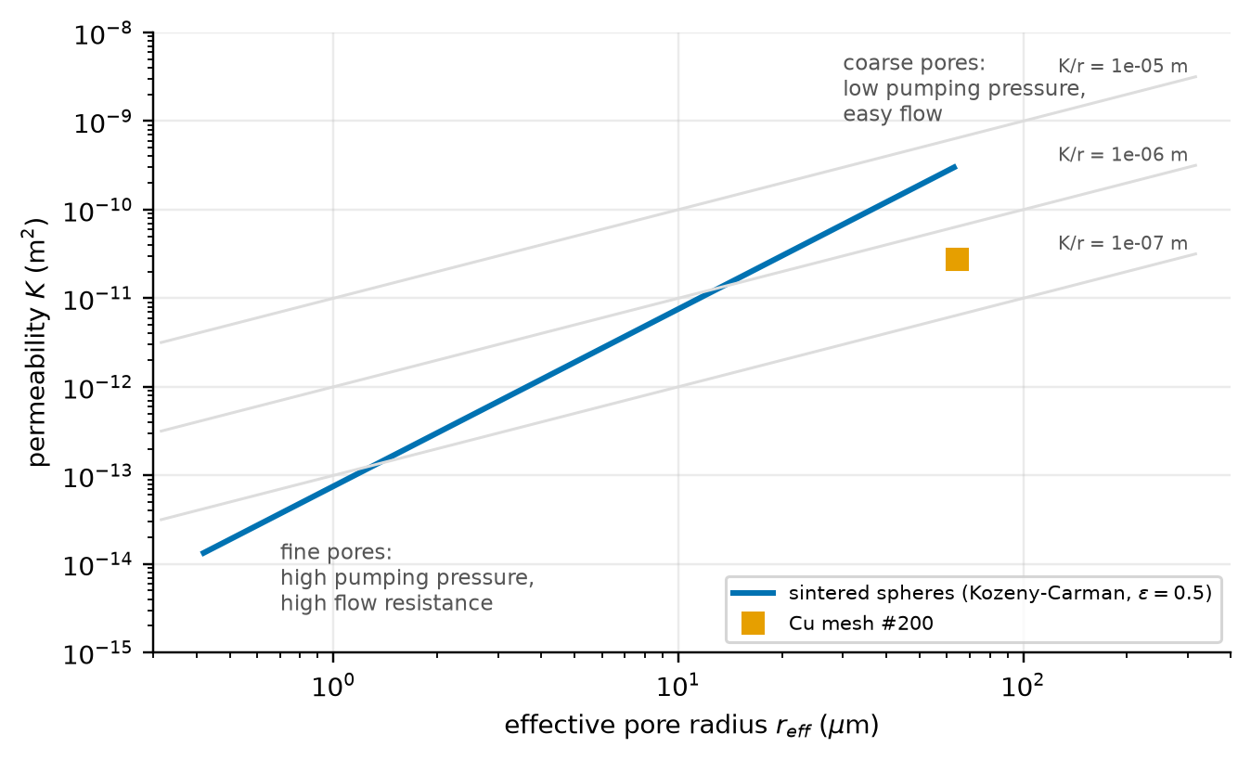
The wick is a trade-off: finer pores pump harder but resist flow more
Wick | r (µm) | ΔP_cap (kPa) | a_l (Pa/W)
Cu mesh #200 | 64 | 2.1 | 24
Sintered 50 µm | 10.5 | 12.6 | 82
Sintered 10 µm | 2.1 | 63.0 | 2055
• 5× pump pressure for 10 µm vs 50 µm
• 25× liquid resistance for the same change
• So: excess pump pressure is wasted; choose the coarsest wick with enough margin
Debanshu Ghosh · 23CH3FP56 · Chemical Engineering, IIT Kharagpur
6
Notes:
Pressure goes as 1 over d, permeability as d squared (Kozeny-Carman). Going from 50 micron powder to 10 micron powder gives 5 times the pump pressure but 25 times the liquid resistance. So the fine wick is liquid-limited: about 29 W whatever the core thickness, while the 50 micron powder reaches 56 W at a 100 micron core. Excess pump pressure is wasted: the best wick is the coarsest one that leaves enough margin. Assumptions: rigid uniform isotropic wick, constant contact angle, no vapour-liquid shear. Real wicks have pore-size distributions and partial dry-out.

Slide 7
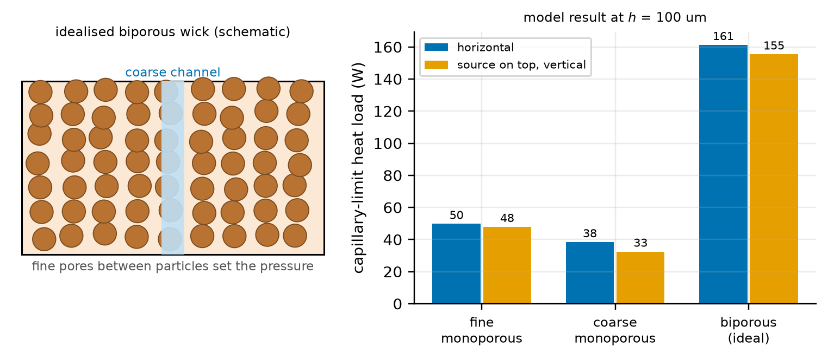
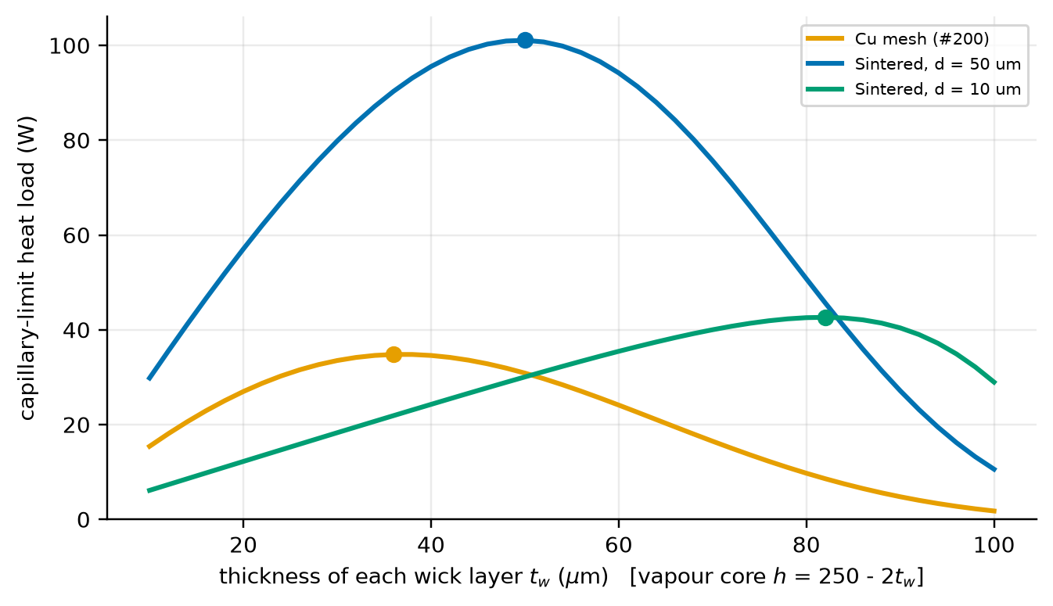
Escaping the trade-off: biporous wicks and an optimal wick thickness
Biporous (ideal upper bound): fine pores set the pressure, coarse channels set the flow.
Wick and vapour core share a fixed thickness, so each wick has an optimum split.
Caveat: the biporous bar assumes fine and coarse regions do not interfere; real structures lose some of the gain.
Debanshu Ghosh · 23CH3FP56 · Chemical Engineering, IIT Kharagpur
7
Notes:
A biporous wick has fine pores for pumping pressure and coarse channels for flow; Semenic and Catton studied them experimentally. In my idealised calculation the capillary limit rises from about 50 W (fine) or 38 W (coarse) to about 161 W. This is an upper bound: it assumes the two regions do not interfere, which they do in real structures. The lesson is the idea: separate the length scale that sets pressure from the one that sets flow. Right: if the inner thickness is fixed at 250 microns, every micron of wick is taken from the vapour core, so there is an optimum wick thickness, 50 microns per layer for the 50 micron powder in this model, and it depends on the wick.

Slide 8
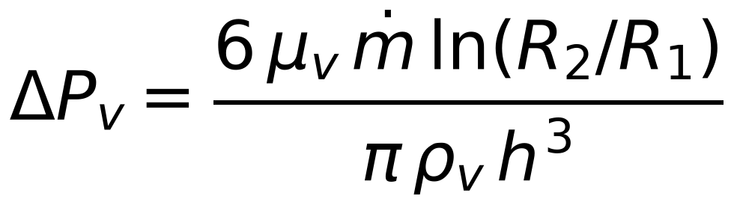
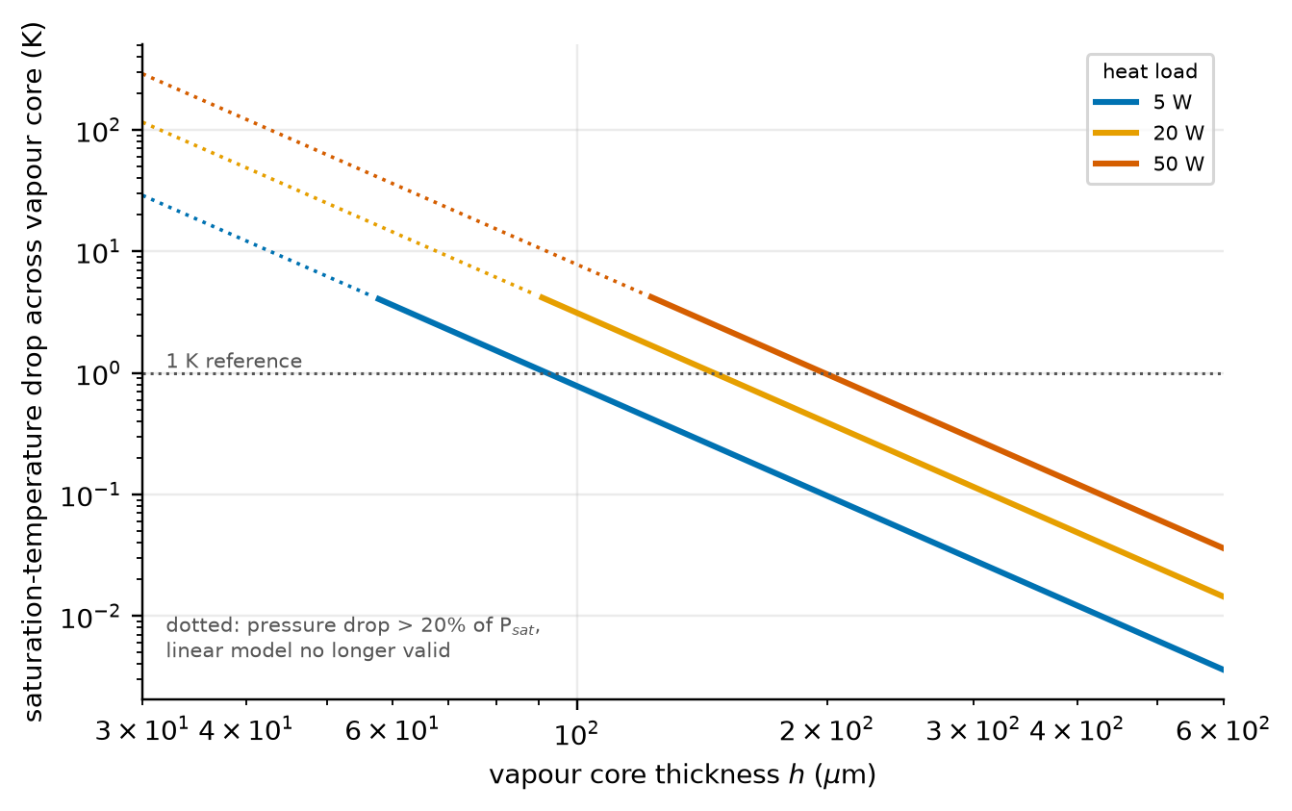
Thin vapour cores: the pressure drop grows as 1/h³
• Halve h: core becomes exactly 8× more resistive
• Pressure → temperature: about 1.1 K per kPa (Clausius–Clapeyron)
• At 5 W: 0.10 K at 200 µm, 0.78 K at 100 µm
• Literature: a biporous condenser wick allowing a thicker core cut skin ΔT by 37% (Patankar 2016)
Debanshu Ghosh · 23CH3FP56 · Chemical Engineering, IIT Kharagpur
8
Notes:
Radial Poiseuille flow in a slit gives delta P v equals 6 mu m-dot ln(R2/R1) over pi rho v h cubed. Halving the thickness makes the core exactly 8 times more resistive. A vapour pressure drop matters because in saturated vapour pressure and temperature are tied: Clausius-Clapeyron gives about 1.1 K per kilopascal for water at 60 C. At a 200 micron core, 5 W costs about 0.10 K; at 100 microns 0.78 K; at 50 microns the model gives about 6 K but that is beyond its validity range. Patankar et al. found that at ultra-thin sizes the vapour core limits performance, and a biporous condenser wick that allows a thicker core cut the peak-to-mean skin temperature difference by 37% in their simulation. Checks: Mach number only 0.01 so incompressible; Knudsen number 0.008 in the core so continuum; but about 0.8 inside 1 micron pores.

Slide 9
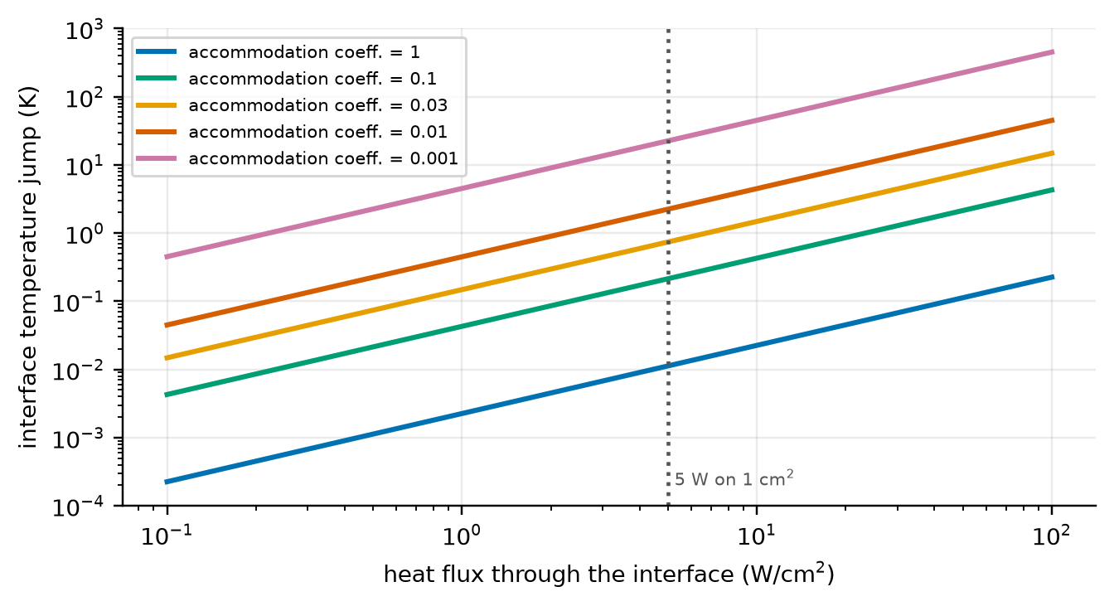
At the interface the physics is uncertain by orders of magnitude
• Accommodation coeff. = 1: interface almost free (4.4 MW/m²K)
• Measured values scatter: roughly 0.01 to 1 for water (Marek & Straub)
• Effect at 5 W/cm²: 11 mK at 1, 2.2 K at 0.01
• Where heat enters: thin liquid films near the contact line, k/δ is large
Debanshu Ghosh · 23CH3FP56 · Chemical Engineering, IIT Kharagpur
9
Notes:
Kinetic theory gives the evaporation flux in terms of molecules striking and leaving the surface, scaled by an accommodation coefficient between 0 and 1. For a coefficient of 1 the interface is almost free, 4.4 MW per square metre kelvin. But measured values for water scatter widely (Marek and Straub), roughly 0.01 to 1. For 5 W on 1 square centimetre the temperature jump is about 11 millikelvin at 1 and 2 kelvin at 0.01, 23 kelvin in the extreme case 0.001. So whether the interface matters in a phone-thin chamber depends on a number the community has not pinned down. Going deeper: heat enters mostly in thin film regions near the contact line (Wayner), where k over delta is large: 650 kW per square metre kelvin at 1 micron, 6.5 at 100 microns. Note that I took the flux over the whole source area, which overstates the jump.

Slide 10
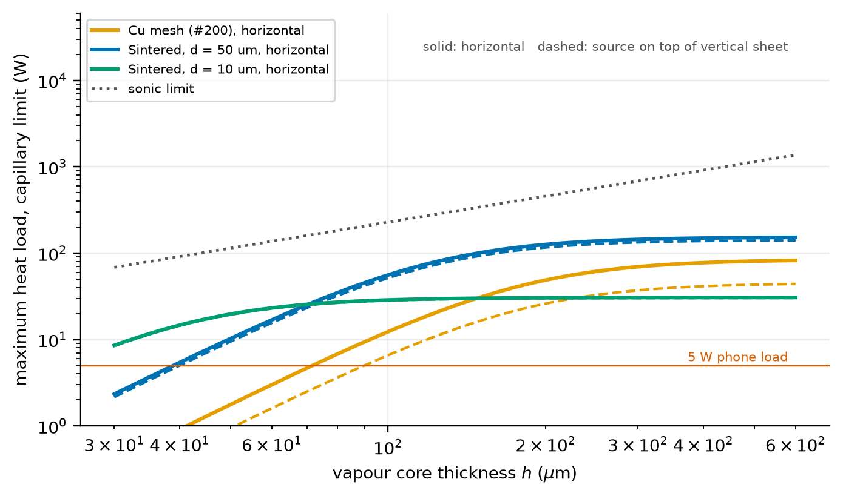
Operating limits: which quantity runs out first?
• Thick core: the wick sets the limit (~150 W, 80 W, 30 W)
• Thin core: the vapour sets it, so Q_max falls fast below ~100 µm
• Gravity: hurts coarse mesh most
• Not in the model: local dry-out, entrainment, boiling
• Experiment: up to 60 W for a 0.5 mm chamber (Yan 2023)
Debanshu Ghosh · 23CH3FP56 · Chemical Engineering, IIT Kharagpur
10
Notes:
Five classical limits: capillary, sonic, entrainment, boiling, viscous. The figure shows the first two from the model. Thick cores: the wick sets the limit, coarse powder near 150 W, mesh near 80 W, fine powder near 30 W. Thin cores: the vapour sets it; the powder gives 56 W at 100 microns and only 10 W at 50 microns, just above a 5 W load. Gravity mostly hurts the coarse mesh: 12 W falls to 6.6 W with the source on top. The sonic limit is well above for a phone. What the model cannot see: local dry-out under the hot spot, entrainment, boiling. Yan et al. measured up to 60 W for a 0.5 mm chamber; Weibel et al. found 600 to 1200 micron sintered wicks handled over 500 W per square centimetre locally without dry-out, but those are much thicker. The closeness of my 56 W to 60 W is a coincidence of order of magnitude, not validation.

Slide 11
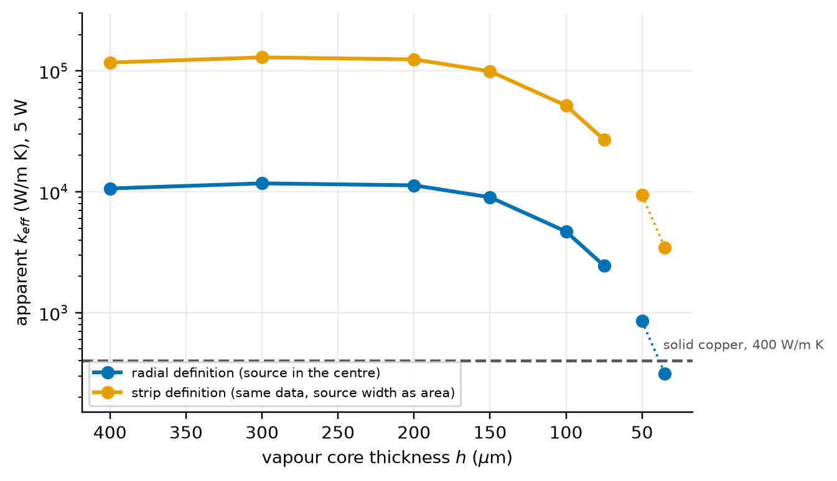
‘Effective thermal conductivity’ is not a property
• Same data, two definitions: × 11 difference
• Not a material property: falls as the core thins; varies with load and orientation
• Reported: 3473–3837 W/m K (0.39 mm, Zhang 2024) vs 11,817 W/m K (0.5 mm, 50 W, anti-gravity, Yan 2023)
• Rule: compare only with the same definition, load and orientation
Debanshu Ghosh · 23CH3FP56 · Chemical Engineering, IIT Kharagpur
11
Notes:
Chambers are rated by an effective conductivity, defined by comparing the temperature drop to a solid conductor. But the geometry used in the definition changes the number: from the same temperature drop, the radial definition gives 11 thousand W per metre kelvin at 200 microns and the strip definition 125 thousand, a factor of 11. It also falls as the core thins, and in experiments it depends on load and orientation. Zhang et al. report 3473 to 3837 W/mK for a 0.39 mm chamber; Yan et al. 11,817 W/mK at 50 W against gravity for a 0.5 mm chamber. These devices differ, so the numbers are not interchangeable without checking definitions. Zhang also found k_eff fell as support column diameter increased: pillars stiffen the shell but block vapour.

Slide 12
Models: each one hides something
Model | Assumes | Hides / fails when
Resistance network (Prasher) | lumped stages; vapour ~ isothermal | pressure loss, dry-out; thin cores, high loads
Analytical 1-D / 2-D (this paper) | laminar, uniform wick, all vapour to rim | pillars, transients, fine wicks (Kn)
3-D porous continuum (Vadakkan) | effective K, k_eff, one interface coefficient | depends on poorly known inputs
Microstructure-aware (Ranjan) | particle size / packing explicit | cost; idealised packings, contact angle
This paper's own model: assumptions to keep in mind
single temperature (60 °C) · disc geometry, all vapour to the rim · full wetting (θ = 0) · linear Clausius–Clapeyron (valid only while ΔP < 20% of P_sat) · steady state · no gas, no pillars
Debanshu Ghosh · 23CH3FP56 · Chemical Engineering, IIT Kharagpur
12
Notes:
Four model families. A resistance network is cheap and good for sizing but treats the vapour as isothermal and cannot see dry-out. Analytical 1-D or 2-D flow models, like the one in this paper, explain trends but ignore pillars, non-uniform condensation and transients. 3-D continuum porous-medium models like Vadakkan et al. predict hot-spot maps but depend on effective K, k_eff and the accommodation coefficient, rarely known independently. Microstructure-aware models like Ranjan et al. put particle size and packing into the model, but are costly and idealised. Message: the cheaper models are not worse, only more limited. Also note my own model's limits: single temperature, disc geometry, full wetting, linear Clausius-Clapeyron valid only for pressure drops under about 20% of saturation pressure, steady state, no gas, no pillars.

Slide 13
Fabrication sets the physics; reliability limits the life
How the process sets the physics
What limits the life
Powder: particle size → r_eff, K
Mesh: wire diameter → coarse r_eff, thin
Grooves: width, depth → directional K
Nanostructures: wetting, small r (age!)
Bonding: hermetic seal, gas level
Pillars: stiffness, but block the vapour
Non-condensable gas at the condenser
Contact-angle drift: 0° → 60° halves the pump pressure
Fouling of the finest pores (Lecture 4 mechanism)
Cu–water compatible; Al–water makes H₂
Sealed at ~20 kPa, below atmosphere → pillars
Freezing: ≈ 9% volume expansion
Debanshu Ghosh · 23CH3FP56 · Chemical Engineering, IIT Kharagpur
13
Notes:
Lectures 2 and 3 covered the fabrication routes themselves; here only what each route fixes for transport. Powder fixes particle size so pore radius and permeability; mesh fixes wire diameter; etched grooves give well-defined directional permeability; nanostructures raise pressure and wetting but age; bonding fixes hermeticity and gas level; pillars stiffen the shell but obstruct the vapour. Reliability: copper and water are compatible; aluminium and water make hydrogen. Non-condensable gas collects at the condenser and shuts off area. A contact angle drift from 0 to 60 degrees halves the pump pressure. Fouling is the Lecture 4 mechanism, here hitting the pump pressure. Water at 60 C is about 20 kPa, below atmospheric, so the shell relies on pillars; freezing expands water by about 9%. In the sources I used, lifetime data are scarcer than steady-state performance data.

Slide 14
What is solid, what is argued over, what is open
Well established
Still argued over
Limits of this review
• capillary pressure vs flow resistance sets every wick
• vapour core ∝ 1/h³ dominates ultra-thin sheets
• biporous / patterned wicks help (experiment and simulation)
• accommodation coefficient and interface resistance
• comparability of k_eff and ‘maximum power’
• how well simple models predict absolute limits
• lifetime behaviour
• one fluid, one geometry, steady state
• illustrative numbers, not design values
• textbook correlations used at face value
Debanshu Ghosh · 23CH3FP56 · Chemical Engineering, IIT Kharagpur
14
Notes:
Established: the pressure budget picture, the wick trade-off, the dominance of the vapour core in ultra-thin sheets, and the benefit of biporous and patterned wicks. Argued over: the accommodation coefficient and the interface, comparability of reported performance, how well simple models predict absolute limits, and long-term behaviour. Limits of this review: one fluid, one geometry, steady state, illustrative numbers, textbook correlations used at face value.

Slide 15
Conclusions
• Pressure budget: capillary pressure must beat wick + vapour + gravity losses
• Two trade-offs: pump pressure vs permeability, and wick thickness vs vapour-core height
• Inverse-cube law: halving the core makes it 8× more resistive, so ultra-thin chambers are vapour-limited
• Open problems: the interface, standard performance metrics, long-term wetting
Key sources
Bhat et al. 2019 (DATE) · Faghri 2012 (J. Heat Transfer) · Weibel & Garimella 2013 · Patankar et al. 2016 · Semenic & Catton 2009 · Marek & Straub 2001 · Yan et al. 2023 · Zhang et al. 2024. Full list of 26 references in the term paper.
Debanshu Ghosh · 23CH3FP56 · Chemical Engineering, IIT Kharagpur
15
Notes:
Close by repeating the three ideas the listener should keep: the pressure budget, the two trade-offs, and the 1 over h cubed law. Then the honest message: the field has a good first-order picture of why thin vapour chambers work, and weaker tools for predicting exactly how well and for how long. Key sources: Faghri 2012 and Weibel and Garimella 2013 for the review base, Bhat 2019 for the problem, Patankar 2016 for the vapour-core result, Semenic and Catton 2009 for biporous wicks, Marek and Straub 2001 for the interface. Thank the audience and invite questions.

