Slide 1
MICROSCALE TRANSPORT PROCESSES · TERM PAPER
Micro heat pipes and vapour chambers
−34%
frame rate of a popular game on a Nexus 6P when thermal throttling kicks in (35 → 23 FPS)
Passive two-phase cooling for smartphones and chips
Bhat et al., DATE 2019 [3]
[Your name] · [Roll number]
Notes:
(about 35 s) Everyone has felt a phone get hot during a game. The phone protects itself by slowing the chip down. In a study on a Nexus 6P, this throttling cut the frame rate of a game from 35 to 23 frames per second, a 34 percent loss. The limit is the temperature of the phone's skin, not of the silicon, and there is no fan. So the real job is to spread heat quickly and evenly through a body under a centimetre thick. My topic is micro heat pipes and vapour chambers, which do this with no moving parts, and I will show that this is a microscale transport story.

Slide 2
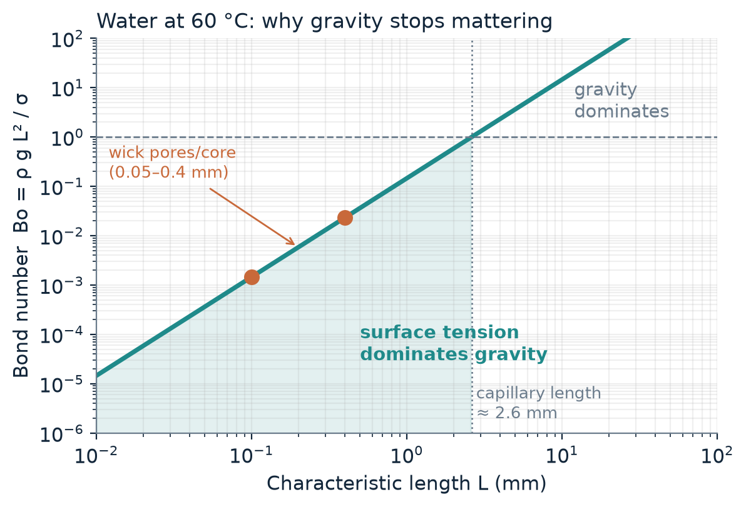
At 0.1 mm, surface tension beats gravity
Bo ≈ 10⁻³
Bond number in wick pores and the vapour core. Liquid returns to the hot spot in any phone orientation.
A/V ≈ 10⁴ m²/m³
Square–cube law: surfaces dominate. Evaporation, condensation and friction all happen at surfaces.
Kn ≈ 10⁻³
Vapour is still a continuum, at the edge of the slip regime, so Navier–Stokes applies (Re ≈ 13, laminar).
Course links: Lecture 1 (square–cube law, Knudsen number). Water at 60 °C.
Notes:
(about 50 s) Why does this work in a phone? Three scaling numbers from Lecture 1. First, the Bond number compares gravity to surface tension. For water, the capillary length is 2.6 millimetres. At wick scales of 0.1 millimetre the Bond number is about a thousandth, so capillary forces win and the device works upside down. Second, the square-cube law: at 0.2 millimetre the surface-to-volume ratio is about ten thousand per metre, so surfaces, where evaporation and friction happen, dominate. Third, the Knudsen number is about a thousandth, so the vapour is still a continuum and ordinary Navier-Stokes works. The vapour Reynolds number is about 13, so the flow is laminar.

Slide 3
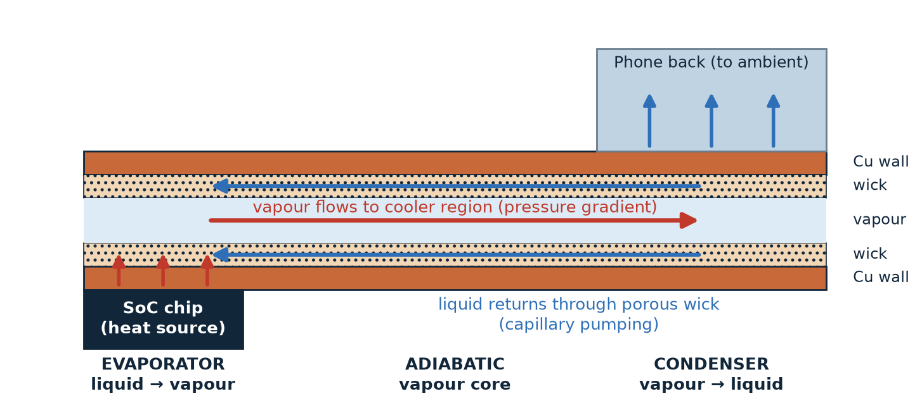
Heat moves as latent heat, not by conduction
1
Evaporate
2
Flow
3
Condense and return
Liquid at the chip boils off, absorbing latent heat
Vapour rushes to the cooler region on a tiny pressure difference
Capillary pumping, ΔP = 2σcosθ / r, sends the liquid back
5 W needs only ~2 mg/s of water, about 56× less mass flow than carrying it as sensible heat in water (10 K rise).
Notes:
(about 60 s) Here is a vapour chamber, a flat heat pipe, with the thickness exaggerated. The chip sits at the left. Step one: liquid in the wick next to the chip evaporates and takes up its latent heat. Step two: the vapour flows through the thin core to the cooler region, driven by a tiny pressure difference. Step three: it condenses, gives the heat to the phone body, and the liquid returns through the porous wick by capillary pumping. The pressure comes from the curved meniscus, two sigma cos theta over the pore radius. The big advantage is latent heat: five watts needs only about two milligrams per second of water, roughly 56 times less than carrying that heat as ordinary warm water. A micro heat pipe is the same idea in a single tiny groove, where the corners of the groove act as the wick.

Slide 4
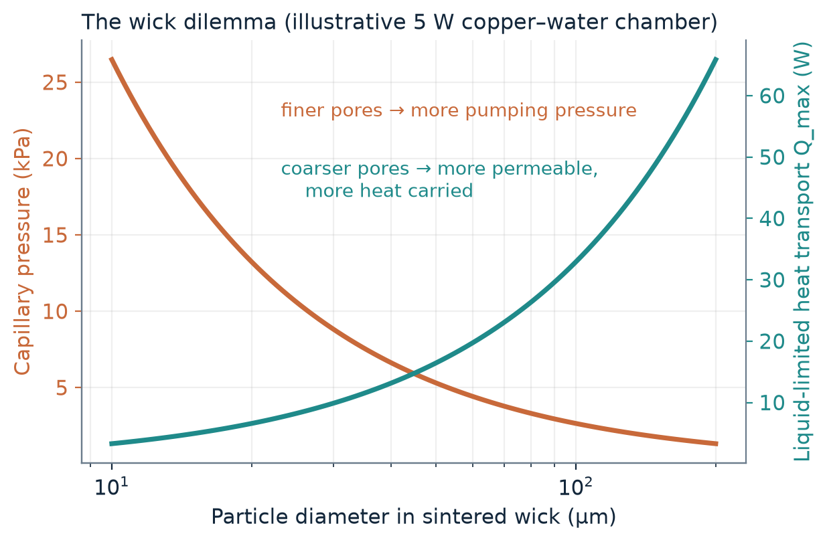
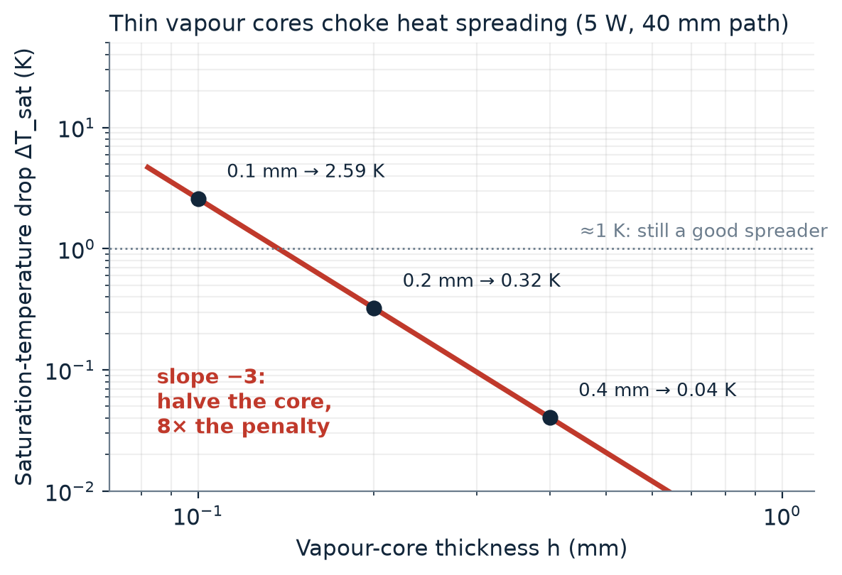
Two trade-offs decide the design
Wick: pressure versus permeability
Vapour core: thin means choked
Finer pores pump harder (∝ 1/r) but resist flow more (K ∝ r²). A 10 µm wick carries ~3 W and dries out at 5 W; 50 µm carries ~16 W.
Δp ∝ 1/h³ (Lecture 4). Halve the core from 0.2 to 0.1 mm and the temperature penalty jumps 8×, from 0.3 K to 2.6 K.
Notes:
(about 75 s) Two trade-offs fix the design, and I worked them out with the equations from our lectures for a 5 watt load. Left: the wick. Capillary pressure goes as one over the pore radius, but permeability goes as radius squared. Fine pores of 10 microns give 26 kilopascals but can carry only about 3 watts, so a 5 watt load dries out the evaporator. Coarser 50 micron pores carry about 16 watts. But coarse pores give less pumping pressure and a thicker, more resistive evaporator, so real designs use biporous wicks. Right: the vapour core. The pressure drop in a thin slit goes as one over thickness cubed, the same Hagen-Poiseuille physics as the pressure-drop slides in Lecture 4. Through the saturation curve, pressure drop becomes temperature drop. Halving the core from 0.2 to 0.1 millimetre raises the penalty from 0.3 kelvin to 2.6 kelvin. That is why ultra-thin chambers are hard. These are order-of-magnitude estimates, not a product design.

Slide 5
Making it thin, and keeping it alive
Top-down (Lectures 2, 4)
What limits performance
Etch grooves and channels (as in V-grooves in silicon); machine and diffusion-bond plates into a sealed envelope [11].
Strength: precise, repeatable geometry.
Capillary limit: wick cannot keep up
Boiling and entrainment: dry-out [6, 7]
Bottom-up (Lecture 3)
Vapour choking in very thin cores
Sinter powder into porous wicks; grow nanostructured wick surfaces to raise the dry-out limit [7].
Strength: fine pores, high capillary pressure.
Corrosion and fouling: a 100 µm layer is fatal in a microchannel (Lecture 4)
Design win: a biporous condenser-side wick cut the peak-to-mean skin temperature difference by 37% [16]
Notes:
(about 50 s) Making them uses both manufacturing philosophies from the course. Top-down: etching grooves and channels, like the V-grooves shown in Lecture 2, and bonding plates into a sealed envelope, as in the diffusion-bonded foils of Lecture 4. Bottom-up: sintered powder wicks and nanostructured surfaces, from Lecture 3. The classical limits are capillary, boiling and dry-out, entrainment, and vapour choking in very thin cores. Lecture 4 adds corrosion and fouling: a 100 micron corrosion layer is tolerable in a big pipe but fatal in a microchannel, so fluid and material must be compatible for life. And a design win: Patankar and co-workers used a biporous condenser-side wick to cut the peak-to-mean skin temperature difference by 37 percent.

Slide 6
Takeaways
1
Surface tension is the engine
At Bo ≈ 10⁻³ capillary pumping works in any orientation.
2
Latent heat is the payload
Almost isothermal spreading with milligrams of fluid.
3
Thin is the hard part
Wick pressure versus permeability, and Δp ∝ 1/h³ in the vapour core.
Sources: [1] Course notes, Lectures 1–4 · [2] Yan et al., Appl. Therm. Eng. 2023 · [3] Bhat et al., DATE 2019 · [4] Garimella et al., IEEE TCPT 2008 · [5] Tuckerman & Pease, 1981 · [6] Faghri, J. Heat Transfer 2012 · [7] Weibel & Garimella, 2013 · [8] Bulut et al., 2019 · [9] Zhou et al., IJHMT 2023 · [10] Duan et al., Materials 2022 · [11] Filippou et al., 2024 · [12] Peterson & Ma, 1996 · [13] Vasiliev, 2008 · [14] Hanlon & Ma, 2003 · [15] Weibel et al., 2010 · [16] Patankar et al., 2016
Full references with DOI links are in the term paper (References and Appendix A).
Notes:
(about 25 s) To sum up. Surface tension is the engine: at a Bond number of a thousandth, capillary pumping works in any orientation. Latent heat is the payload: almost uniform temperature with milligrams of fluid. And thin is the hard part: the wick trades pressure against permeability, and the vapour core pressure drop scales as one over thickness cubed. Thank you. Full references with links are in the paper. Happy to take questions.

