Slide 1
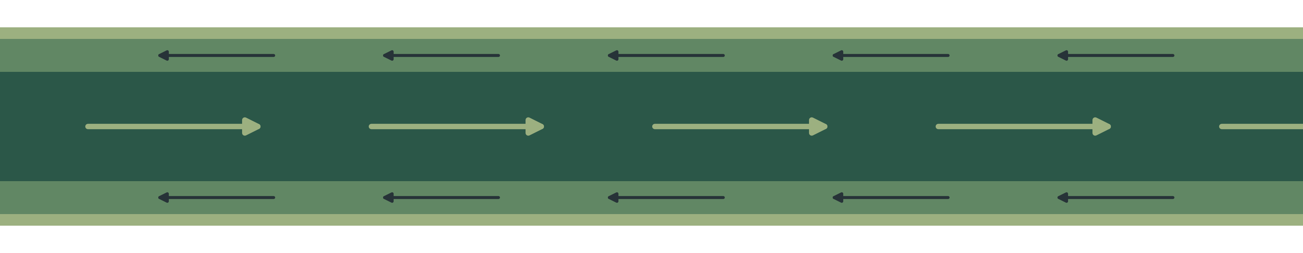
MICROSCALE TRANSPORT PROCESSES · TERM PAPER
Micro Heat Pipes and Vapour Chambers
Liquid return in the wick, wick-thickness optimisation and vapour flow in a thin core
Debanshu Ghosh · Roll No. 23CH3FP56
Department of Chemical Engineering, IIT Kharagpur
Notes:
TIME: 5 s (running total 0:05)
SAY: "Vapour chambers are the thin sheets that spread heat in a phone."

Slide 2
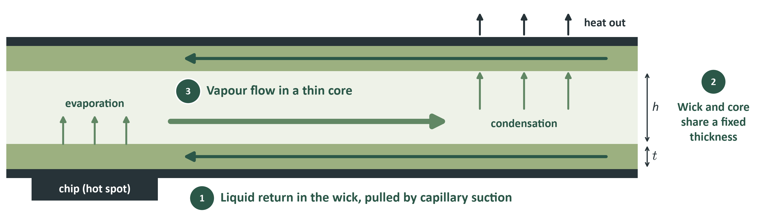
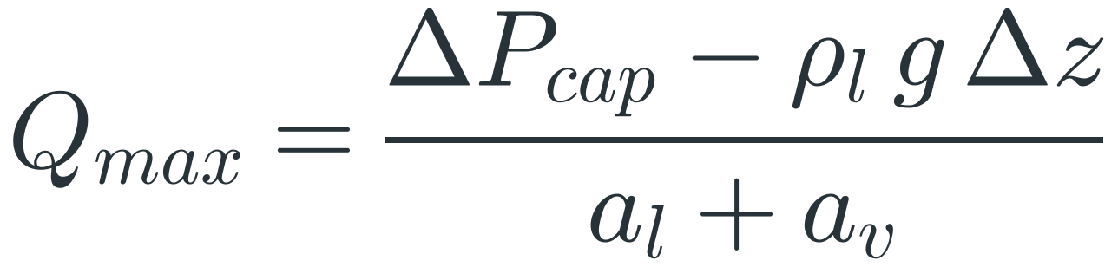
A capillary pump must beat every loss in the loop
OVERVIEW
The pressure budget
So the heat load has a ceiling (capillary limit)
Notes:
TIME: 30 s (running total 0:35)
SAY: "Heat evaporates water at the chip. Vapour flows through the core, condenses at the cool end, and the liquid returns through a porous wick, with no pump except the wick itself. So the capillary pressure must beat the liquid loss, the vapour loss and gravity. That sets a maximum heat load, the capillary limit. My three topics are the terms of this one equation: the liquid return, how to split the thickness, and the vapour core."
HOW THE FORMULA COMES
1. Pressure around the closed loop must balance. Only the meniscus raises pressure; everything else loses it: ΔP_cap ≥ ΔP_l + ΔP_v + ΔP_g.
2. Mass flow from an energy balance: ṁ = Q/h_fg. At 5 W and h_fg = 2.358 MJ/kg, ṁ = 2.1 mg/s.
3. Both flow losses are laminar, so linear in ṁ and hence in Q. Write ΔP_l = a_l Q and ΔP_v = a_v Q, where a is a flow resistance in Pa/W.
4. Gravity: ΔP_g = ρ_l g Δz. Substitute with equality and solve for Q: Q_max = (ΔP_cap − ρ_l g Δz)/(a_l + a_v).
IF ASKED
Numbers use saturated water at 60 °C and an illustrative disc: R1 = 5.64 mm (10 × 10 mm source), R2 = 48 mm (same area as a 60 × 120 mm sheet). They are not measured device data.

Slide 3
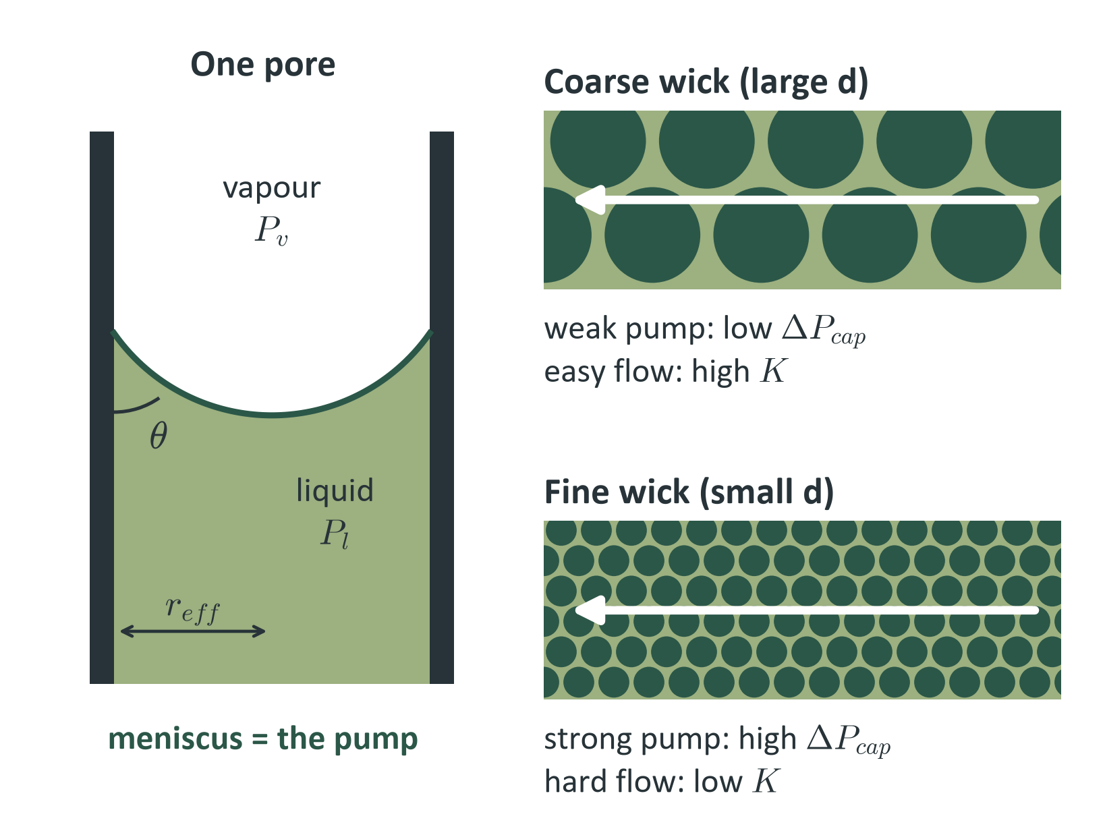
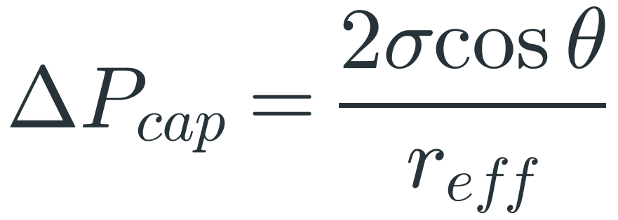
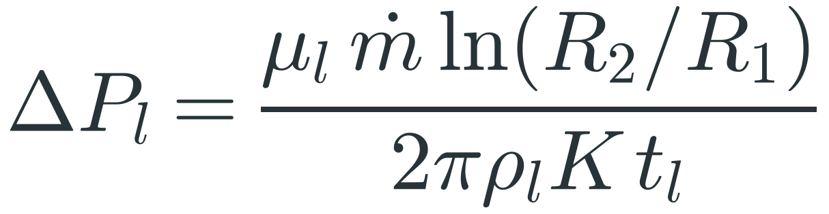
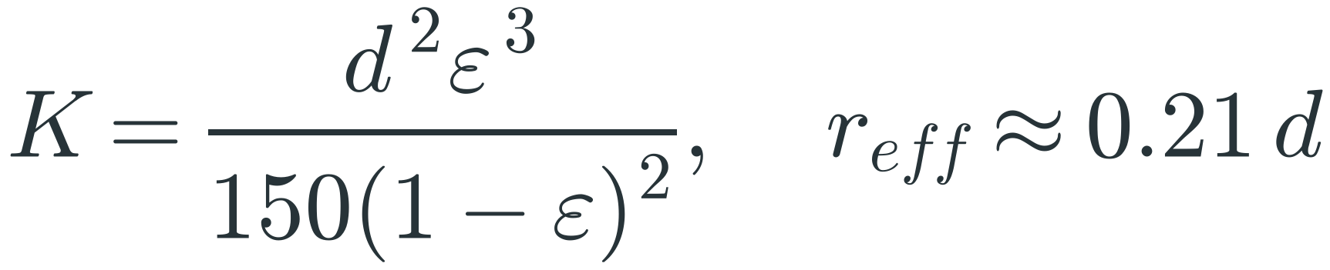
Finer pores pump harder but resist flow far more
TOPIC 1 · LIQUID RETURN IN THE WICK
Pump: Young–Laplace
Loss: radial Darcy flow
Permeability: Kozeny–Carman
5×
25×
pump pressure
10 µm vs 50 µm powder
liquid resistance
10 µm vs 50 µm powder
Notes:
TIME: 35 s (running total 1:10)
SAY: "The meniscus in each pore is the pump. Young-Laplace says pressure goes as one over pore radius. But the liquid must also flow through the wick, and Darcy's law gives that loss. Kozeny-Carman says permeability goes as particle size squared. So one length, d, sets both. Going from 50 micron to 10 micron powder gives five times the pump pressure but twenty-five times the liquid resistance. Extra pump pressure is wasted, so the best wick is the coarsest one that still has enough margin."
HOW THE FORMULAS COME
Young-Laplace: a spherical interface of radius R has a pressure jump 2σ/R. In a pore of radius r_eff the meniscus meets the wall at contact angle θ, so geometry gives R = r_eff/cos θ. Hence ΔP_cap = 2σ cos θ / r_eff.
Water at 60 °C: σ = 0.0662 N/m. For θ = 0 and r_eff = 10.5 µm: 2(0.0662)/10.5e-6 = 12.6 kPa.
Darcy in radial flow: Darcy's law is dP/dr = μ_l u / K. Mass conservation across a cylinder of radius r through total wick thickness t_l gives ṁ = ρ_l u (2π r t_l), so u = ṁ/(2π ρ_l r t_l).
Substitute: dP/dr = μ_l ṁ / (2π ρ_l K t_l r). Integrate from R1 to R2, where ∫dr/r = ln(R2/R1). Hence ΔP_l = μ_l ṁ ln(R2/R1) / (2π ρ_l K t_l).
Here t_l = 2t because there is a wick on each wall.
Kozeny-Carman: treat the pores as bundled tubes with Hagen-Poiseuille flow, using the hydraulic diameter of a packed bed, ∝ ε d/(1−ε). This gives K = d²ε³/[150(1−ε)²]. With ε = 0.5, K = d²/300. Rule of thumb for sintered spheres: r_eff ≈ 0.21 d.
THE 5× AND 25×
ΔP_cap ∝ 1/d, so 50 → 10 µm gives ×5 (12.6 → 63.0 kPa). K ∝ d², so a_l goes ×25 (82 → 2055 Pa/W). The liquid-only limit goes as ΔP_cap·K ∝ d, so finer alone loses.
IF ASKED
Darcy and Kozeny-Carman are continuum models and need a wick many particles thick. A 50 µm layer of 50 µm powder is about one particle thick, so treat this case as an order-of-magnitude estimate. Contact-angle drift matters too: θ = 60° halves ΔP_cap.

Slide 4
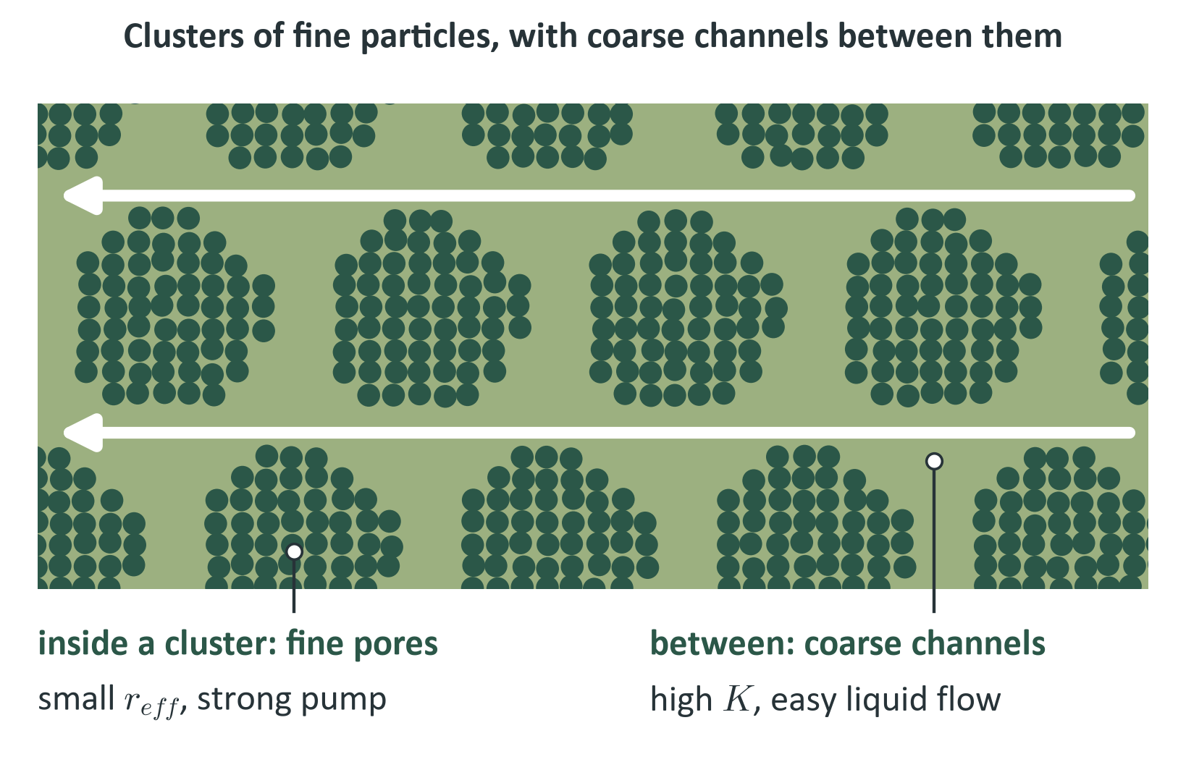
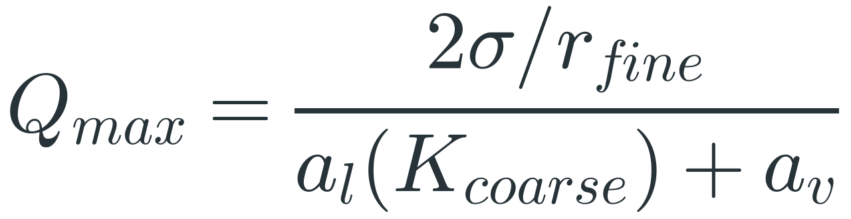
Biporous wicks separate the pump from the flow path
TOPIC 1 · BIPOROUS WICK
Each from its own scale
37%
Upper bound, not a prediction: it assumes the fine and coarse regions do not interfere.
lower surface ΔT in a
simulation (Patankar 2016)
Notes:
TIME: 25 s (running total 1:35)
SAY: "A biporous wick escapes the trade-off. Fine pores inside clusters set the pump pressure; coarse channels between clusters carry the flow. In my idealised estimate, the limit rises from about 50 or 38 watts to about 161, as an upper bound. In Patankar's simulation, a biporous condenser wick cut the peak-to-mean surface temperature difference by 37 percent."
HOW THE FORMULA COMES
Start from Q_max = ΔP_cap/(a_l + a_v). In a single-pore-size wick, r_eff and K both come from the same d. A biporous wick lets each come from its own length scale:
• ΔP_cap = 2σ/r_fine, because the smallest menisci at the evaporator set the pump.
• a_l uses K_coarse, because the liquid takes the easiest path through the channels.
THE THREE BARS (h = 100 µm, 2 × 50 µm wick, a_v = 144 Pa/W)
Fine: r = 5 µm, ΔP_cap = 26.5 kPa, K = 1.76e-12 m² (d = 23 µm), a_l = 389 Pa/W. Q = 26480/(389+144) = 50 W.
Coarse: r = 21 µm, ΔP_cap = 6.3 kPa, K = 3.33e-11 m² (d = 100 µm), a_l = 20.5 Pa/W. Q = 6305/(20.5+144) = 38 W.
Biporous: fine ΔP_cap with coarse K. Q = 26480/(20.5+144) = 161 W.
IF ASKED
Why an upper bound? It assumes the regions do not interfere and it borrows K from 100 µm particles, which would not fit in a 50 µm layer. Channels also take up volume and break the conduction path. The lesson is the principle, not the number.
Be exact about the 37%: it is a simulation, it is the condenser surface peak-to-mean temperature difference, and it is relative to a monolithic wick (Patankar, Weibel and Garimella 2016). Experiments on biporous evaporator wicks: Semenic and Catton 2009.

Slide 5
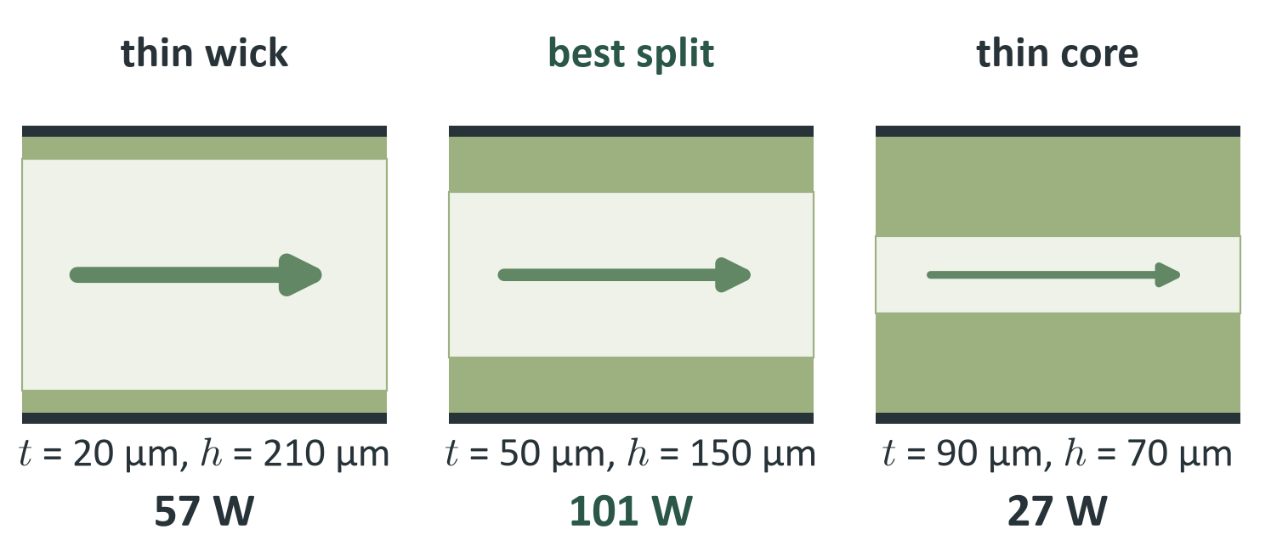
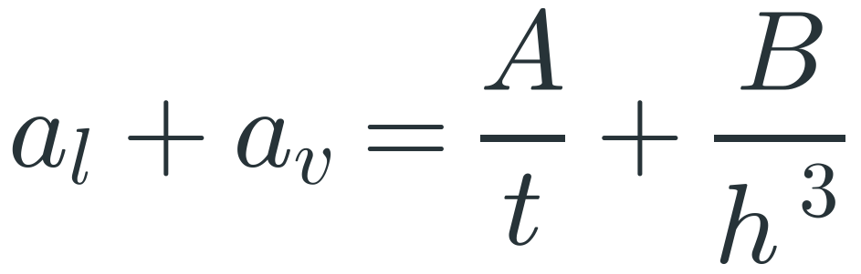
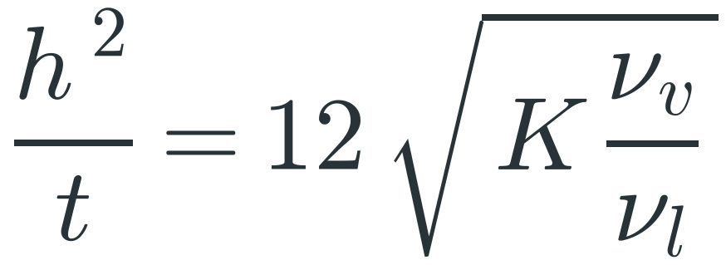
In a fixed thickness, every wick has a best split
TOPIC 2 · THICKNESS OPTIMISATION
Minimise the total resistance, with h = H − 2t
Optimum: set the derivative to zero
Notes:
TIME: 32 s (running total 2:07)
SAY: "The inner thickness is fixed, here 250 microns, so every micron of wick comes out of the vapour core. Liquid resistance falls as one over t, but vapour resistance climbs as one over h cubed, so the sum has a minimum. Setting the derivative to zero gives a simple result: h squared over t depends only on permeability and the fluid. For the 50 micron powder, that is a 50 micron wick, a 150 micron core, and about 101 watts."
HOW THE FORMULA COMES
1. Constraint: H = 2t + h, so h = H − 2t and dh/dt = −2.
2. From the earlier slides, with t_l = 2t: a_l = A/t where A = μ_l ln(R2/R1) / (4π ρ_l K h_fg). And a_v = B/h³ where B = 6 μ_v ln(R2/R1) / (π ρ_v h_fg).
3. ΔP_cap does not depend on t, so maximum Q means minimum (a_l + a_v). Differentiate: d/dt [A/t + B/h³] = −A/t² + 6B/h⁴ = 0. (The 6 is 3 from the cube times 2 from dh/dt = −2.)
4. Rearrange: h⁴/t² = 6B/A = 144 K (μ_v/ρ_v)/(μ_l/ρ_l). Take the root: h²/t = 12 √(K ν_v/ν_l), where ν = μ/ρ is kinematic viscosity.
NUMBERS
Water at 60 °C: ν_v/ν_l = 175. For d = 50 µm, K = 8.33e-12 m²: 12√(K·175) = 458 µm.
Then (250 − 2t)² = 458 t gives t = 49.6 µm, h = 151 µm. The numerical sweep agrees (50 µm).
All three wicks: mesh t = 37 µm, 35 W; 50 µm powder t = 50 µm, 101 W; 10 µm powder t = 82 µm, 43 W.
WHAT IT TELLS YOU
• The optimum does not depend on Q, σ, θ or R2/R1, only on K and the fluid. Lower K pushes the optimum to a thicker wick.
• At the optimum a_l/a_v = 6t/h, so the loss split is not 50:50. It is 2.0:1 for the 50 µm powder.
IF ASKED
This maximises the capillary limit only, not thermal resistance. At these ceiling loads the vapour drop is no longer small: 4.2 kPa for the 50 µm powder (about 21% of P_sat), so read the watts as trends. The closed-form derivation is mine, not from a cited paper; it was checked against the sweep.

Slide 6
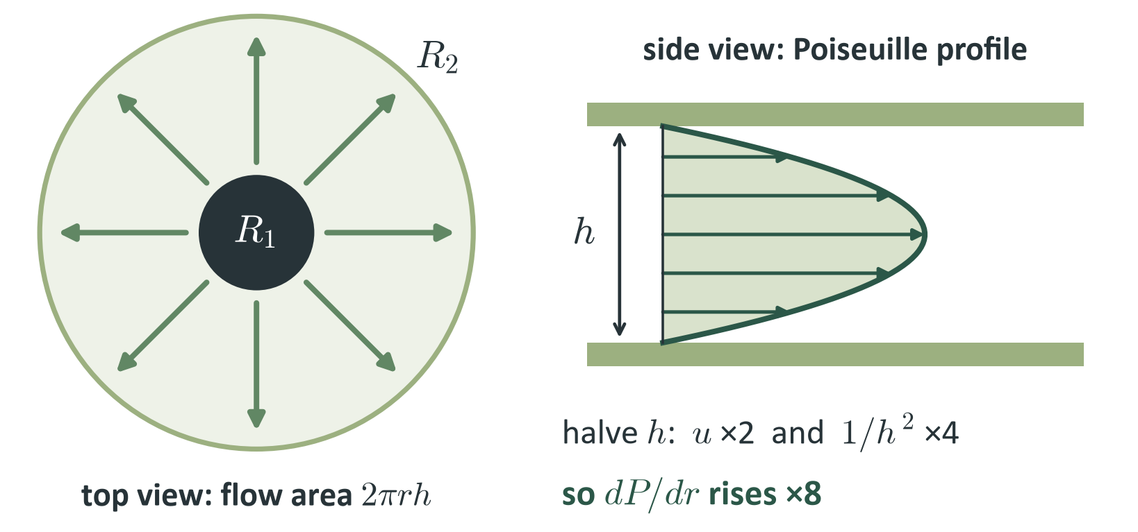
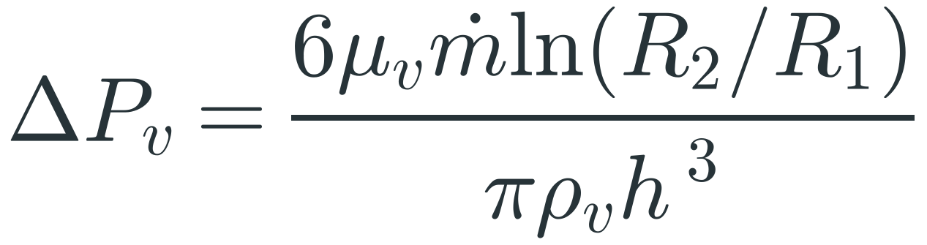
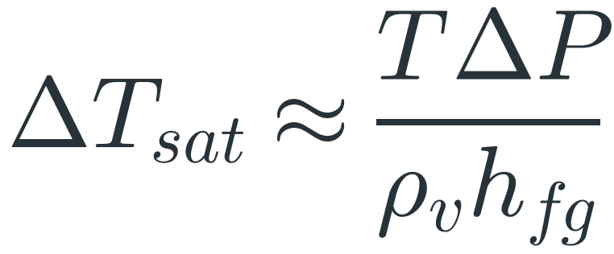
Halve the vapour gap and its resistance rises eightfold
TOPIC 3 · VAPOUR FLOW IN A THIN CORE
Radial Poiseuille flow
Clausius–Clapeyron
Same drop as a temperature, ΔT at 5 W
0.01 K
0.10 K
0.78 K
≈6 K*
400 µm
200 µm
100 µm
50 µm *trend
Notes:
TIME: 32 s (running total 2:39)
SAY: "Vapour spreads radially in a thin slit, which is Poiseuille flow, and integrating gives a pressure drop going as one over h cubed. Halve the gap: velocity doubles and wall drag per unit velocity goes up four times, so eight times the drop. Pressure and temperature are tied in saturated vapour, at about 1.1 kelvin per kilopascal. So at 5 watts the drop is 0.1 kelvin at 200 microns, 0.8 at 100, and about 6 at 50. Thin cores become the bottleneck."
HOW THE FORMULAS COME
Plane Poiseuille flow between plates a gap h apart: the mean velocity is u = (h²/12μ)(−dP/dr), so dP/dr = −12 μ_v u / h².
Mass conservation for radial flow: the flow area at radius r is 2π r h, so u = ṁ/(ρ_v 2π r h). Velocity falls as 1/r.
Substitute: dP/dr = −[12 μ_v / h²]·[ṁ/(2π ρ_v r h)] = −6 μ_v ṁ / (π ρ_v h³ r).
Integrate from R1 to R2: ΔP_v = 6 μ_v ṁ ln(R2/R1) / (π ρ_v h³).
Where the h³ comes from: one power from velocity (u ∝ 1/h) and two from the wall shear (dP/dr ∝ u/h²). So halving h gives 2 × 4 = 8.
Clausius-Clapeyron: dP/dT = h_fg/(T v_fg). With v_fg ≈ 1/ρ_v this is dP/dT = ρ_v h_fg / T. Rearranged for small drops: ΔT_sat ≈ T ΔP / (ρ_v h_fg).
Water at 60 °C: 333.15/(0.1304 × 2.358e6) = 1.08e-3 K/Pa = 1.08 K/kPa.
WORKED EXAMPLE (5 W, h = 100 µm)
ṁ = 5/2.358e6 = 2.12e-6 kg/s; ln(R2/R1) = ln(48/5.64) = 2.14. ΔP_v = 6(1.08e-5)(2.12e-6)(2.14)/[π(0.1304)(1e-4)³] = 718 Pa, so ΔT = 0.78 K.
IF ASKED
Validity checks at 100 µm: Mach = 0.010, so incompressible. Knudsen = 0.0077 (mean free path 0.77 µm), so continuum and no slip.
50 µm is flagged with * because its 5.7 kPa is above 20% of P_sat (19.95 kPa), where the linear relation stops being valid (below about 56 µm at 5 W). Read it as a trend.
The model assumes all vapour reaches R2. Real vapour condenses along the way, so the true drop is lower by an order-one factor. Support pillars would raise it.

Slide 7
Three results, and where they come from
REFERENCES
1
Wick
DasGupta & Ganguly. Microscale Transport Processes, course notes, IIT Kharagpur.
Faghri (2012). Review and advances in heat pipe science and technology. J. Heat Transfer 134(12), 123001.
Weibel & Garimella (2013). Recent advances in vapor chamber transport characterization. Adv. Heat Transfer 45, 209–301.
Semenic & Catton (2009). Experimental study of biporous wicks for high heat flux applications. IJHMT 52, 5113–5121.
Patankar, Weibel & Garimella (2016). Patterning the condenser-side wick in ultra-thin vapor chamber heat spreaders. IJHMT 101, 927–936.
Peterson (1994). An Introduction to Heat Pipes: Modeling, Testing, and Applications. Wiley.
Faghri (1995). Heat Pipe Science and Technology. Taylor & Francis.
One length sets pump and resistance; biporous wicks separate them
2
Thickness
h²/t = 12√(K νᵥ/νₗ) gives the best split
3
Vapour
ΔPᵥ ∝ 1/h³, so thin cores become the bottleneck
Calculated values are illustrative (water at 60 °C, disc geometry). Full list in the term paper.
Notes:
TIME: 8 s (running total 2:47)
SAY: "So: one length sets the wick, a simple formula sets the split, and h cubed sets the vapour limit. Thank you."
The script is about 2:47 at 150 words a minute, which leaves a small margin. If you run over, drop the 37% sentence on the biporous slide first.

