Slide 1



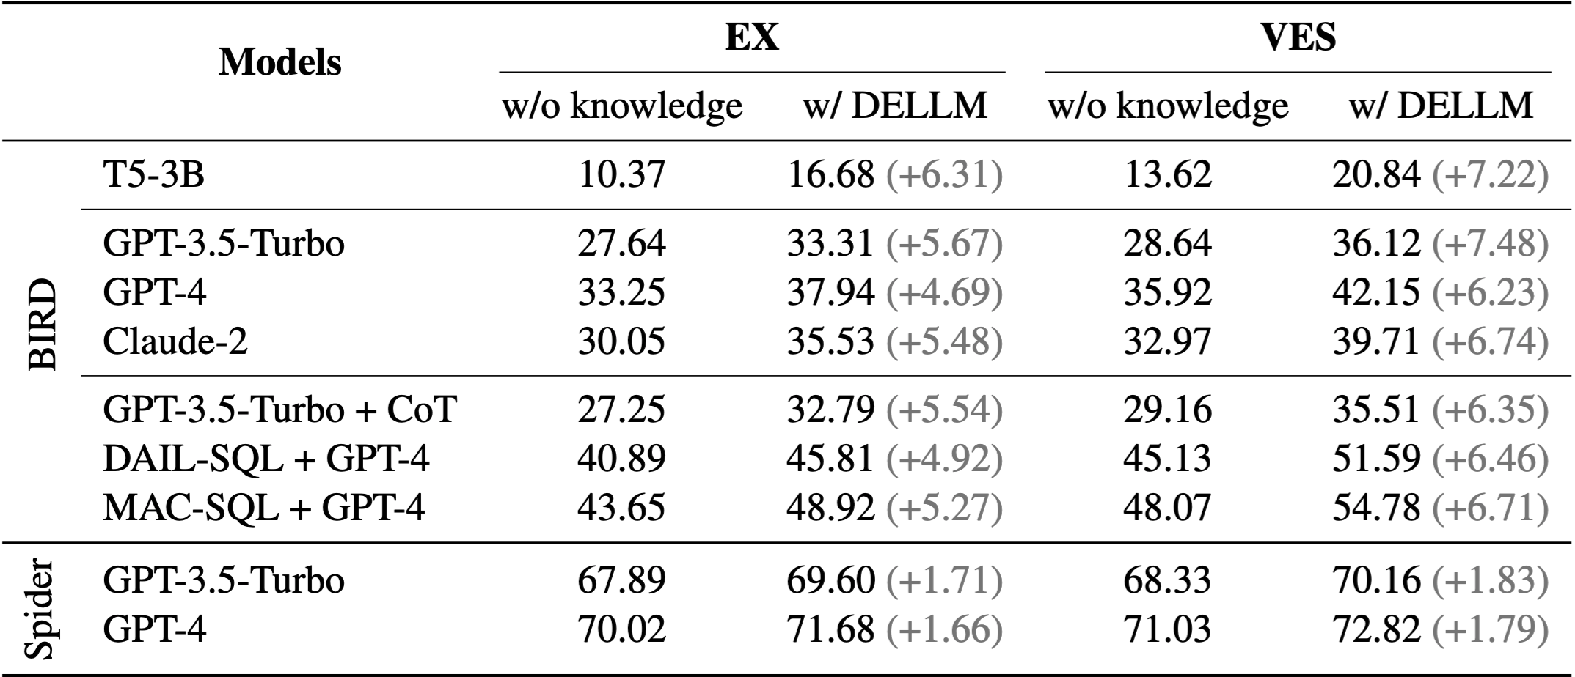
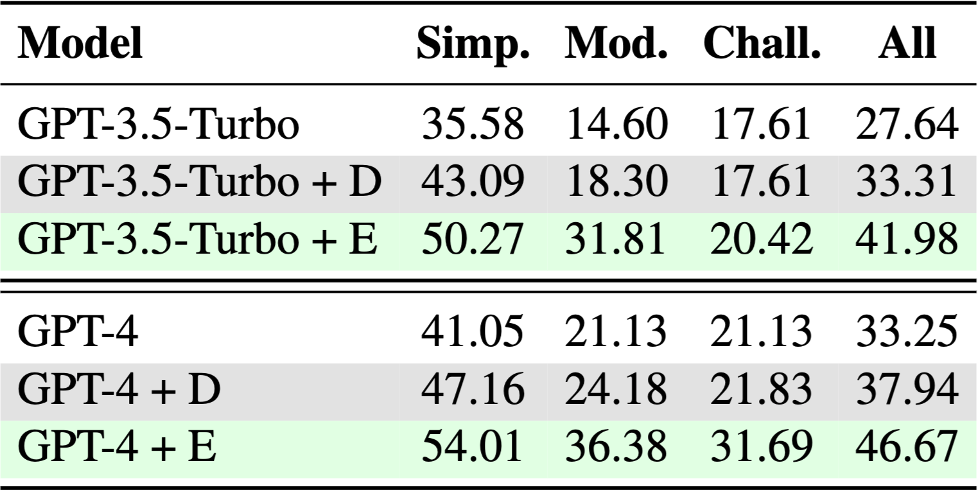
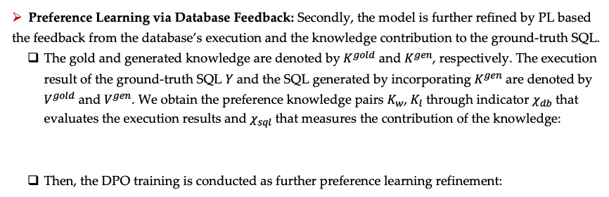
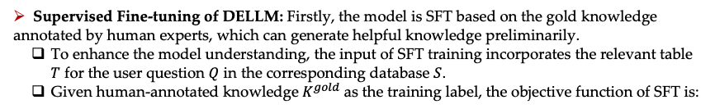
Knowledge-to-SQL: Enhancing SQL Generation with
Data Expert LLM
Zijin Hong, Zheng Yuan, Hao Chen, Qinggang Zhang, Feiran Huang, Xiao Huang
Jinan University, The Hong Kong Polytechnic University
Introduction
Proposed Method
﻿The text-to-SQL task involves converting natural language question into executable SQL query.
﻿Given challenging questions and complex database structures, LLMs often make mistakes without sufficient specialized knowledge.
Incorporating "Expert Knowledge" linking domain-specific content with the database and question can help.
We propose a novel framework that can generate the required knowledge to assist in accurate SQL generation.
SFT: Supervised Fine-tunes the DELLM based on enhanced input and human-annotated knowledge.
﻿PLDBF: Optimizes knowledge generation through preference learning with database feedback.
Knowledge-to-SQL: Integrates generated knowledge to assist an off-the-shelf text-to-SQL model, significantly improving the accuracy.
Training Details of Data Expert LLM (DELLM)
Supervised Fine-tuning of DELLM: Firstly, the model is SFT based on the gold knowledge annotated by human experts, which can generate helpful knowledge preliminarily.
To enhance the model understanding, the input of SFT training incorporates the relevant ﻿table $T$ for the user question $Q$ in the corresponding database $S$.
﻿Given human-annotated knowledge$K^{gold}$ as the training label, the objective function of SFT is:
Experiments
Preference Learning via Database Feedback: Secondly, the model is further refined by PL based the feedback from the database’s execution and the knowledge contribution to the ground-truth SQL.
The gold and generated knowledge are denoted by$K^{gold}$ and $K^{gen}$, respectively. The execution result of the ground-truth SQL $Y$ and the SQL generated by incorporating $K^{gen}$ are denoted by $V^{gold}$ and $V^{gen}$. We obtain the preference knowledge pairs $K_{w}$, $K_{l}$ through indicator $χ_{db}$ that evaluates the execution results and $χ_{sql}$ that measures the contribution of the knowledge:
Then, the DPO training is conducted as further preference learning refinement:
Compared to human expert annotations
EX
VES
The improvement brought by DELLM to different methods on Spider and BIRD
Performance on partial training data
Contact: hongzijin@stu2020.jnu.edu.cn, xiaohuang@comp.polyu.edu.hk, huangfr@jnu.edu.cn (corresponding author)
Code: https://github.com/Rcrossmeister/Knowledge-to-SQL Paper: https://arxiv.org/pdf/2402.11517

