Slide 1
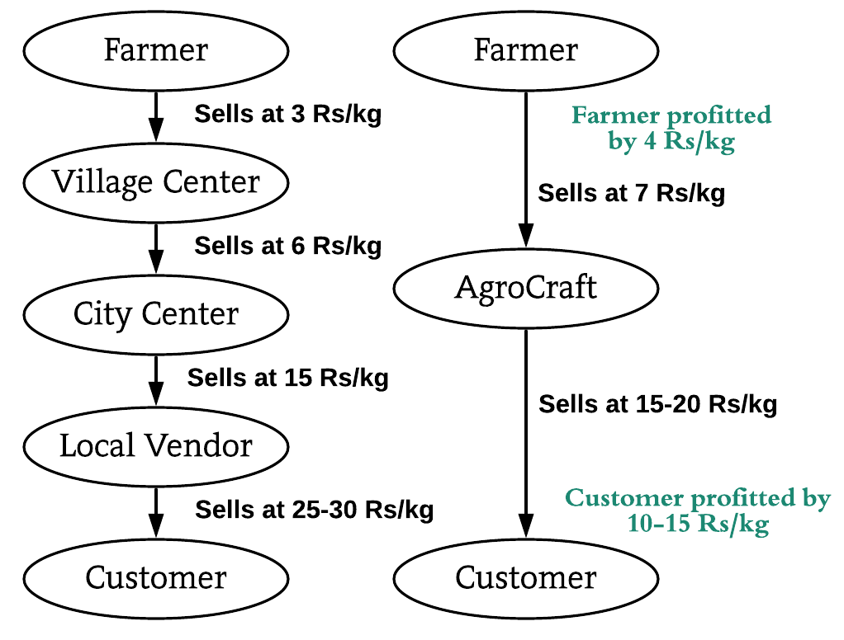
SOLUTION PROTOTYPE
Multilingual SMS and Call System for illiterate farmers to insert/edit/upload products & Multilingual portal also available.
Minimum selling price will be made visible to farmers for rough estimate to enter price of product.
Buyer can order from all over India, so if scarcity of a product arises, the buyer will be suggested of locations near to him, where the product is available.
For packaging delivery, local transportation services, courier services and Indian postal(rural areas covered) will be integrated.
Review system & Reporting system(verification team will respond, guilty farmer will be penalised and buyer, compensated).
Bestseller and Recommendation features.
Subscription feature. (Order once, product will be delivered for the specified duration). Government warehouses available for storage to reduce the repeated delivery charges.
Bookmark system (buyer prefers a farmer, he will be notified every time the farmer uploads).
Filter system(filter by price and location).
Conventional v/s AgroCraft
TECHNOLOGY STACK
Modern Technology :- Big Data , Data Analytics , Visualization, Machine learning .
Mobile Development :-Android Studio, Android SDK and Jellybean version and above.
Web Technology : - HTML, CSS, JavaScript, AJAX, Bootstrap , Django and nodeJS .
Backend Development : -MySQL Database and Firebase.
Programming languages : - Python.

Slide 2
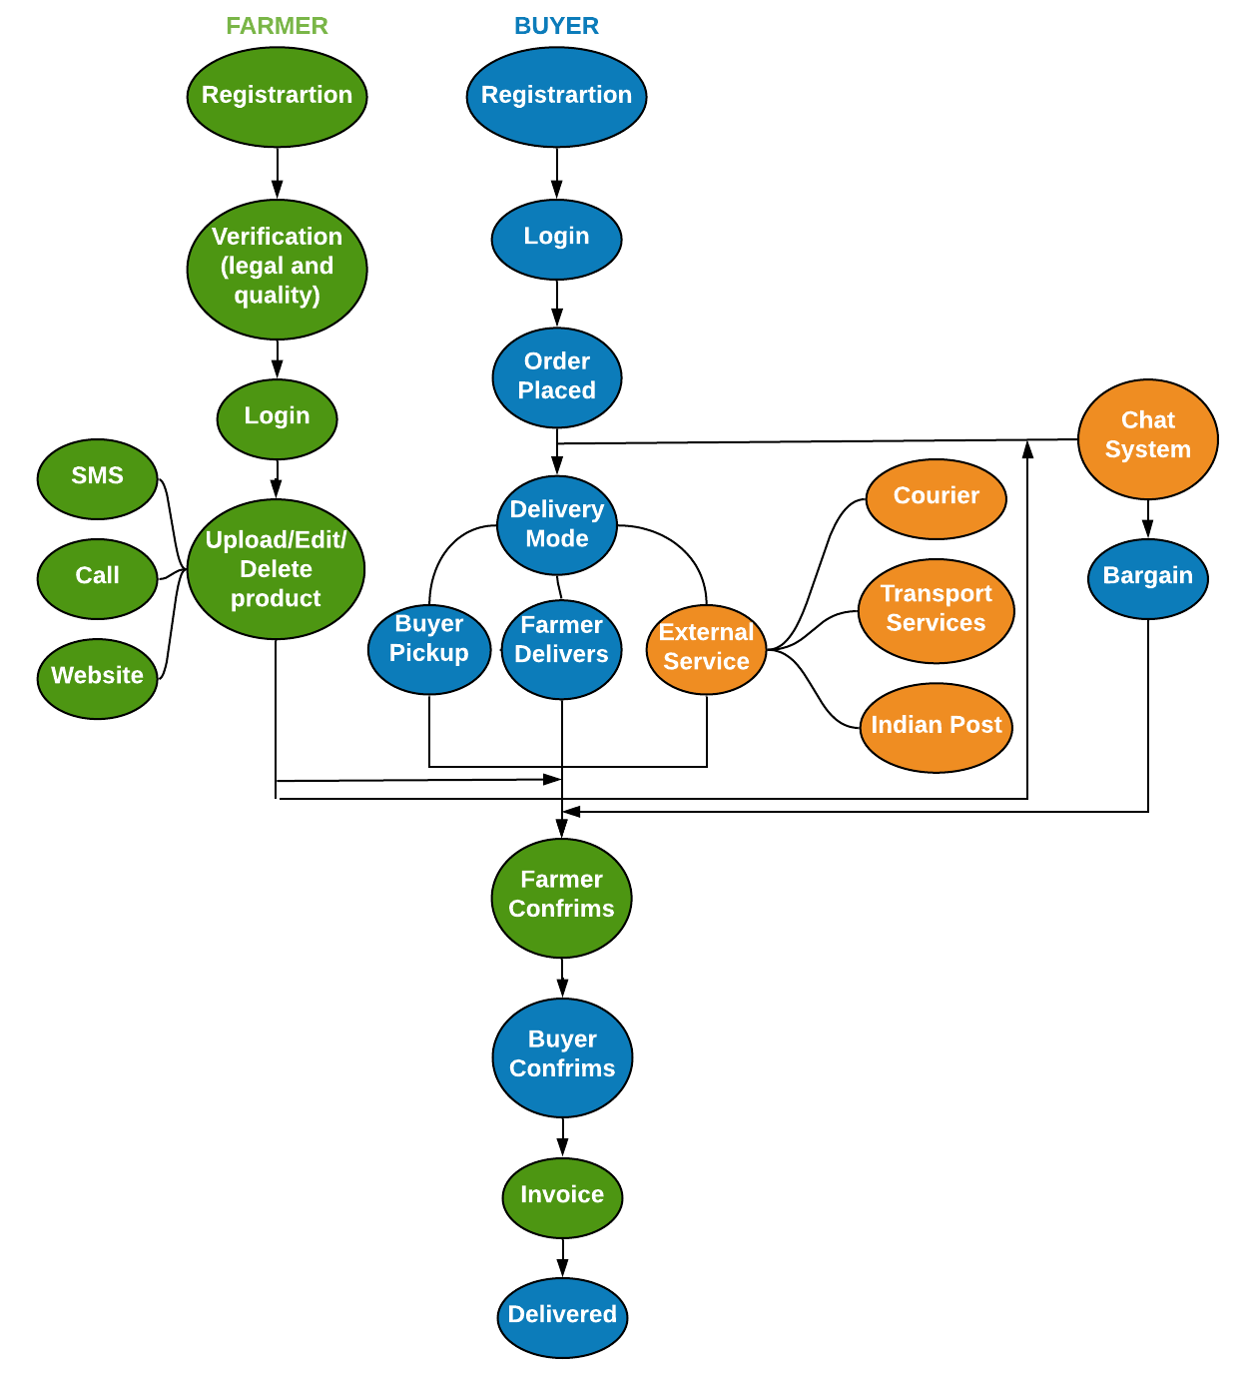
USE CASE
DEPENDENCIES
The farmer must possess a basic phone and legal documents.
This application can be installed in all devices having Android version Jellybean and higher.
An online portal generated shall require IE v9 or higher, Google Chrome, Mozilla Firefox, or any other web browser.
SHOWSTOPPERS
In India 47 percent of the farmer are illerates , to resolve this issue farmers can upload product through multilingual SMS and call centers.
The application ensures the farmer profits since he sells at better rates, the buyer profits since he can buy at cheaper rates, and the multiple transport systems because of the increase of clients at their end.
Buyers can get their hands directly on fresh products from all over India, and he is no longer restricted to his city.
Multiple farmers (many of which reside in remote areas) get in direct touch with buyers in capital cities and the prices are negotiable between them with no involvement of the admin whatsoever.

