Slide 1
DATA ANALYTICS PORTFOLIO PROJECT
Customer Churn Analysis & Customer Intelligence
Finding who leaves an OTT streaming platform, why they leave, and what it costs — using SQL and Python.
Deepa Singh
Master of Applied Technologies (Data Analytics & Intelligence) · Unitec, Auckland
Notes:
Introduce yourself and the project: an end-to-end churn analysis on a subscription streaming dataset, from SQL extraction in Python through cleaning, feature engineering, EDA and business recommendations.

Slide 2
In a crowded OTT market, keeping subscribers is cheaper than winning new ones
01 · BUSINESS SCENARIO
The challenge
The data — SQLite customer_churn
Tech stack
Act as the analyst for a streaming platform (Netflix, Hotstar, Prime).
Identify which subscribers have left or are likely to leave, explain why, and size the revenue at stake.
Churn = a subscription with a cancellation date.
db_customer — 21 customers: name, country, state, gender, date of birth
db_subscription — plan, contract, channel, charges, CLTV, churn score, cancellation
db_support — 9 complaints: escalations, CSAT score
SQL + Python: sqlite3, pandas, numpy
Visualisation: matplotlib, seaborn
Workflow: extract → clean → engineer features → EDA → insights
Notes:
Set the context: retention drives survival in streaming. The data sits in three related SQLite tables joined on customerid, pulled into pandas with SQL queries.

Slide 3
Three messy tables became one analysis-ready view of 21 customers
02 · DATA CLEANING & FEATURE ENGINEERING
Issue found | Fix applied (pandas / numpy) | Result
Empty columns | Dropped interests, pincode, col_1, comment | Only usable fields kept
3 missing countries | Filled from a state → country mapping | 0 nulls in country
Inconsistent gender labels | Mapped Men / Women → Male / Female | 2 consistent categories
Dates stored as text | pd.to_datetime on dob, start, renewal, cancellation and complaint dates | Tenure calculations possible
Duplicate complaints | Counted complaints per customer, kept the latest record (9 → 7 rows) | Join no longer inflates 21 → 23 rows
New features | churn_flag, tenure_days, churn_risk (low <50, med 50–69, high ≥70) | Final table: 21 rows × 24 columns
Notes:
Key quality check: a naive left join on support duplicated customers (23 rows instead of 21). Deduplicating support to one row per customer with a complaint count fixed it. Categorical fields were then ordinal-encoded (Basic < Standard < Premium) for the correlation heatmap.

Slide 4
More than 1 in 4 subscribers has churned
03 · EDA — HEADLINE KPIs
28.6%
71.4%
₹18.85
1,575
Churn rate (6 of 21)
Retention rate
ARPU (avg monthly charge)
Avg tenure (days)
₹73.94
2,047
19.0%
0.77
Monthly revenue lost (≈19%)
CLTV lost from churned customers
Escalation rate
Correlation: escalation ↔ churn
Orange = warning sign. Tenure measured to cancellation date or today.
Notes:
Churned customers took ₹73.94 of ₹395.83 monthly revenue (about 19%). An escalated complaint is strongly associated with churn (r = 0.77), which makes support a leading indicator.

Slide 5
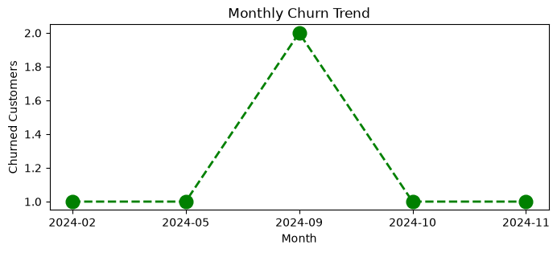
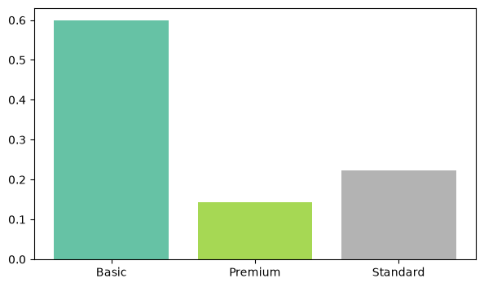
Cancellations peaked in Sep 2024, and Basic plans churn most
04 · VISUALISATION — WHEN AND WHICH PLAN
Monthly churn trend. 2 of 6 cancellations fell in September 2024 — check for a price change, content gap or outage that month.
Churn by plan. Basic 60% · Standard 22% · Premium 14%. Basic users are the most price-sensitive.
Notes:
Left: monthly cancellations grouped by cancellation month. Right: mean churn_flag by plan_type. Contract type adds to this: monthly contracts churn at 55.6% versus 8.3% for annual.

Slide 6
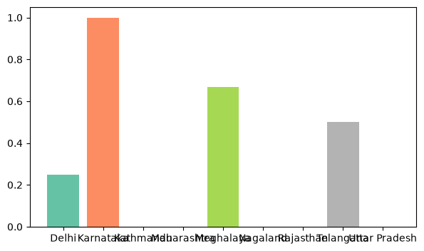
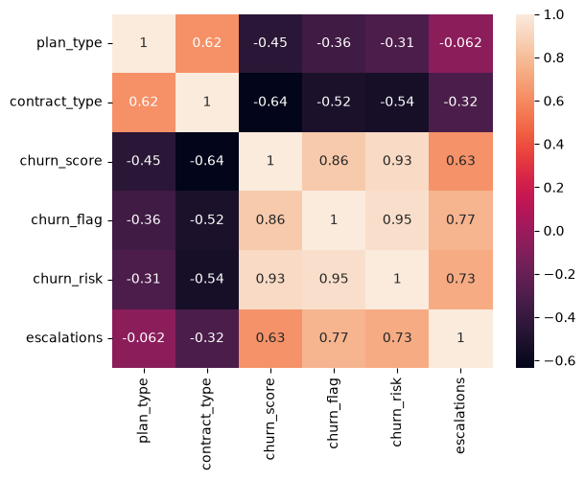
Churn concentrates in a few states and follows escalations
05 · VISUALISATION — WHERE AND WHY
Churn by state. Karnataka 100% (2 of 2) · Meghalaya 67% · Telangana 50%. Maharashtra, Rajasthan, UP, Kathmandu: 0%.
Correlation heatmap. Churn tracks churn score (0.86) and escalations (0.77); annual contracts pull the other way (−0.52).
Notes:
Acquisition channel matters too: referral customers churn at 83%, paid at 17%, organic at 0%. Top cancellation reasons: switching to a competitor (2), price, content and streaming quality. The sample is only 21 customers, so state-level rates rest on very few people.

Slide 7
Move subscribers to annual plans and fix escalations before they cancel
06 · BUSINESS INSIGHTS & RECOMMENDATIONS
What the data says
Recommended actions
Monthly contracts churn at 55.6% vs 8.3% for annual — 6.7× higher
Basic plan churn is 60%, but it is low-revenue; Premium is stable (14%)
Referral sign-ups churn at 83% — trial users who “forgot to cancel”
Escalated complaints strongly signal churn (r = 0.77)
Churn costs ₹73.94/month (≈19% of revenue) and 2,047 in CLTV
Contract migration: offer a discounted annual upgrade to monthly and Basic users
Early warning: any escalation or churn score ≥70 triggers a retention call within 48 hours
Fix referral onboarding: trial-end reminders and first-month content picks
Investigate: Karnataka and September 2024 — pricing, outages, competitor launches
Based on a sample of 21 customers — validate on the full subscriber base.
Notes:
Close with the priority: protect high-value, high-risk customers first (high churn risk plus high CLTV), then migrate monthly users to annual. Next step: build a predictive churn model on the full dataset and track churn monthly on a dashboard.

