Slide 1
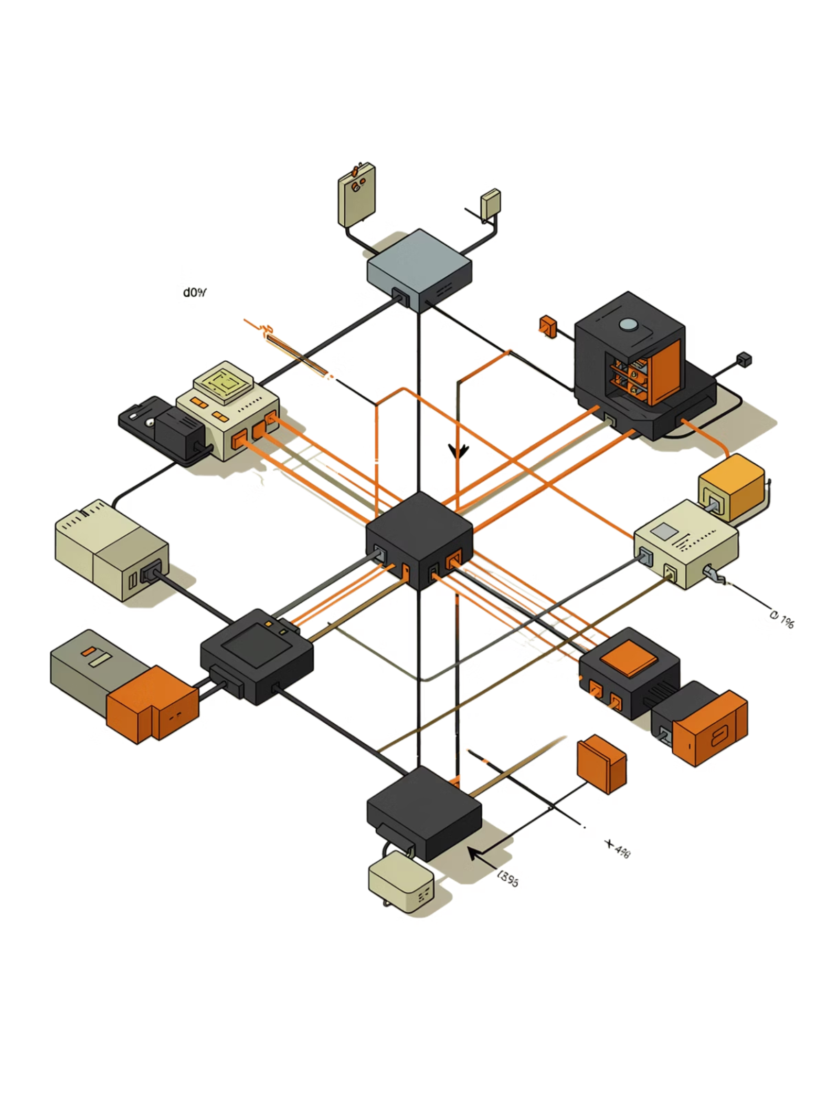
Spark DAG Scheduler: Simple View
How Spark plans work, splits stages, and runs tasks faster

Slide 2
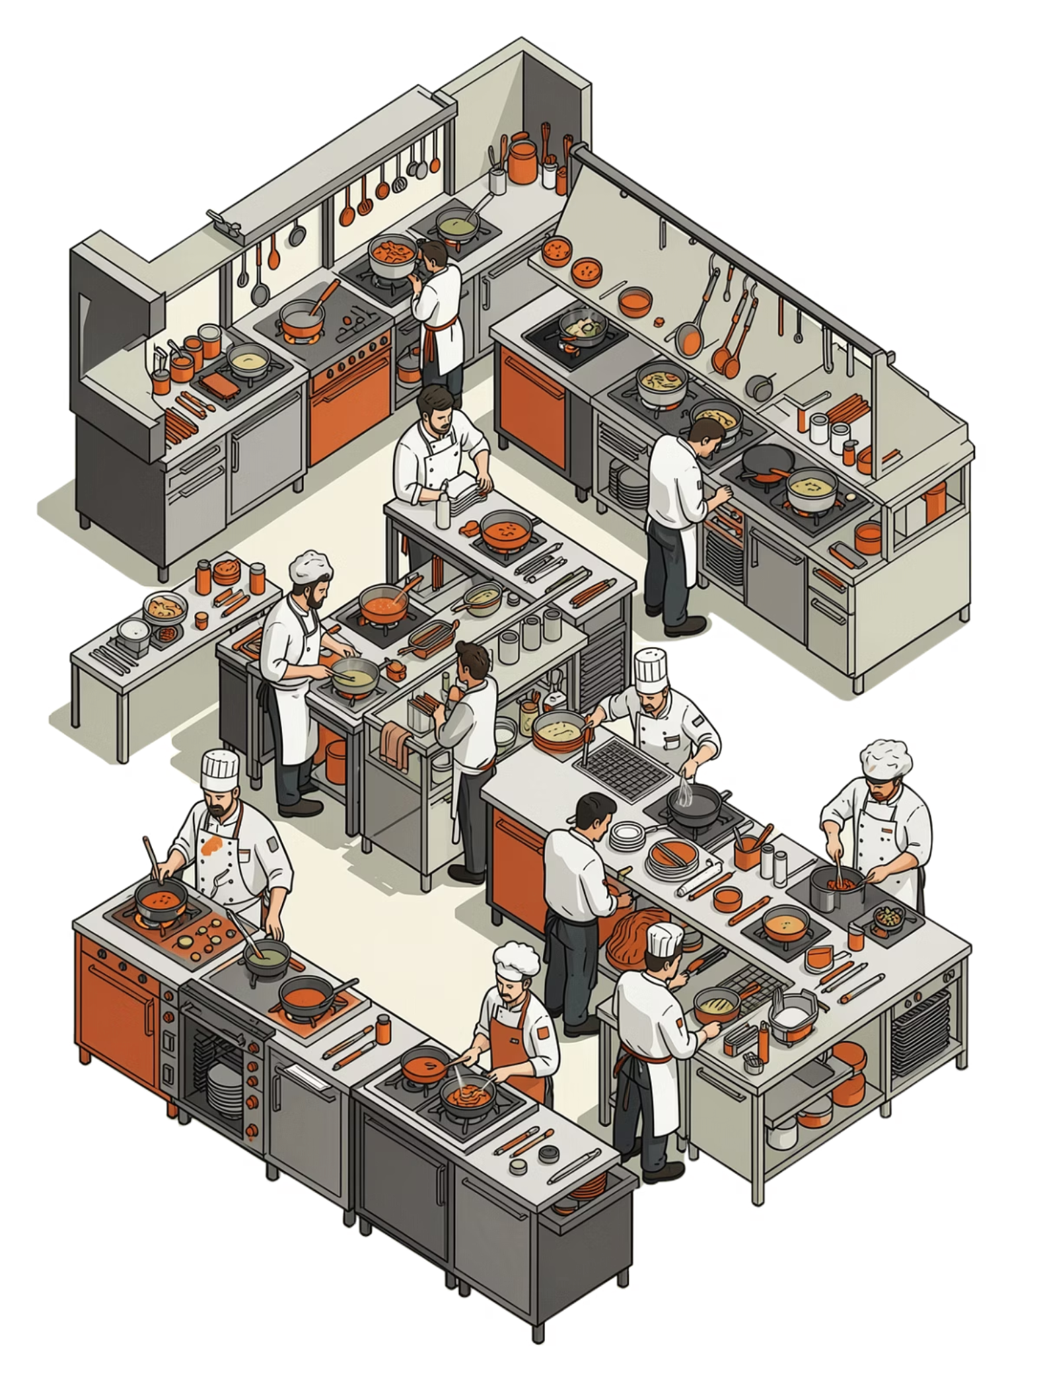
What the DAG Scheduler Does
Plans the Job
It turns Spark transformations into an execution plan.
Real-Life Example
Think of a food delivery app: order first, restaurant next, driver last. Many orders move at the same time, but each order follows the right sequence.

Slide 3
How Spark Builds the DAG
01
02
03
Read the Code
Create the DAG
Split Into Stages
Spark reads transformations such as map, filter, and join.
It builds a graph of operations in the correct order, with no loops.
Operations that need a data shuffle start a new stage.

Slide 4
Stages, Tasks, and Execution
Stage
Task
Scheduler
A group of operations that can run together.
One unit of work that runs on a single data partition.
The DAG Scheduler orders stages, then the Task Scheduler runs the tasks on executors.

Slide 5

Why the DAG Matters
Speed
Recovery
Debugging
Spark pipelines work inside a stage and reduce extra data movement.
If a node fails, Spark rebuilds only the lost partitions by using lineage.
The Spark UI shows the DAG, so bottlenecks are easier to find.

