Slide 1
Fundamentals of
Computer Networks
Prof. DEEPAK PALAVALASA
Assistant Professor
Artificial Intelligence & Data Science (AI&DS) Department

Slide 2
Content
Definition……………………………………………………..3
2. Importance of Networks in AI Applications………5
3. Importance of Networks in IoT Applications……..6
4. Network Types………………………………………………….7
5.OSI Reference Model………………………………………..12
6. TCP/IP Protocol Suite & Comparison with OSI Model………………………………………………………………….16
7.TCP/IP vs. OSI – Structural Comparison……………..19
8.TCP/IP vs. OSI – Functional Differences……………..20
9. Network Topologies..………………………………………..21
10.Switching Techniques………………………………………26

Slide 3
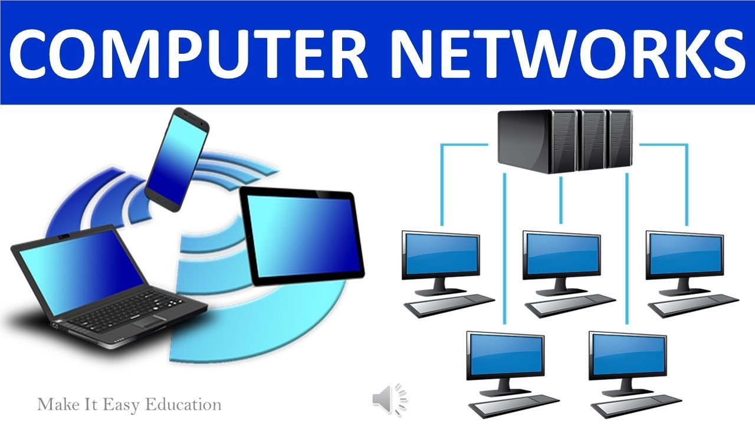
Computer Networks:
A computer network is a collection of interconnected devices that communicate to share data, resources, and services.
It enables communication between computers, smartphones, servers, sensors, and cloud platforms.
Networking uses physical media (cables, radio waves) and protocols (TCP/IP, HTTP) to ensure reliable communication.

Slide 4
History:
Networking began with ARPANET (1969), the first packet-switched network that led to the modern internet.
The development of TCP/IP in the 1970s standardized communication across systems.
The 1990s saw rapid internet growth, Wi-Fi emergence, and global digital connectivity.

Slide 5
Importance of Networks in AI Applications:
AI systems require fast access to large datasets, cloud storage, and computational servers.
Networks enable real-time communication between AI models running on cloud and edge devices.
AI-based services (chatbots, recommendation systems, autonomous vehicles) rely on stable, low-latency networks.
Networking improves scalability, allowing AI to run across multiple machines.

Slide 6
Importance of Networks in IoT Applications:
IoT devices like sensors, smart appliances, and wearables depend on networks to send and receive data.
Networks allow continuous monitoring, automation, and remote control of IoT systems.
Protocols like Wi-Fi, Bluetooth, Zigbee, and 5G support IoT connectivity for different environments.
Reliable networking ensures real-time decision-making in smart homes, health monitoring, and industrial IoT.

Slide 7
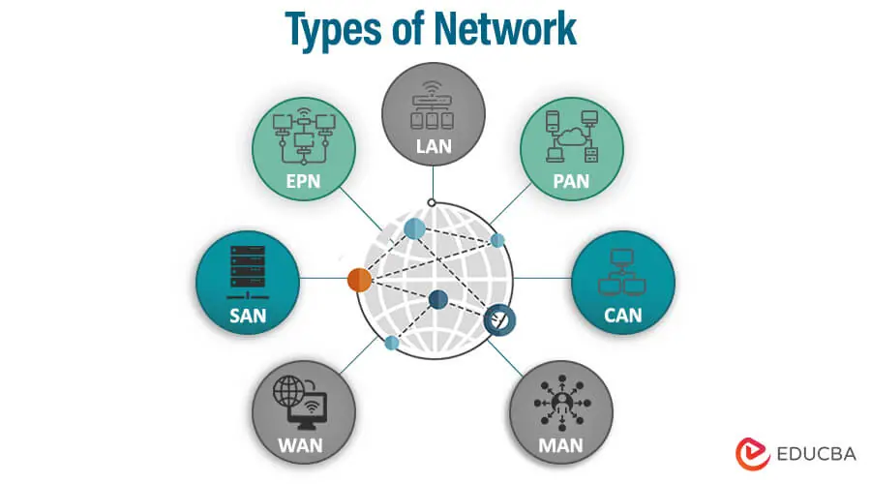
Network Types:
Network types are classified based on coverage area, ownership and usage.
The major types are LAN, WAN, MAN, and PAN, and etc., each serving different communication needs.
They range from short-distance personal connectivity to long-distance global communication.

Slide 8
LAN(Local Area Network):
Characteristics
Covers a small geographical area such as a home, school, laboratory, or office.
High data transfer speed and low latency due to short distances.
Usually owned, managed, and controlled by a single organization.
Use Cases
Connecting computers and printers in offices.
Home Wi-Fi networks.
School and campus networks.

Slide 9
MAN(Metropolitan Area Network):
Characteristics
Covers an area larger than a LAN but smaller than a WAN—typically a city or a group of buildings.
Uses high-speed fiber networks to connect multiple LANs within a metropolitan region.
Often maintained by government or telecom companies.
Use Cases
City-wide public Wi-Fi.
Connectivity between branches of an organization across a city.
Cable TV networks.

Slide 10
WAN(Wide Area Network):
Characteristics
Spans a large geographical area—country, continent, or even globally.
Uses satellite links, undersea cables, and telecom networks for long-distance communication.
Lower speeds compared to LANs due to long distances and shared infrastructure.
Use Cases
The Internet (largest WAN).
Corporate networks connecting global offices.
Banking networks linking ATMs nationwide.

Slide 11
PAN(Personal Area Network):
Characteristics
Very small network around an individual, typically within a 10-meter range.
Low-power, short-range wireless technologies like Bluetooth, Zigbee, and Infrared.
Designed for personal devices.
Use Cases
Connecting smartphones to earphones (Bluetooth).
Smartwatch and mobile communication.
Personal hotspot sharing internet.

Slide 12
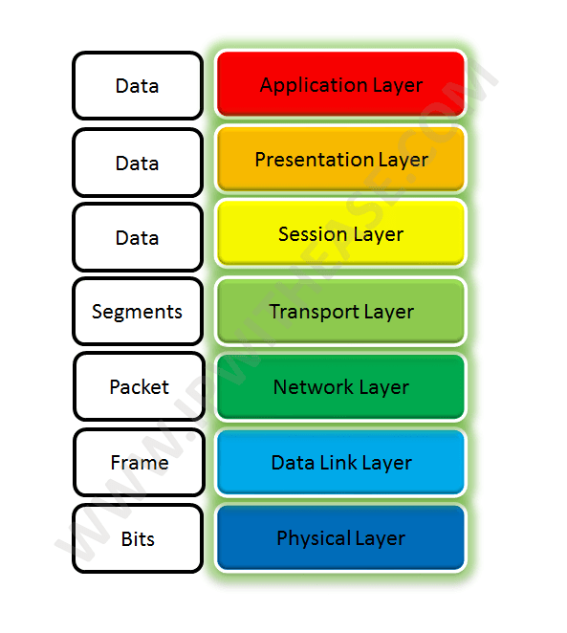
OSI Reference Model:
The OSI (Open Systems Interconnection) model is a 7-layer conceptual framework that standardizes how data travels across networks.
Each layer performs a specific function and communicates with the layers directly above and below it.
It helps in understanding networking operations, troubleshooting, and protocol design.

Slide 13
Upper Layers (Application, Presentation, Session)
Application Layer (Layer 7)
Provides network services directly to end users and applications (e.g., HTTP, FTP).
Handles user interactions and data access.
Presentation Layer (Layer 6)
Translates data between application format and network format.
Handles encryption, compression, and data encoding.
Session Layer (Layer 5)
Manages communication sessions between devices.
Controls opening, maintaining, and closing of communication channels.

Slide 14
Middle Layers (Transport & Network)
Transport Layer (Layer 4)
Provides end-to-end communication and reliability.
Uses protocols like TCP (reliable) and UDP (fast, unreliable).
Handles segmentation, error control, and flow control.
Network Layer (Layer 3)
Responsible for routing packets across different networks.
Uses IP addressing, path selection, and packet forwarding.
Routers operate at this layer.

Slide 15
Lower Layers (Data Link & Physical)
Data Link Layer (Layer 2)
Provides reliable link between two directly connected devices.
Performs MAC addressing, error detection, and framing.
Switches operate at this layer.
Physical Layer (Layer 1)
Deals with the transmission of raw bits over physical media.
Includes cables, switches, voltages, frequencies, and signaling.
Converts digital data into electrical/optical signals.

Slide 16
TCP/IP Protocol Suite & Comparison with OSI Model
Overview of the TCP/IP Protocol Suite
The TCP/IP model is a practical, implementation-based networking model used in real-world communication.
Developed by the U.S. Department of Defense for interoperability between systems.
Forms the foundation of the modern Internet and uses standard protocols like TCP, UDP, IP, and HTTP.

Slide 17
The 4/5 Layers of the TCP/IP Model
1. Application Layer
Combines OSI Layers 5, 6, and 7.
Includes protocols such as HTTP, FTP, DNS, SMTP, and DHCP.
Provides network services to end-user applications.
2. Transport Layer
Responsible for process-to-process communication.
Uses TCP (reliable, connection-oriented) and UDP (fast, connectionless).
Manages segmentation, flow control, and error handling.

Slide 18
3. Internet Layer
Equivalent to OSI’s Network Layer.
Handles logical addressing (IP addressing) and routing.
Protocols: IP, ICMP, ARP.
4. Network Access Layer (Link Layer)
Combines OSI Layers 1 and 2.
Deals with hardware addressing, framing, and physical transmission.
Includes Ethernet, Wi-Fi, MAC addressing, and physical media.

Slide 19
TCP/IP vs. OSI – Structural Comparison
Number of Layers
OSI Model: 7 layers
TCP/IP Model: 4/5 layers (depending on representation)
Design Focus
OSI: Theoretical and conceptual, used for teaching and design.
TCP/IP: Practical and protocol-oriented, used in real networks.
Layer Mapping
OSI Layers 5–7 ↔ TCP/IP Application Layer
OSI Layer 4 ↔ TCP/IP Transport Layer
OSI Layer 3 ↔ TCP/IP Internet Layer
OSI Layers 1–2 ↔ TCP/IP Network Access Layer

Slide 20
TCP/IP vs. OSI – Functional Differences
Protocol Dependency
OSI is protocol-independent.
TCP/IP is protocol-specific (built around TCP and IP).
Encapsulation Process
Both models use encapsulation, but TCP/IP is optimized for real-world networking.
Encapsulation flow: Application Data → Segment → Packet → Frame → Bits.
Usage in Real Networks
OSI is mainly educational for understanding concepts.
TCP/IP is used in all internet and modern communication systems.

Slide 21
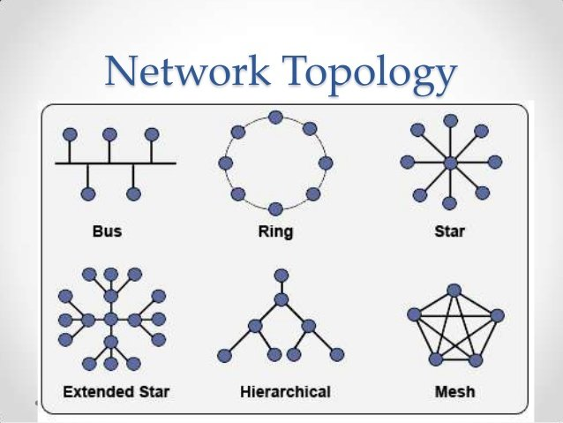
Network Topologies
Overview of Network Topologies
A network topology defines how computers and devices are arranged and connected in a network.
Common topologies include Bus, Star, Ring, and Mesh, each with unique structures and performance characteristics.
Topology affects network speed, reliability, cost, and ease of maintenance.

Slide 22
Bus Topology
Structure
All devices are connected to a single central cable (bus backbone).
Data is broadcast to all devices, but only the intended recipient accepts it.
Pros
Easy to install and cost-effective (less cabling).
Works well for small networks.
Cons
Entire network fails if the main cable breaks.
Performance decreases as more devices are added (heavy collisions).
Troubleshooting is difficult.

Slide 23
Bus Topology
Structure
All devices are connected to a single central cable (bus backbone).
Data is broadcast to all devices, but only the intended recipient accepts it.
Pros
Easy to install and cost-effective (less cabling).
Works well for small networks.
Cons
Entire network fails if the main cable breaks.
Performance decreases as more devices are added (heavy collisions).
Troubleshooting is difficult.

Slide 24
Ring Topology
Structure
Devices are connected in a circular loop, where each device connects to two others.
Data travels in one direction (or both in dual-ring).
Pros
No data collisions because data moves in a structured path.
Performs well under heavy load compared to bus topology.
Cons
Failure of one device can disrupt the entire network.
Troubleshooting is difficult.
Adding or removing devices is challenging.

Slide 25
Mesh Topology
Structure
Every device is connected to every other device (full mesh)
or connected to several others (partial mesh).
Offers multiple paths for data.
Pros
Highly reliable and fault-tolerant.
If one path fails, data takes another route.
Ideal for critical systems like military or backbone networks.
Cons
Very expensive due to extensive cabling.
Complex installation and maintenance.
Not suitable for small networks.

Slide 26
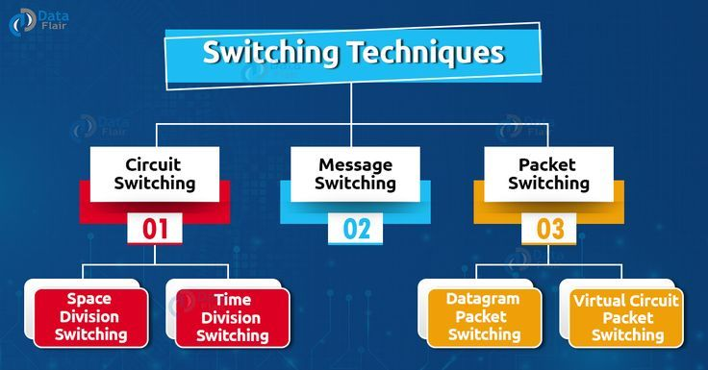
Switching Techniques
Overview of Switching Techniques
Switching techniques determine how data is transferred between devices in a network.
The three major techniques are Circuit Switching, Packet Switching, and Message Switching.
Each method has advantages depending on reliability, speed, and network type.

Slide 27
Circuit Switching
Mechanism
A dedicated communication path is established between sender and receiver before data transfer begins.
The channel remains reserved for the entire duration of the communication.
Pros
Guaranteed, continuous data flow.
No delays once the connection is established.
Reliable for real-time voice/video (e.g., traditional telephone networks).
Cons
Inefficient: reserved path cannot be used by others even when idle.
Connection setup time is required.

Slide 28
Message Switching
Mechanism
Entire message is transmitted from one node to another (store-and-forward).
Each intermediate node stores the whole message before forwarding it.
Pros
No need for a dedicated path.
Good for long, large messages.
Useful in applications where delay is acceptable.
Cons
High delay because nodes must store the entire message.
Requires large memory at intermediate nodes.
Not suitable for real-time communication.

Slide 29
Packet Switching
Mechanism
Data is broken into small packets; each packet may take a different route to the destination.
Two types: Datagram Packet Switching and Virtual Circuit Packet Switching.
Pros
Efficient use of network bandwidth.
Highly scalable and suitable for Internet traffic.
Supports multiple users sharing the same network.
Cons
Packets may arrive out of order or get delayed.
Requires complex protocols for reassembly and error handling.

